Slide 1
EE 521/ECE 582 – Analysis of Power systems
Class #4 – September 6, 2022
Dr. Noel N. Schulz
Edmund O. Schweitzer III Chair in
Power Apparatus and Systems
Chief Scientist Joint Appointment, PNNL
Co-Director, PNNL/WSU Advanced Grid Institute (AGI)
Washington State University Pullman
Noel.Schulz@wsu.edu EME 35
509-335-0980 (o) and 509-336-5522 (c)

Slide 2
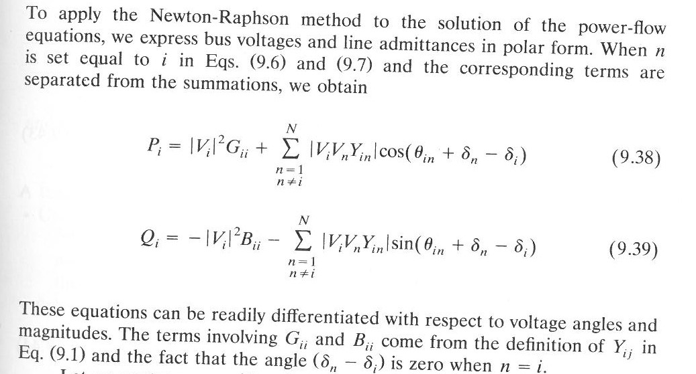
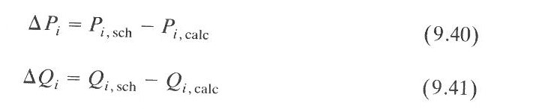
Newton-Raphson and Power Problem

Slide 3
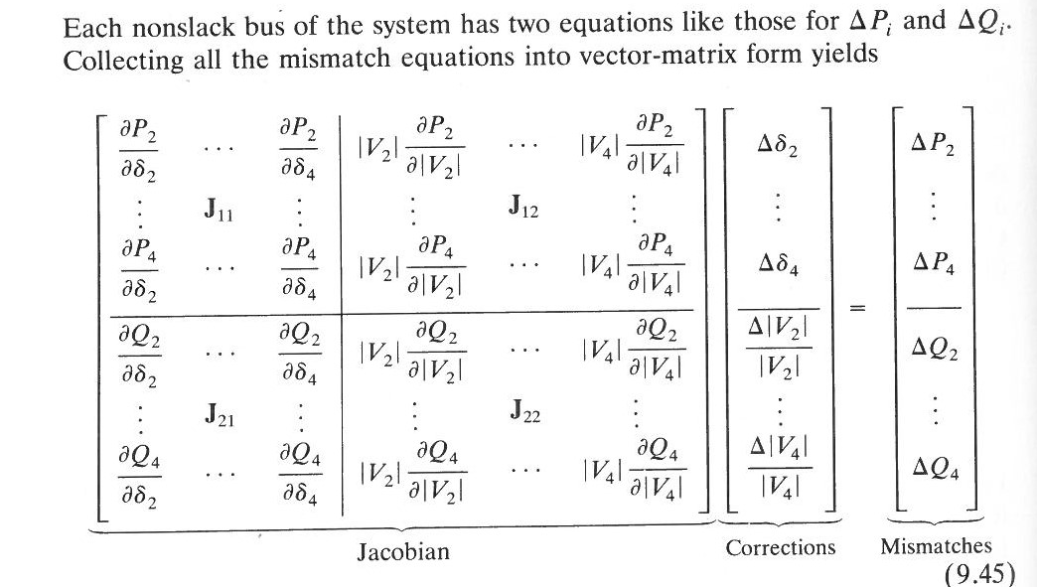
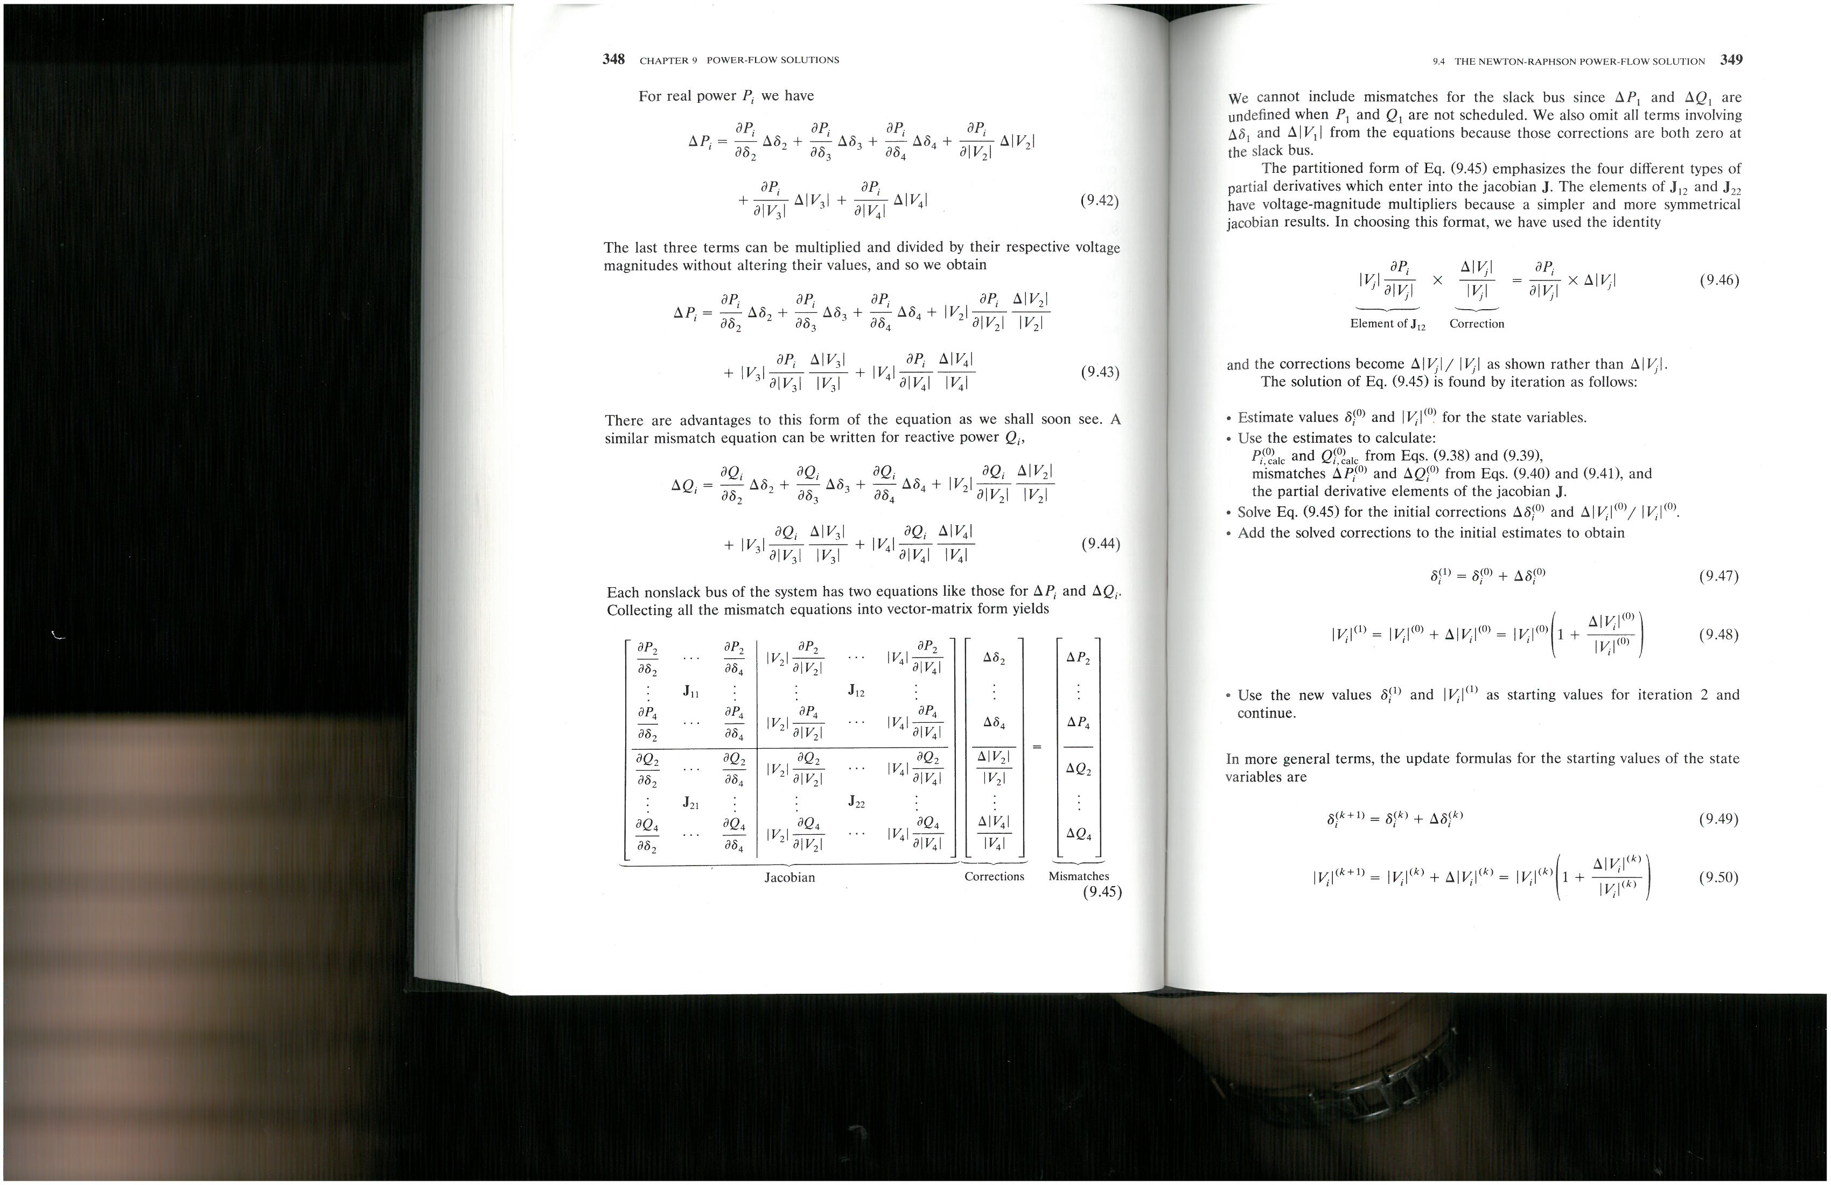
Calculating the Jacobian

Slide 4
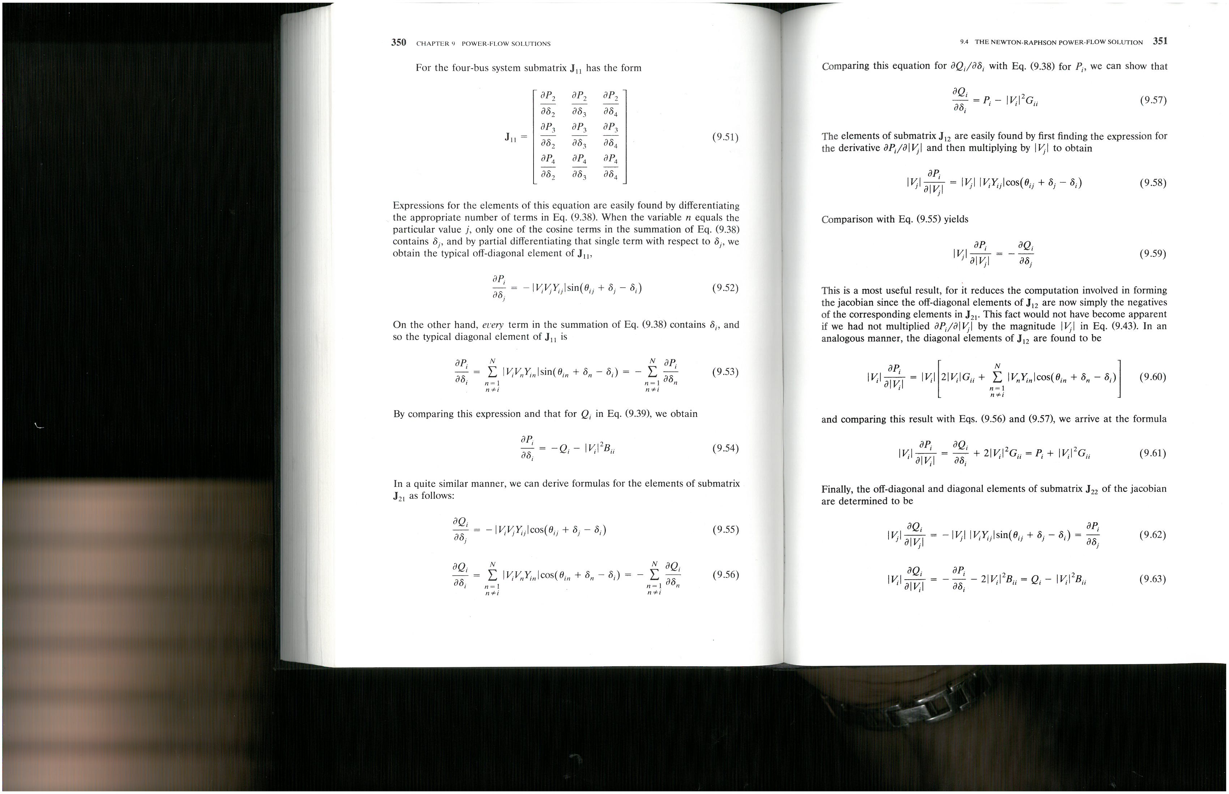
Newton-Raphson and Jacobian

Slide 5
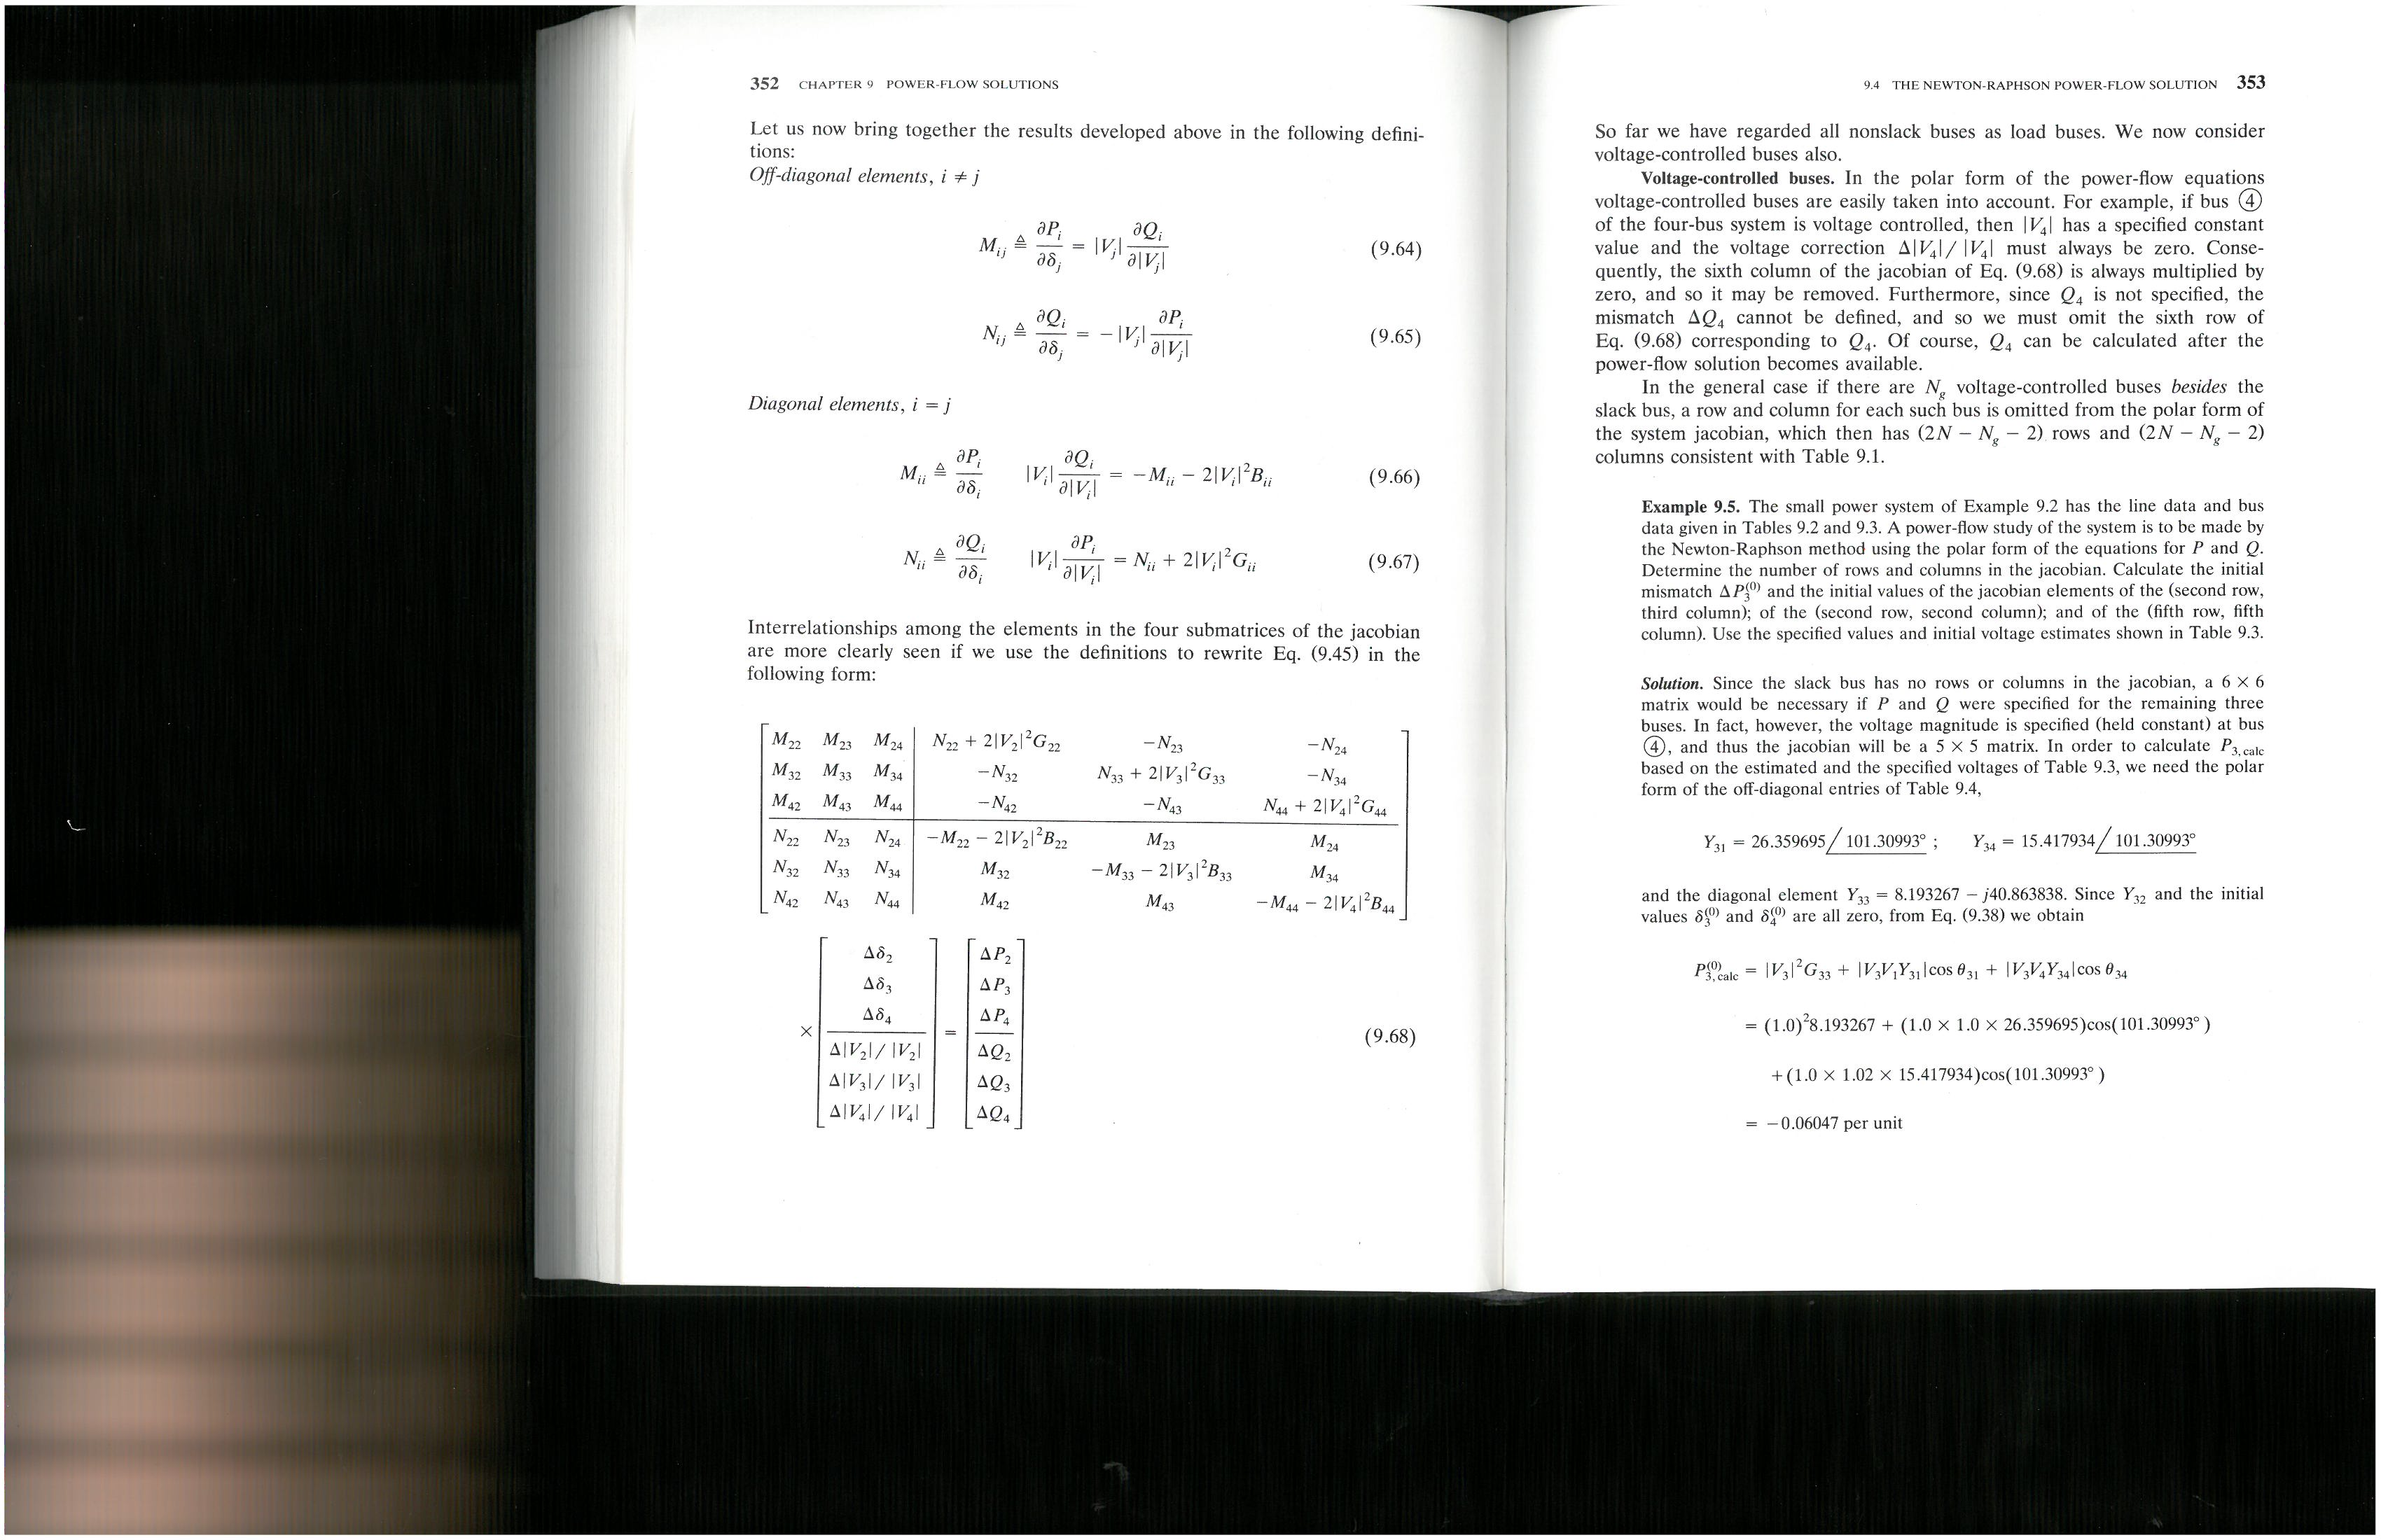
Newton-Raphson and Power Problem
Slack Bus ---
Voltage Controlled Bus ---
Jacobian Matrix is

Slide 6
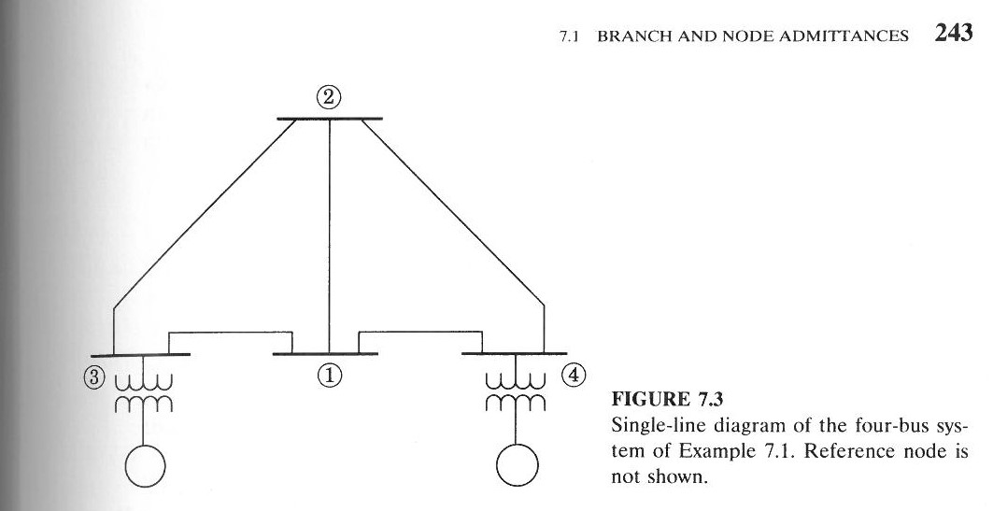
Newton-Raphson and Power Problem
Slack Bus ---
Voltage Controlled Bus ---
Jacobian Matrix is
Example – Bus 1 is Swing, Bus 3 PV
Example – Bus 1 is Swing, Buses 3&4 PV

Slide 7
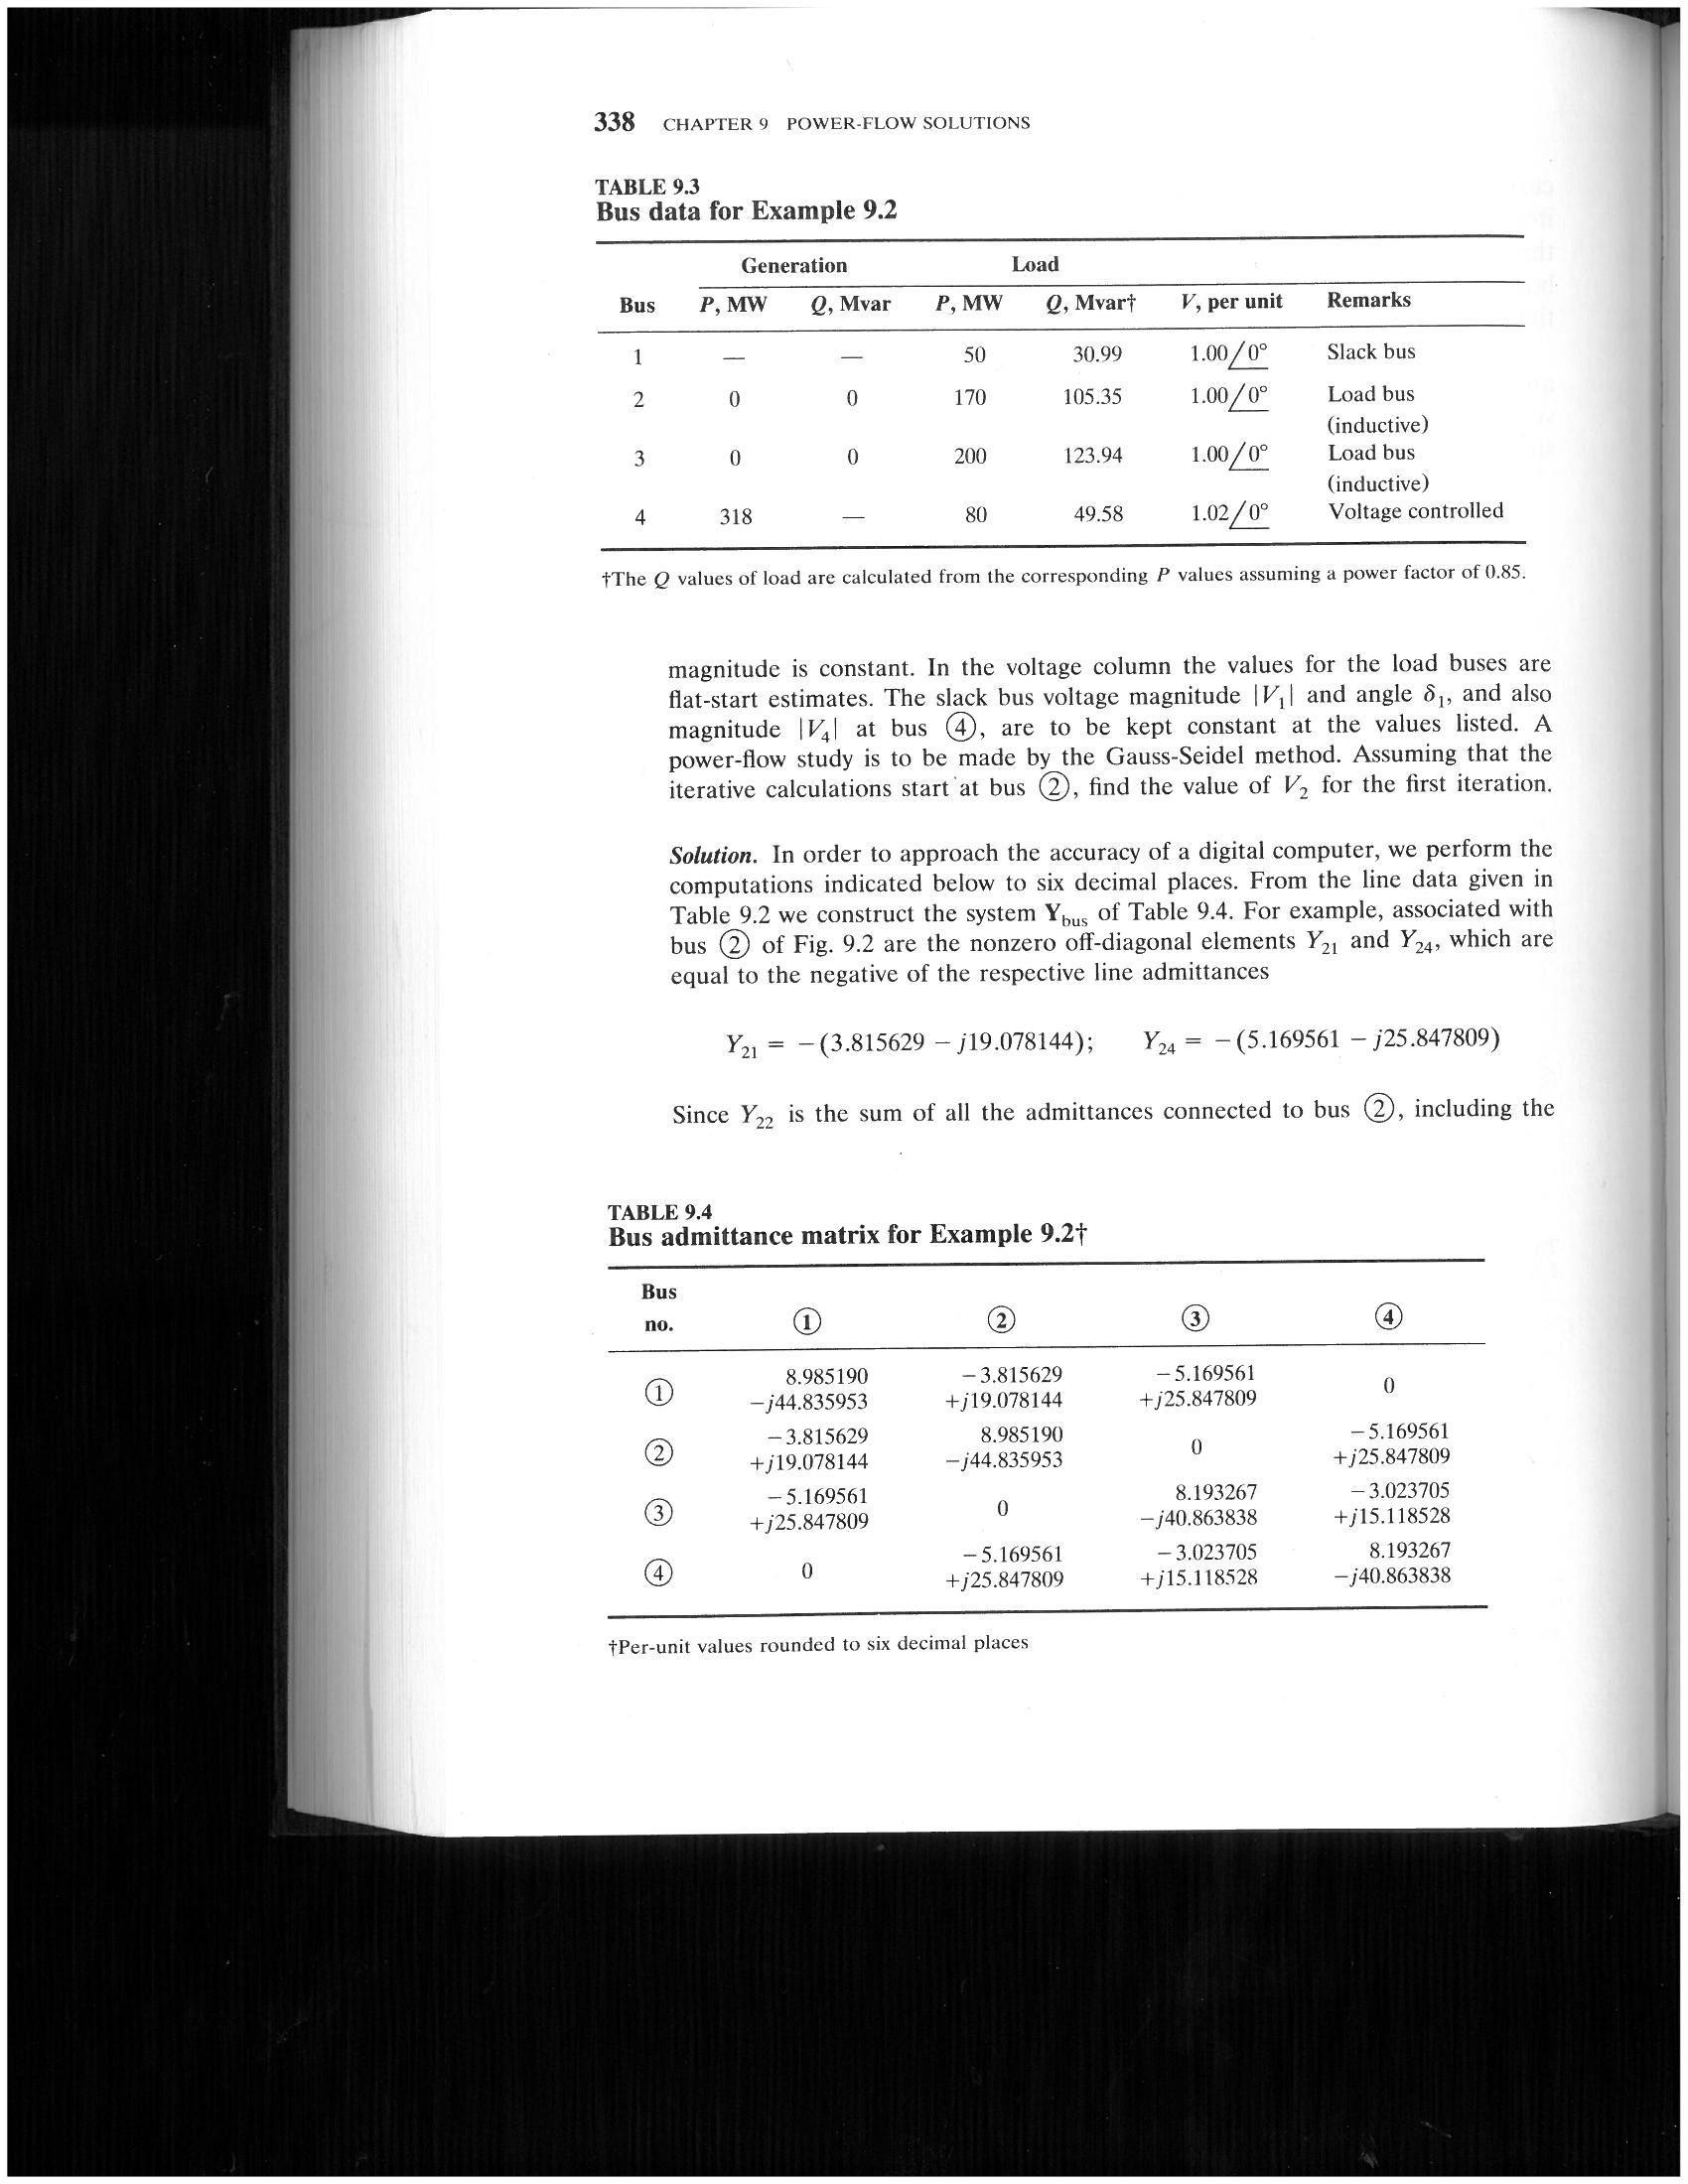
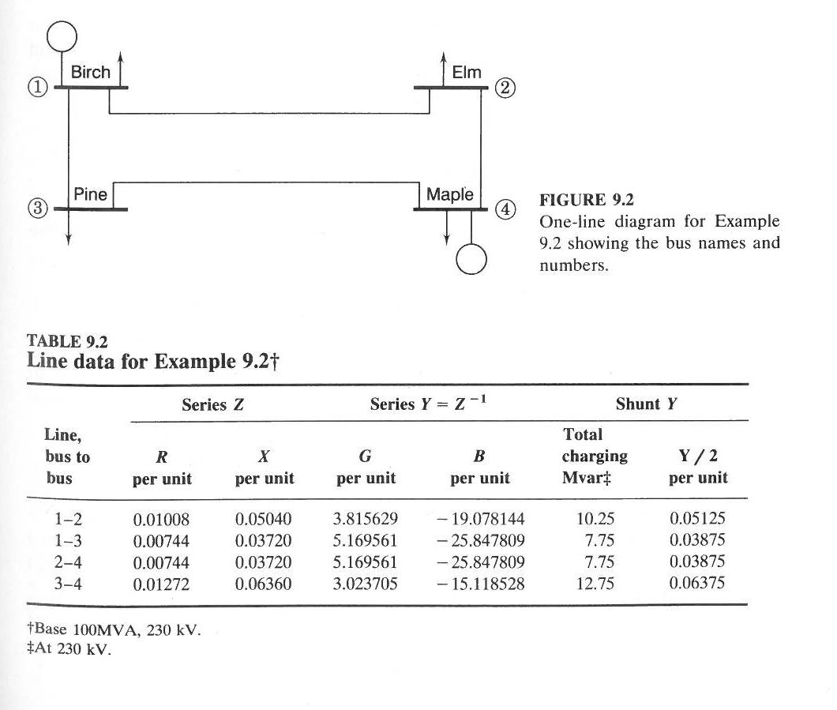
Newton-Raphson and Power Problem

Slide 8
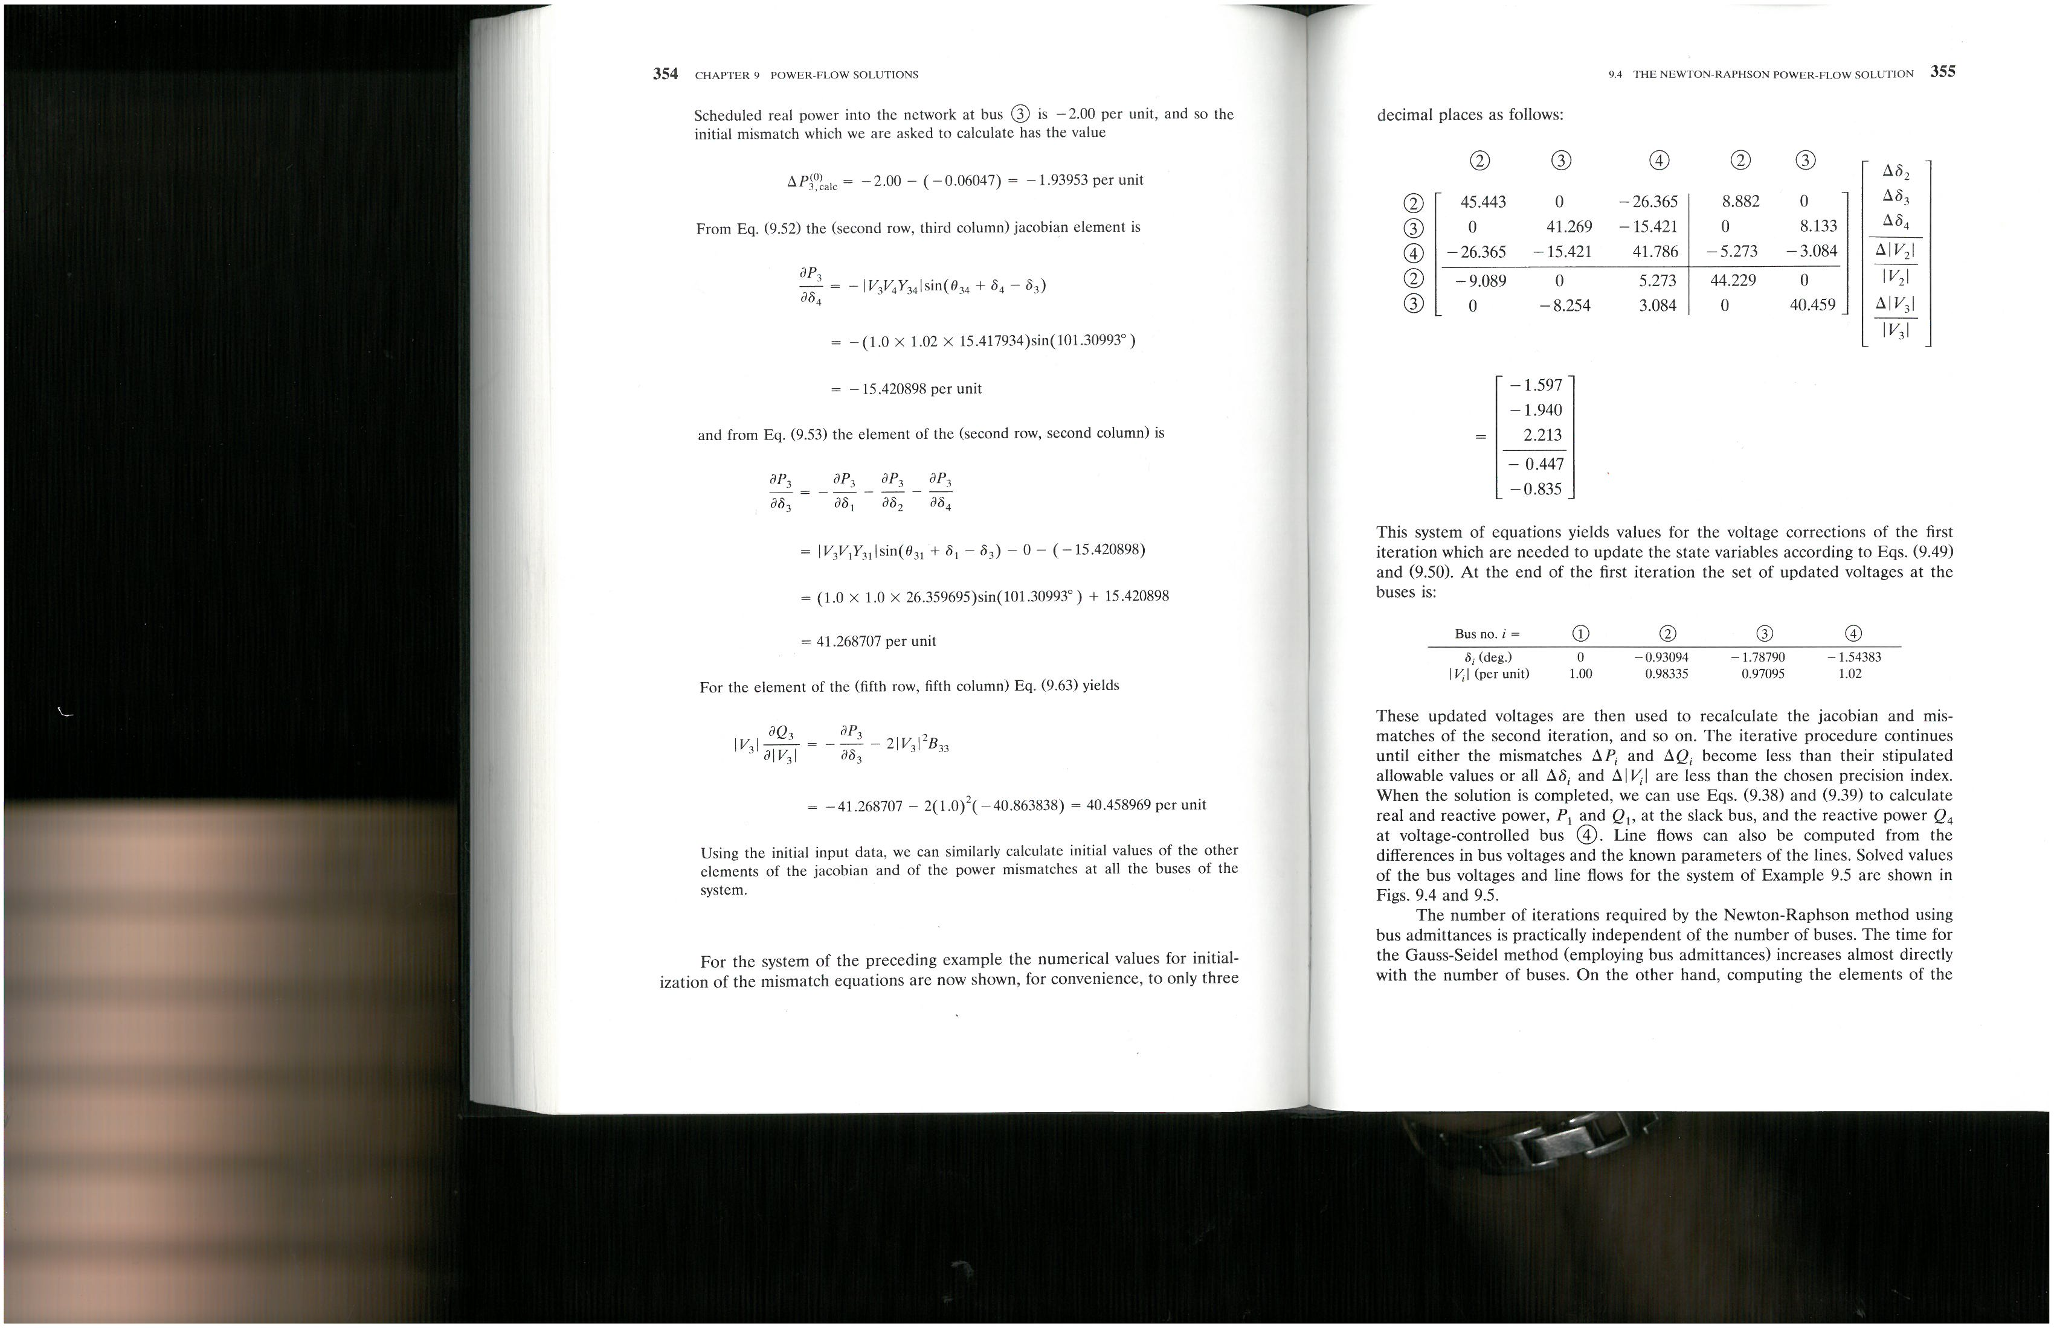
Newton-Raphson and Power Problem

Slide 9
Newton-Raphson and Power Problem

Slide 10
Newton-Raphson and Parts
Input Data
Calculate Jacobian Terms
Calculate Y_{bus}
Solve Equation [A][x] = [b]
Calculate Jacobian Terms
Calculate Mismatch]
_{Iterative Solution}
Check Mismatch?
Small enough
Output Results
Output Results

Slide 11
Solving the Matrix once you calculate it

Slide 12
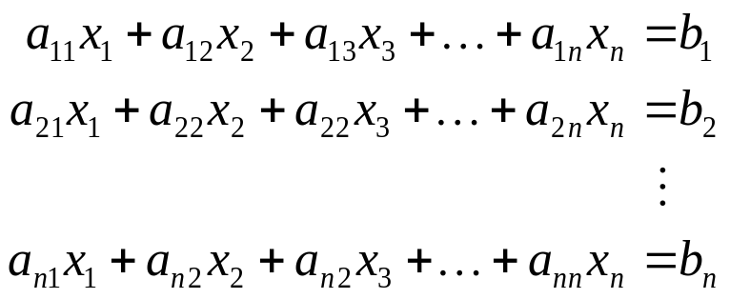


A linear system may be generically modeled as:
Or in matrix form as:
Matrix of coefficients
Vector of known quantities
Vector of unknown quantities
If A⁻¹ exists, then is the unique solution

Slide 13
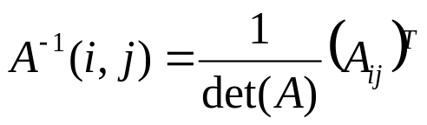
Old method you probably learned is Cramer’s Rule:
determinant
Cofactor of ij^{th} entry
This method requires 2(n+1)! multiplications to find A⁻¹
Not computationally efficient!

Slide 14
Considerations for solving Ax=b:
Do we really need to find A⁻¹ if we can find the solution x* in another, more computationally efficient, way?
Direct methods
Iterative methods

Slide 15
Direct methods for solving Ax=b:
Direct methods (also known as elimination methods) find the exact solution through a finite number of arithmetic operations.
These methods are accurate to within the roundoff error of the computer on which they are implemented
Examples include:
  Gaussian elimination
  LU factorization

Slide 16
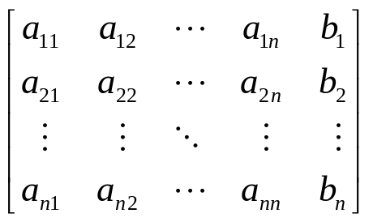
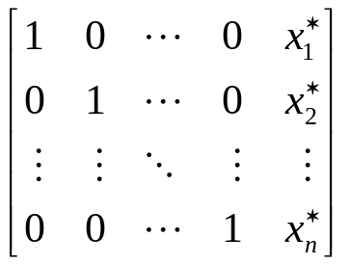
Gaussian Elimination for solving Ax=b
is the process of using a series of elementary row operations to convert:
Identity matrix
An elementary row operation is one of the following:
  Interchange any two rows of the matrix
  Multiply any row by a constant
  Take a linear combination of rows and add it to another row
solution

Slide 17
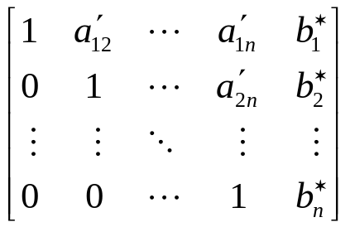
Basic Approach to Gaussian Elimination
Upper Triangularize (i.e. zero out all elements below the diagonal) using elementary row operations (EROs)
Then back substitute to find solutions
(EROs)
All zeros below diagonal

Slide 18
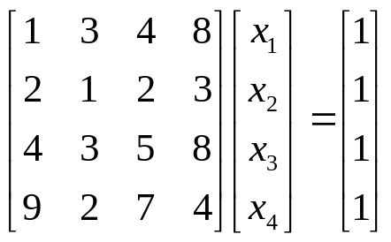
Example: Use Gaussian Elimination to solve:
Use elementary row operations to eliminate elements below diagonal in first column.
Since there are 3x2x1 lower diagonal elements and 4 diagonals, there will be 10 EROs
Column 1: We want each ERO to multiply row j (j=2, …, 4) by -a_{j1}/a₁₁ and add it to row 1 to zero out the elements.

Slide 19
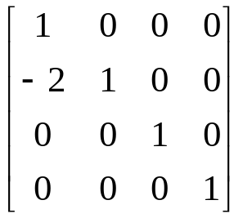
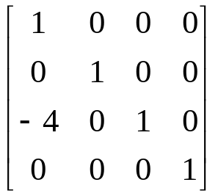
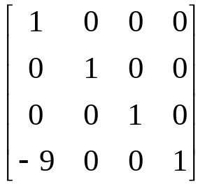
ERO(1)
ERO(2)
ERO(3)

Slide 20
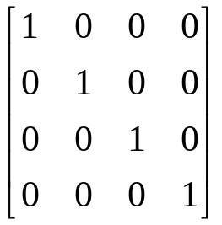
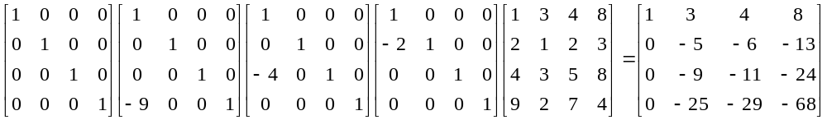
ERO(4)
Scale diagonal a₁₁ to 1
(in this case ERO(4) = identity since a₁₁ is already 1)
Update A by EROs 1 through 4
ERO(4)
ERO(3)
ERO(2)
ERO(1)
A
A’
All zeros

Slide 21
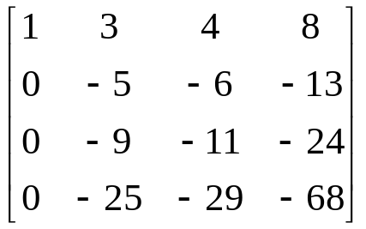
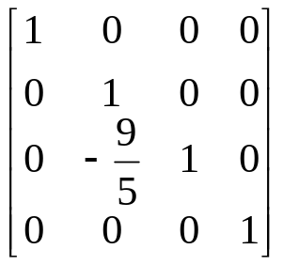
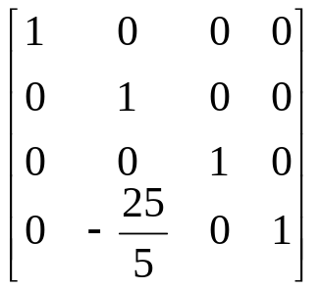
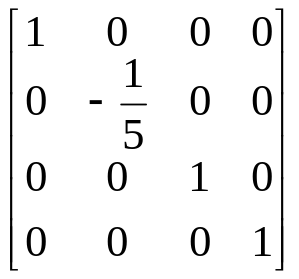
Repeat process on A’ to zero out elements below diagonal 2
diagonalize
ERO(5)
ERO(6)
ERO(7)

Slide 22
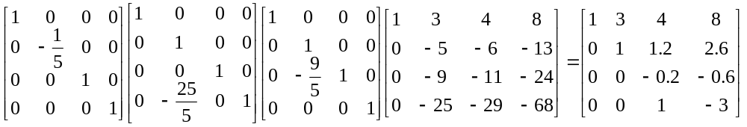
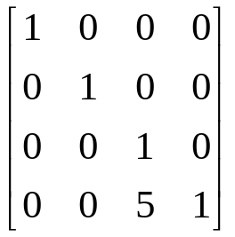
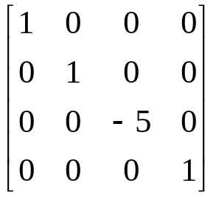
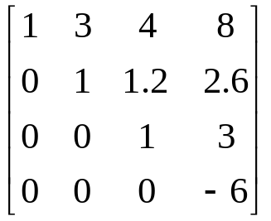
Update A’ by EROs 5 through 7
ERO(7)
ERO(6)
ERO(5)
A’
A’’
All zeros
Now eliminate third column
A’’’
And diagonalize
ERO(8)
ERO(9)

Slide 23
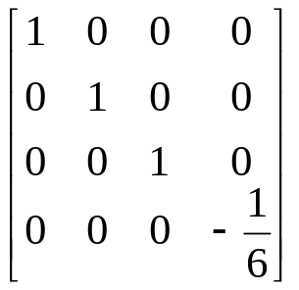
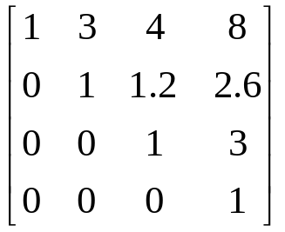
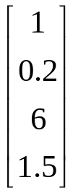
A’’’
Normalize to 1
ERO(10)
Multiply b by EROs 1 through 10:
ERO(10)ERO(9)ERO(8)…ERO(1)b = b’’’’ =

Slide 24
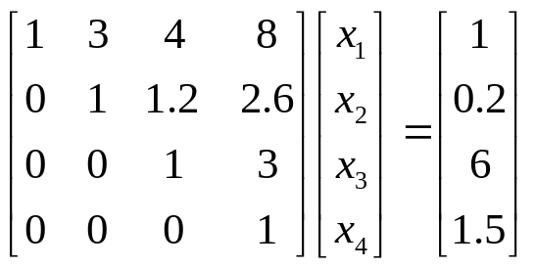

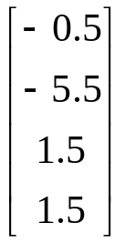


Now we can use back substitution to find x₁, x₂, x₃, and x₄
x*

Slide 25
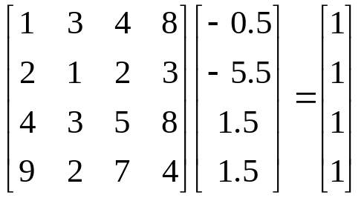
Check: Ax*=b?
✓

Slide 26
Announcements
Remember two discussions
Read Chapter 2.5-2.7
Review Chapter 2 examples
Working on MATLAB Program
  Input the CDF file
  Start working on building the Ybus
  Think about developing Jacobian values

