Slide 1
Dynamic Programming for Damping Oscillations in Power Systems
IEEE Transactions on Systems, Man and Cybernetics (2008)
Chao Lu, Jennie Si, and Xiaorong Xie
Aryan Ritwajeet Jha

Slide 2
Motivation
Global stability problems such as low-frequency network oscillation at the network level can be countered using proper coordination of these controllers.
However, most controllers are designed and tuned:
Independently of each other.
Relying on having accurate system models

Slide 3
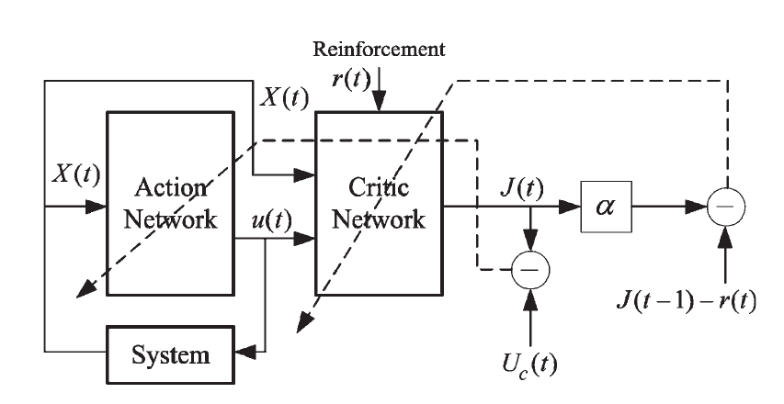
Approximate Dynamic Programming (ADP)
Schematic for implementation of Direct Heuristic Dynamic Programming (HDP).
Model Independent.
Complex, Continuous State/Control MIMO Non-Linear System with Uncertainty.
Good for Low Frequency Oscillation Problem because swing period long enough to provide sufficient time for controller to learn and adapt.

Slide 4
Online Learning Control by Association and Reinforcement
IEEE Transactions on Neural Networks (2001)
Jennie Si and Yu-Tsung Wang
Among the various algorithms of Adaptive Critic Designs, a specific system architecture called
Action Dependent Heuristic Dynamic Programming (ADHDP)
for online learning control is proposed and demonstrated in this paper.

Slide 5
Motivation behind Heuristic Dynamic Programming
Domain: A class of learning decision and control problems where the environment/system that interacts with the ‘learner’ is NOT known beforehand.
Environment: The environment can be Stochastic, Non-Linear and Subject to change over time. (PUT AN EXAMPLE)
Problem Statement: Devise a control learning algorithm which optimizes some sort of figure of merit over time. (PUT AN EXAMPLE)

Slide 6
Motivation behind Heuristic Dynamic Programming
Learning Timeline: ‘On-the-fly’ i.e. Online learning during interaction with the environment itself.
Learning Outcome: While measurements from the environment are available from one decision and control step to the next, a final outcome of the learning process from a generated sequence of decisions and controls may come as a delayed signal in only an indicative ‘win’ or ‘lose’ format.

Slide 7
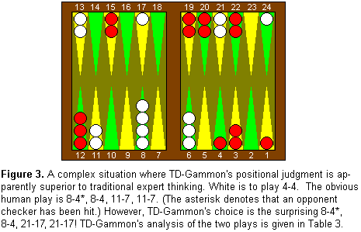
Motivation behind Heuristic Dynamic Programming
Reinforcement Learning (RL) has garnered great intuitive appeal for solving such class of problems, especially since the implementation of Temporal Difference (TD) Learning Method. Noteworthy example: TD-Gammon program has learnt to play Backgammon at a grandmaster level.

Slide 8
Motivation behind Heuristic Dynamic Programming
RL excels in Markovian Environments compared to traditional Supervised and Unsupervised Machine Learning Algorithms.
Markovian Environment: An environment where a system’s next state is dependent on the current control step as well as the previous N states of the system.

Slide 9
Online Learning Control by Association and Reinforcement
IEEE Transactions on Neural Networks (2001)
Jennie Si and Yu-Tsung Wang
A Critic network ‘critiques’ the generated action value in order to optimize a future ‘reward-to-go’ by propagating a temporal difference between consecutive estimates from the critic/prediction network.

