Slide 1
Dynamic Programming for Damping Oscillations in Power Systems
IEEE Transactions on Systems, Man and Cybernetics (2008)
Chao Lu, Jennie Si, and Xiaorong Xie
Aryan Ritwajeet Jha

Slide 2
Motivation
Global stability problems such as low-frequency network oscillation at the network level can be countered using proper coordination of these controllers.
However, most controllers are designed and tuned:
Independently of each other.
Relying on having accurate system models

Slide 3
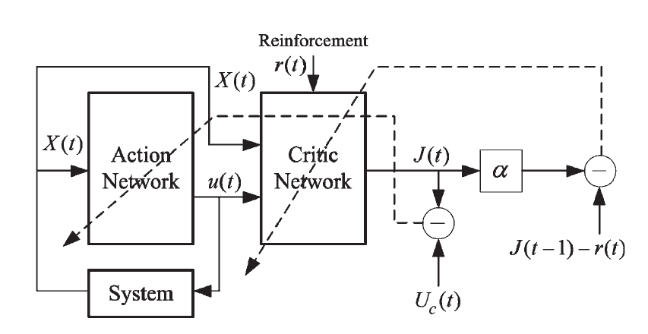
Approximate Dynamic Programming (ADP)
Schematic for implementation of Direct Heuristic Dynamic Programming (HDP).
Model Independent.
Complex, Continuous State/Control MIMO Non-Linear System with Uncertainty.
Good for Low Frequency Oscillation Problem because swing period long enough to provide sufficient time for controller to learn and adapt.

Slide 4
Online Learning Control by Association and Reinforcement
IEEE Transactions on Neural Networks (2001)
Jennie Si and Yu-Tsung Wang

