Slide 1
EE 521/ECE 582 – Analysis of Power systems
Class #14 – October 13, 2022
Dr. Noel N. Schulz
Edmund O. Schweitzer III Chair in
Power Apparatus and Systems
Chief Scientist Joint Appointment, PNNL
Co-Director, PNNL/WSU Advanced Grid Institute (AGI)
Washington State University Pullman
Noel.Schulz@wsu.edu EME 35
509-335-0980 (o) and 509-336-5522 (c)

Slide 2
Reminders
Student Hours This Week
Tuesday 4:30-5:30 pm (after class) – Zoom or EME 35 Pullman
Check in Meetings
Friday (Zoom or EME 35) - 11am -12 pm
Monday (Zoom) - 2-3 pm
Tuesday (EME 35 or Zoom) - 8:30-9:00 am or 4:30-5:30 pm
Wednesday (EME 35 or Zoom) - 1:30-2:30 pm or 4-5 pm
Final Paper – Think about Topic - Oct 14

Slide 3
Topics for Final Paper – Upload by Friday (10/14)
Other Possible Aspects:
Distribution
AI/ML
Data Science
New Numerical Techniques
Power Electronics
Microgrids
Modeling of Renewable Energy Resources within Analysis
Modeling of Storage within Analysis
Keywords:
Power Flow
Newton Raphson
Fast Decoupled
Sparse Power Flow
Continuation Power Flow
State Estimation
Optimal Power Flow

Slide 4
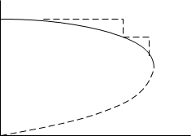




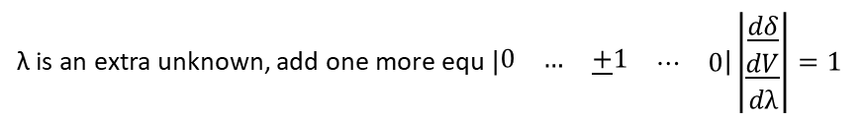



Dr. Bose’s notes
Continuation Power Flow
PV curve
Nose curve
$$\underline{K}=\underline{f}(\underline{δ},\underline{V})$$
$$\left|V\right|$$
Let
$$λ\underline{K}−\underline{f}\left(\underline{δ},\underline{V}\right)=\underline{0}$$
where $\underline{K}$ is loading profile $\left|\begin{matrix}\underline{P} \\ \underline{Q}\end{matrix}\right|$
$$F\left(λ, \underline{δ},\underline{V}\right)=\underline{0}$$
λ is loading parameter
P
$$\frac{∂F}{∂δ}dδ+\frac{∂F}{∂V}dV+\frac{∂F}{∂λ}dλ=0$$
λ is an extra unknown, add one more equ $\left|\begin{matrix}\begin{matrix}0 & … & \underline{+}1\end{matrix} & \begin{matrix}⋯ & 0\end{matrix}\end{matrix}\right|\left|\begin{matrix}\underline{dδ} \\ \underline{dV} \\ dλ\end{matrix}\right|=1$
$$e_{k}$$
When dλ + ve, load increasing
dλ - ve, load decreasing
dV - ve, voltage decreasing

Slide 5
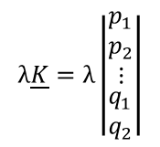



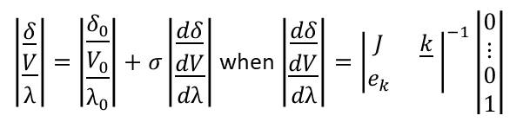
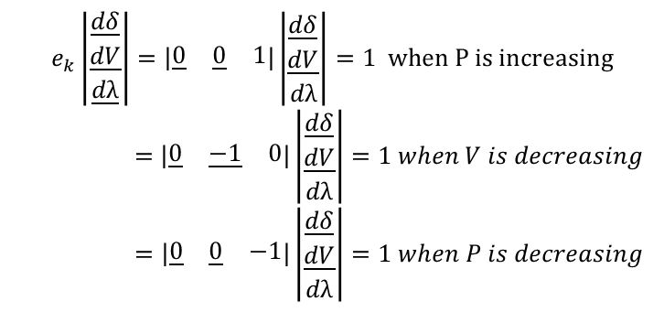
Dr. Bose’s notes
$\left|\begin{matrix}\underline{δ} \\ \underline{V} \\ λ\end{matrix}\right|=\left|\begin{matrix}\underline{δ_{0}} \\ \underline{V_{0}} \\ λ_{0}\end{matrix}\right|+σ\left|\begin{matrix}\underline{dδ} \\ \underline{dV} \\ dλ\end{matrix}\right|$ when $\left|\begin{matrix}\underline{dδ} \\ \underline{dV} \\ dλ\end{matrix}\right|={\left|\begin{matrix}J & \underline{k} \\ e_{k} & \end{matrix}\right|}^{−1}\left|\begin{matrix}\begin{matrix}0 \\ ⋮\end{matrix} \\ 0 \\ 1\end{matrix}\right|$
Predictor:
Corrector:
$$F\left(\underline{δ},\underline{V},λ\right)=\underline{0}$$
$${\underline{x} }_{k}−{{\underline{x} }_{k}}_{}^{predicted}=\underline{0}$$
$$∆λ=0$$
$$λ\underline{K}=λ\left|\begin{matrix}\begin{matrix}p_{1} \\ p_{2} \\ ⋮\end{matrix} \\ \begin{matrix}q_{1} \\ q_{2}\end{matrix}\end{matrix}\right|$$
$$e_{k}\left|\begin{matrix}\underline{dδ} \\ \underline{dV} \\ \underline{dλ}\end{matrix}\right|=\left|\begin{matrix}\underline{0} & \underline{0} & 1\end{matrix}\right|\left|\begin{matrix}\underline{dδ} \\ \underline{dV} \\ dλ\end{matrix}\right|=1 when P is increasing$$
$$=\left|\begin{matrix}\underline{0} & \underline{−1} & 0\end{matrix}\right|\left|\begin{matrix}\underline{dδ} \\ \underline{dV} \\ dλ\end{matrix}\right|=1 when V is decreasing$$
$$=\left|\begin{matrix}\underline{0} & \underline{0} & −1\end{matrix}\right|\left|\begin{matrix}\underline{dδ} \\ \underline{dV} \\ dλ\end{matrix}\right|=1 when P is decreasing$$
When P is changing, corrector is PF equation
V is changing, corrector is same as predictor

Slide 6
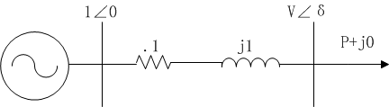
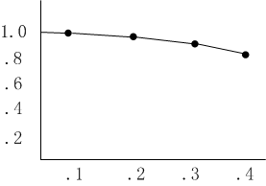





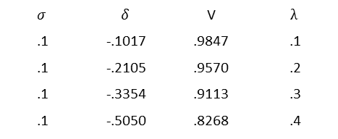
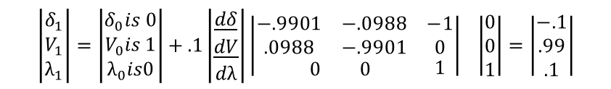

Dr. Bose’s notes
2-Bus Example
$$P=−.995Vcos\left(δ−95.7°\right)−.995V^{2}cos84.3°$$
$$Q=−.995Vsin\left(δ−95.7°\right)−.99{5V}^{2}sin84.3°$$
$$Let λ\underline{K}=λ\left|\begin{matrix}−1 \\ 0\end{matrix}\right| and σ=0.1$$
$$∴$$
$$J=\left|\begin{matrix}.995Vsin\left(δ−95.7°\right) & −.995cos\left(δ−95.7°\right)−1.99Vcos84.3 \\ .995Vcos\left(δ−95.7°\right) & −.995sin\left(δ−95.7°\right)−1.99Vsin84.3\end{matrix}\right|$$
$$\left|\begin{matrix}δ_{1} \\ V_{1} \\ λ_{1}\end{matrix}\right|=\left|\begin{matrix}δ_{0}is 0 \\ V_{0}is 1 \\ λ_{0}is0\end{matrix}\right|+.1\left|\begin{matrix}\underline{dδ} \\ \underline{dV} \\ dλ\end{matrix}\right|{\left|\begin{matrix}\begin{matrix}−.9901 & −.0988 \\ .0988 & −.9901\end{matrix} & \begin{matrix}−1 \\ 0\end{matrix} \\ \begin{matrix} 0 & 0\end{matrix} & 1\end{matrix}\right|}^{}\left|\begin{matrix}0 \\ 0 \\ 1\end{matrix}\right|=\left|\begin{matrix}−.1 \\ .99 \\ .1\end{matrix}\right|$$
Predictor:
$.1=λ$=-.995Vcos $\left(δ−95.7°\right)−.995V^{2}cos84.3°$
Corrector:
$$δ=−.1017$$
0$=−.995Vsin\left(δ−95.7°\right)−.99{5V}^{2}sin84.3°$
V$=.9847$
$$σ$$ | $$δ$$ | V | $$λ$$
.1 | -.1017 | .9847 | .1
.1 | -.2105 | .9570 | .2
.1 | -.3354 | .9113 | .3
.1 | -.5050 | .8268 | .4
PF diverges

Slide 7
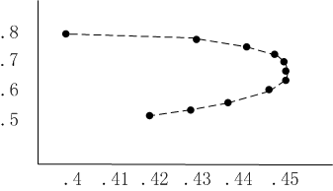



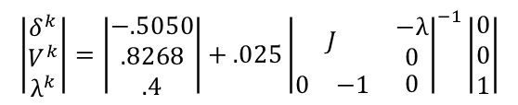

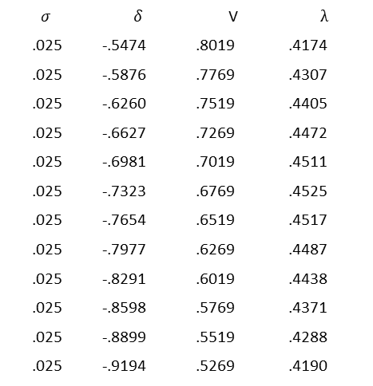
Dr. Bose’s notes
Switch $λ to \underline{V}$
$$\left|\begin{matrix}δ^{k} \\ V^{k} \\ λ^{k}\end{matrix}\right|=\left|\begin{matrix}−.5050 \\ .8268 \\ .4\end{matrix}\right|+.025{\left|\begin{matrix}J & \begin{matrix}−λ \\ 0\end{matrix} \\ \begin{matrix}0 & −1\end{matrix} & 0\end{matrix}\right|}^{−1}\left|\begin{matrix}0 \\ 0 \\ 1\end{matrix}\right|$$
Predictor:
$λ$=-.995Vcos $\left(δ−95.7°\right)−.995V^{2}cos84.3°$
Corrector:
$$0=−.995Vsin\left(δ−95.7°\right)−.99{5V}^{2}sin84.3°$$
$$V=V^{predicted}$$
$$σ$$ | $$δ$$ | V | $$λ$$
.025 | -.5474 | .8019 | .4174
.025 | -.5876 | .7769 | .4307
.025 | -.6260 | .7519 | .4405
.025 | -.6627 | .7269 | .4472
.025 | -.6981 | .7019 | .4511
.025 | -.7323 | .6769 | .4525
.025 | -.7654 | .6519 | .4517
.025 | -.7977 | .6269 | .4487
.025 | -.8291 | .6019 | .4438
.025 | -.8598 | .5769 | .4371
.025 | -.8899 | .5519 | .4288
.025 | -.9194 | .5269 | .4190
C$hanging λ to decreasing P$

Slide 8
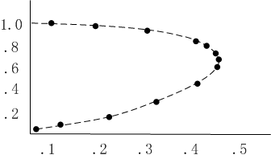
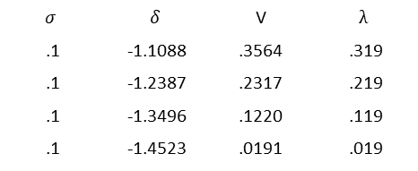
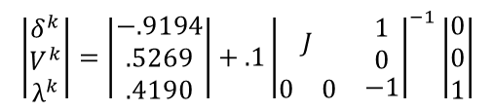
Dr. Bose’s notes
$$\left|\begin{matrix}δ^{k} \\ V^{k} \\ λ^{k}\end{matrix}\right|=\left|\begin{matrix}−.9194 \\ .5269 \\ .4190\end{matrix}\right|+.1{\left|\begin{matrix}J & \begin{matrix}1 \\ 0\end{matrix} \\ \begin{matrix}0 & 0\end{matrix} & −1\end{matrix}\right|}^{−1}\left|\begin{matrix}0 \\ 0 \\ 1\end{matrix}\right|$$
Predictor:
$$σ$$ | $$δ$$ | V | $$λ$$
.1 | -1.1088 | .3564 | .319
.1 | -1.2387 | .2317 | .219
.1 | -1.3496 | .1220 | .119
.1 | -1.4523 | .0191 | .019

Slide 9
PDF’s on Canvas
Dr. Liu’s example
Two Reference Publications

Slide 10
Announcements
Re-Review Sections 3.5.5 & 3.5.6
Start Reading Chapter 6
Set up Time for Program #1 Discussions if you haven’t
Remember to start on Discussion Set #2

