Slide 1
EE 521/ECE 582 – Analysis of Power systems
Class #17 – October 20, 2022
Dr. Noel N. Schulz
Edmund O. Schweitzer III Chair in
Power Apparatus and Systems
Chief Scientist Joint Appointment, PNNL
Co-Director, PNNL/WSU Advanced Grid Institute (AGI)
Washington State University Pullman
Noel.Schulz@wsu.edu EME 35
509-335-0980 (o) and 509-336-5522 (c)

Slide 2
Reminders
Office Hours Next Week
Tuesday (Vancouver or Zoom) – 4:30-5:30 pm
Wednesday (Vancouver or Zoom) – 4-5 pm
Friday (EME 35 or Zoom) – 1:30-2:30 pm
Other times by appt
Check in Meetings
Friday (EME 35 or Zoom) – 1:30-2:30 pm
Next Week Classes:
Tuesday Class from Vancouver Classroom
NO on-campus Pullman class on Thursday, 10/27. Class via zoom
Discussion Set #2 – Questions due: 10/21
Work on Programs #1 and #3 (hold on #2 for now)

Slide 3
Discussion Set #2
Assignment #2 | Column A: Summarize (150 to 200 word summary of article) | Column B: List of three questions for class to answer? | Column C: Answer the Questions or Add to Discussions (Each response should be between 25 and 100 words)
See Canvas for Papers | Due: 10/18 | Due: 10/21 | Due: 10/28
Paper #1 | Liadi Akande | Noah Allison | All students in class should respond to three of these papers.
Paper #2 | Jacob Hastings | Sajjad Uddin Mahmud | All students in class should respond to three of these papers.
Paper #3 | Asif Iftekhar Omi | Md Samiul Islam Sagar | All students in class should respond to three of these papers.
Paper #4 | Sumanjali Pannala | Saeed Salimi Amiri | All students in class should respond to three of these papers.
Paper #5 | Md Mehedi Hasan Tanim | Leonardo Stingini | All students in class should respond to three of these papers.
Paper #6 | Hassan Yazdani | Ke Wang | All students in class should respond to three of these papers.
discussion_2_paper1_GPU-Based_Sparse_Power_Flow_Studies_With_Modified_Newtons_Method.pdf
discussion_2_paper2_The_continuation_power_flow_a_tool_for_steady_state_voltage_stability_analysis.pdf
discussion_2_paper3_Continuation_three phase_power_flow_a_tool_for_voltage_stability_analysis_of_unbalanced_three-phase_power_systems.pdf
discussion_2_paper_4_Grid_Influences_From_Reactive_Power_Flow_of_Photovoltaic_Inverters_With_a_Power_Factor_Specification_of_One.pdf
discussion_2_paper_5_Intergrid_A_Future_Electronic_Energy_Network.pdf
Discussion_2_paper_6_Successive-Intersection-Approximation-Based_Power_Flow_Method_for_Integrated_Transmission_and_Distribution_Networks.pdf

Slide 4
Program #3 – Continuation Power Flow
Develop the Continuation Power Flow algorithm to determine the P-V curves for all the required buses in the IEEE 14 bus test case with taps. Do not worry about Q limits for this problem.

Slide 5
Least Squares Estimation (LSE)
State Estimation is the process of estimating unknown states from measured quantities.
In many systems, more measurements are made than are necessary to uniquely determine the operating point.
Conversely, not all of the states may be available for measurement.
State estimation gives the “best estimate” of the state of the system in spite of uncertain, redundant, and/or conflicting measurements.

Slide 6
Let z be the set of measured quantities
The measured values of z may not equal the true values of z^{true} due to
measurement errors,
missing data, or
intentional misdirection (hacking)
We’d like to
Identify bad data
Minimize the error between the true and measured values
States of the system

Slide 7
“squared error”
Minimize
Minimizing the square of the error is desired to negate any effects of sign differences between the measured and true values.
Minimize

Slide 8
Minimize
Take derivative and set equal to zero:
Solving for x:
Solve using LU factorization (or other linear solver)
Analytic solution

Slide 9
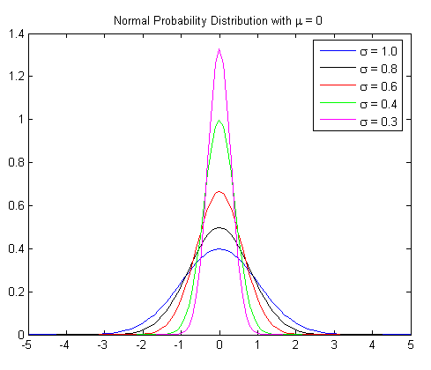
Weighted Least Squares Estimation (WLSE)
Suppose we have more confidence in certain types of measurements:
Certain sensors have been more recently calibrated
Some types of sensors tend to be more accurate (smaller standard deviation)
We’d like to apply more weight to measurements in which there is greater confidence
Introduce a weighting factor:
In matrix form:

Slide 10
A plausible weighting matrix that reflects the level of confidence in each measurement set is the inverse of the covariance matrix W = R⁻¹.
Measurements that come from instruments with good consistency (small variance) will carry greater weight than measurements that come from less accurate instruments (high variance).

Slide 11
How could someone use measurements to cause issues with the grid?

Slide 12
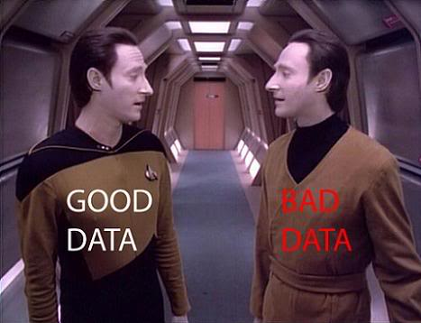
Bad Data Detection
Bad data may cause the accuracy of the estimate to deteriorate
To determine whether the estimated values differ significantly from the measured values, a useful statistical measure is the χ² (chi-squared) test of inequality.
By comparing the weighted sum of errors with the
χ² value for a particular degree of freedom and significance level, it can be determined whether it is likely that bad data exists
A significance level of 0.05 indicates there is a 5% likelihood that bad data exist, or conversely, a 95% level of confidence in the goodness of the data.

Slide 13
Bad Data Types and their Effects

Slide 14
Test for Bad Data
Use z to estimate x
Calculate the error
e = z − Ax
Evaluate the weighted sum of squares
For k = m − n and a specified probability α, if then the data are good; otherwise at least one bad data point exists.

Slide 15
Resulting in
with

Slide 16
Using the chi-square test of inequality with α=0.01, check for the presence of bad data
The number of states is 2 and the number of measurements is 4: k = 4-2 = 2.
2
Data good (with 99% confidence)

Slide 17
Nonlinear Least Squares Estimation
Minimize
Nonlinear equations
The approach to finding the states (and inputs) that minimize the weighted, squared error is similar to the linear case.

Slide 18
The state values that minimize the error are found by setting the derivatives of the error function to zero:
where
solve using a nonlinear solution method such as Newton-Raphson

Slide 19
Using Newton-Raphson to solve the nonlinear system of equations requires the Jacobian matrix:
Combining with the NR iteration yields the iteration:
not just this
whole expression must be ≈ 0 for convergence

Slide 20

Optimization and Airplanes

Slide 21
Linear Programming
Linear programming is one of the most common forms of optimization.
Linear programming can be used when a problem can be expressed by a linear objective (or cost) function to be maximized (or minimized) subject to linear equality or inequality constraints.
Any linear programming problem described by (A, b, c), there exists another equivalent, or dual problem (−A^{T} ,−c,−b).

Slide 22
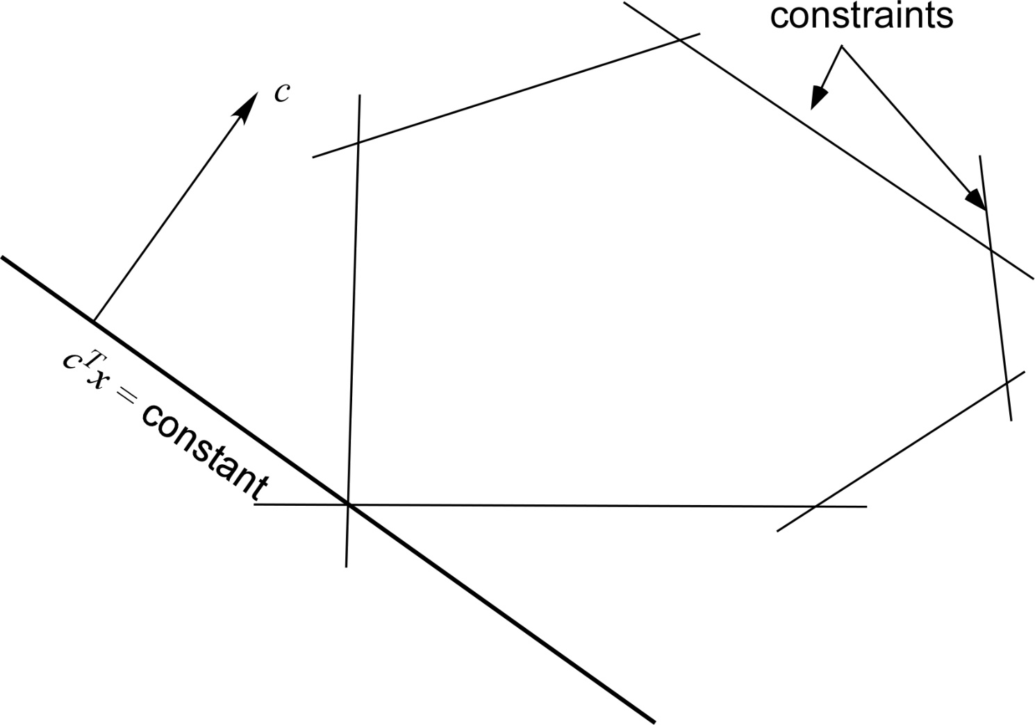
feasible region
minimum cost
The simplex method is an organized search of the vertices by moving along the steepest edge of the polytope

Slide 23
Comments:
maximizing is the same as minimizing
any constraint of the form is equivalent to
any constraint of the form is equivalent to and
if a problem does not require x_{i} to be nonnegative, then x_{i} can be replaced by the difference of two variables x_{i} = u_{i} ‒ v_{i} where u_{i} and v_{i} are nonnegative.
If a linear programming problem and its dual both have feasible points (i.e. any point that satisfies Ax ≤ b, x ≥ 0 or −A^{T} y ≤ −c, y ≥ 0 for the dual problem), then both problems have solutions and their values are the negatives of each other.

Slide 24
Simplex Method
The simplex method is often accomplished by representing the problem in tableau form, which is then modified in successive steps according to given rules.
The tableau has the following initial form:
c^{T}
0
0
A
I
b
0
b^{T}

Slide 25
Rules:
The x vector must satisfy the equality constraints Ax = b
The x vector must satisfy the inequality x ≥ 0
There are n components of x (designated nonbasic variables) that are zero. The remaining m components are usually nonzero and are designated as basic variables.
In the matrix that defines the constraints, each basic variable occurs in only one row.
The objective function f(x) must be expressed only in terms of nonbasic variables.
An artificial variable may be added to one or more constraints to obtain a starting solution.

Slide 26
Simplex Algorithm
If all coefficients in f(x)=c^{T}x (i.e. top row of the tableau) are greater than or equal to zero, then the current x vector is the solution.
Select the nonbasic variable whose coefficient in f(x) is the largest negative entry. This variable becomes the new basic variable x_{i}.
Divide each b_{i} by the coefficient of the new basic variable in that row, a_{ij}. The value assigned to the new basic variable is the least of these ratios
Using pivot element a_{kj}, create zeros in column j of A with Gaussian elimination. Return to 1.

Slide 27
Example:
Minimize:
Subject to:

Slide 29
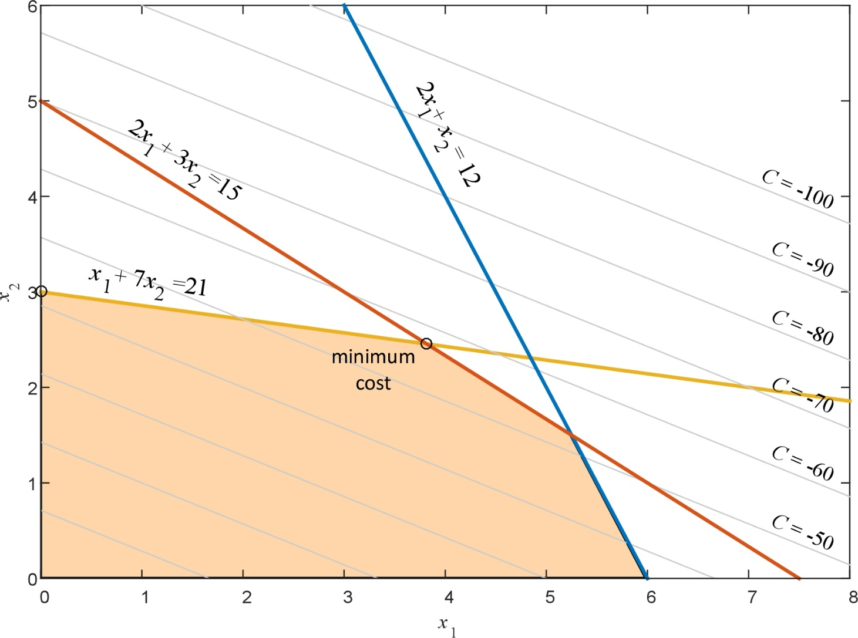
feasible region

Slide 30
Rewrite:
Minimize:
Subject to:
basic variables

Slide 31
Tableau
c^{T}x
I
b
-6 | -14 | 0 | 0 | 0 | 0
2 | 1 | 1 | 0 | 0 | 12
2 | 3 | 0 | 1 | 0 | 15
1 | 7 | 0 | 0 | 1 | 21
0 | 0 | 12 | 15 | 21
A

Slide 32
x₁
x₂
x₃
x₄
x₅
f(x)
-6 | -14 | 0 | 0 | 0 | 0
2 | 1 | 1 | 0 | 0 | 12
2 | 3 | 0 | 1 | 0 | 15
1 | 7 | 0 | 0 | 1 | 21
0 | 0 | 12 | 15 | 21
3
9
6
0
Increasing x₂ will decrease f(x) most rapidly, therefore hold x₁ constant at zero and let x₂ increase.
Set x₂ = 3 (with x₁ = 0) and solve:
x₅ is now a non-basic variable and x₂ is a basic variable
most restrictive

Slide 33
x₁
x₂
x₃
x₄
x₅
f(x)
-4
2
-42
-6 | -14 | 0 | 0 | 0 | 0
2 | 1 | 1 | 0 | 0 | 12
2 | 3 | 0 | 1 | 0 | 15
1 | 7 | 0 | 0 | 1 | 21
0 | 3 | 9 | 6 | 0
0
Must express f(x) in terms of non-basic variables:

Slide 34
x₁
x₂
x₃
x₄
x₅
f(x)
-4 | 0 | 0 | 0 | 2 | -42
2 | 1 | 1 | 0 | 0 | 12
2 | 3 | 0 | 1 | 0 | 15
1 | 7 | 0 | 0 | 1 | 21
0 | 3 | 9 | 6 | 0
Need to zero out below x₂ with Gaussian elimination:
doesn’t change except to normalize

Slide 35
x₁
x₂
x₃
x₄
x₅
f(x)
-4 | 0 | 0 | 0 | 2 | -42
13/7 | 0 | 1 | 0 | -1/7 | 9
11/7 | 0 | 0 | 1 | -3/7 | 6
1/7 | 1 | 0 | 0 | 1/7 | 3
0 | 3 | 9 | 6 | 0
Need to zero out below x₂ with Gaussian elimination:

Slide 36
x₁
x₂
x₃
x₄
x₅
f(x)
-4 | 0 | 0 | 0 | 2 | -42
13/7 | 0 | 1 | 0 | -1/7 | 9
11/7 | 0 | 0 | 1 | -3/7 | 6
1/7 | 1 | 0 | 0 | 1/7 | 3
0 | 3 | 9 | 6 | 0
Return to Step 1.
The cost function will only decrease for an increase in x₁: set x₅ to zero and let x₁ increase.
New constraints:
most restrictive

Slide 37
x₁
x₂
x₃
x₄
x₅
f(x)
-4 | 0 | 0 | 0 | 2 | -42
13/7 | 0 | 1 | 0 | -1/7 | 9
11/7 | 0 | 0 | 1 | -3/7 | 6
1/7 | 1 | 0 | 0 | 1/7 | 3
0 | 3 | 9 | 6 | 0
Set and solve for remaining variables:
New nonbasic variables

Slide 38
x₁
x₂
x₃
x₄
x₅
f(x)
0 | 0 | 0 | 28/11 | 2 | -630/11
0 | 0 | 1 | -13/11 | -1/7 | 21/11
1 | 0 | 0 | 7/11 | -3/11 | 42/11
0 | 1 | 0 | -1/11 | 1/7 | 27/11
42/11 | 27/11 | 21/11 | 0 | 0
-4 | 0 | 0 | 0 | 2 | -42
13/7 | 0 | 1 | 0 | -1/7 | 9
11/7 | 0 | 0 | 1 | -3/7 | 6
1/7 | 1 | 0 | 0 | 1/7 | 3
0 | 3 | 9 | 6 | 0
Rewrite f (x) in terms of nonbasic variables:
Both coefficients > 0, therefore no more reduction in f (x) is possible
Solve for x₁ in terms of x₄:

Slide 39
Announcements
Reading Chapter 6
Remember to start on Discussion Set #2
Check-in meetings this week
Set aside time for PROGRAMS – Try to have Program #1 done by Oct 31, if not sooner.
Start working on Program #3 when done with #1
Next week
I’ll teach from Vancouver classroom on Tuesday
Office Hours from Vancouver and via zoom on Tuesday & Wednesday
Class on next Thursday (10/27) via Zoom or Vancouver classroom (no class in Pullman classroom)

