Slide 1
EE 521/ECE 582 – Analysis of Power systems
Class #18 – October 25, 2022
Dr. Noel N. Schulz
Edmund O. Schweitzer III Chair in
Power Apparatus and Systems
Chief Scientist Joint Appointment, PNNL
Co-Director, PNNL/WSU Advanced Grid Institute (AGI)
Washington State University Pullman
Noel.Schulz@wsu.edu EME 35
509-335-0980 (o) and 509-336-5522 (c)

Slide 2
Reminders
Office Hours This Week
Tuesday (Vancouver or Zoom) – 4:30-5:30 pm
Wednesday (Vancouver or Zoom) – 4-5 pm
Friday (EME 35 or Zoom) – 1:30-2:30 pm
Other times by appt
This Week Classes:
Tuesday Class from Vancouver Classroom
NO on-campus Pullman class on Thursday, 10/27. Class via zoom
Discussion Set #2 – Response to Questions Due: 10/28
Work on Programs #1 and #3 (hold on #2 for now)

Slide 3
Discussion Set #2
Assignment #2 | Column A: Summarize (150 to 200 word summary of article) | Column B: List of three questions for class to answer? | Column C: Answer the Questions or Add to Discussions (Each response should be between 25 and 100 words)
See Canvas for Papers | Due: 10/18 | Due: 10/21 | Due: 10/28
Paper #1 | Liadi Akande | Noah Allison | All students in class should respond to three of these papers.
Paper #2 | Jacob Hastings | Sajjad Uddin Mahmud | All students in class should respond to three of these papers.
Paper #3 | Asif Iftekhar Omi | Md Samiul Islam Sagar | All students in class should respond to three of these papers.
Paper #4 | Sumanjali Pannala | Saeed Salimi Amiri | All students in class should respond to three of these papers.
Paper #5 | Md Mehedi Hasan Tanim | Leonardo Stingini | All students in class should respond to three of these papers.
Paper #6 | Hassan Yazdani | Ke Wang | All students in class should respond to three of these papers.
discussion_2_paper1_GPU-Based_Sparse_Power_Flow_Studies_With_Modified_Newtons_Method.pdf
discussion_2_paper2_The_continuation_power_flow_a_tool_for_steady_state_voltage_stability_analysis.pdf
discussion_2_paper3_Continuation_three phase_power_flow_a_tool_for_voltage_stability_analysis_of_unbalanced_three-phase_power_systems.pdf
discussion_2_paper_4_Grid_Influences_From_Reactive_Power_Flow_of_Photovoltaic_Inverters_With_a_Power_Factor_Specification_of_One.pdf
discussion_2_paper_5_Intergrid_A_Future_Electronic_Energy_Network.pdf
Discussion_2_paper_6_Successive-Intersection-Approximation-Based_Power_Flow_Method_for_Integrated_Transmission_and_Distribution_Networks.pdf

Slide 4
Program #3 – Continuation Power Flow
Develop the Continuation Power Flow algorithm to determine the P-V curves for all the required buses in the IEEE 14 bus test case with taps. Do not worry about Q limits for this problem.

Slide 5
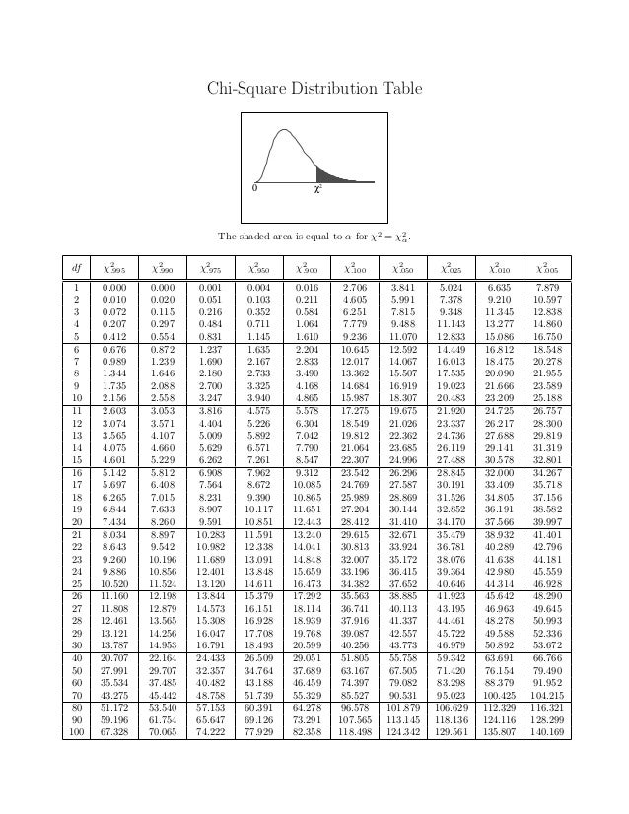

Slide 6
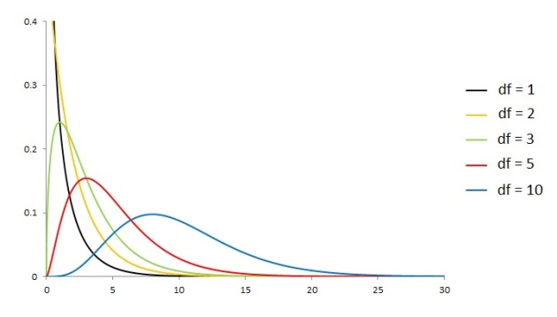
The Chi-Squared Distribution, Part 1 | Topics in Actuarial Modeling (wordpress.com)

Slide 7
State Estimation
The state estimator is designed to give the best estimates of the voltages and phase angles minimizing the effects of the measurement errors.
A set of specified measurements of a power system is said to be observable if the entire state vector of bus voltage magnitude and phase angles can be estimated from the set of available measurements.
An unobservable system is one in which the set of measurements do not span the entire state space, and therefore not all states can be estimated.

Slide 8
Estimate the power system states and use the chi-square test of inequality with α = 0.01 to check for the presence of bad data in the measurements.

Slide 9
Recall:
Minimize
What is x?
What is W?

Slide 10
What is h(x)?

Slide 11
Set up equations:
What is H_{x} ?

Slide 12
The Newton-Raphson iteration to solve for the set of states x that minimize
the weighted errors is:
Iteration 1: Starting with a flat start:
and

Slide 13
and
too large → not converged
Repeat iterations
Repeating until convergence yields:
and
compare with

Slide 14
To check for the presence of bad data, the weighted sum of squares of the
measurement errors are compared to the chi-square distribution for k = 2 and
α = 0.01.
The weighted sum of squares is
k = m-n = 5-3
This value is less than χ_{2,0.01} = 9.21; therefore, the data set is good and does
not contain any spurious measurements.

Slide 15
Optimization Techniques
Least Squares State Estimation
Linear Programming
Simplex Method
Interior Point Method
Nonlinear Programming
Quadratic Programming
Steepest Descent Algorithm
Sequential Quadratic Programming Algorithm

Slide 16
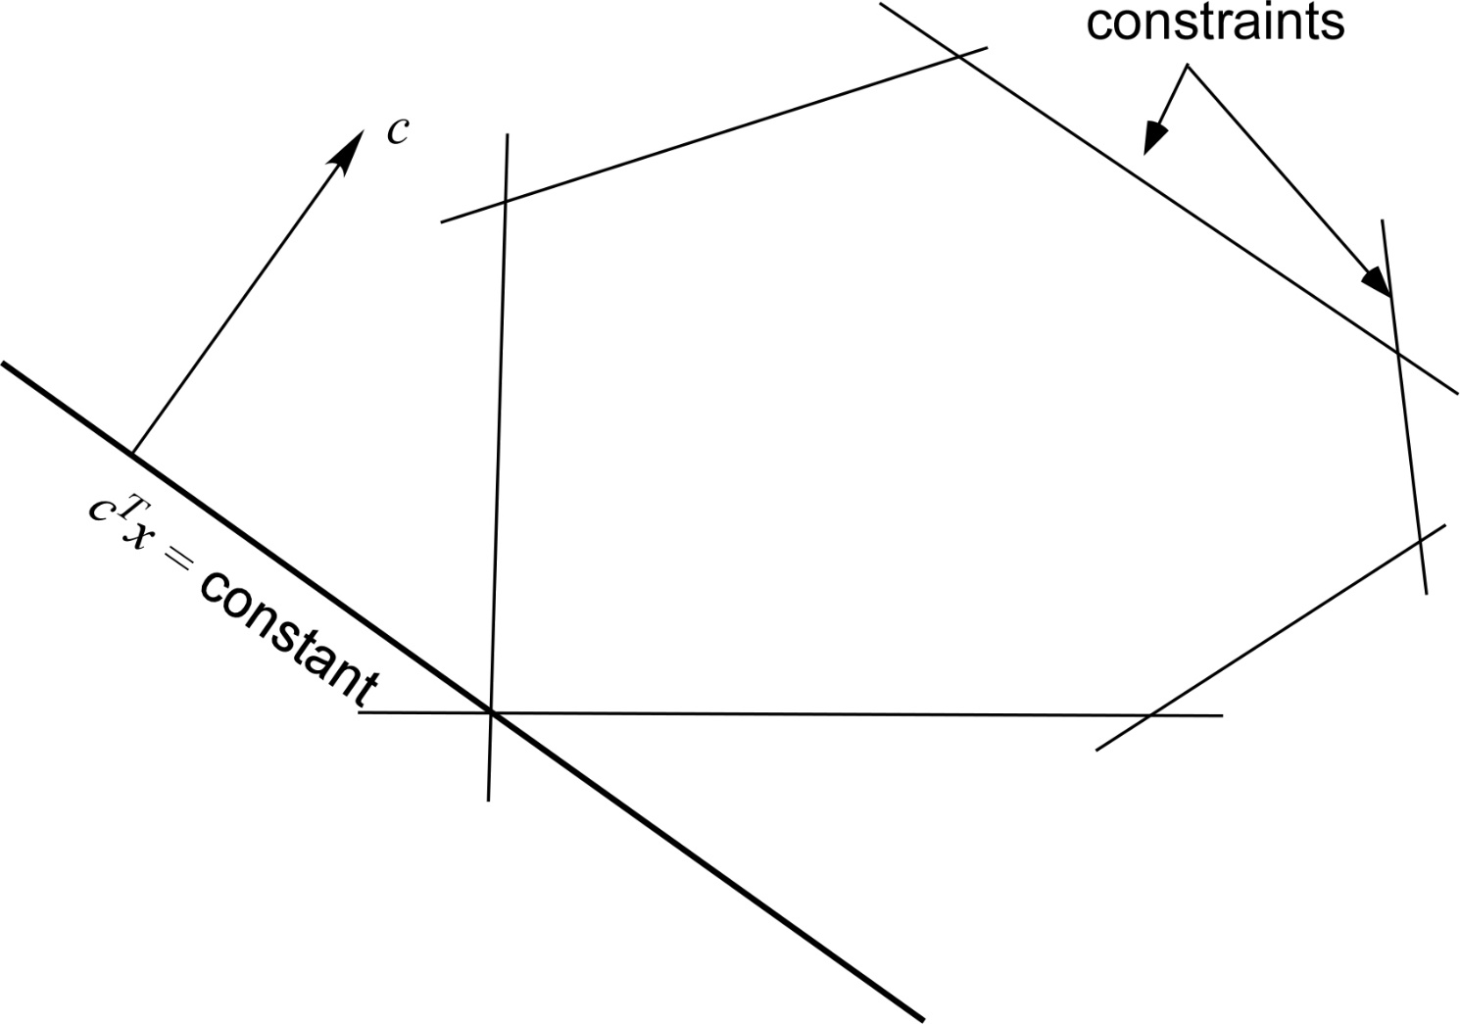
Interior Point Method
feasible region
Iterations stay in the interior of the feasible region

Slide 17
Interior point methods construct a sequence of strictly feasible points that converges to the solution
stepsize
direction
One of the key aspects of the interior point method is that a transformation is applied such that the current feasible point is moved (through the transformation) to the center of the interior.
The new direction is then computed and the interior point is transformed back to the original space. Each p^{k} must be orthogonal to the rows of A

Slide 18
The projection matrix P
will transform any vector v into Pv=p
The transformation will also center the new iterate in the feasible space through scaling.
Scale so that where D is the diagonal matrix.

Slide 19
Primal Affine Interior Point Method
Let k = 0.
Let D = diag(x^{k})
Compute
Compute
Set
Set
Compute
Compute
If then done. Else set k=k+1. Go to step 2.

Slide 20
Example:
Minimize:
Subject to:
(Same example system as before)

Slide 21
Rewrite with slack variables (as before):
Minimize:
Subject to:

Slide 22
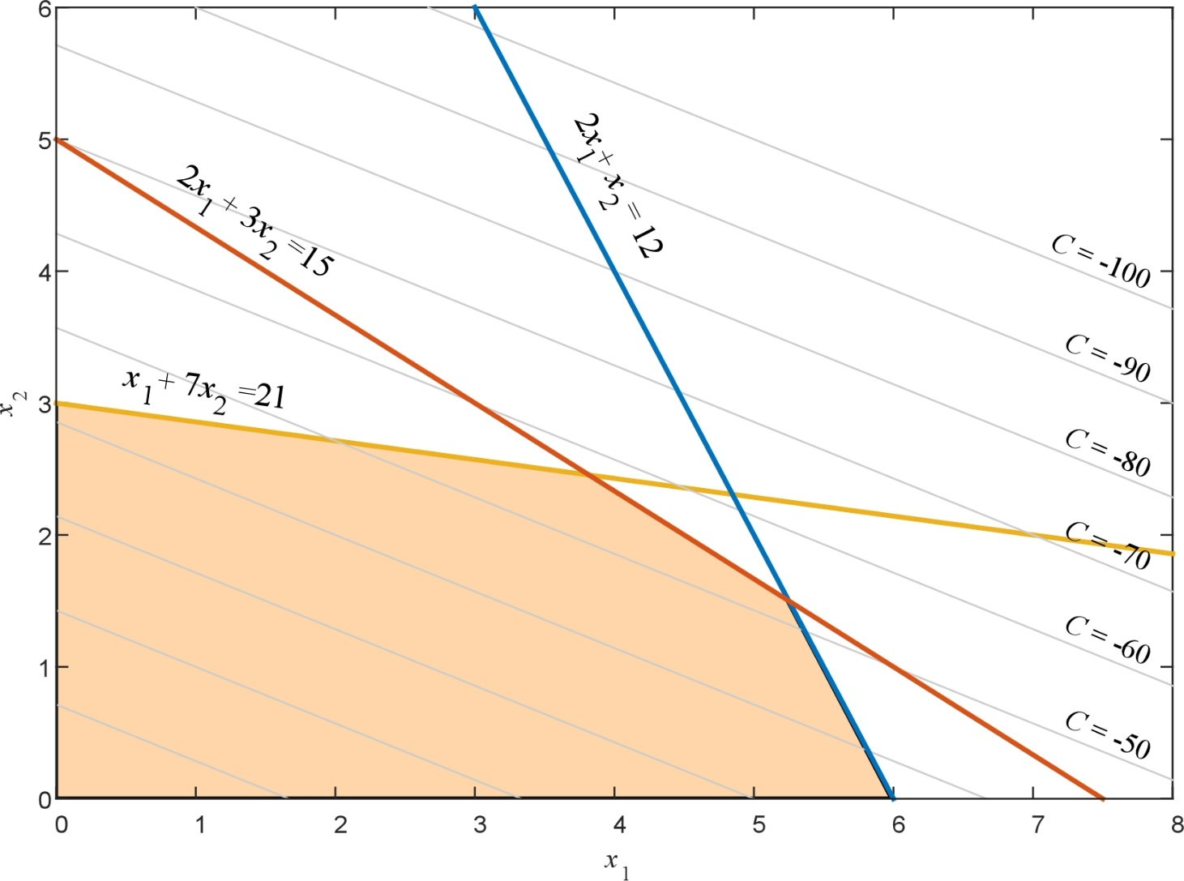
Choose a feasible initial starting point:
The first scaling matrix is

Slide 23
The rescaled matrix and objective function vector are computed as:

Slide 24
The projection matrix is:

Slide 25
The projected gradient is

Slide 26
Calculate = 5.5373.
Rescale the current iterate to
and move to in the transformed space with α = 0.9:

Slide 27
Transforming this point back to the original space:
which has the cost function:
Continue until convergence.

Slide 28
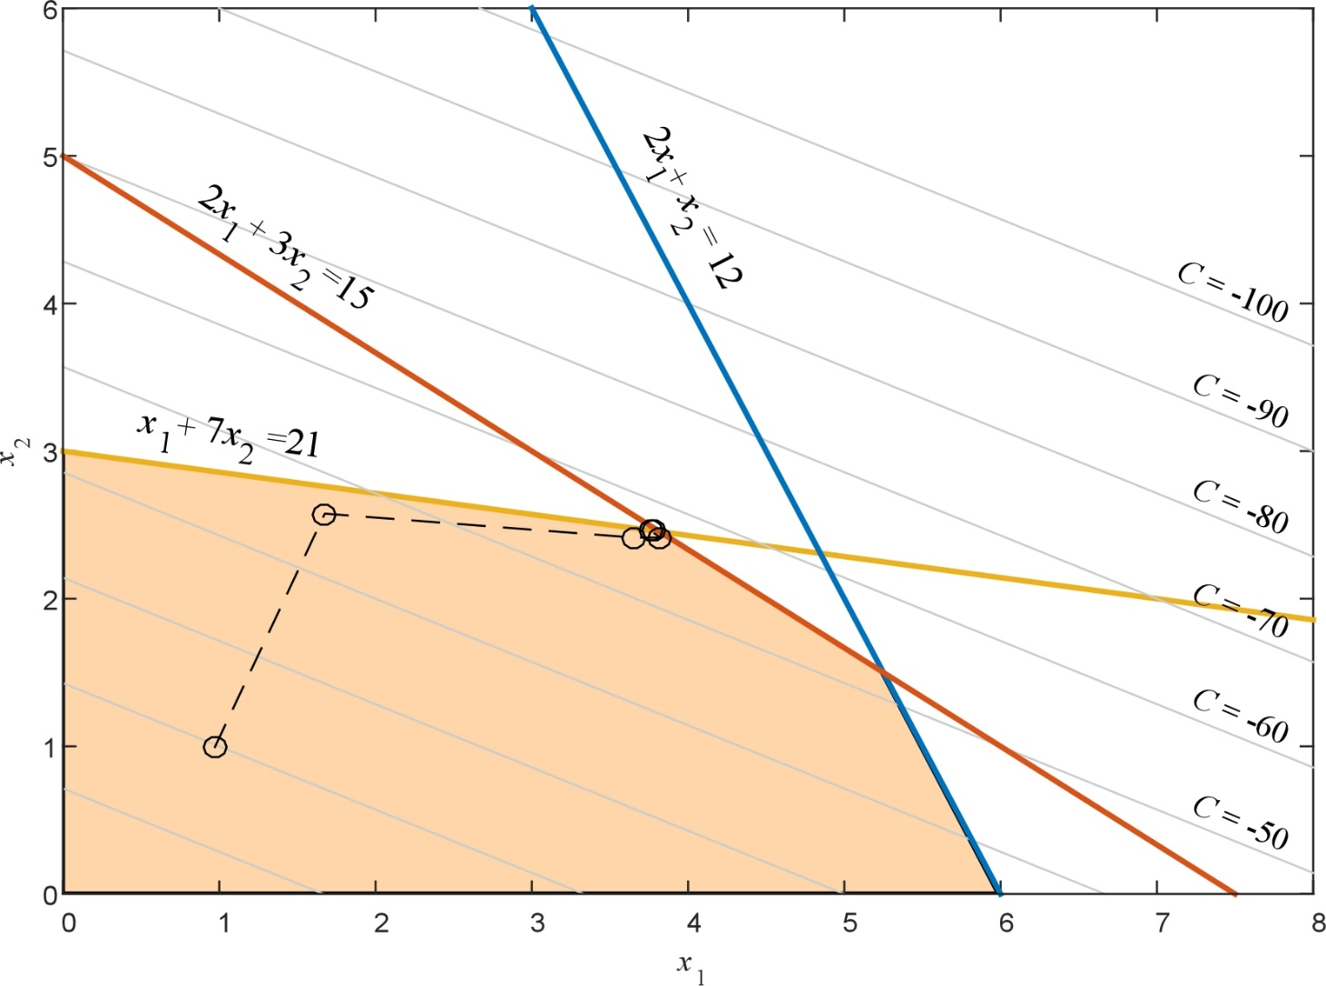
Same result as Simplex method
(1)
(2)
(0)

Slide 29
Nonlinear Programming
These problems take the form:

Slide 30
Quadratic Programming
A special form of nonlinear program is quadratic programming, in which
In this case, the cost function is nonlinear (quadratic), but the constraints are linear.
If Q is a positive semidefinite matrix, then f(x) is a convex function,

Slide 31
Since the constraints are linear, the quadratic cost function can be recast as a linear function by introducing additional artificial variables.
Introduce a Lagrangian function:
Minimizing this equation yields:
These are often called the Karush-Kuhn-Tucker or KKT equations
The solution of these equations is the constrained minimum of the quadratic equation

Slide 32
To put these equations in a more manageable form, the nonnegative slack
variables y and v are introduced to the inequalities
Full set of equations:
which can be solved using linear programming (Simplex or Interior Point Methods)

Slide 33
Minimize:
Subject to:
Rewrite in matrix form:
Minimize:
Subject to:

Slide 34
KKT equations:

Slide 35
Put in linear programming form. Introduce a₁ through a₄ as basic variables:
Minimize:
Subject to:
Note that the KKT equalities are enforced when
which gives the minimum cost f(x)=0

Slide 36
Solution:
All zero

Slide 37
Optimization using Lagrangian functions
This is an approach to solve the generalized nonlinear optimization problem
by minimizing the Lagrangian function where λ is the Lagrangian multiplier

Slide 38
Consider the case in which there are no inputs and neglecting inequalities:
which becomes:
This is solved by taking the derivatives and setting them equal to zero:
enforces equality constraint

Slide 39
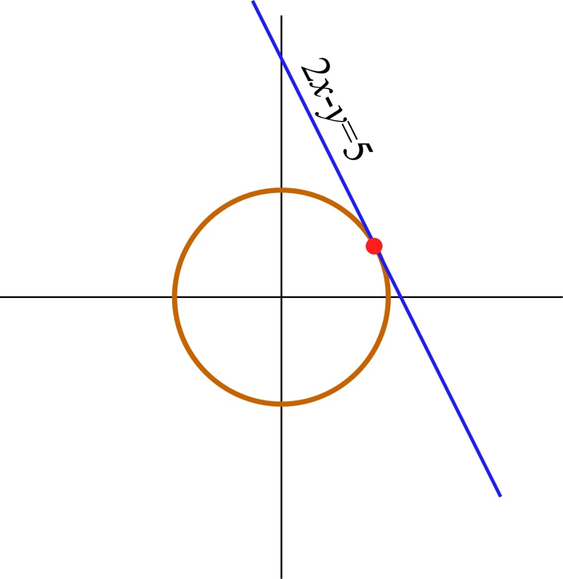
Example: Minimize
Subject to:
The point that minimizes the constrained cost function is the point in the x-y plane where the constraint line intersects the circle defined by C.
The minimum corresponds to the minimum radius of the circle centered at the origin.
minimum

Slide 40
The augmented (Lagrangian) cost function is:
The solution is obtained by solving:
Resulting in with

Slide 41
If the cost function or equality constraints contain the input u, then an iterative approach is used (neglecting inequalities)
a vector with dimension m
Taking derivatives:

Slide 42
Steepest Descent
In the Steepest Descent method, the solution process alternates between solving for x and u to minimize the augmented cost function.
The solution starts with a feasible solution (one that satisfies the equality constraint) and updates u in the direction of greatest change of the cost function (i.e. the direction of steepest descent towards the minimum)
Feasible solution:
(first derivative equation)
Solve for λ:
(second derivative equation)

Slide 43
Substitute into third equation:
Gradient of C* with respect to u

Slide 44
Steepest Descent Algorithm
Let k = 0. Guess an initial vector u^{k}=u⁰.
Solve the (possibly nonlinear) system of equations for a feasible solution x.
Calculate and . If stop.
Calculate the new vector where γ is a positive number which is the user-defined stepsize of the algorithm.
k=k+1. Go to step 2.

Slide 45
At every step, the gradient is chosen such that the descent is in the steepest direction (i.e. normal to the constant cost curve)
The size of the step is determined by the steplength γ. A large steplength typically provides rapid convergence, but may oscillate around the minimum if too large.
curves of constant cost

Slide 46
Example: Minimize
Subject to:
Use γ = 0.05
Take derivatives:

Slide 47
Calculate gradient:

Slide 48
First iteration: Start with u = 1 and solve for x₁ and x₂ (feasible solution)
Two possible solutions (found using NR):
lowest cost
Calculating gradient:
Update u:

Slide 49
Second iteration:
Two possible solutions (found using NR):
Converged?
(need to repeat)
Calculating gradient:
Update u:

Slide 50
Third iteration:
Two possible solutions (found using NR):
This process continues until the final solution is reached
The final values are:
x₁ = 0.5774,
x₂ = ‒ 0.7354, and
u = 0.4605 which yield the minimum cost function f = 1.6270.

Slide 51
Sequential Quadratic Programming
Gradient descent techniques work well for small nonlinear systems, but become inefficient as the dimension of the search space grows.
Sequential quadratic programming (SQP) optimization is more computationally efficient
The SQP is an iterative procedure that sequentially solves the QP problem to produce the solution to the original nonlinear problem in much the same way that the Newton-Raphson sequentially solves a series of linear problems to find the solution to a nonlinear problem.

Slide 52
The SQP method solves the system
by using Lagrange multipliers

Slide 53
The KKT conditions are
Lagrange multipliers
Slack variables

Slide 54
Neglecting inequalities, the nonequations become:
Which can be solved using Newton-Raphson:
Or:

Slide 55
Example: Minimize
Subject to:
Applying the KKT conditions:

Slide 56
Nonlinear system of equations:
The Newton-Raphson iteration becomes

Slide 58
Announcements
Reading Chapter 6
Remember to start on Discussion Set #2
Set aside time for PROGRAMS – Try to have Program #1 done by Oct 31, if not sooner.
Start working on Program #3 when done with #1
This Week
Office Hours from Vancouver and via zoom on Tuesday & Wednesday
Class on Thursday (10/27) via Zoom or Vancouver classroom (no class in Pullman classroom)

