Slide 1
EE 521/ECE 582 – Analysis of Power systems
Class #19 – November 1, 2022
Dr. Noel N. Schulz
Edmund O. Schweitzer III Chair in
Power Apparatus and Systems
Chief Scientist Joint Appointment, PNNL
Co-Director, PNNL/WSU Advanced Grid Institute (AGI)
Washington State University Pullman
Noel.Schulz@wsu.edu EME 35
509-335-0980 (o) and 509-336-5522 (c)

Slide 2

Reminders
Office Hours This Week
Tuesday (WSU TC or Zoom) – 4:30-5:30 pm
Wednesday (WSU TC or Zoom) – 4-5 pm
Friday (EME 35 or Zoom) – 1:30-2:30 pm
Other times by appt
This Week Classes:
Tuesday Class via Zoom
Thursday Class via Zoom
Discussion Set #3
Final Paper progress
Updates on Programs

Slide 3

Discussion Set #3
Assignment #3 | Column A: Summarize (150 to 200 word summary of article) | Column B: List of three questions for class to answer? | Column C: Answer the Questions or Add to Discussions (Each response should be between 25 and 100 words)
See Canvas for Papers | Due: 11/8 | Due: 11/10 | Due: 11/18
Paper #1 | Noah Allison | Ninad Gaikwad | All students in class should respond to three of these papers.
Paper #2 | Sajjad Uddin Mahmud | Aryan Jha | All students in class should respond to three of these papers.
Paper #3 | Md Samiul Islam Sagar | Annika Lawrence | All students in class should respond to three of these papers.
Paper #4 | Saeed Salimi Amiri | Ben McCornack | All students in class should respond to three of these papers.
Paper #5 | Leonardo Stingini | Mauricio Silveira | All students in class should respond to three of these papers.
Paper #6 | Ke Wang | Augusto Zanin Bertoletti | All students in class should respond to three of these papers.
See assignment for articles

Slide 4
Program #3 – Continuation Power Flow
Develop the Continuation Power Flow algorithm to determine the P-V curves for all the required buses in the IEEE 14 bus test case with taps. Do not worry about Q limits for this problem.

Slide 5
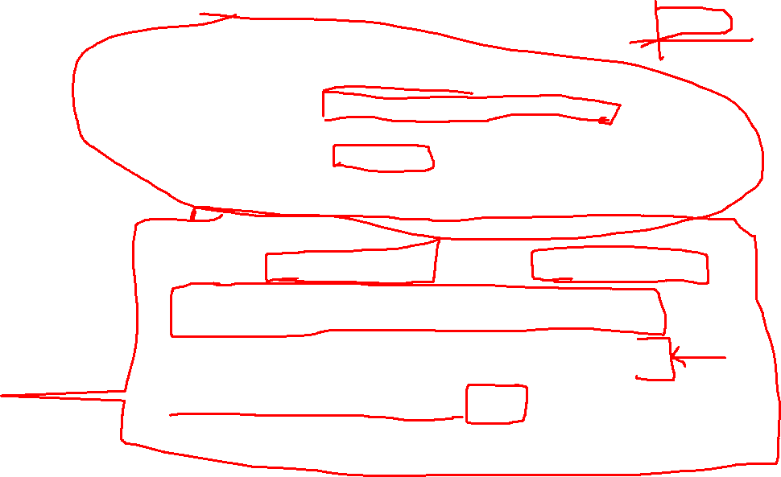
Program #3 – Continuation Power Flow
Individual Programs #1 and #3
Program #1 – Power Flow
Program #3 – Continuation Power Flow
Develop the Continuation Power Flow algorithm to determine the P-V curves for all the required buses in the IEEE 14 bus test case with taps. Do not worry about Q limits for this problem.
Group Project Option
Programs #4, #5 and #2 (TBD) can be done in pairs
Identify your partner by Nov 4 for all three remaining programs.
Programs #4 and #5 discussed in detail on Thursday
Can work alone if you want. Need to submit that you will not have a partner.

Slide 6
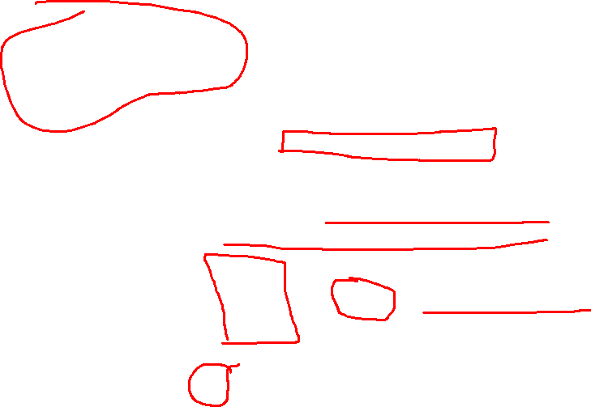
Steepest Descent
In the Steepest Descent method, the solution process alternates between solving for x and u to minimize the augmented cost function.
The solution starts with a feasible solution (one that satisfies the equality constraint) and updates u in the direction of greatest change of the cost function (i.e. the direction of steepest descent towards the minimum)
Feasible solution:
(first derivative equation)
Solve for λ:
(second derivative equation)

Slide 7
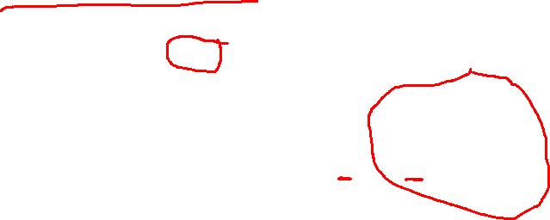
Substitute into third equation:
Gradient of C* with respect to u

Slide 8
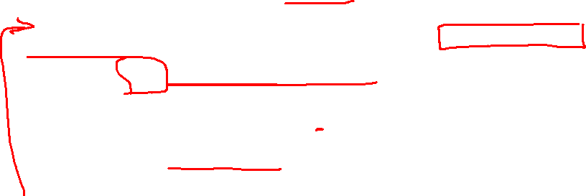
Steepest Descent Algorithm
Let k = 0. Guess an initial vector u^{k}=u⁰.
Solve the (possibly nonlinear) system of equations for a feasible solution x.
Calculate and . If stop.
Calculate the new vector where γ is a positive number which is the user-defined stepsize of the algorithm.
k=k+1. Go to step 2.

Slide 9
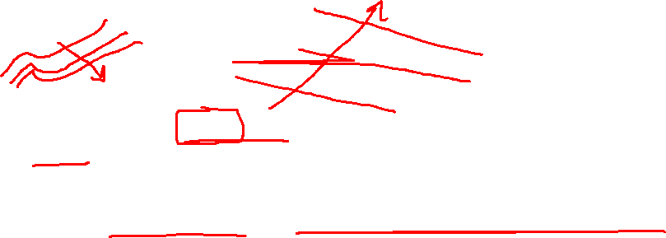
At every step, the gradient is chosen such that the descent is in the steepest direction (i.e. normal to the constant cost curve)
The size of the step is determined by the steplength γ. A large steplength typically provides rapid convergence, but may oscillate around the minimum if too large.
curves of constant cost

Slide 10
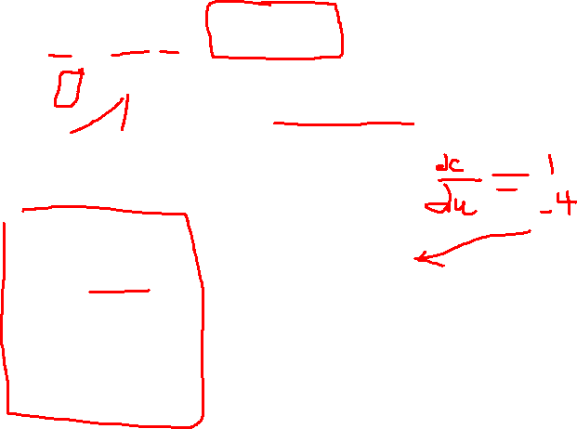
Example: Minimize
Subject to:
Use γ = 0.05
Take derivatives:

Slide 11

Calculate gradient:

Slide 12
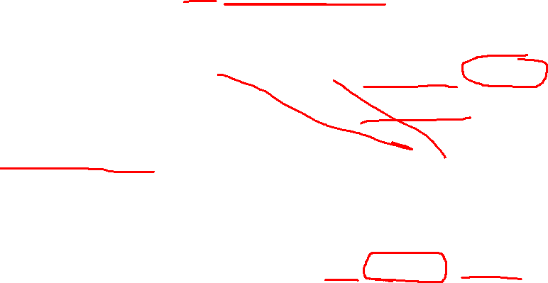
First iteration: Start with u = 1 and solve for x₁ and x₂ (feasible solution)
Two possible solutions (found using NR):
lowest cost
Calculating gradient:
Update u:

Slide 13
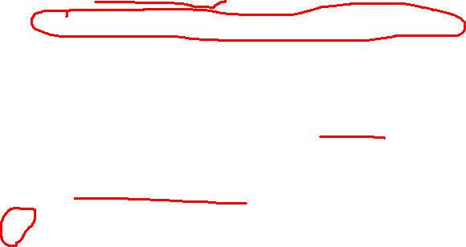
Second iteration:
Two possible solutions (found using NR):
Converged?
(need to repeat)
Calculating gradient:
Update u:

Slide 14
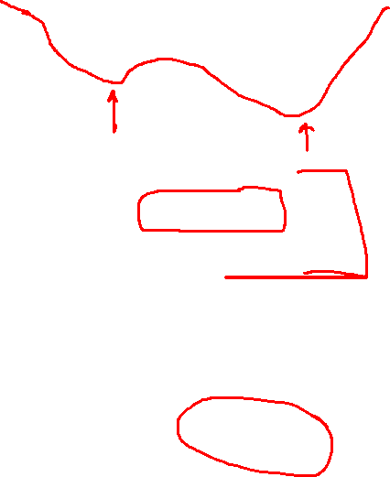
Third iteration:
Two possible solutions (found using NR):
This process continues until the final solution is reached
The final values are:
x₁ = 0.5774,
x₂ = ‒ 0.7354, and
u = 0.4605 which yield the minimum cost function f = 1.6270.

Slide 15

Sequential Quadratic Programming
Gradient descent techniques work well for small nonlinear systems, but become inefficient as the dimension of the search space grows.
Sequential quadratic programming (SQP) optimization is more computationally efficient
The SQP is an iterative procedure that sequentially solves the QP problem to produce the solution to the original nonlinear problem in much the same way that the Newton-Raphson sequentially solves a series of linear problems to find the solution to a nonlinear problem.

Slide 16
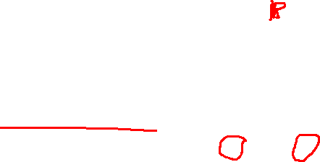
The SQP method solves the system
by using Lagrange multipliers

Slide 17
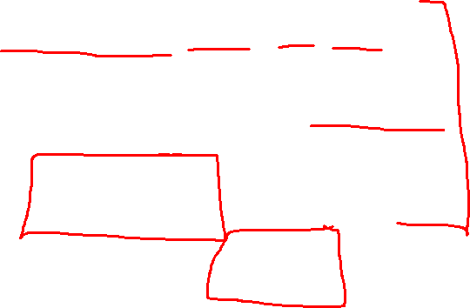
The KKT conditions are
Lagrange multipliers
Slack variables

Slide 18
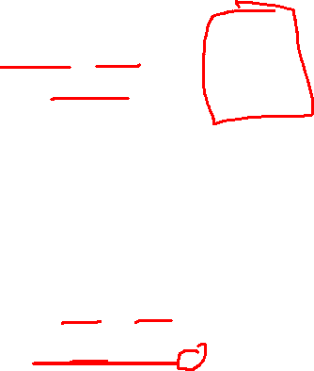
Neglecting inequalities, the nonequations become:
Which can be solved using Newton-Raphson:
Or:

Slide 19

Example: Minimize
Subject to:
Applying the KKT conditions:

Slide 20

Nonlinear system of equations:
The Newton-Raphson iteration becomes

Slide 21
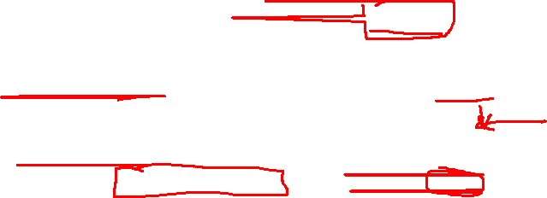

Slide 22
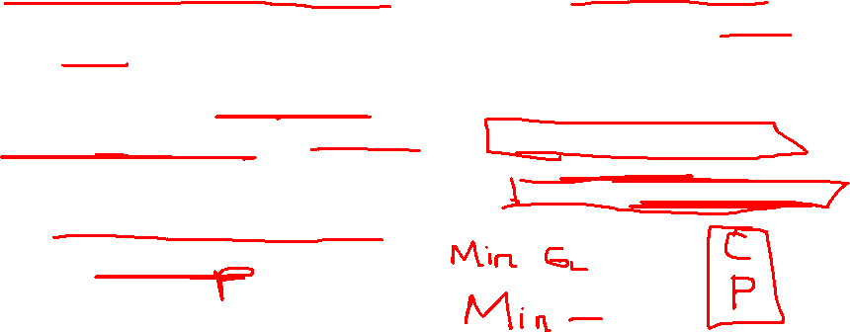
Optimal Power Flow
The optimal power flow problem is to formulate the power flow problem to find system voltages and generated powers within the framework of the objective function.
In this application, the inputs to the power flow are systematically adjusted to maximize (or minimize) a scalar function of the power flow state variables.
The two most common objective functions are minimization of generating costs and minimization of active power losses.

Slide 23
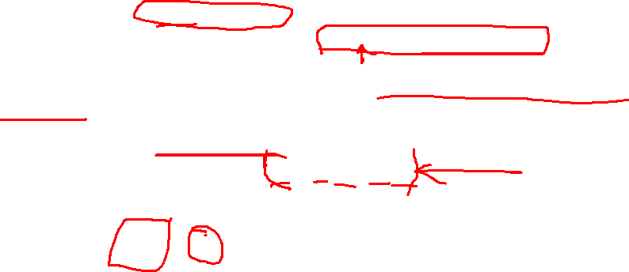
The case in which active power losses in the system are neglected, the optimal power flow problem is typically called the Economic Dispatch problem.
The individual generating unit costs are given as quadratic functions of generating power P_{i}
Minimize
Subject to:
Total system load

Slide 24
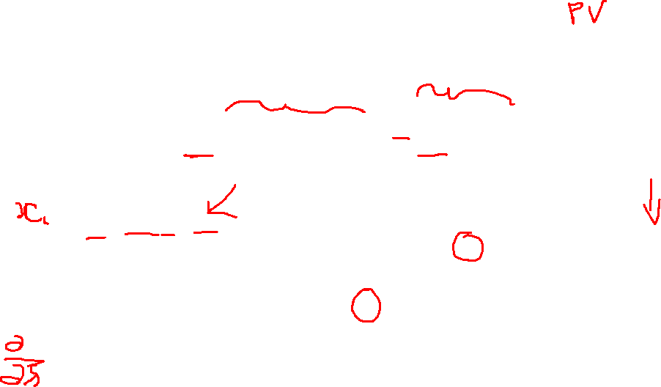
Introduce Lagrangian multipliers:
Minimize:
Taking derivatives:
Linear system of equations

Slide 25
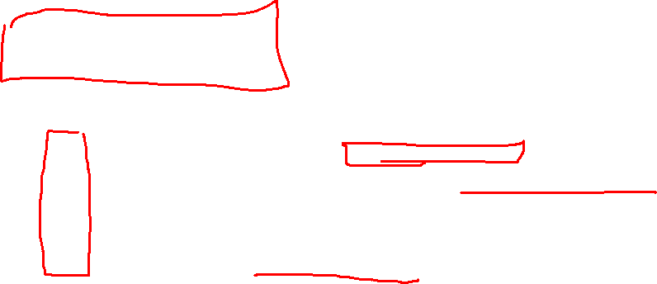
Equal incremental cost rule
Note that
λ is called the “incremental cost” and this problem solution is known as the “equal incremental cost” rule.
The optimal solution occurs when the incremental cost for each generator is the same. That implies that an incremental change in any generator’s output will result in the same incremental cost increase.

Slide 26

Example: Three generators with the following cost functions serve a load of 952 MW.
Assuming a lossless system, calculate the optimal generation scheduling.
Using the equal incremental cost rule:

Slide 27
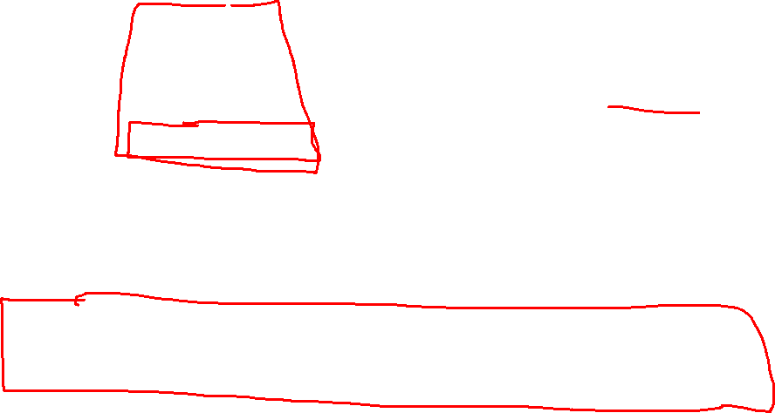
Solving:
which yields a generating cost of $7,616/hr
The value of λ is the incremental or break-even cost of production.
The value of λ can provide insight into whether or not a utility should buy or sell generation.

Slide 28
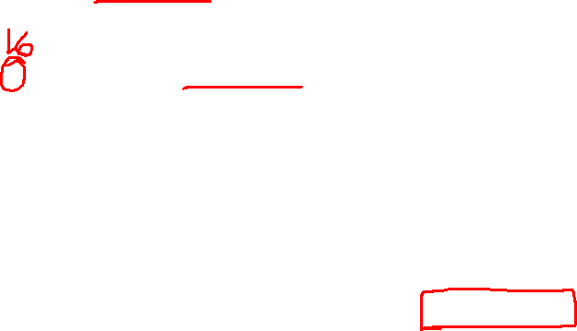
If a buyer is willing to pay $16/MW hr for generation, how much excess generation
should be produced and sold, and what is the profit for this transaction?
Rewriting:
Substituting λ= $16/MW hr into the generation equations:

Slide 29

The excess generation is:
The new cost of generation is:
Amount received for sale of excess generation:
Therefore, the total cost is $8,670–1,088 = $7,580/hr. This amount is $34/hr less than the original cost of $7,616/hr; thus, $34/hr is the profit achieved from the sale of the excess generation at $16/MW hr.

Slide 30
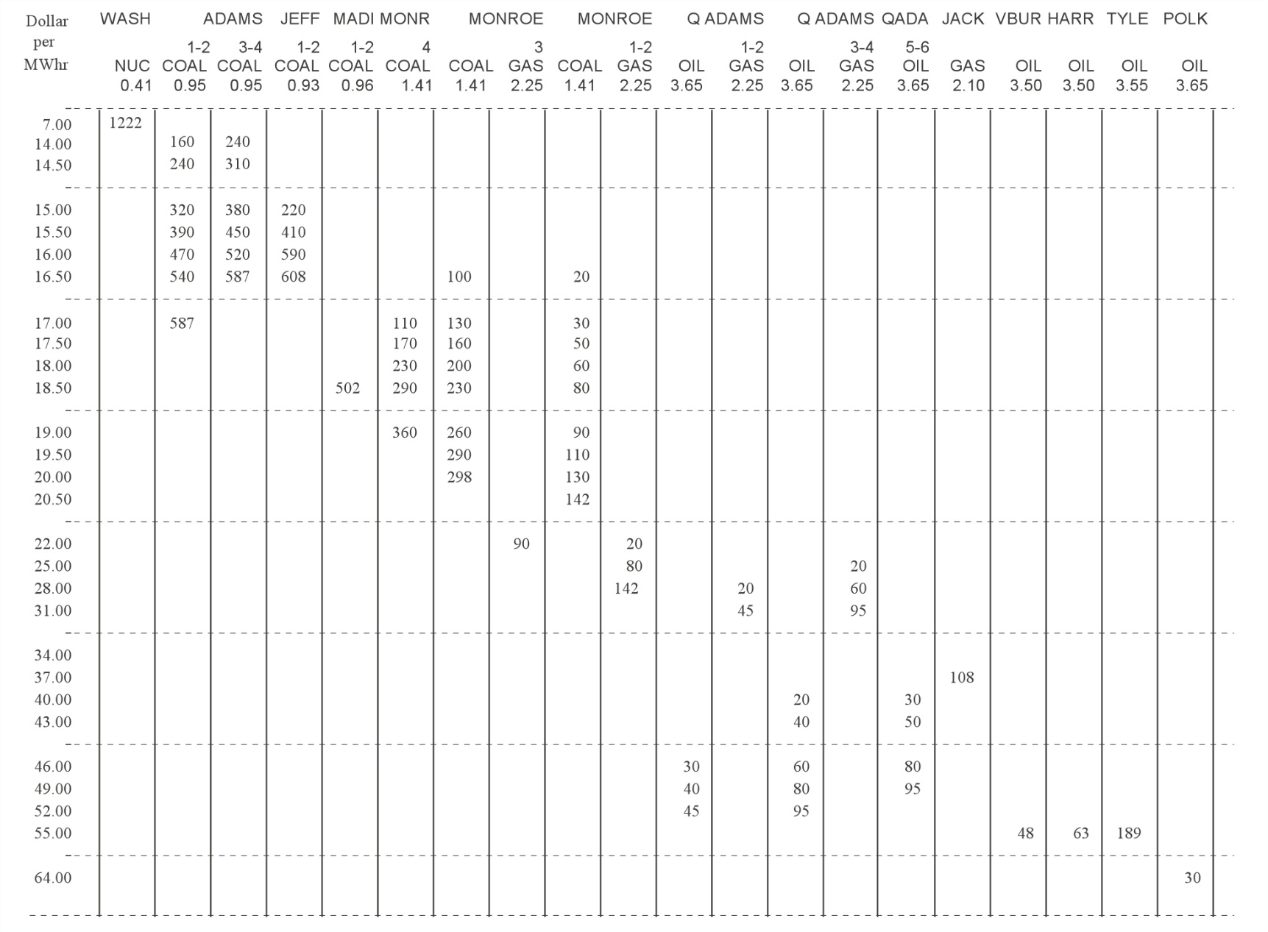

Utility incremental cost table:
What incremental corresponds to 10,000 MW?
Total generation
Units
1222
+160+240
+240+310
+320+380+220
+390+450+410
+470+520+590
+540+587+608+100+20
+587+110+130+30
+170+160+50
+230+200+60
+502+290+230+80
1222
1622
2172
3092
4342
5922
7777
8634
9014
9504
10606

Slide 31
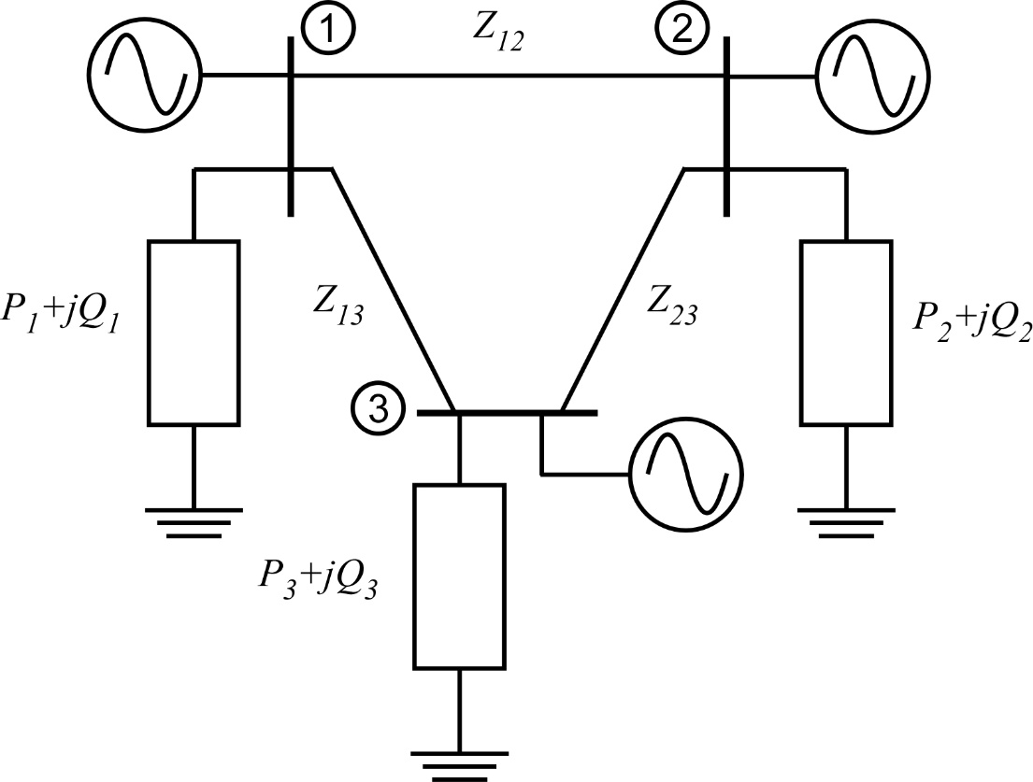
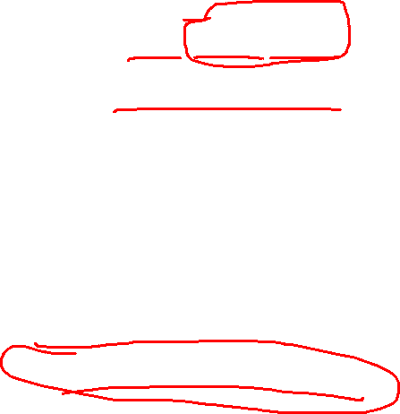
From equal incremental cost rule
Using as a starting point, find the optimal scheduling of this system considering losses.
The cost functions of the generators are
Use the steepest descent method

Slide 32
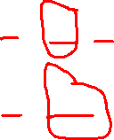
Set up equations:
Gradient:
Cost function:
Equality constraints:
Why not P₁?

Slide 33

Find matrices:
System Jacobian

Slide 34
Continuing:

Slide 35
Per unit
Start deepest descent iteration
Starting with find the corresponding x values (from powerflow):
Calculate matrices:

Slide 36
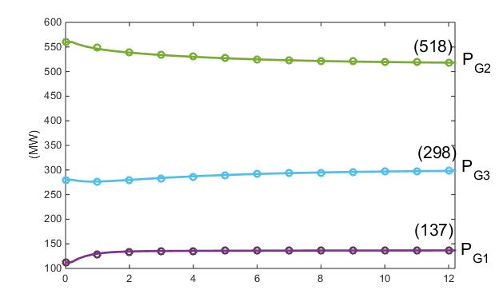
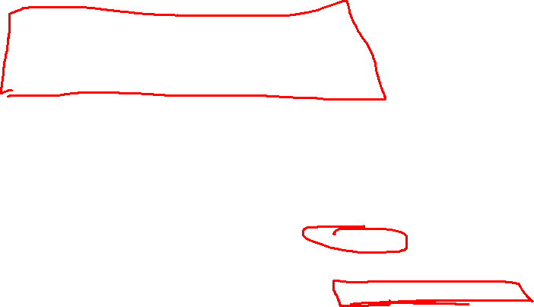
Gradient:
With γ = 1
Proceeding until convergences yields the final powers:
Higher than the lossless case
with cost: $7,698/MWhr

Slide 37

Limitations on Independent Variables (inputs):
Let
exceeded
If any P_{i} exceeds its limit, set it to its limit (i.e. P₃ = 0.25 pu) and reduce the number of inputs by 1
The new partial derivatives become:
solving
with cost: $7,728/MWhr
Higher than the unconstrained case

Slide 38
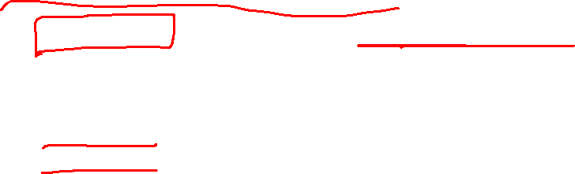
Limitations on Dependent Variables (states):
Let (the powerflow in line 2-3 – originally 121.1 MW)
Two approaches:
Soft constraint – violating the limiting factor is undesirable
Hard constraint – violating the limiting factor is catastrophic

Slide 39
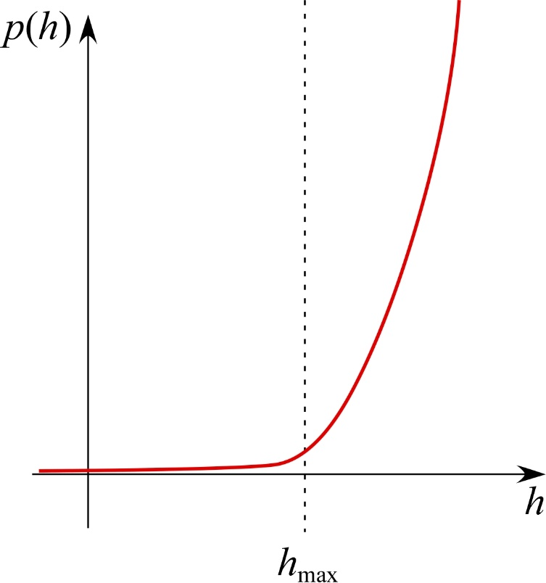
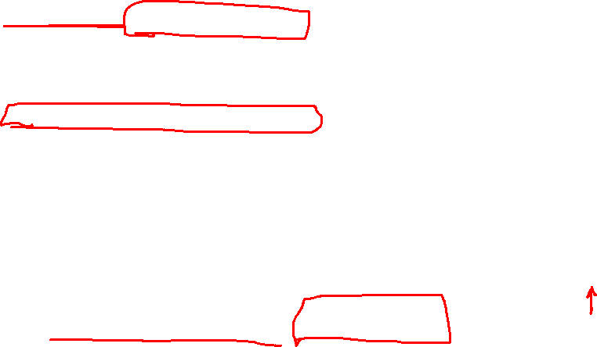
Soft constraint: Use Penalty Functions
A penalty function is a function that is small for values less than the limit, but increases rapidly if the limit is violated
The new cost function becomes:

Slide 40

Use a penalty function to enforce the constraint
Let
The new partial derivatives are all the same except:
From penalty function

Slide 41
Proceeding with the steepest gradient algorithm iterations yields the final constrained optimal generation scheduling:
with cost: $7,781/MWhr
Higher than the unconstrained case
and P₂₃ = 101.2 MW.

Slide 42

Hard constraint: Dual Variable Approach
In this approach, the inequality constraints are added as additional equality constraints with the inequality set equal to the limit (upper or lower) that is violated.
This introduces an additional set of Lagrangian multipliers. This is often referred to as the dual variable approach, because each inequality has the potential of resulting in two equalities: one for the upper limit and one for the lower limit.
However, the upper and lower limit cannot be simultaneously violated; thus, out of the possible set of additional Lagrangian multipliers only one of the two will be included at any given operating point and thus the dual limits are mutually exclusive.

Slide 43

In this case, the additional equation is added:
This now increases the number of equality constraints to 3 (including the two original powerflow equations)
Therefore an additional unknown state is required
Choose P_{G3}

Slide 44
New Jacobian:

Slide 47
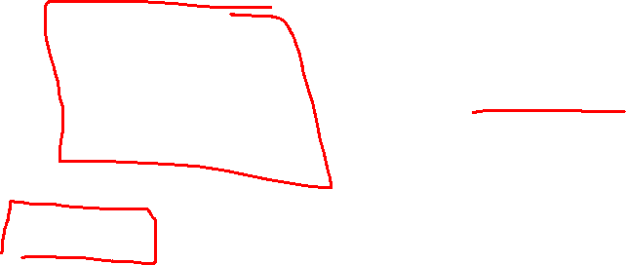
Proceeding with the steepest gradient algorithm iterations yields the final constrained optimal generation scheduling:
with cost: $7,785/MWhr
and P₂₃ = 100.0 MW.
Only slightly different from penalty function approach

Slide 48
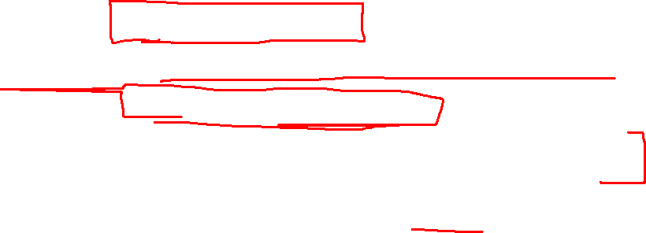
Announcements
Finish Chapter 6
Remember to start on Discussion Set #3
Work on your final paper
Set aside time for PROGRAMS – Try to have Program #1 done by Oct 31, if not sooner.
Start working on Program #3 when done with #1
This Week
Office Hours from Tri-Cities and via zoom on Tuesday & Wednesday
Class on Thursday from Tri-Cities
Office Hours for Friday via Zoom or EME 35

