Slide 1
EE 521/ECE 582 – Analysis of Power systems
Class #20 – November 3, 2022
Dr. Noel N. Schulz
Edmund O. Schweitzer III Chair in
Power Apparatus and Systems
Chief Scientist Joint Appointment, PNNL
Co-Director, PNNL/WSU Advanced Grid Institute (AGI)
Washington State University Pullman
Noel.Schulz@wsu.edu EME 35
509-335-0980 (o) and 509-336-5522 (c)

Slide 2
Reminders
Office Hours This Week and Next
Friday (EME 35 or Zoom) – 1:30-2:30 pm
Tuesday (Zoom) – 4:30-5:30 pm
Wednesday (EME 35 or Zoom) – 4-5 pm
Friday - University Holiday
Other times by appt
Next Week Classes:
Tuesday Class via Zoom
Thursday Class via WSU Pullman Classroom
Discussion Set #3
Final Paper progress
Updates on Programs

Slide 3
Remaining Schedule
EE 521 or ECE 582
 | Discussion Set #3 | Final Paper/Presentation | Programs 1-5
Nov 7 Week | Summary Due (11/8) & Questions Due (11/10)
Nov 14 Week | Responses (11/18)
Nov 21 Week | Break week | Break week | Break week
Nov 28 Week |  | Presentations
Dec 5 Week |  | Presentation; Final PPT Due: Dec 8 & Final Report Due: Dec 9
Dec 12 Week |  |  | Last Day for Program Summary meeting with Dr. Schulz 12/13; Last Day for Reports 12/16

Slide 4
Discussion Set #3
Assignment #3 | Column A: Summarize (150 to 200 word summary of article) | Column B: List of three questions for class to answer? | Column C: Answer the Questions or Add to Discussions (Each response should be between 25 and 100 words)
See Canvas for Papers | Due: 11/8 | Due: 11/10 | Due: 11/18
Paper #1 | Noah Allison | Ninad Gaikwad | All students in class should respond to three of these papers.
Paper #2 | Sajjad Uddin Mahmud | Aryan Jha | All students in class should respond to three of these papers.
Paper #3 | Md Samiul Islam Sagar | Annika Lawrence | All students in class should respond to three of these papers.
Paper #4 | Saeed Salimi Amiri | Ben McCornack | All students in class should respond to three of these papers.
Paper #5 | Leonardo Stingini | Mauricio Silveira | All students in class should respond to three of these papers.
Paper #6 | Ke Wang | Augusto Zanin Bertoletti | All students in class should respond to three of these papers.
See assignment for articles

Slide 5
Individual Programs
Individual Programs #1 and #3
Program #1 – Power Flow
Program #3 – Continuation Power Flow
Develop the Continuation Power Flow algorithm to determine the P-V curves for all the required buses in the IEEE 14 bus test case with taps. Do not worry about Q limits for this problem.

Slide 6
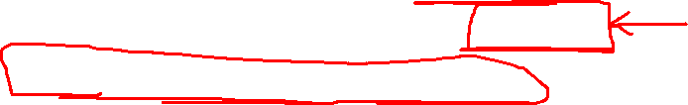
Group Programs – Programs 2, 4 and 5
Programs 2, 4 and 5 can be done as a team of two.
Explanation times with Dr. Schulz should included both partners for groups of two.
Program #2 will be defined by 11/10
Programs #4 and #5 defined next

Slide 7
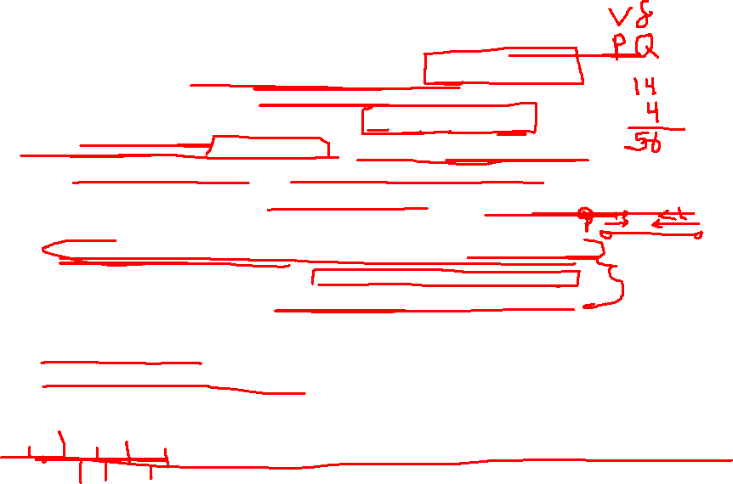
Program 4: State Estimation
Write a computer program to solve the State Estimation
Use the IEEE 14 Bus Power Flow with taps results as measurements
Calculate the branch flows for all lines, Pij, Pji, Qij and Qji.
Add Noise to all the measurements (voltages, angles, Pbus and Pline). Use consistent error bands for various types of measurements.
Solve State Estimation and Check for Bad Data as discussed in class for the below cases
Case #1 – State estimation with given “noisy” measurements
Case #2 – State estimation with one measurement with error
Case #3 – State estimation with three measurements with error
Compare the state estimation results for the three cases including the check for bad data. Submit report describing the SE program, how you added “noise” to measurements, how you checked for bad data and results. Submit program.

Slide 8
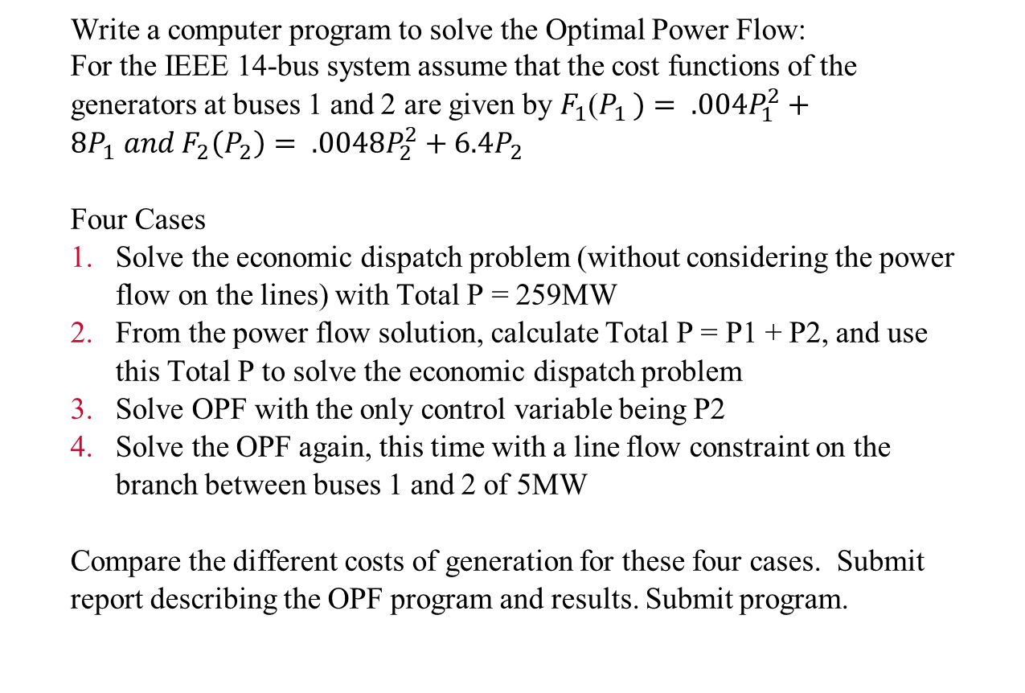
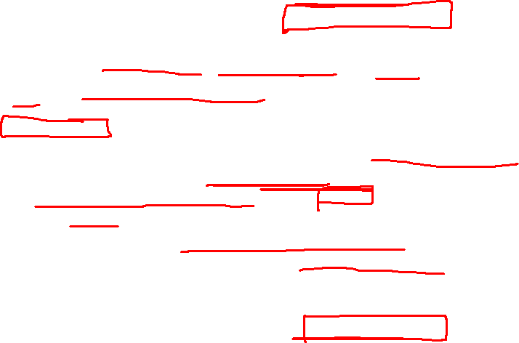
Program 5: OPF Assignment
Write a computer program to solve the Optimal Power Flow:
For the IEEE 14-bus system assume that the cost functions of the generators at buses 1 and 2 are given by $F_{1}$($P_{1 })= .004P_{1}^{2}+8P_{1} and F_{2}\left(P_{2}\right)= .0048P_{2}^{2}+6.4P_{2}$
Four Cases
Solve the economic dispatch problem (without considering the power flow on the lines) with Total P = 259MW
From the power flow solution, calculate Total P = P1 + P2, and use this Total P to solve the economic dispatch problem
Solve OPF with the only control variable being P2
Solve the OPF again, this time with a line flow constraint on the branch between buses 1 and 2 of 5MW
Compare the different costs of generation for these four cases. Submit report describing the OPF program and results. Submit program.

Slide 9
Optimal Power Flow
The optimal power flow problem is to formulate the power flow problem to find system voltages and generated powers within the framework of the objective function.
In this application, the inputs to the power flow are systematically adjusted to maximize (or minimize) a scalar function of the power flow state variables.
The two most common objective functions are minimization of generating costs and minimization of active power losses.

Slide 10
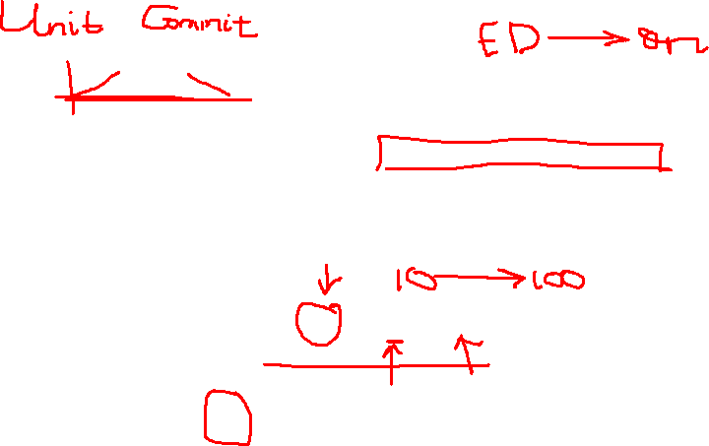
The case in which active power losses in the system are neglected, the optimal power flow problem is typically called the Economic Dispatch problem.
The individual generating unit costs are given as quadratic functions of generating power P_{i}
Minimize
Subject to:
Total system load

Slide 11
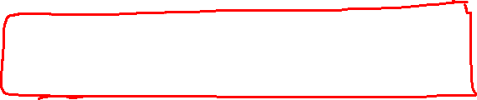
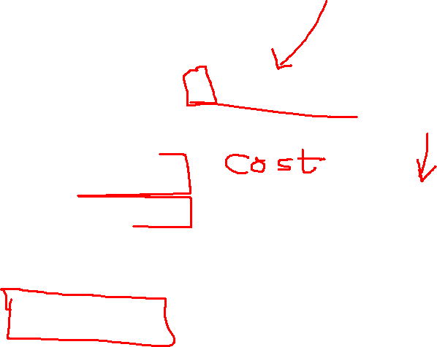
Introduce Lagrangian multipliers:
Minimize:
Taking derivatives:
Linear system of equations

Slide 12
Equal incremental cost rule
Note that
λ is called the “incremental cost” and this problem solution is known as the “equal incremental cost” rule.
The optimal solution occurs when the incremental cost for each generator is the same. That implies that an incremental change in any generator’s output will result in the same incremental cost increase.

Slide 13

Example: Three generators with the following cost functions serve a load of 952 MW.
Assuming a lossless system, calculate the optimal generation scheduling.
Using the equal incremental cost rule:

Slide 14


Solving:
which yields a generating cost of $7,616/hr
The value of λ is the incremental or break-even cost of production.
The value of λ can provide insight into whether or not a utility should buy or sell generation.

Slide 15
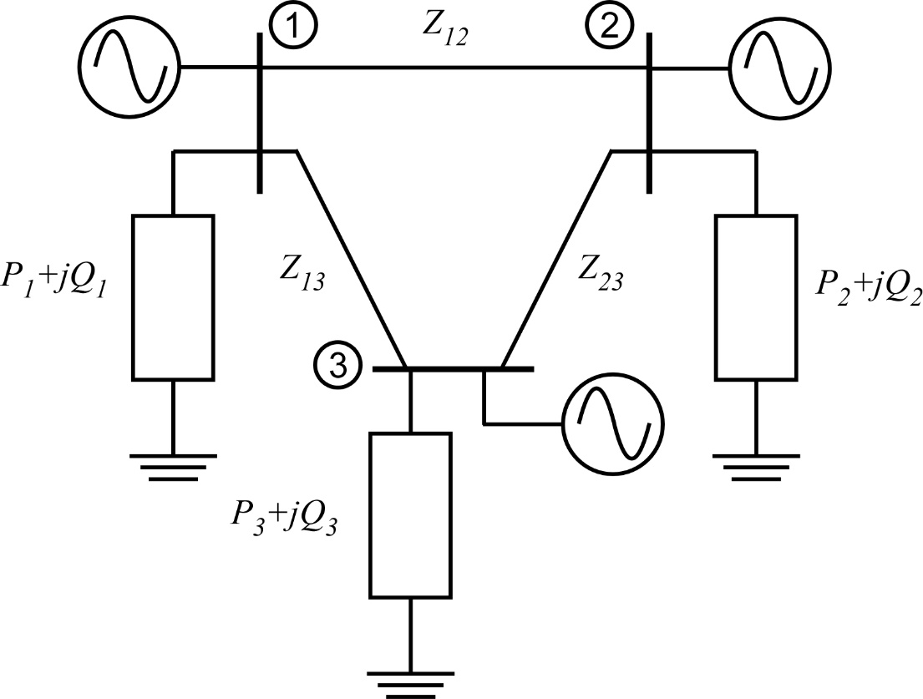

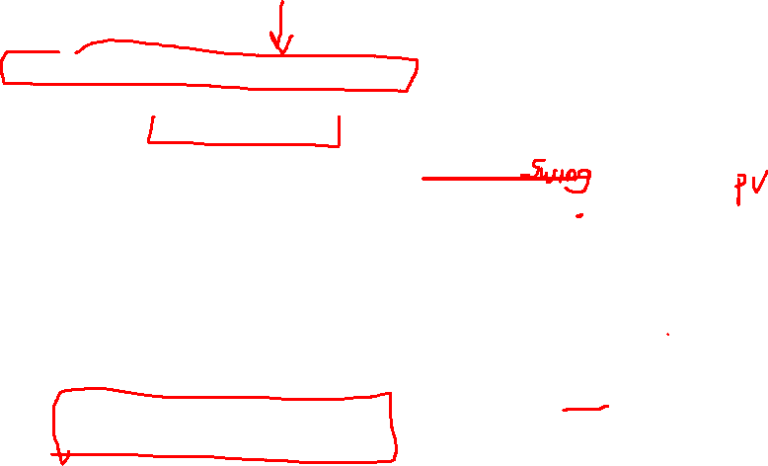
From equal incremental cost rule
Using as a starting point, find the optimal scheduling of this system considering losses.
The cost functions of the generators are
Use the steepest descent method

Slide 16

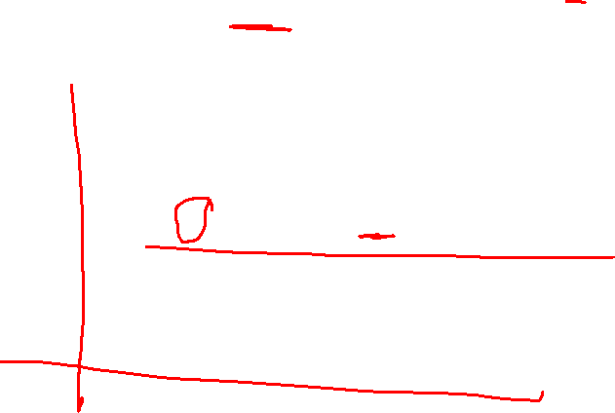
Set up equations:
Gradient:
Cost function:
Equality constraints:
Why not P₁?

Slide 17


Find matrices:
System Jacobian

Slide 18
Continuing:

Slide 19
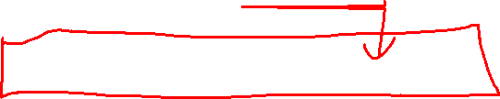
Per unit
Start deepest descent iteration
Starting with find the corresponding x values (from powerflow):
Calculate matrices:

Slide 20
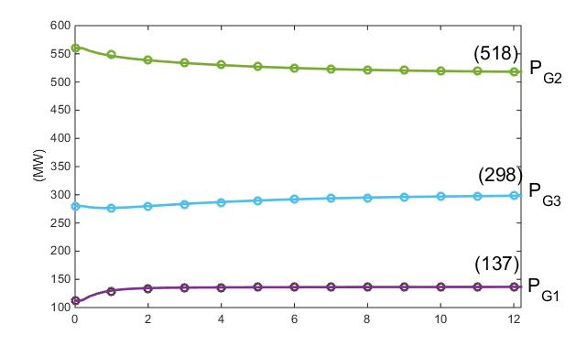


Gradient:
With γ = 1
Proceeding until convergences yields the final powers:
Higher than the lossless case
with cost: $7,698/MWhr

Slide 21
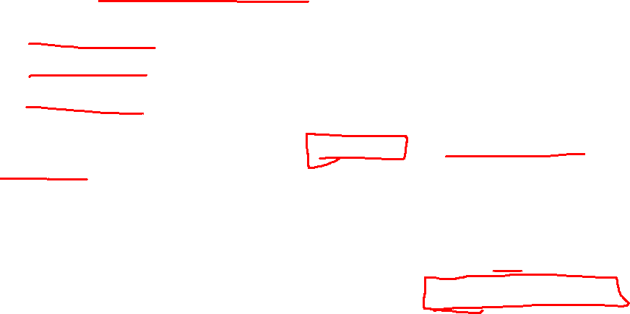
Limitations on Independent Variables (inputs):
Let
exceeded
If any P_{i} exceeds its limit, set it to its limit (i.e. P₃ = 0.25 pu) and reduce the number of inputs by 1
The new partial derivatives become:
solving
with cost: $7,728/MWhr
Higher than the unconstrained case

Slide 22

Limitations on Dependent Variables (states):
Let (the powerflow in line 2-3 – originally 121.1 MW)
Two approaches:
Soft constraint – violating the limiting factor is undesirable
Hard constraint – violating the limiting factor is catastrophic

Slide 23
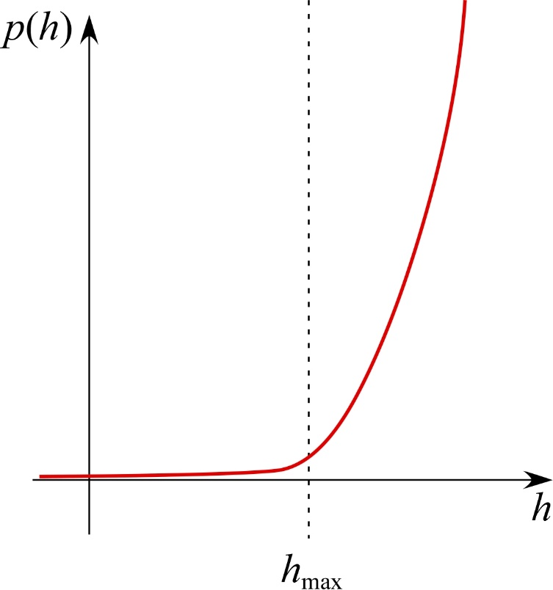
Soft constraint: Use Penalty Functions
A penalty function is a function that is small for values less than the limit, but increases rapidly if the limit is violated
The new cost function becomes:

Slide 24

Use a penalty function to enforce the constraint
Let
The new partial derivatives are all the same except:
From penalty function

Slide 25
Proceeding with the steepest gradient algorithm iterations yields the final constrained optimal generation scheduling:
with cost: $7,781/MWhr
Higher than the unconstrained case
and P₂₃ = 101.2 MW.

Slide 26
Hard constraint: Dual Variable Approach
In this approach, the inequality constraints are added as additional equality constraints with the inequality set equal to the limit (upper or lower) that is violated.
This introduces an additional set of Lagrangian multipliers. This is often referred to as the dual variable approach, because each inequality has the potential of resulting in two equalities: one for the upper limit and one for the lower limit.
However, the upper and lower limit cannot be simultaneously violated; thus, out of the possible set of additional Lagrangian multipliers only one of the two will be included at any given operating point and thus the dual limits are mutually exclusive.

Slide 27
In this case, the additional equation is added:
This now increases the number of equality constraints to 3 (including the two original powerflow equations)
Therefore an additional unknown state is required
Choose P_{G3}

Slide 28

New Jacobian:

Slide 31
Proceeding with the steepest gradient algorithm iterations yields the final constrained optimal generation scheduling:
with cost: $7,785/MWhr
and P₂₃ = 100.0 MW.
Only slightly different from penalty function approach

Slide 32
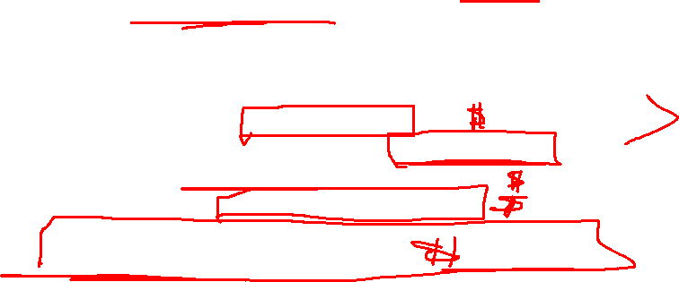
Program 5: OPF Assignment
Write a computer program to solve the Optimal Power Flow:
For the IEEE 14-bus system assume that the cost functions of the generators at buses 1 and 2 are given by $F_{1}$($P_{1 })= .004P_{1}^{2}+8P_{1} and F_{2}\left(P_{2}\right)= .0048P_{2}^{2}+6.4P_{2}$
Four Cases
Solve the economic dispatch problem (without considering the power flow on the lines) with Total P = 259MW
From the power flow solution, calculate Total P = P1 + P2, and use this Total P to solve the economic dispatch problem
Solve OPF with the only control variable being P2
Solve the OPF again, this time with a line flow constraint on the branch between buses 1 and 2 of 5MW
Compare the different costs of generation for these four cases. Submit report describing the OPF program and results. Submit program.

Slide 33
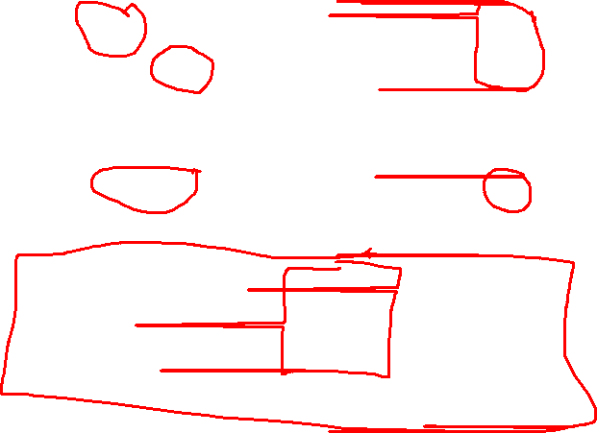

Slide 34
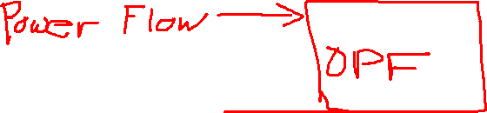

Slide 35
State Estimation
The state estimator is designed to give the best estimates of the voltages and phase angles minimizing the effects of the measurement errors.
A set of specified measurements of a power system is said to be observable if the entire state vector of bus voltage magnitude and phase angles can be estimated from the set of available measurements.
An unobservable system is one in which the set of measurements do not span the entire state space, and therefore not all states can be estimated.

Slide 36
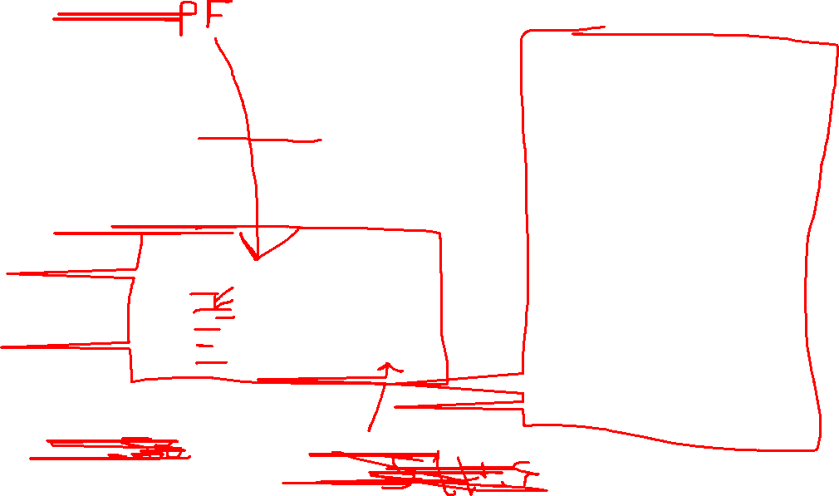
Estimate the power system states and use the chi-square test of inequality with α = 0.01 to check for the presence of bad data in the measurements.

Slide 37
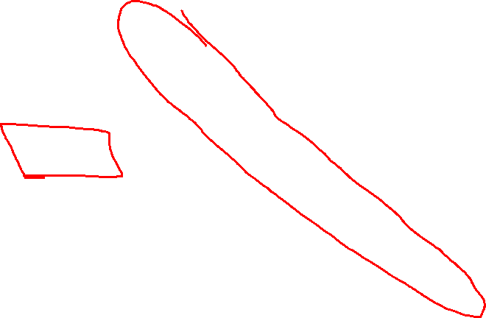
Recall:
Minimize
What is x?
What is W?

Slide 38

What is h(x)?

Slide 39

Set up equations:
What is H_{x} ?

Slide 40
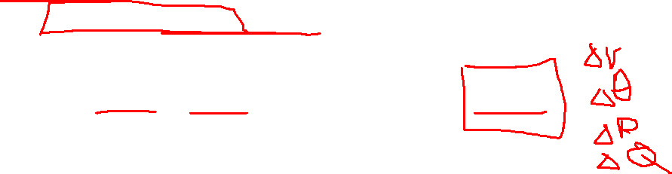
The Newton-Raphson iteration to solve for the set of states x that minimize
the weighted errors is:
Iteration 1: Starting with a flat start:
and

Slide 41
and
too large → not converged
Repeat iterations
Repeating until convergence yields:
and
compare with

Slide 42

To check for the presence of bad data, the weighted sum of squares of the
measurement errors are compared to the chi-square distribution for k = 2 and
α = 0.01.
The weighted sum of squares is
k = m-n = 5-3
This value is less than χ_{2,0.01} = 9.21; therefore, the data set is good and does
not contain any spurious measurements.

Slide 43
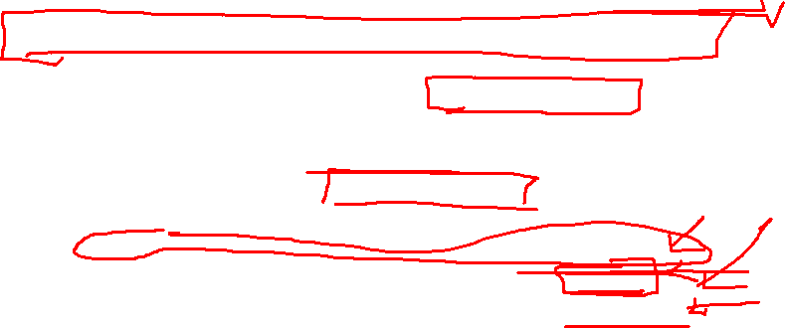
Program 4: State Estimation
Write a computer program to solve the State Estimation
Use the IEEE 14 Bus Power Flow with taps results as measurements
Calculate the branch flows for all lines, Pij, Pji, Qij and Qji.
Add Noise to all the measurements (voltages, angles, Pbus and Pline). Use consistent error bands for various types of measurements.
Solve State Estimation and Check for Bad Data as discussed in class for the below cases
Case #1 – State estimation with given “noisy” measurements
Case #2 – State estimation with one measurement with error
Case #3 – State estimation with three measurements with error
Compare the state estimation results for the three cases including the check for bad data. Submit report describing the SE program, how you added “noise” to measurements, how you checked for bad data and results. Submit program.

Slide 44
Announcements
Finish Chapter 6
Remember to start on Discussion Set #3
Work on your final paper
Set aside time for PROGRAMS – Try to have Program #1 done by Oct 31, if not sooner.
Start working on Program #3 when done with #1
This Week
Office Hours from Tri-Cities and via zoom on Tuesday & Wednesday
Class on Thursday from Tri-Cities
Office Hours for Friday via Zoom or EME 35

