Slide 1
EE 521/ECE 582 – Analysis of Power systems
Class #21 – November 8, 2022
Dr. Noel N. Schulz
Edmund O. Schweitzer III Chair in
Power Apparatus and Systems
Chief Scientist Joint Appointment, PNNL
Co-Director, PNNL/WSU Advanced Grid Institute (AGI)
Washington State University Pullman
Noel.Schulz@wsu.edu EME 35
509-335-0980 (o) and 509-336-5522 (c)

Slide 2
Reminders
Office Hours This Week and Next
Tuesday (Zoom) – 4:30-5:30 pm
Wednesday (EME 35 or Zoom) – 4-5 pm
Friday - University Holiday
Other times by appt
Next Week Classes:
Thursday Class – Noel in Pullman Classroom
Discussion Set #3
Final Paper progress
Updates on Programs

Slide 3

Remaining Schedule
EE 521 or ECE 582
 | Discussion Set #3 | Final Paper/Presentation | Programs 1-5
Nov 7 Week | Summary Due (11/8) & Questions Due (11/10)
Nov 14 Week | Responses (11/18)
Nov 21 Week | Break week | Break week | Break week
Nov 28 Week |  | Presentations
Dec 5 Week |  | Presentation; Final PPT Due: Dec 8 & Final Report Due: Dec 9
Dec 12 Week |  |  | Last Day for Program Summary meeting with Dr. Schulz 12/13; Last Day for Reports 12/16

Slide 4
Discussion Set #3
Assignment #3 | Column A: Summarize (150 to 200 word summary of article) | Column B: List of three questions for class to answer? | Column C: Answer the Questions or Add to Discussions (Each response should be between 25 and 100 words)
See Canvas for Papers | Due: 11/8 | Due: 11/10 | Due: 11/18
Paper #1 | Noah Allison | Ninad Gaikwad | All students in class should respond to three of these papers.
Paper #2 | Sajjad Uddin Mahmud | Aryan Jha | All students in class should respond to three of these papers.
Paper #3 | Md Samiul Islam Sagar | Annika Lawrence | All students in class should respond to three of these papers.
Paper #4 | Saeed Salimi Amiri | Ben McCornack | All students in class should respond to three of these papers.
Paper #5 | Leonardo Stingini | Mauricio Silveira | All students in class should respond to three of these papers.
Paper #6 | Ke Wang | Augusto Zanin Bertoletti | All students in class should respond to three of these papers.
See assignment for articles

Slide 5
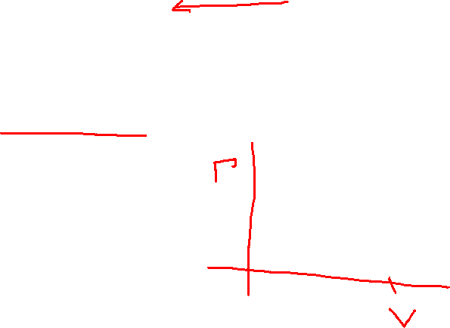
Individual Programs
Individual Programs #1 and #3
Program #1 – Power Flow
Program #3 – Continuation Power Flow
Develop the Continuation Power Flow algorithm to determine the P-V curves for all the required buses in the IEEE 14 bus test case with taps. Do not worry about Q limits for this problem.

Slide 6

Group Programs – Programs 2, 4 and 5
Groups mostly set
One person looking for a partner
Programs 2, 4 and 5 can be done as a team of two.
Explanation times with Dr. Schulz should included both partners for groups of two.
Program #2 will be defined by 11/10
Programs #4 and #5 defined next

Slide 7

Program 4: State Estimation
Write a computer program to solve the State Estimation
Use the IEEE 14 Bus Power Flow with taps results as measurements
Calculate the branch flows for all lines, Pij, Pji, Qij and Qji.
Add Noise to all the measurements (voltages, angles, Pbus and Pline). Use consistent error bands for various types of measurements.
Solve State Estimation and Check for Bad Data as discussed in class for the below cases
Case #1 – State estimation with given “noisy” measurements
Case #2 – State estimation with one measurement with error
Case #3 – State estimation with three measurements with error
Compare the state estimation results for the three cases including the check for bad data. Submit report describing the SE program, how you added “noise” to measurements, how you checked for bad data and results. Submit program.

Slide 8
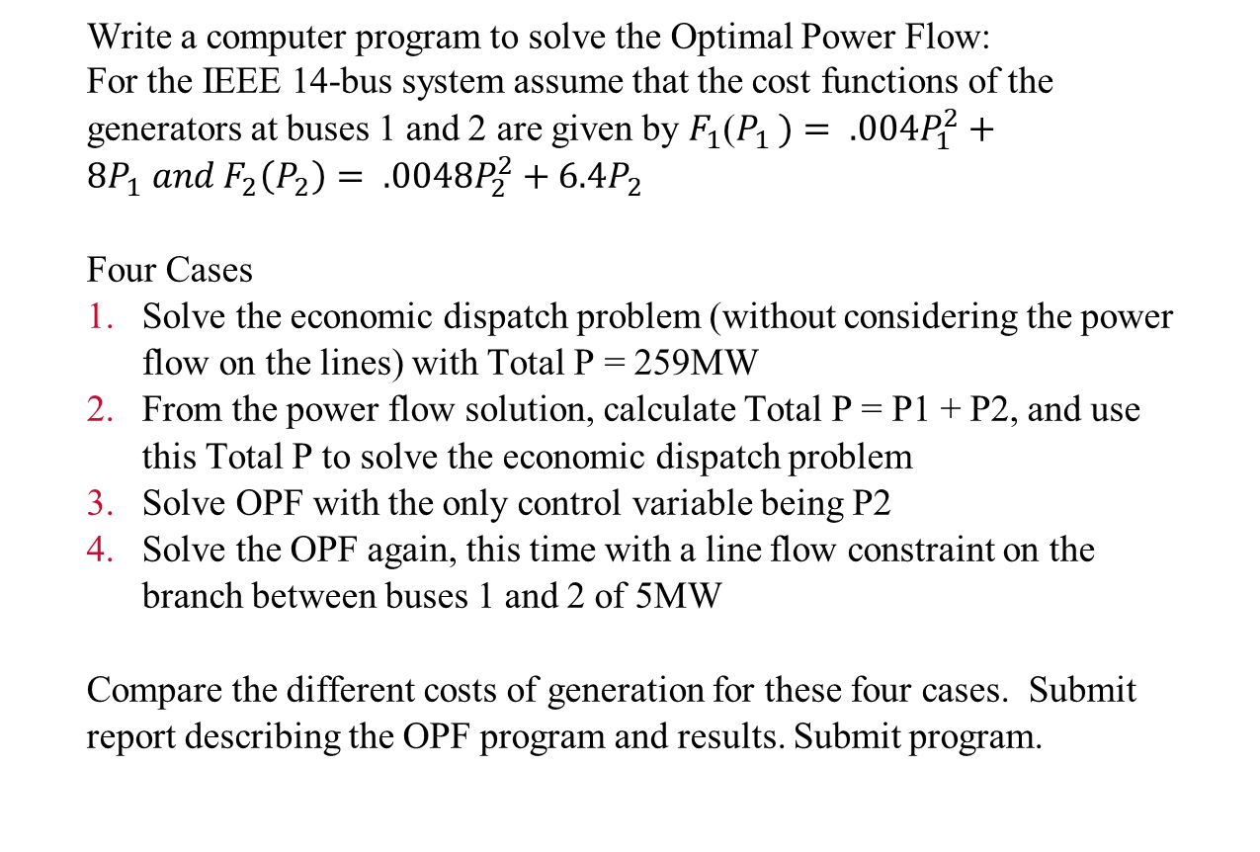

Program 5: OPF Assignment
Write a computer program to solve the Optimal Power Flow:
For the IEEE 14-bus system assume that the cost functions of the generators at buses 1 and 2 are given by $F_{1}$($P_{1 })= .004P_{1}^{2}+8P_{1} and F_{2}\left(P_{2}\right)= .0048P_{2}^{2}+6.4P_{2}$
Four Cases
Solve the economic dispatch problem (without considering the power flow on the lines) with Total P = 259MW
From the power flow solution, calculate Total P = P1 + P2, and use this Total P to solve the economic dispatch problem
Solve OPF with the only control variable being P2
Solve the OPF again, this time with a line flow constraint on the branch between buses 1 and 2 of 5MW
Compare the different costs of generation for these four cases. Submit report describing the OPF program and results. Submit program.

Slide 9
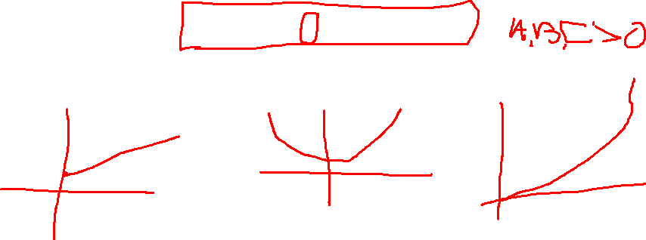
$F_{1}$($P_{1 })=A+BP_{1}+CP_{1}^{2}$
C = 0
B = 0
A = 0

Slide 10
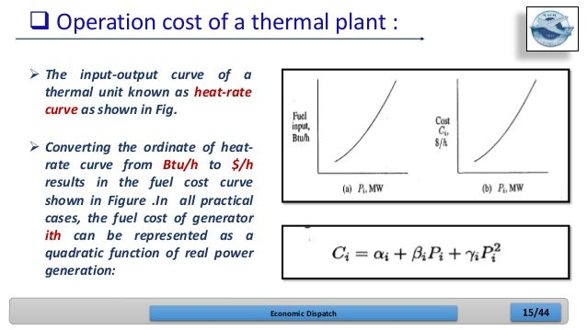

Economic dispatch (slideshare.net)

Slide 11
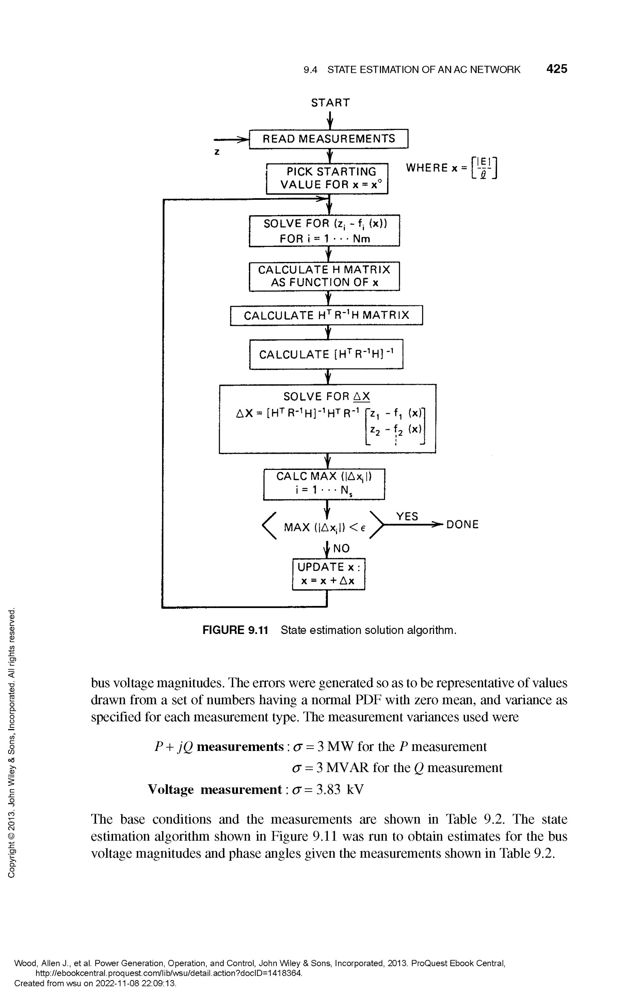
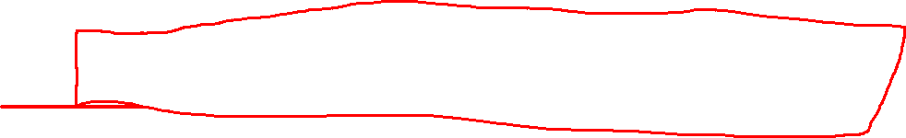
Chapter 3

Slide 12
Chapter 8

Slide 13
Chapter 9

Slide 15
How to get the Wood, Wollenberg & Sheble Book Digitally through WSU Libraries

Slide 16
Announcements
Office Hours This Week and Next
Tuesday (Zoom) – 4:30-5:30 pm
Wednesday (EME 35 or Zoom) – 4-5 pm
Friday - University Holiday
Other times by appt
Next Week Classes:
Thursday Class – Noel in Pullman Classroom
Discussion Set #3
Final Paper progress
Updates on Programs

