Slide 1
EE 521/ECE 582 – Analysis of Power systems
Class #6 – September 12, 2022
Dr. Noel N. Schulz
Edmund O. Schweitzer III Chair in
Power Apparatus and Systems
Chief Scientist Joint Appointment, PNNL
Co-Director, PNNL/WSU Advanced Grid Institute (AGI)
Washington State University Pullman
Noel.Schulz@wsu.edu EME 35
509-335-0980 (o) and 509-336-5522 (c)

Slide 2
Student Hours
Pullman this week
Tuesdays 4:30-5:30 pm (after class)
Wednesdays 4-5 pm
Fridays 1:30-2:30 pm
Join from PC, Mac, Linux, iOS, or Android: https://wsu.zoom.us/j/8237216735 (Links to an external site.)
Meeting ID: 823 721 6735
Or by request via email noel.Schulz@wsu.edu or phone 509-336-5522

Slide 3
Matlab Resources
Amazon.com : matlab
Learn with MATLAB and Simulink Tutorials - MATLAB & Simulink (mathworks.com)
Matrices in the MATLAB Environment - MATLAB & Simulink (mathworks.com)

Slide 4
Programming Projects: (80%)
Power Flow Project (20%)
Y_{bus}, Jacobian matrices – Newton Raphson
LU Factorization, Backward-Forward substitution for NR
Fast Decoupled
Q-limits, transformer taps
Using IEEE 14 bus system as given, and I will provide a slightly modified version after you confirm the 14-bus system.
Projects build on each other, adding different features
In addition to getting the right answers, for each program we’ll set up a session for you to describe your code to me.
Copying code from a colleague or from on-line resources is not permitted.

Slide 5
Newton-Raphson and Parts
Input Data
Calculate Jacobian Terms
Calculate Y_{bus}
Solve Equation [A][x] = [b]
Calculate Jacobian Terms
Calculate Mismatch]
_{Iterative Solution}
Check Mismatch?
Small enough
Output Results
Output Results

Slide 6
Math Methods behind solving Matrices

Slide 7
Stationary Iterative methods for solving Ax=b:
Iterative methods generate a sequence of approximations to x* from an initial guess (i.e. x⁰, x¹, x², … x^{k} ) such that x^{k} → x* as k → ∞.
If convergent¹, these methods are accurate to within a user-defined convergence criterion.
Examples include:
Gauss Jacobi
Gauss Seidel
Successive Over-Relaxation
¹ we’ll discuss convergence later

Slide 8
Relaxation methods for solving Ax=b:
Start with Ax = b
Define a matrix M such that:
Rearranging:
Adding iteration indices:
The choice of M determines if, and how fast, Ax – b → 0.
When , for some small ε, then the iteration is said to have converged.

Slide 9
Jacobi
Let M = D (the diagonal elements of A), then
Or in scalar form:
This method is attractive for parallel processing applications because each depends only previous values of x^{k}. Thus each i^{th} element can be calculated independently.

Slide 10
Solve using the Jacobi method.
Set up the equations:

Slide 11
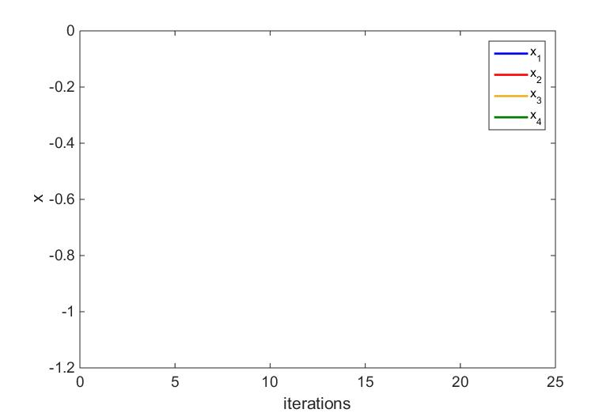
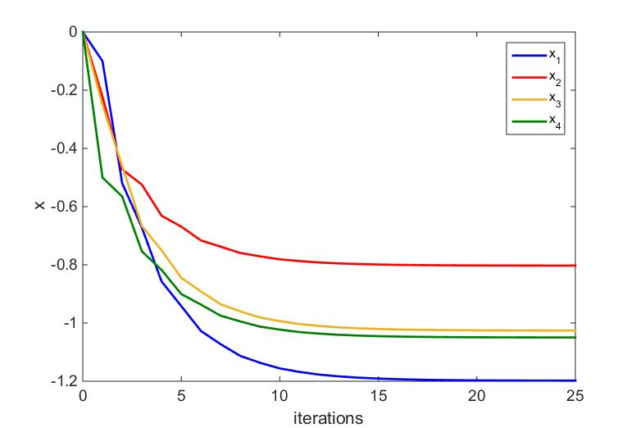
Jacobi
-0.8026
-1.0258
-1.0494
-1.1978

Slide 12
Solve using the Gauss-Seidel method.
Set up the equations:

Slide 13
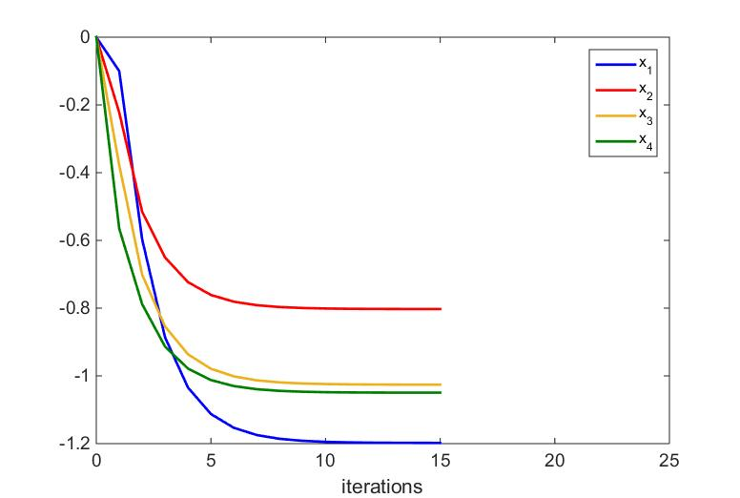
Gauss-Seidel
-0.8026
-1.0258
-1.0494
-1.1978

Slide 14
Jacobi
Gauss-Seidel

Slide 15
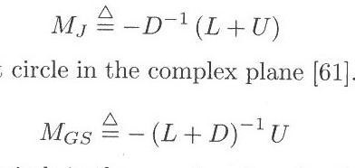
The Gauss Seidel method took fewer iterations to converge than did the Gauss Jacobi method.
Is it possible to predict if, and how fast, a method may converge?
Consider the matrices M_{J} and M_{GS}. If all of the eigenvalues of M_{J} or M_{GS} lie within the unit circle in the complex plane, then the iteration will converge for any initial guess.

Slide 16
eig(M_{J})=
Convergence guaranteed!
eig(M_{GS})=
Convergence guaranteed!

Slide 17
Consider now the Jacobi method applied to the following system of equations:
(used previously in LU factorization example)
Iterations will not converge
Not converging!

Slide 18
Iterations will not converge
Not converging!

Slide 19
Successive Overrelaxation
The Gauss-Seidel iteration
can be rewritten as:
Upper triangular part of A
(not the U from LU factorization)
Add a weighting factor 0 < ω < 2:
If ω = 1, then the method reduces to the Gauss-Seidel.
For large systems, this method can potentially converge much more rapidly than
either Jacobi or Gauss-Seidel, but it is difficult to find an optimal value of ω

Slide 20
Subspace methods
The classical iterative solvers discussed up to this point were of the form
with constant G and c. Such methods are also known as stationary methods. We will now study a different class of iterative solvers based on optimization.
These methods typically attempt to minimize the error in the residual of Ax-b at every step by successively reducing the error in the subspace defined by carefully selected vectors.

Slide 21
Subspace methods do not use an iterative matrix like stationary methods, but rather update the current approximation based on past vector information.
Additionally, unlike stationary methods, subspace methods are typically guaranteed to converge in at most n iterations. Some methods require special matrix features such as positive definiteness.
These methods may converge rapidly if the A matrix is very large with relatively few non-zero entries.

Slide 22
Conjugate Gradient Methods
The Conjugate Gradient (CG) method requires that A be positive definite, i.e. that
x^{T}Ax > 0 for any non-zero vector x.
The CG method can be considered a minimization method for the error function
E(x) = ∥Ax − b∥²
along a succession of directional vectors (rays).

Slide 23
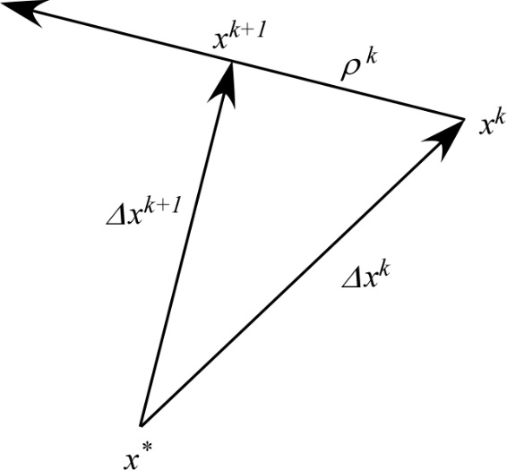
The CG method produces a series of vector iterates, such that
α
direction in which step is taken
step length (i.e. how big a step is taken)
To eventually reach x* in a finite number of steps

Slide 24
Conjugate Gradient algorithm for solving Ax=b
Initialization: Let k=1, and
r_{k} is called the “residual”
While ∥r_{k} ∥ ≥ ε

Slide 25
Solve
using the Conjugate Gradient method with zeros as the initial conditions
Initialize:

Slide 26
k = 1
Watch this number

Slide 27
k = 2

Slide 28
k = 3

Slide 29
k = 4
This is sufficiently small, therefore the method has converged in less than 5 iterations!

Slide 30
If the A matrix is not symmetric or positive definite, the conjugate gradient method is not guaranteed to work.
(it may still converge, but probably with poor convergence)
An alternate method is the Generalized Minimal Residual Algorithm (GMRES)
The k^{th} iteration of the GMRES method is the solution to the least squares problem
the Krylov subspace

Slide 31
Some necessary precursors:
One of the components of the GMRES method is based on similarity transformations of the form
A = QHQ*
where H is an upper Hessenberg matrix.
An upper Hessenberg matrix is a square matrix that has zero entries below the first subdiagonal.

Slide 32
A Given’s rotation is used to remove single nonzero elements of matrices in reduction to triangular (Hessenberg) form.
The Given’s rotation to zero out element A_{jk} is a transformation based on the matrix
j^{th} row
k^{th} row
j^{th} column
k^{th} column

Slide 33
GMRES algorithm for solving Ax=b
Initialize:

Slide 35
Solve
using the GMRES method with zeros as the initial conditions and ε = 10⁻³
Convergence tolerance
Initialize:

Slide 36
k = 1

Slide 37
Applying Given’s rotation to zero out H(2,1):
Since k = 1, this step isn’t performed

Slide 38
Now zero
Since error (= 4.5993) is greater than ε, repeat process

Slide 39
k = 2

Slide 40
Applying Given’s rotation to zero out H(3,2):

Slide 41
Now zero
Since error (= 1.7708) is greater than ε, repeat process

Slide 42
k = 3

Slide 43
Applying Given’s rotation to zero out H(4,3):
Note: for j = 1 and 2

Slide 44
Now zero
Since error (= 0.3473) is greater than ε, repeat process

Slide 45
k = 4
Don’t need to perform this step since n = 4

Slide 46
Applying Given’s rotation
Note: for j = 1, 2, and 3

Slide 47
Since error is now less than ε,

Slide 48
Preconditioners for Iterative Solvers
The rate of convergence of iterative methods depends on the condition number of the iteration matrix. Therefore, it may be advantageous to transform the linear system of equations into an equivalent system (i.e. one that has the same solution) that has more favorable properties.
The matrix, or matrices, that perform this transformation are called preconditioners.
If M⁻¹A approximates the identity matrix I, then the condition number is close to one and the iterates will converge rapidly

Slide 49
Jacobi Preconditioner
In this preconditioning, the matrix M is chosen such that M = D (the diagonal elements of A). The advantage of this method is that D is easy to find and D ⁻¹ is computationally efficient to calculate.

Slide 50
Symmetric Successive Over-Relaxation Preconditioner
In this preconditioning, the matrix M uses the upper (U) and lower (U) triangular matrices of A.
The factor has no impact on the convergence and can be neglected.
If ω is taken to be equal to 1, then this preconditioner is called the symmetric Gauss-Seidel method.

Slide 51
Incomplete LU factorization
For an effective preconditioner, it is desired to find a matrix M ⁻¹ that closely approximates A⁻¹.
Since then approximations to U and L may lead to a good approximation to M ⁻¹ and U⁻¹ and L⁻¹ are computationally easy to compute (because they are triangular).
An LU factorization is called incomplete if, during the factorization process, one or more fill elements are ignored.

Slide 52
Solve with different preconditioners
using the GMES method

Slide 53
Jacobi Preconditioner

Slide 54
Symmetric Successive Over-Relaxation Preconditioner

Slide 55
Incomplete LU factorization
Note that these L and U matrices are different than the L and U matrices of the SSOR preconditioner

Slide 57
Results:
Without preconditioning, the GMRES method takes a full 10 iterations to converge (n=10)
Fastest convergence, but takes the most computation to find M⁻¹

Slide 58
Why do I care?
Power Flow Project
Y_{bus}, Jacobian matrices – Newton Raphson
Factorization, Backward-Forward substitution for NR
Fast Decoupled
Q-limits, transformer taps
Sparse Power Flow Project
Continuation Power Flow Project
State Estimation Project
Optimal Power Flow Project

Slide 59
Power Flow Project (20%)
Y_{bus}, Jacobian matrices – Newton Raphson
LU Factorization, Backward-Forward substitution for NR
Fast Decoupled
Q-limits, transformer taps
Using IEEE 14 bus system as given, and I will provide a slightly modified version after you confirm the 14-bus system.
Projects build on each other, adding different features
In addition to getting the right answers, for each program we’ll set up a session for you to describe your code to me.
Copying code from a colleague or from on-line resources is not permitted.

Slide 60
Announcements
Review examples from Chapter 2
Read Sections 3.1-3.4
Working on MATLAB Program
Input the CDF file – Start with Data in Program
Start working on building the Ybus
Calculate Jacobian Matrix Values
Work on LU Decomposition
Extra Video will drop this week

Slide 61
Student Hours
Pullman this week
Tuesdays 4:30-5:30 pm (after class)
Wednesdays 4-5 pm
Fridays 1:30-2:30 pm
Join from PC, Mac, Linux, iOS, or Android: https://wsu.zoom.us/j/8237216735 (Links to an external site.)
Meeting ID: 823 721 6735
Or by request via email noel.Schulz@wsu.edu or phone 509-336-5522

