Slide 1
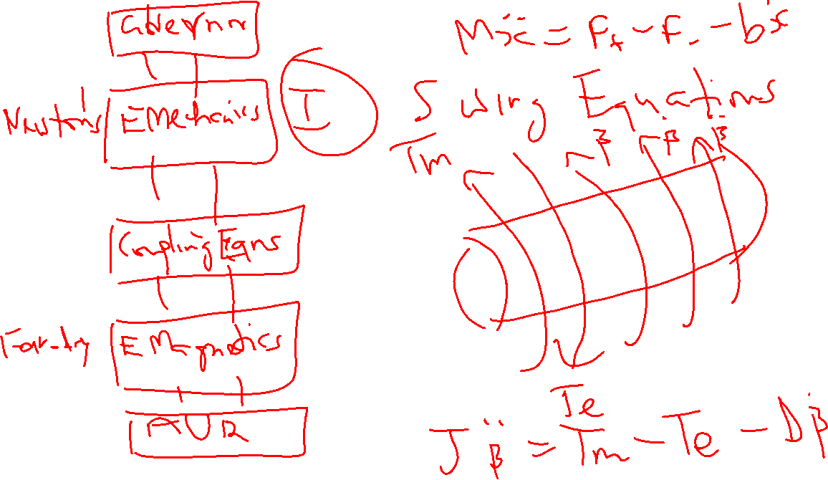

Slide 2
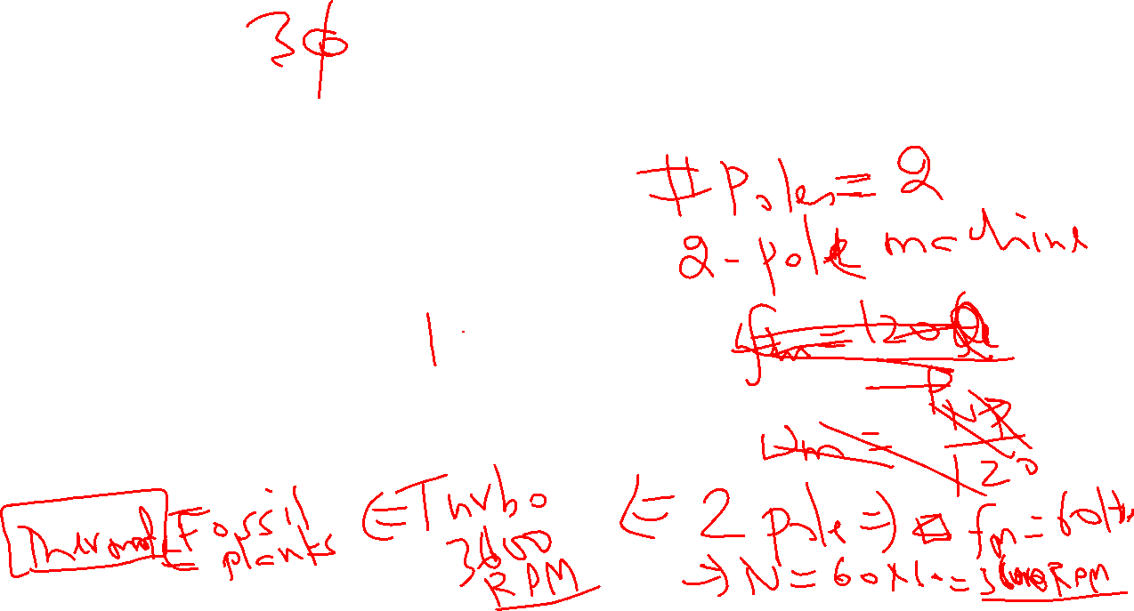

Synchronous Machines
X
β
Figure 3.1 (Page 46)

Slide 3







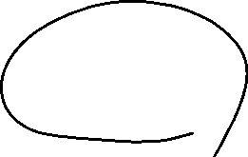























Synchronous Machines
X
β
Figure 3.1 (Page 46)

Slide 4














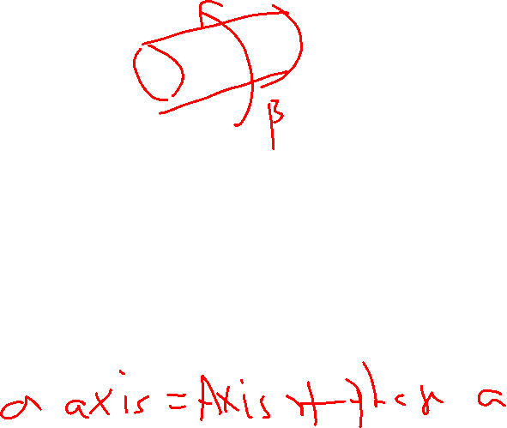








Synchronous Machines
X
β
Figure 3.1 (Page 46)

Slide 5
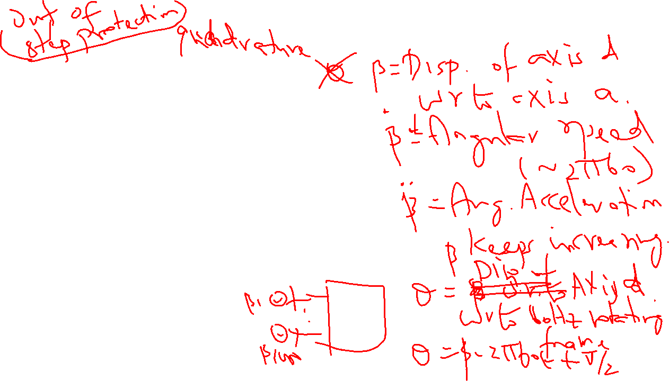
Synchronous Machines
X
β
Figure 3.1 (Page 46)

Slide 6
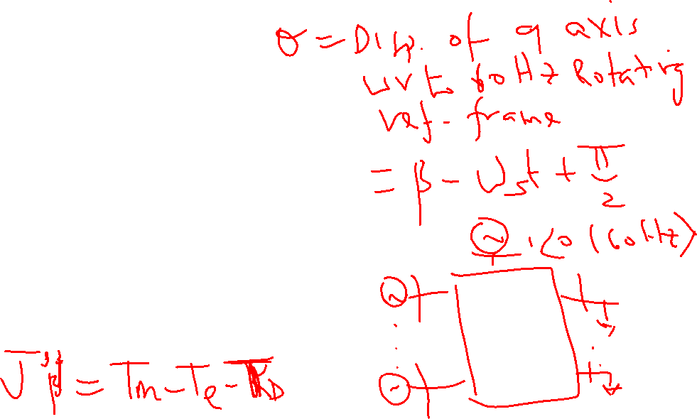
Synchronous Machines
X
β
Figure 3.1 (Page 46)

Slide 7
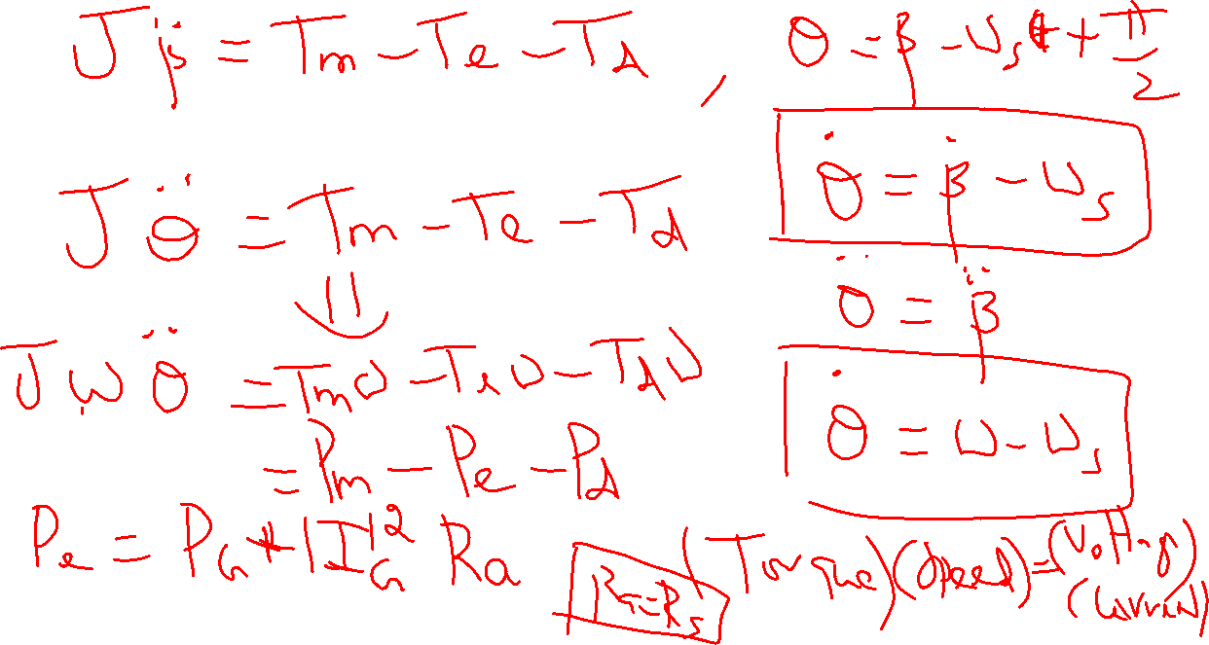

Slide 8
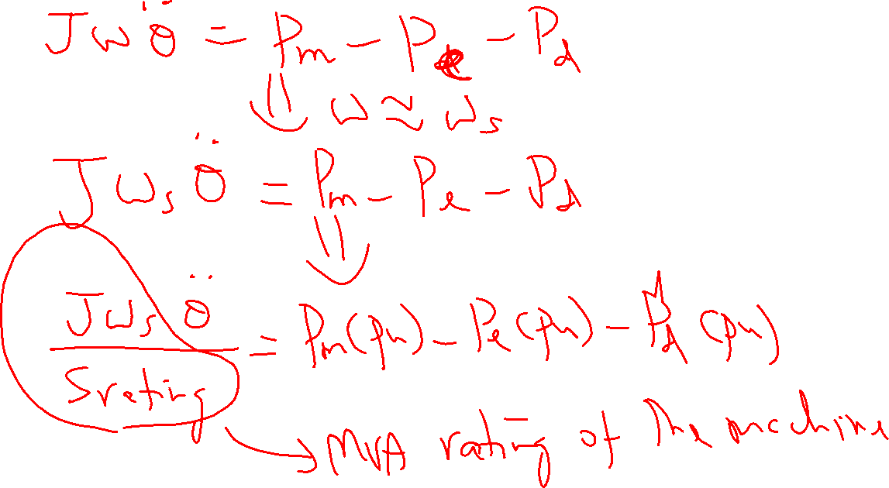

Slide 9
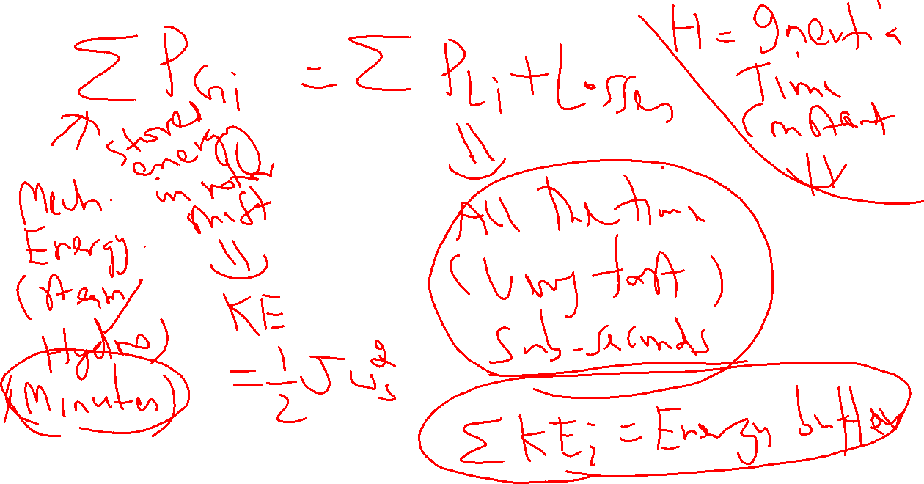

Slide 10
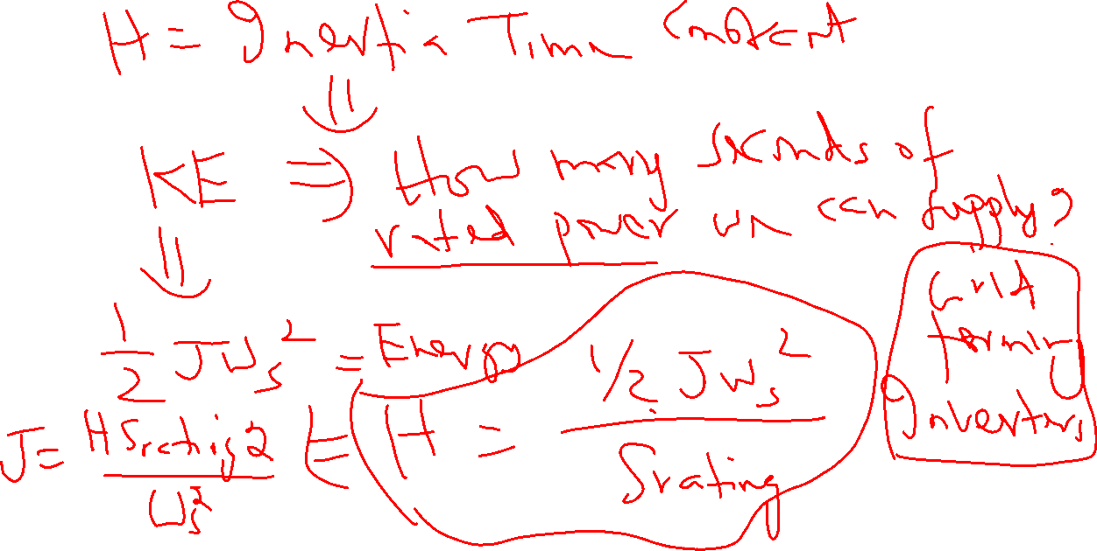

Slide 11
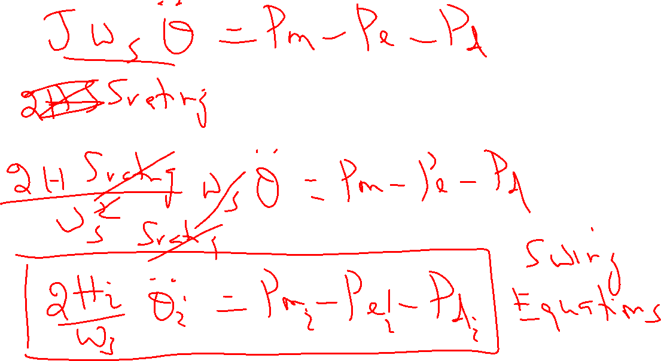

Slide 12
