Slide 1


Autonomous Driving Robot
Jow102 – MMP Mid-Project Demo

Slide 2


Overview
The project’s main aim is to develop a robot that can detect and navigate lanes on a UK road while obeying current UK traffic laws.
There is also a secondary aim to have the robot be able to automatically detect and obey road signs (e.g., speed limits).

Slide 3
Technologies Involved
Turtlebot3 – Waffle Pi (Robot)
ROS (Robot Control)
OpenCV (Image Processing)
Github (Version Control)

Slide 4
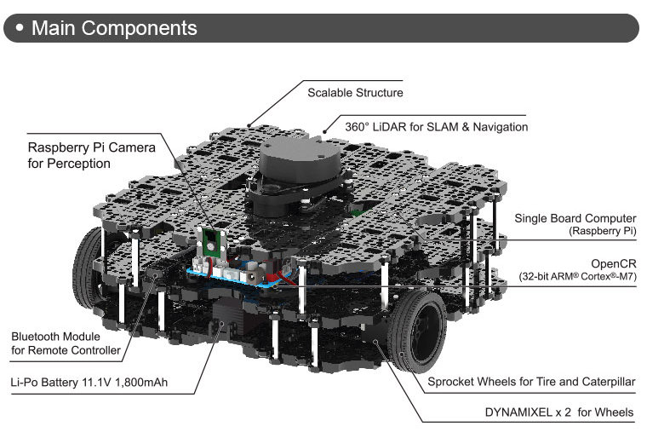
Turtlebot3 (Waffle Pi)
Turtlebot3 (Waffle Pi) is the robot which I have selected for use during this project.
The robot for this project is simply required to have a forward facing camera, and the ability to drive around.

Slide 5
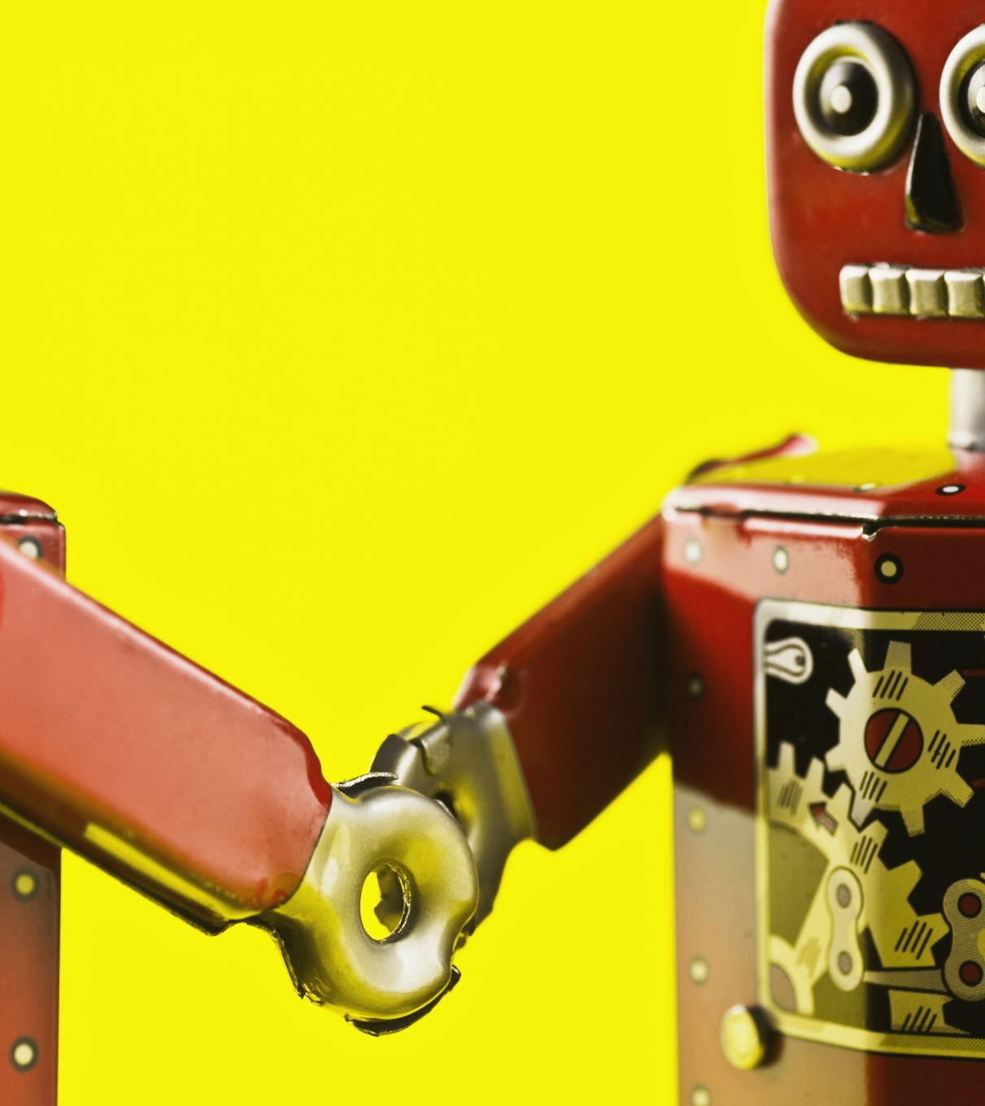

ROS
ROS (Robot Operating System): While it’s name suggests that it is an ‘operating system’, it is actually just the middleware that is used to run the programs and control the robot.

Slide 6
OpenCV
OpenCV is used to perform all the image processing in this project.
This library offers access to many image manipulation and processing tools.
The ‘CV_Bridge’ ROS library provides an interface between OpenCV and ROS.

Slide 7
C++
The project is being developed in C++
I chose to use C++ over Python as I feel it provides a more in-depth library, and I am much more confident working in C++ compared to Python.

Slide 8
Lane Detection Steps
Crop image – The top half of the image is not useful, and would only complicate the lane detection.
Convert to HSV colour space – Makes for easier colour masking
Colour Mask – Mask the image so only the white lines are visible.
Canny Edge Detector – Detects and highlights the edges of the lines.
HoughLinesP – Detects and draws lines along the detected edges.
Path Planning – Track best available Hough Lines and calculate centre of lane.

Slide 9
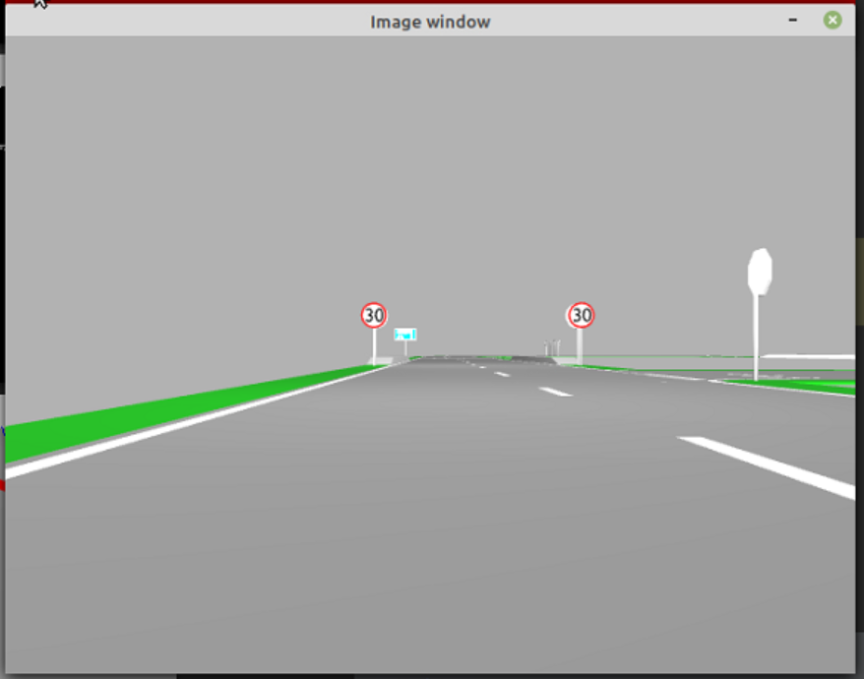
Crop Image

Slide 10
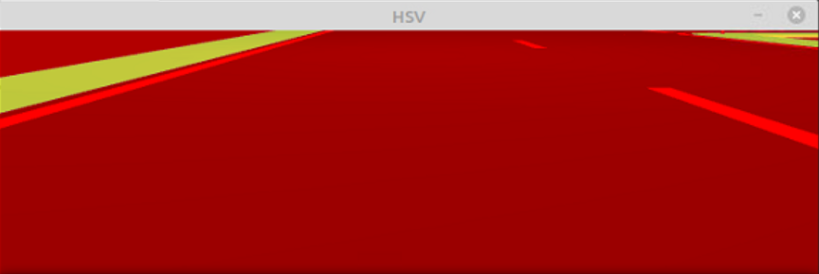

Convert to HSV

Slide 11
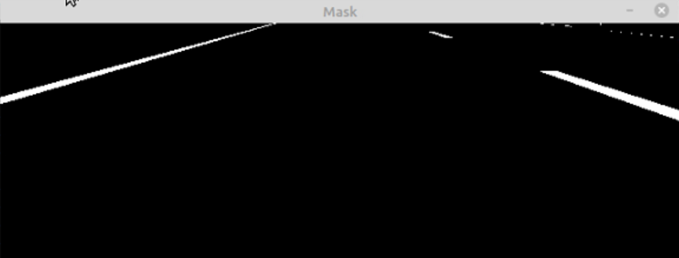
Colour Mask

Slide 12
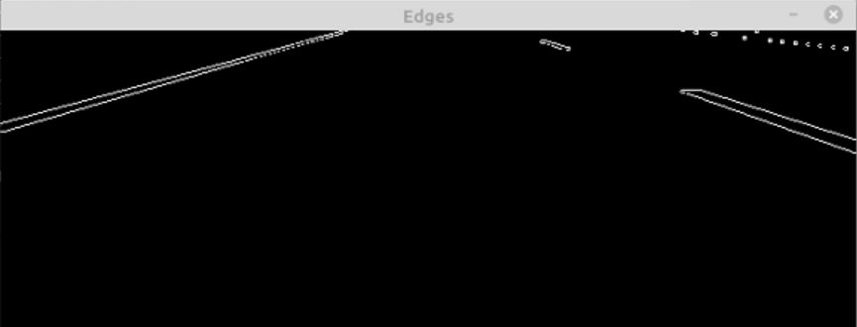
Canny Edge Detection

Slide 13
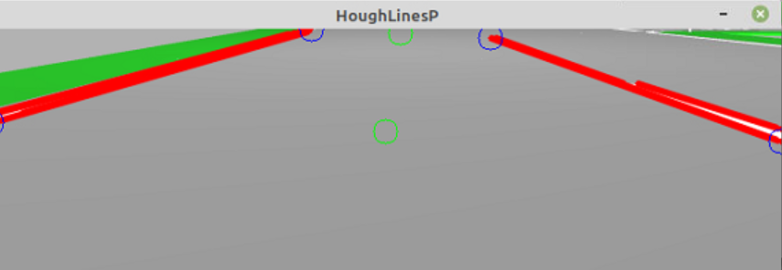
HoughLinesP & Path Planning

Slide 14
Technical Issues Encountered
I had attempted a different approach to detecting the lines, by warping the image on either side of the robot to allow for easier identification of the lines. However this method quickly fell apart.
Tracking the most appropriate hough lines proved difficult, and still requires some fine tuning of the values for the edge detector and HoughLinesP. As well as some adjustments to the line selection algorithm.

Slide 15
Intent For Rest of Project
Implement behaviour that drives robot along the planned path
Implement behaviour that will stop robot once it reaches the end of the road/give way. Behaviour should also automatically turn the robot onto the road.
Implement road sign recognition.

