Slide 1
Root Cause Mapping WG
November 20, 2024
This meeting is being recorded

Slide 2
Agenda
2024 CWE Top 25
LLMs for CWE mapping: internal testing update
Discussion of View-1003
Open Discussion

Slide 3
2024 CWE Top 25 Update
2024 CWE Top 25 was released yesterday, November 19th
Main sections: Top 25 List, Key Insights, Methodology
Final Stats:
31,770 CVE Records in entire dataset
9,900 requested CVE reviews (31%), across 247 CNAs
Feedback received on 2,717 CVEs (27% of requested) across 148 CNAs (60%)

Slide 4
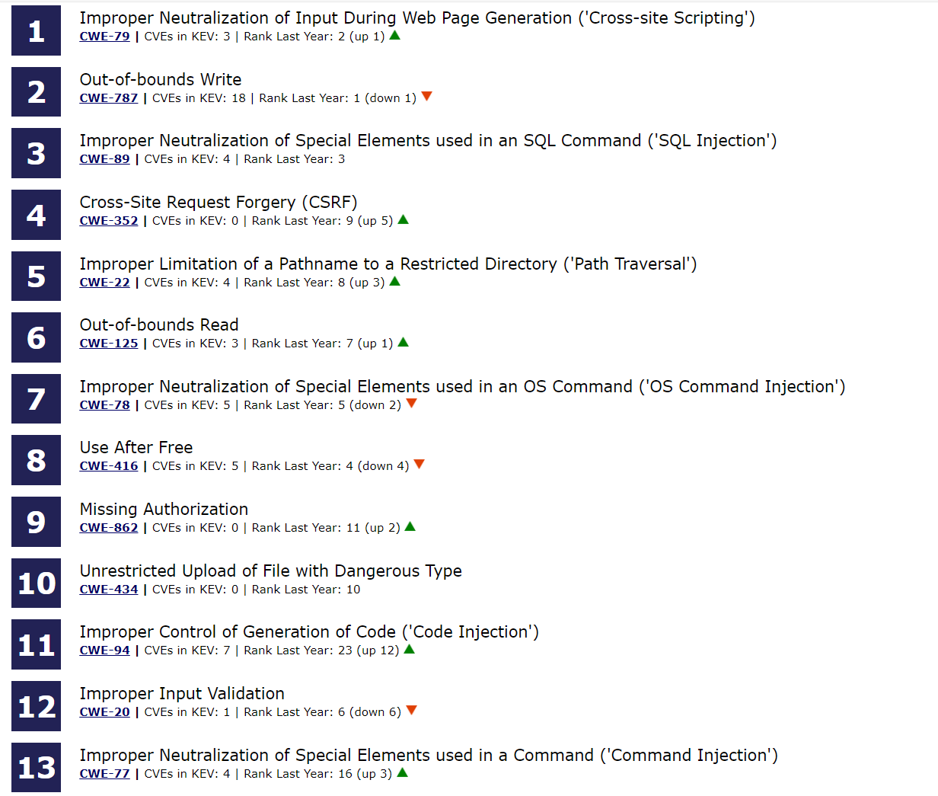
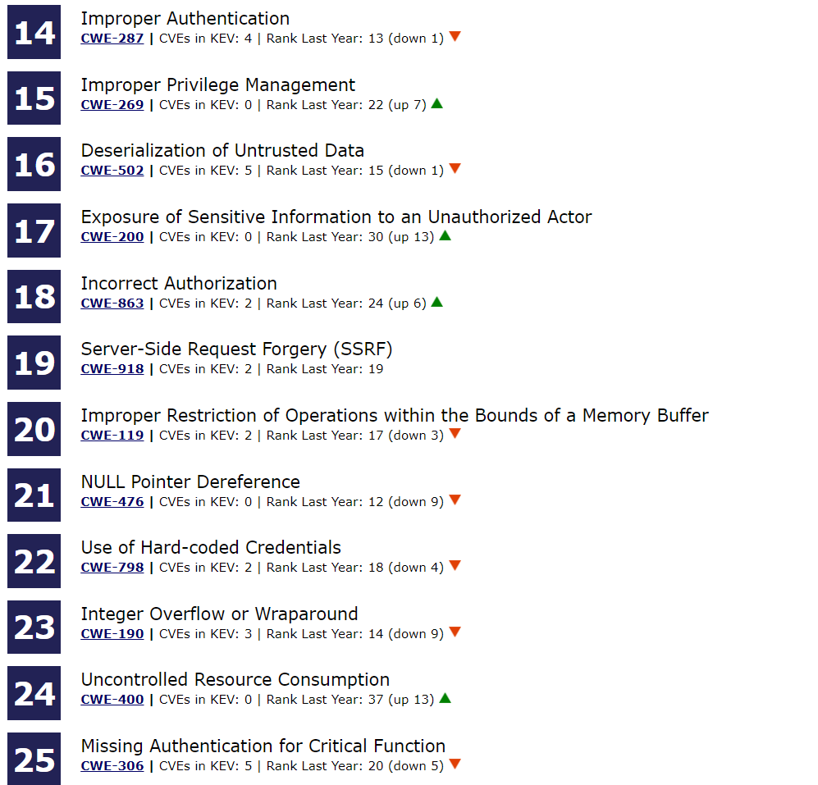

Slide 5
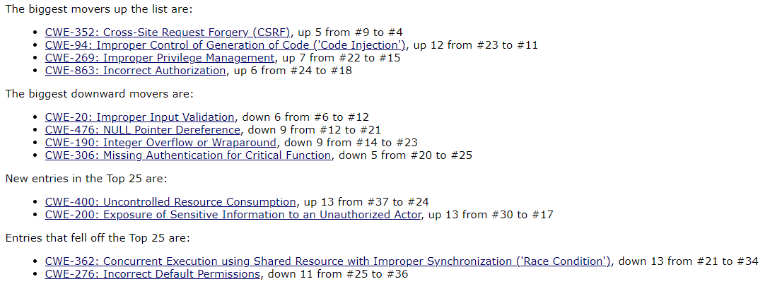
Key Insights – List movement

Slide 6
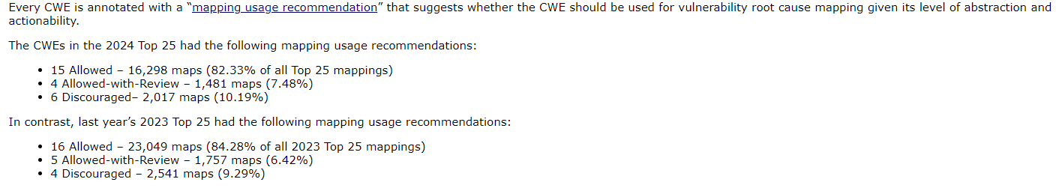
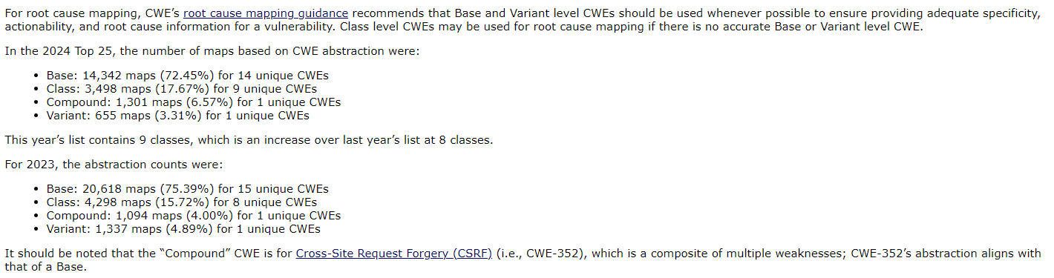


Key Insights – mapping usage and abstraction

Slide 7
Methodology
Dataset: all CVE-2023-* and CVE-2024-* published between June 1, 2023, and June 1, 2024
Requests sent to CNAs were scoped to only include CVE Records whose mappings:
Were considered too high level
Differed from an internal keyword matcher based on the CVE description
Responses were updated in our internal data
For CVE Records with no response, the existing mapping(s) found in CVE data were used
CVSS 3.0 and 3.1 scores were used for calucations (vulnrichment and NVD as source)
All mappings were normalized (rolled up) to View-1003
More discussion on this later

Slide 8
Consensus, Grounded LLM RCM Tool Test Implementation Update Nick Orr, MITRE

Slide 9
Revisiting View-1003

Slide 10
View-1003: Background
View-1003: Weaknesses for Simplified Mapping of Published Vulnerabilities
(aka what’s seen in large-scale vuln DBs / info sources such as NVD)
130 Weaknesses
Widely used, not just by NVD
Originally created in December 2015 with NIST NVD staff
Replaced View-635, which had been used from 2008 to 2016
Aka “The NIST 19” – 19 CWEs… including 4 categories ☹
General goal for View-1003
“Give analysts more CWEs to reflect the variety of weaknesses being disclosed”
Be “data-driven” based on what’s popular (not followed religiously)
Relatively shallow hierarchy – mostly Base level, some Classes for “flexibility”

Slide 11
Revisiting View 1003
CWE adoption and root cause analysis is much more widely adopted than it was 10 years ago
Some adopters want to use all available CWEs at lower levels of abstraction
Sometimes there is forced or perceived “compliance” with View-1003
900+ weaknesses is still too many CWEs for people
Many CWEs in View-1003 are too high-level and are mapped too quickly, especially if all View-1003 CWEs are presented as a flat list
View-1003 has not been regularly updated on a yearly basis
Could be more purely “data-driven”
Areas like memory safety often map to lower-level CWEs not in View- 1003 (e.g., CWE-121/CWE-122 for stack/heap based overflows)

Slide 12
Next Steps for 1003?
Short term suggestions
Update View-1003 in the next CWE release (early 2025)
Add more CWEs that are frequently seen (we have lots of Top 25 data!)
Remove unused/rare entries
Consider deeper hierarchical structure
New capabilities:
Incorporate better mapping capability in CVE Record generator clients
CWE chatbot…
Longer term
Make mapping easier – usability improvements ongoing
Encourage CNAs and others to use lower-level CWEs
Understand why people rely on View-1003
Clarify problems with <any> view that has a subset of weaknesses

Slide 13
Open Discussion

