Slide 1
Root Cause Mapping WG
December 18th, 2024
Connor Mullaly
Steve Christey Coley
This meeting is being recorded

Slide 2
Agenda
Root Cause Mapping Example – Improper Privilege Management
RCM LLM tool implementation update
Chris Madden, Yahoo
Nick Orr, MITRE
Open Discussion

Slide 3
Level set – Privileges vs Permissions
Privileges: code can assign (or define) privileges for a particular user (e.g. administrator, regular, guest). Generally speaking, within CWE, the "privilege" concept can include roles or capabilities.
Permissions: "the explicit specifications for a resource, or a set of resources, that defines which actors are allowed to access that resource, and which actions may be performed by those actors. Permissions can contribute to the definition of one or more intended control spheres.“
Defines who can access an object or resource (ex: a file)
Roughly: privileges are tied to people; permissions are for resources
CWE glossary: https://cwe.mitre.org/documents/glossary/index.html
Significant challenge: for different CWE users, the same concept has different meanings in different technologies and access control models (privilege, role, permission [sic], capability, …)

Slide 4
Mapping Discussion – Privileges
CWE-269: Improper Privilege Management
The product does not properly assign, modify, track, or check privileges for an actor, creating an unintended sphere of control for that actor.
A common mapping mistake is using CWE-269 in situations where an adversary is able to gain privileges as an impact
"gain privileges" / "gain root access" / "escalate privileges" and other phrases do not prove CWE-269
151+ CWEs have “Gain Privileges or Assume Identity” potential impact
Ranked 15th on this year’s Top 25 with 324 total mappings despite being “discouraged”
The name attempts to generalize from a classification perspective

Slide 5
Bad Mapping Example – CWE-269
“[Product] contains a local privilege escalation vulnerability. A console user with access to [Product] may exploit this vulnerability to escalate privileges to gain root access to the system.
Original CNA mapping: CWE-269 Improper Privilege Management
Corrected mapping after consult: CWE-78 OS Command Injection
A better CVE description would have made this mapping easier to identify by including information about the root cause.
Considering all technical references at the time of mapping could have helped as well (… assuming such references were available at that time)

Slide 6
Good mapping example - Privileges
A Improper Privilege Management vulnerability in [Product] causes permission changes in [Product] not to be reflected to users while they are logged in the [Product]. This would cause the users to retain their previous permissions, even if they change groups on [Product], for example, to a lower privileged group, or are removed from a group, thus retaining their access instead of losing it.
Original mapping: CWE-269 Improper Privilege Management
Corrected mapping after consult: CWE-266 Incorrect Privilege Assignment
The original mapping encompassed the root cause weakness, although a more specific child was a better mapping choice
Note: this is part of a broader pattern of “not propagating changes” that may need a new CWE entry(ies)

Slide 7
Technical Impact Phrases - Privileges
Privileges "gain privileges" / "gain root access" / "gain [XYZ] access/privileges"
"escalate privileges" / "escalation of privileges"
"elevation of privilege" / "elevate privilege"
"privilege escalation" / "vertical privilege escalation" / "horizontal privilege escalation"
"local privilege escalation" / LPE

Slide 8
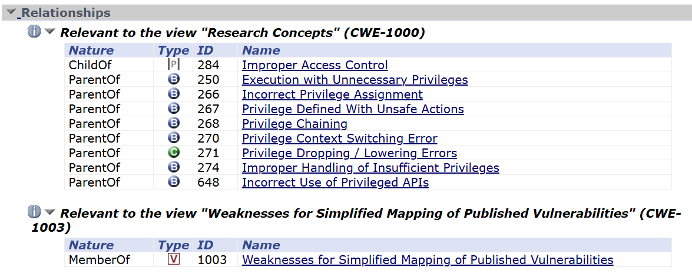
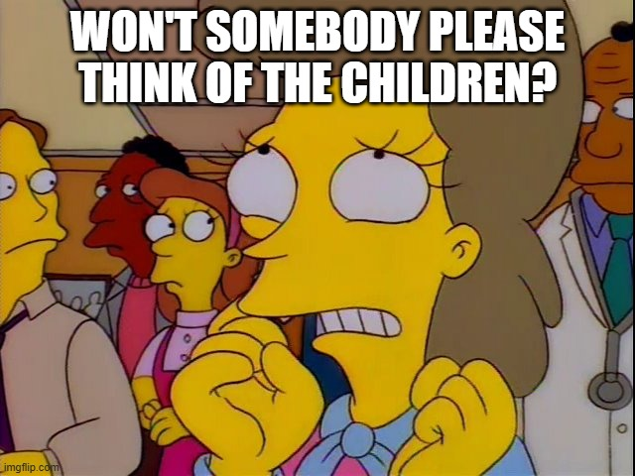
How to Help Users Look at Other Relationships?

Slide 9
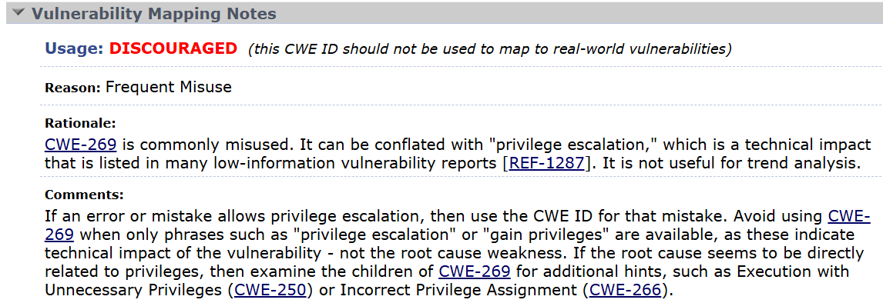
CWE-269 Vulnerability Mapping Notes

Slide 10
Consensus, Grounded LLM RCM Tool Community Development Update Chris Madden, Yahoo

Slide 11
Consensus, Grounded LLM RCM Tool MITRE Test Implementation Update Nick Orr, MITRE

Slide 12
Open Discussion

Slide 13
Other Topics
Does the current meeting time and cadence conflict with your schedule?
What future topics would be most useful to you?
Are there past topics which you would like to revisit?

