Slide 1
Root Cause Mapping WG
August 14th, 2024

Slide 2
This meeting may be recorded

Slide 3
Agenda
Preview 2024 CWE Top 25 Strategy
New mapping notes flow diagrams
Presentation:
Applying LLMs for CWE Assignment (Chris Madden, Yahoo)

Slide 4
2024 CWE Top 25
In Previous Years:
Used the past 2 years of NVD data
CWE team independent analysis on thousands of CVE records
Difficulties with lack of information
This year’s plan
Use only the past year of NVD data
Use our internal keyword matcher and analysis scripts to present CVE records back to CNAs to improve or correct mappings
CNAs have more insight into their products to provide the best mappings

Slide 5
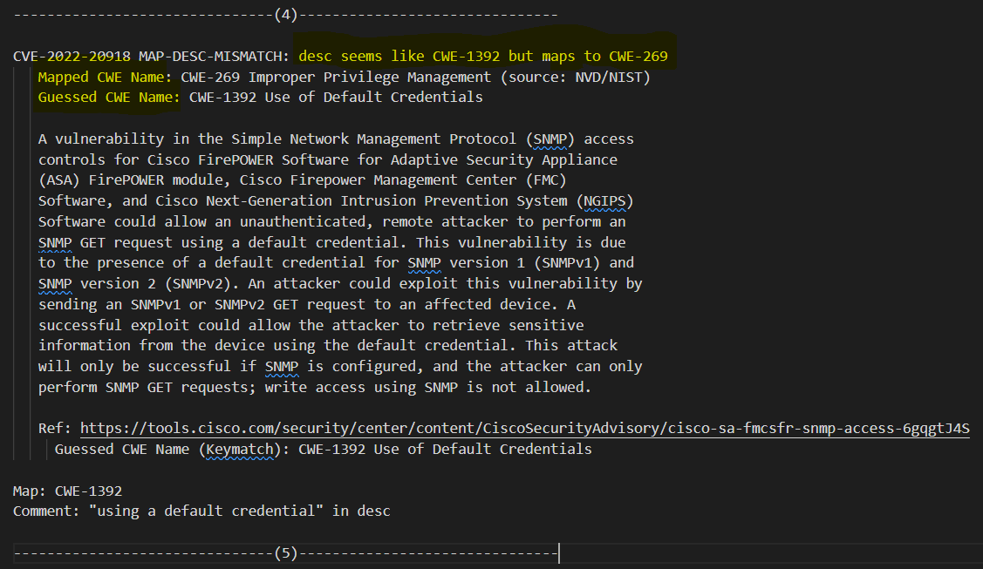
2024 CWE Top 25 – Data presentation
FEEDBACK: how should we present mapping data to CNAs?
Option 1: using our text file format
Option 2: excel file with one CVE per row that a CNA can fill out
CVEs with multiple weaknesses would have multiple rows

Slide 6
2024 CWE Top 25 – Considerations
Will CNAs have the capacity and willingness to help with mapping analysis?
How to ensure overall mapping accuracy/quality?
Handle conflicting / problematic mappings
Aiming for base-level weaknesses (CWE Mapping Guidance)
Potential for 2024 list to be considerably different than previous, depending on community participation
Possibility of sharing mapping changes publicly for education and propogating lessons-learned

Slide 7
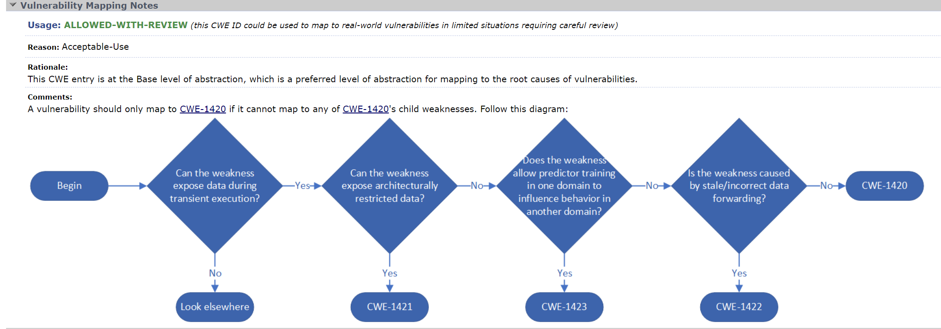
Mapping Notes – new flow diagram
New in CWE 4.15 – image for CWE-1420: Exposure of Sensitive Information during Transient Execution

Slide 8
Mapping Flow Diagrams – Ongoing Work
CWE team members are investigating how to build and represent these diagrams

Slide 9
Mapping Notes flow diagrams – Other CWEs to consider in future
CWE-77: Command Injection
Likely candidate for a diagram
Most useful at the base or class level to identify the correct child to map to
What CWEs do the group struggle with creating specific mappings?
Other Ideas:
CWE-119: Improper Restriction of Operations within the Bounds of a Memory Buffer
CWE-284: Improper Access Control

Slide 10
Open Discussion
Future Topics?
Mapping Woes?
CWE Mapping Usability Improvement Ideas?

