Slide 1
Root Cause Mapping WG – CWE Mapping Examples
May 8, 2024

Slide 2
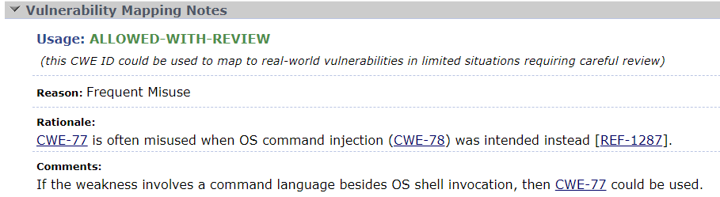
CWE-77: Improper Neutralization of Special Elements used in a Command ('Command Injection')
Most of the time, this should map to its child CWE-78: Improper Neutralization of Special Elements used in an OS Command ('OS Command Injection’)
An annual problem in Top 25 analysis

Slide 3
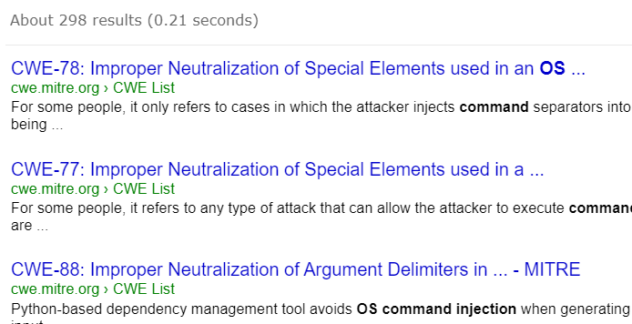
CWE site search results
Search for “OS command injection”

Slide 4
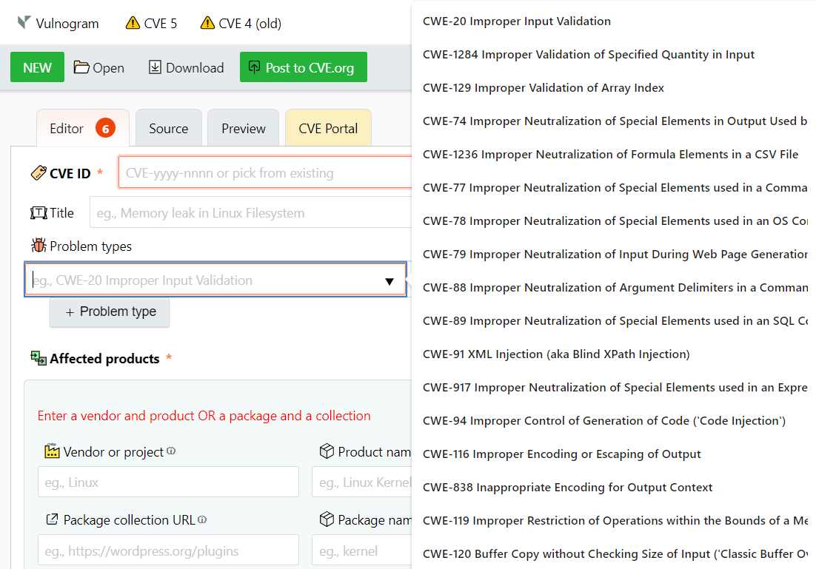
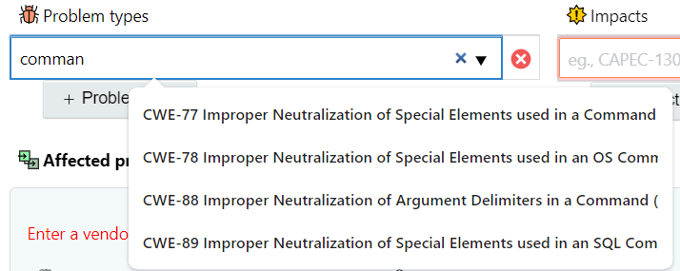
Vulnogram
CWE-77 is listed before CWE-78
No parent/child relationships displayed

Slide 5
CWE-77 examples
CVE-2023-20075 - "injecting operating system commands into a legitimate command"
Cisco CNA maps to CWE-77
NVD maps to CWE-78

Slide 6
CWE-77 examples
CVE-2023-36642 - "An improper neutralization of special elements used in an OS command vulnerability [CWE-78]"
Fortinet CNA maps to CWE-77, even though its own advisory says CWE-78
NVD maps to CWE-78

Slide 7
CWE-77 examples
CVE-2024-21887 - "A command injection vulnerability in web components of Ivanti Connect Secure"
This is one of the CVE Records cited in the recent MITRE incident
Mapped in NVD to CWE-77
Because the description only has "command injection" we need to look at the references to see if we can get more specific
https://www.vicarius.io/vsociety/posts/two-zero-day-critical-vulnerabilities-in-ivanti-cve-2023-48605-and-cve-2024-21887-21889:
Ivanti 0-day "command injection" appears to be basic shell metacharacters, thus OS command injection.

Slide 8
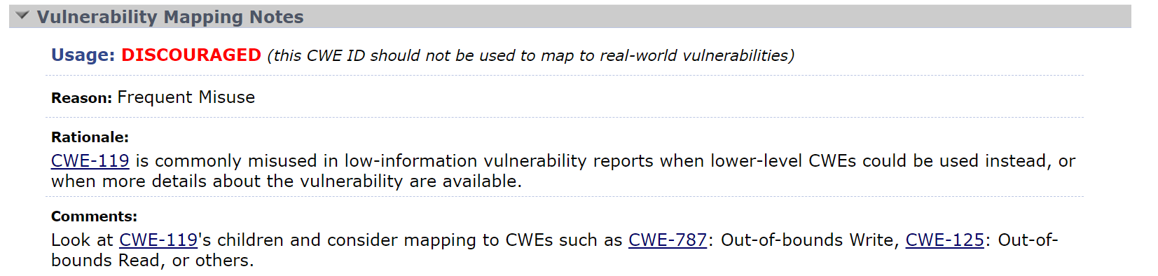
CWE-119: Improper Restriction of Operations within the Bounds of a Memory Buffer
Mostly used in buffer errors with low info, but a more specific child is always preferrable when the info is there

Slide 9
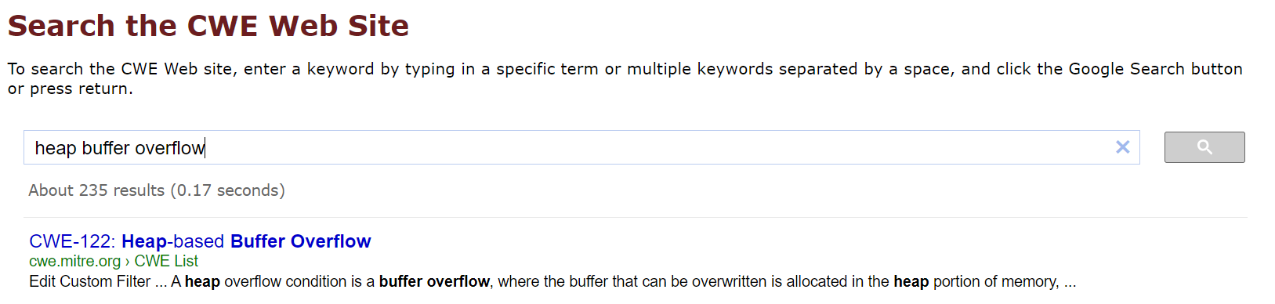
CWE-119 Example
CVE-2023-30774 - "This security flaw causes a heap buffer overflow issue"
Red Hat CNA maps to CWE-119: Out-of-bounds Write
NVD maps to CWE-787 (closest parent forced by view-1003 compliance)
Best mapping is CWE-122: Heap-based Buffer Overflow based on keyword matching

Slide 10
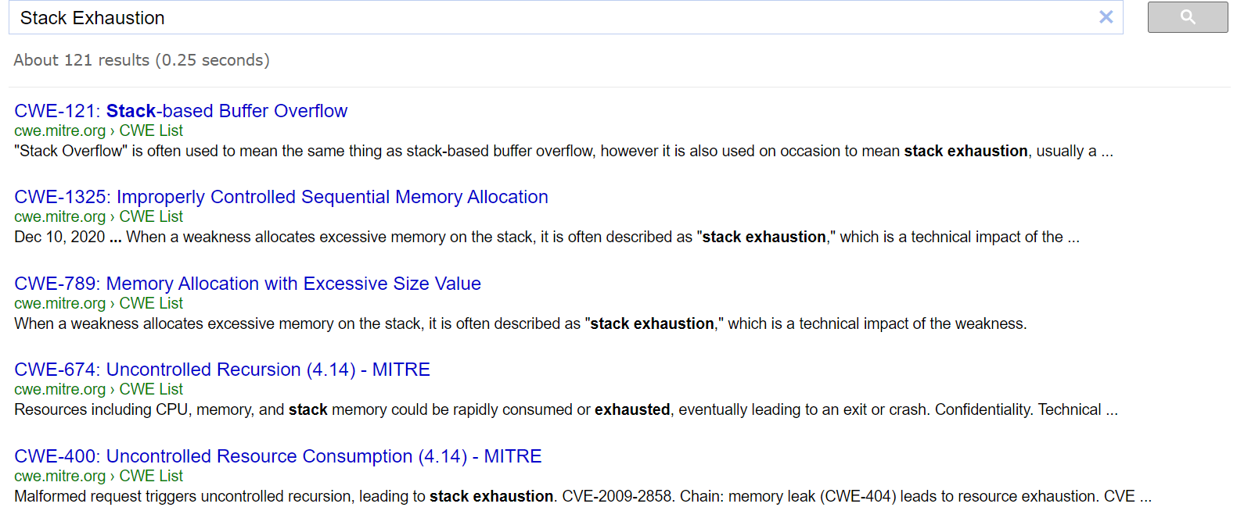
Problems with the phrase "Stack Overflow"
Is sometimes used for two meanings:
Stack based buffer overflow
Running out of available stack memory ("Stack Exhaustion")
Unfortunately, this is the search for "Stack Exhaustion":

Slide 11
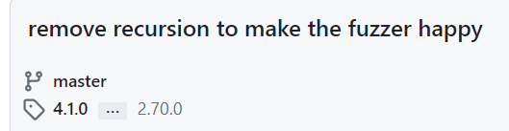
"Stack Overflow" Example
CVE-2023-2798 - "may be vulnerable to Denial of service attacks (DoS). If HtmlUnit is running on user supplied web pages, an attacker may supply content that causes HtmlUnit to crash by a stack overflow"
Google CNA mapped to CWE-400: Uncontrolled Resource Consumption
NVD Mapped to CWE-787: Out-of-bounds Write
Looking at a Commit reference indicates excessive recursion, so it should be mapped to CWE-674: Uncontrolled Recursion.

Slide 12
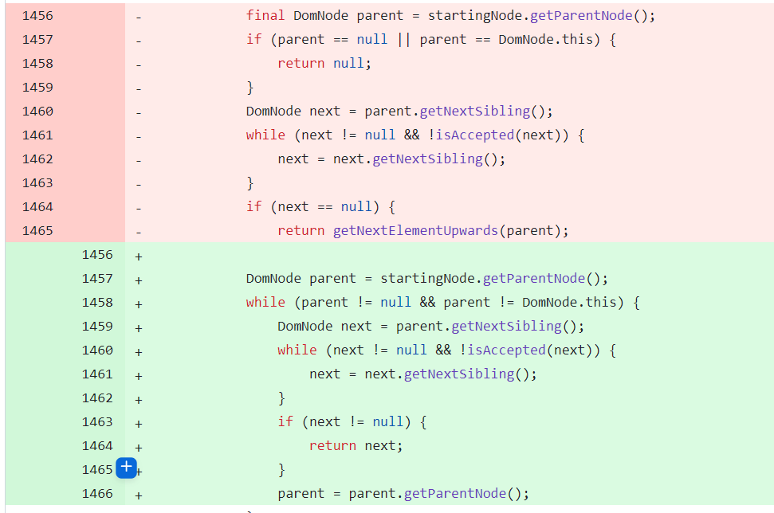
"Stack Overflow" example

Slide 13
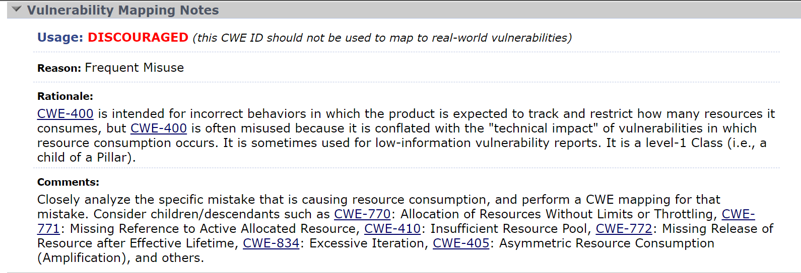
"Stack Overflow" Example
Why is CWE-400: Uncontrolled Resource Consumption not a good mapping here?

Slide 14
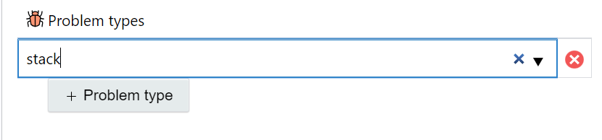
Vulnogram
Unfortunately, vulnogram does not have any search results for anything related to "stack"

Slide 15
Mapping Examples from the group?
Any recent difficulties
Comments on the previous examples
Thoughts on avoiding high level mappings?

