Slide 1

Gramine: Securing unmodified Linux Applications with Confidential Computing
Presenters: Michał Kowalczyk, Mona Vij

Slide 2
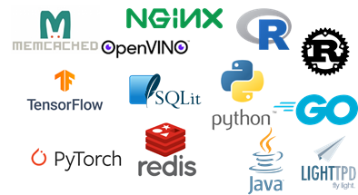
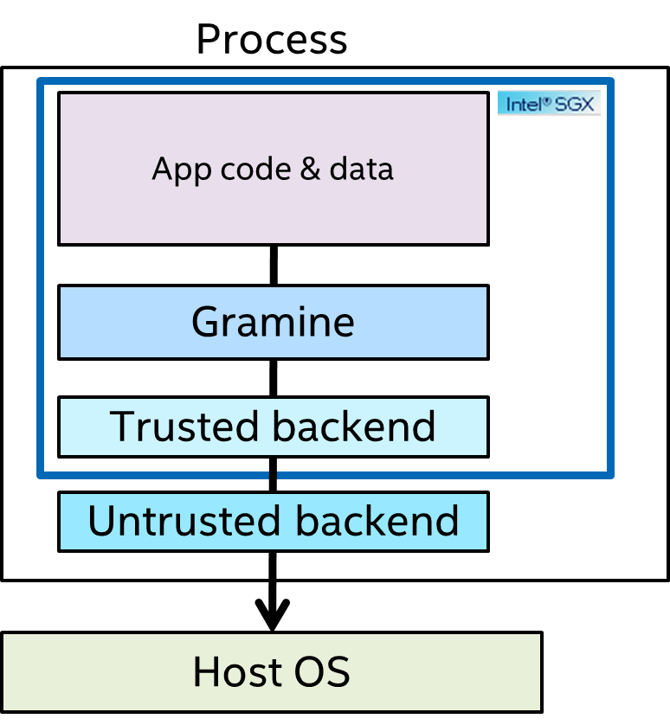


Gramine
Gramine is a multi-process Library OS and run unmodified Linux applications on SGX
Community-maintained open-source (LGPL) project hosted on GitHub
Gramine project joined Confidential Compute Consortium (CCC) in Sep’21
Provides several tools for SGX solutions; containerization, attestation
Latest production ready Gramine v1.4, released in Feb’23; under active development
Process
Customers
Deployed Use Cases
IBM
Cosmian
Edgeless Systems
JD Cloud
Tencent Cloud
Enclaive
Eder Labs
IBM ePrescription
BigDL PPML
OpenVINO™ Security Add-on
OpenFL deep learning framework
CCZoo projects

Slide 3
Progress since last update
Gramine releases are packaged for popular Linux distributions (Debian/Ubuntu and RHEL/CentOS)
Started releasing an official Gramine Docker image
Started integration with Azure cloud services
Introduced several workloads available at Azure Marketplace
Core Gramine changes
Major overhaul of:
memory management
file system
networking
ELF parsing and loading
Support for musl C v1.2.2 and Glibc v2.35 standard libraries
Support for Intel Advanced Matrix Extensions (AMX)
CPU/NUMA topology sanitization
Support for executable scripts (shebangs)
Support for EDMM (Enclave dynamic memory management)

Slide 4
Ongoing work and plans
Ongoing work:
Support communication with hardware accelerators (GPUs)
EDMM optimizations
Support dynamic thread creation/destruction
Continued development to support additional runtimes and workloads
Integration with confidential container deployments (Kata Containers, enclave-CC)
Interoperable RA-TLS (standardization)
Experimental/future work:
Support additional TEE backends (Intel TDX)
Explore coarse-grained partitioning for certain I/O bound applications (DPDK)

Slide 5
Gramine Talks and Blogs
FOSDEM’22 and FOSDEM’23
Confidential Computing Consortium (CCC) webinar
Third SGX community Day
Gramine highlighted in several use cases and projects at the Open Confidential Computing Conference (OC3 2022) conference
Whitepaper “Computation offloading to hardware accelerators in Intel SGX and Gramine Library OS”,
Blog post “How Open Source Gramine Accelerates Expanding Confidential Computing Market”,
Azure Blog post “Developers guide to Gramine Open-Source Lib OS for running unmodified Linux Apps with Intel SGX”,
A series of technical blog posts.

Slide 6
Gramine deployments
In production:
Deployment with IBM/Gematik e-prescription solution
Deployment by a major china CSP with BigDL PPML that builds on top of Gramine
Integration with other open source projects
Integrated with Open Federated Learning (OpenFL) framework (LF AI and Data incubation project)
Integrated with Edgeless systems/MarbleRun for deployment with K8 environments
Reference solutions with Confidential Computing Zoo (CCZoo)
Integrated with OpenVINO™ Security Add-on for Gramine
Several production ready services developed on top of Gramine by enclaive.io
Production ready AI services by Cosmian

Slide 7
Gramine Project
Technical Charter
No change in charter
Project Code of Conduct
Finalized CoC (Contributor Covenant 2.0 with a PostgreSQL sentence, “The Committee may determine that a violation of this policy was inadvertent …”)
Gramine Project - https://github.com/gramineproject
Core gramine - https://github.com/gramineproject/gramine
Examples - https://github.com/gramineproject/examples
Gramine Shielded Containers - https://github.com/gramineproject/gsc
Third party code related to Gramine - https://github.com/gramineproject/contrib
Archived Graphene - https://github.com/gramineproject/graphene
Issue Tracker
https://github.com/gramineproject/gramine/issues
Documentation
Gramine: https://gramine.readthedocs.io/en/latest/
GSC: https://gramine.readthedocs.io/projects/gsc/en/latest/
Roadmap
Roadmap: https://github.com/orgs/gramineproject/projects/1

Slide 8
Management Team
The currently active members of the management team are:
Michał Kowalczyk (Invisible Things Lab/Intel)
Dmitrii Kuvaiskii (Intel)
Borys Popławski (Invisible Things Lab/Intel)
Wojtek Porczyk (Invisible Things Lab/Intel)
Don Porter (UNC)
Chia-Che Tsai (Texas A&M University)
Mona Vij (Intel)
The past (inactive) members of the management team are:
Paweł Marczewski
Rafał Wojdyła
Isaku Yamahata
The active members have the review and voting rights. The past (inactive) members have only the review rights.
The active members are also the TSC voting members as described in the Technical Charter for Gramine project.

Slide 9
Current Mode of Operation
Repository on GitHub
Reviewable.io
UNC Zoom for team meetings
Gitter chat service
Google group mailing list

Slide 10
Budget
2022
~$10,000 used for buying 2 ICX servers
Hosted in UNC for CI
Intel donated 2 ICX servers for CI
2023
Need budget for creation of Gramine website
currently static content hosted at ITL
Need VPS server for the packages and the website
waiting for LF to organize it

Slide 11
Vulnerability Management Coordination
Provide a way to easily communicate and exchange security information between the projects
Waiting for updates from CCC

Slide 12
Github Repo
https://github.com/gramineproject/gramine
Gramine Documentation
https://gramine.readthedocs.io
Gitter
https://gitter.im/gramineproject/community
Gramine Project
https://gramineproject.io/

Slide 13



@ConfidentialC2
confidential-computing
confidentialcomputing.io

Slide 14




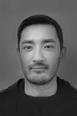







Meet the team
Dmitrii Kuvaiskii
Mona Vij
Michał Kowalczyk
Borys Popławski
Wojciech Porczyk
Don Porter
Chia-Che Tsai
Several other contributors from several companies and academic partners
Intel team has ownership of productizing Gramine

Slide 15
Gramine Project
Gramine is a multi-process Library OS and portability framework
Unmodified Linux applications running on several backends
Current backends: Linux (direct), Linux-SGX
Future backends: VM, TDX
Community-maintained open-source (LGPL) project hosted on GitHub
Joined Confidential Compute Consortium (CCC) in Sep‘21
Cloud deployment with Azure and AliCloud
Several production deployments (TBD)
Four major releases since initial v1.0 in Oct ‘21
Latest v1.4 in Feb ’23

Slide 16





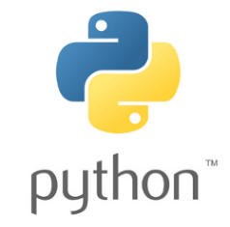










Gramine examples of applications
AI/ML
Databases
Web Servers
Languages
Misc

Slide 17
Gramine runs unmodified applications
(currently available)
(hypothetically in future)
Linux app
Linux app
Linux app
Linux kernel
Gramine
Gramine
x86-64
Linux kernel
Windows kernel
Intel SGX
RISC-V Keystone

Slide 18
Gramine has modular architecture
Process
App code & data
169 syscalls
Linux API
Gramine
50 functions
Gramine API
Gramine backend
Syscall interface
Host OS
* as of January 2023; numbers don’t include debugging functions

Slide 19

SGX port needs a new, SGX-aware backend
Process
App code & data
169 syscalls
Linux API
Gramine
50 functions
Gramine API
Trusted backend
45 OCALLs
SGX OCALL interface
Untrusted backend
Syscall interface
Host OS
* as of January 2023; numbers don’t include debugging functions

Slide 20
Gramine codebase is small
Gramine TCB
Redis
Redis
144K LOC
Gramine
Gramine
27K LOC
27K LOC
15K LOC
Backend
SGX trusted backend
15K LOC
270K(tinyconfig)
LOC
Linux kernel
SGX untrusted backend
4K LOC
x86-64
Linux kernel
Intel SGX

