Slide 1
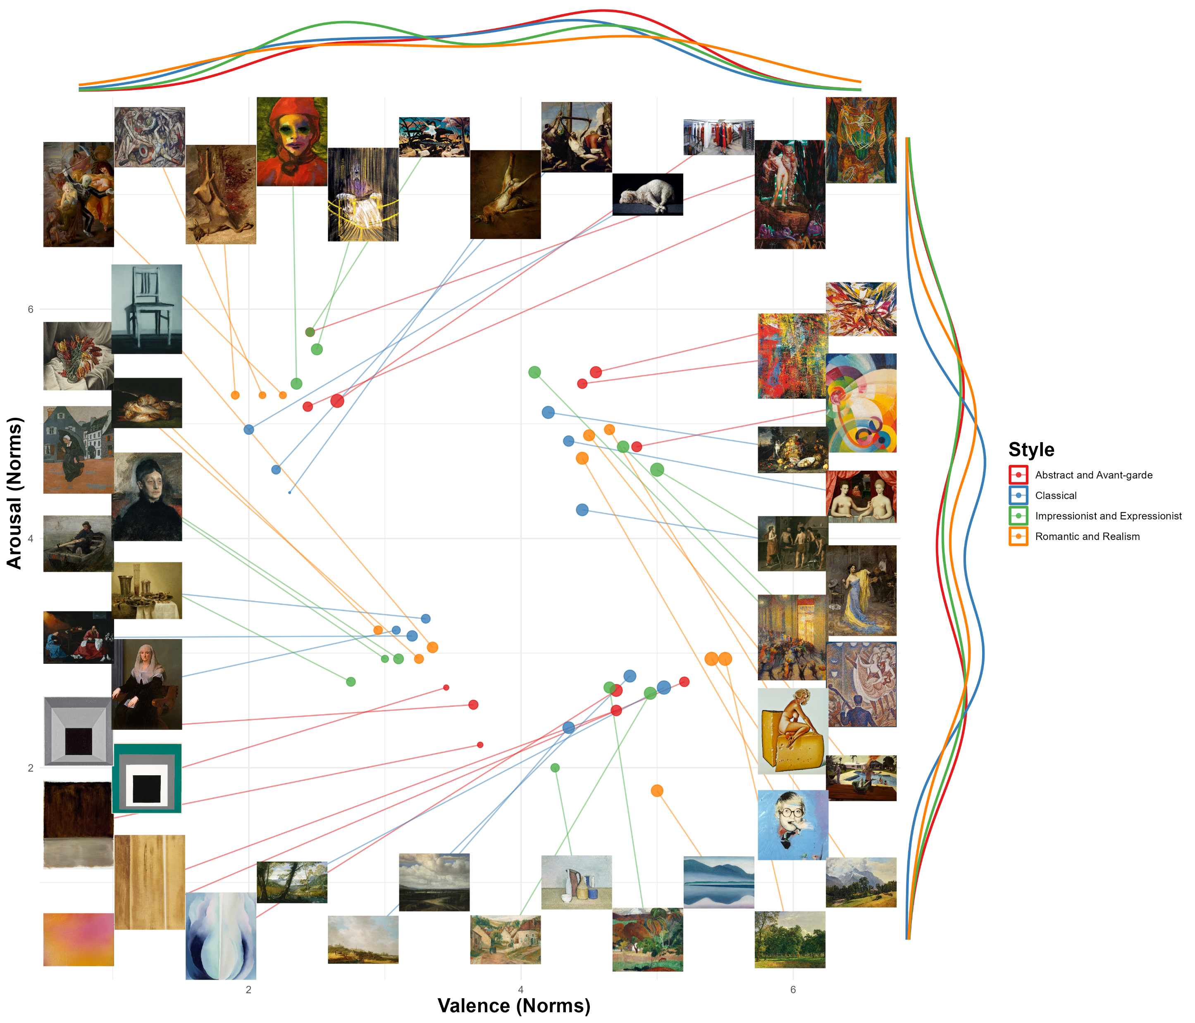
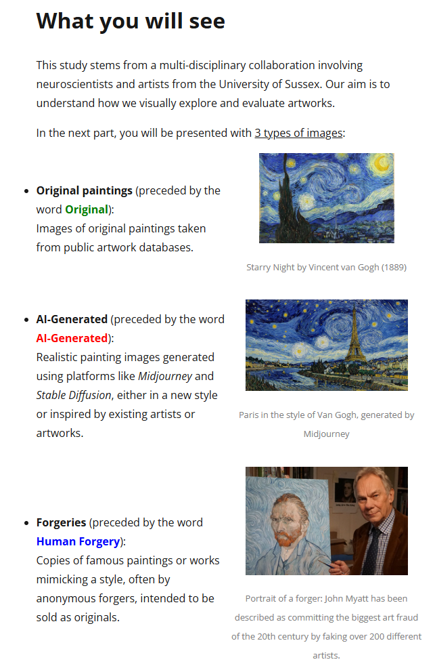
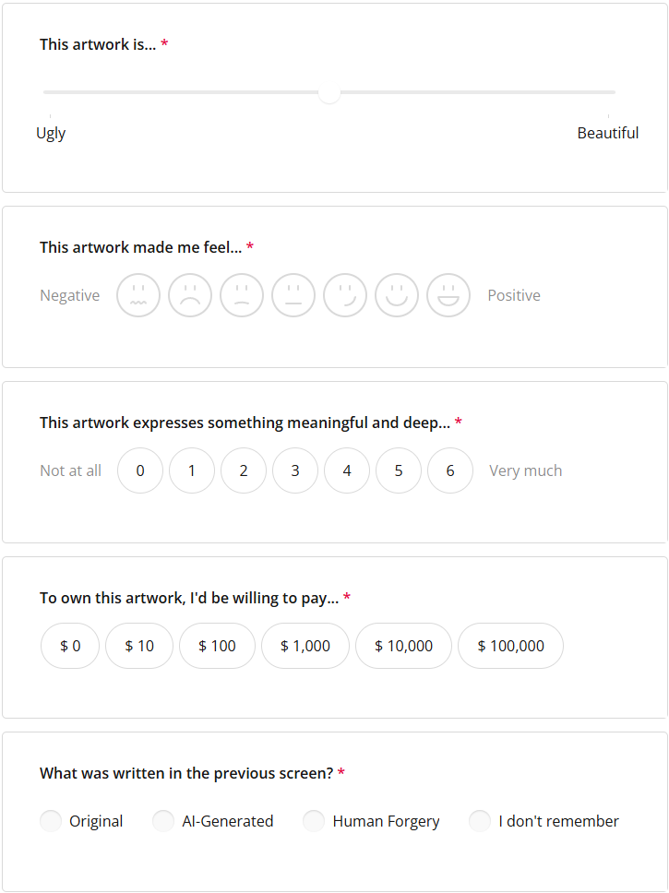
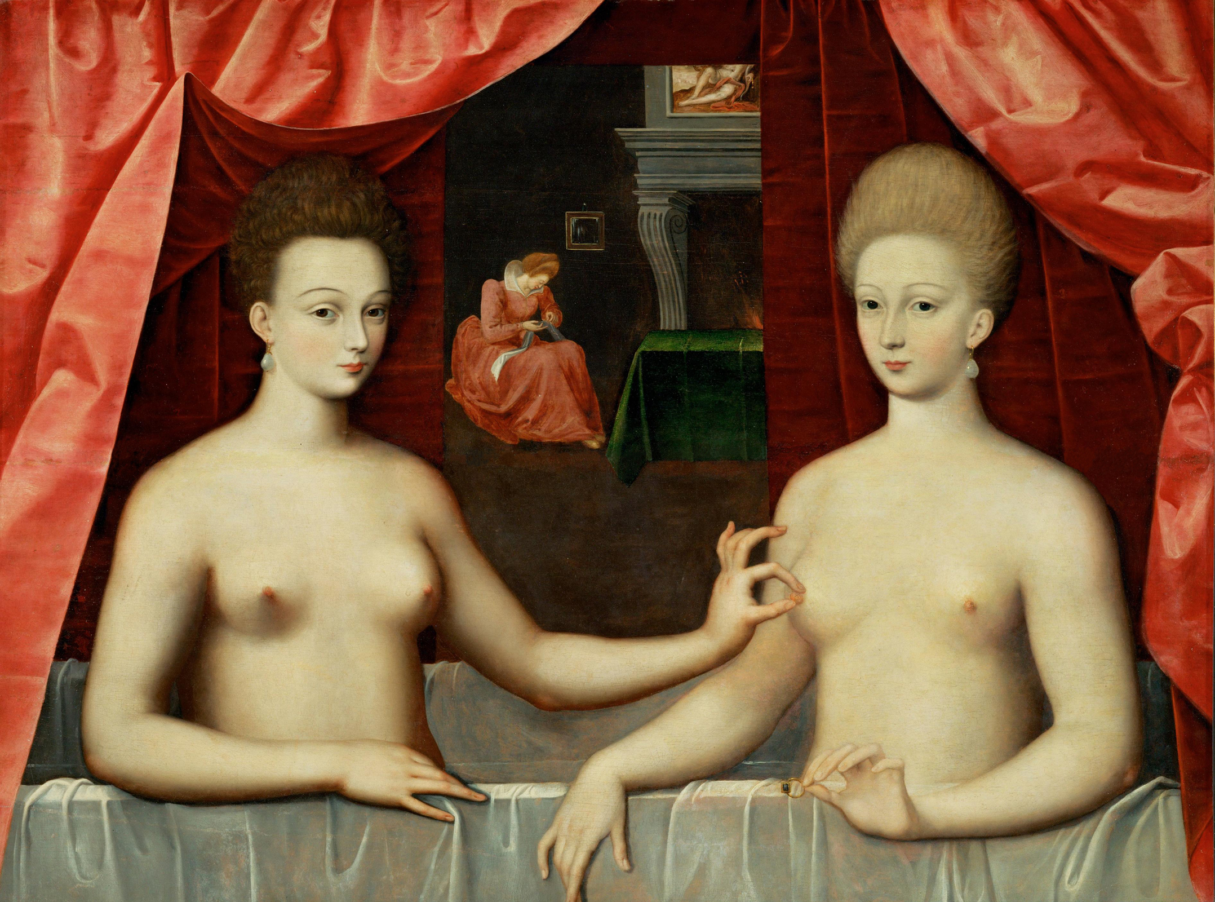







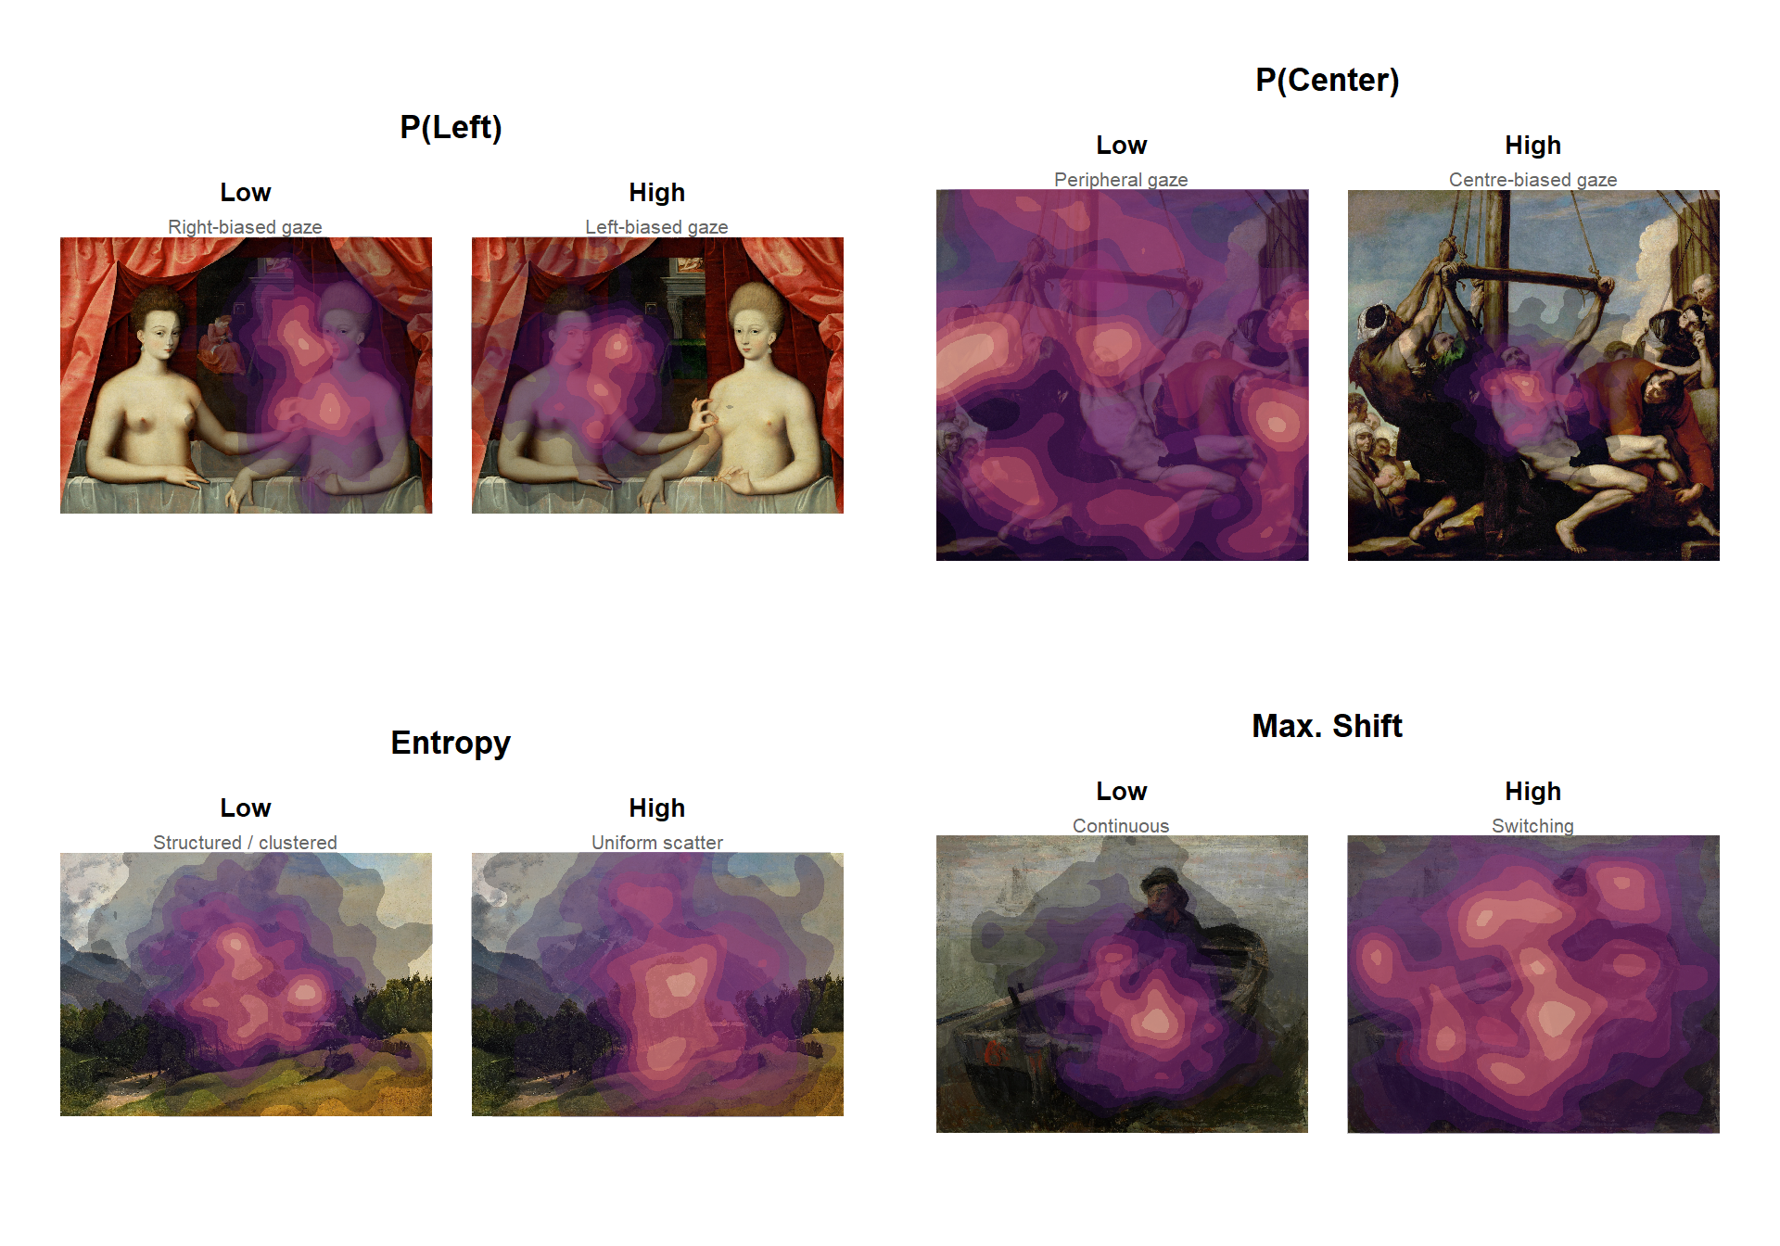









Stimuli Selection
Phase 1: Aesthetic Evaluation
N_{item}= 48
+
Original
3 Conditions
0.5 s
Original
AI-Generated
Human Forgery
1 s
+
0.5 s
5 s
Outcomes
Subjective Ratings
Eye tracking Features
Beauty
Laterality
Centerdness
Valence
Meaning
Worth
Entropy
Max. Shift

