Slide 1
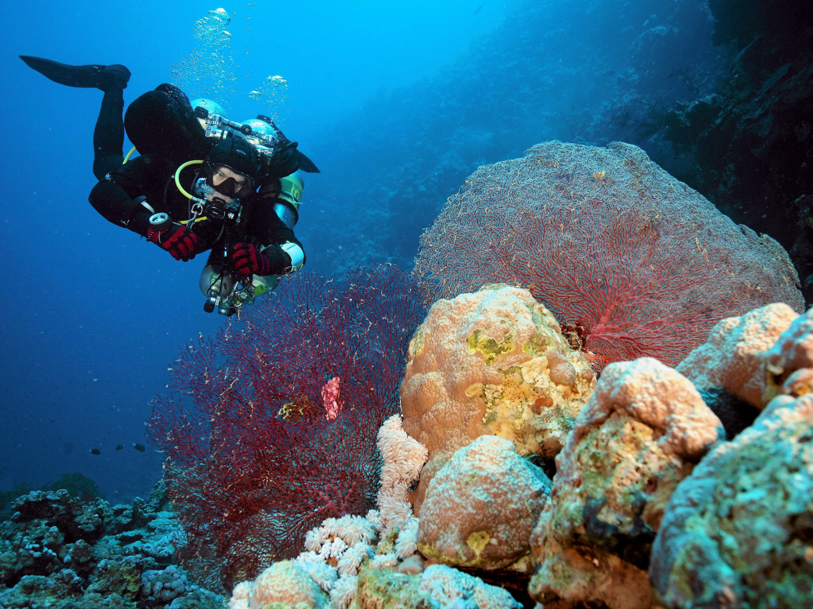
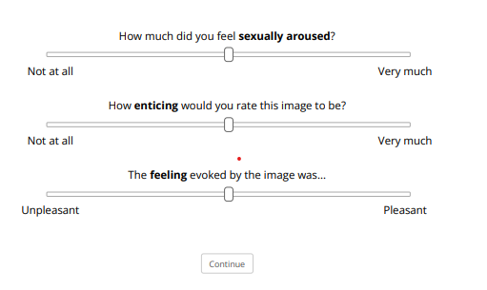

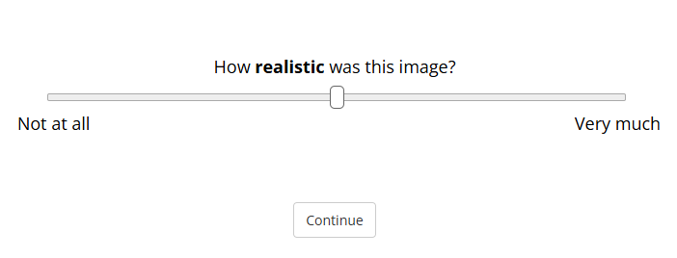
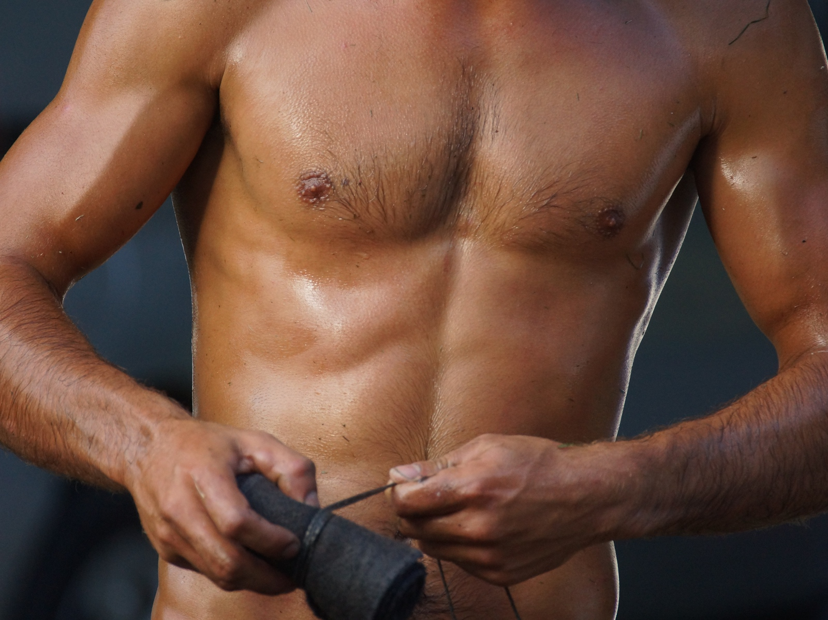
Phase 1
AI-Generated
Photograph
1-2 s
3 s
Subjective Ratings
1-2 s
3 s
Subjective Ratings
Phase 2
3 s
Realness Ratings
3 s
Realness Ratings
3 s
Realness Ratings

