Slide 1
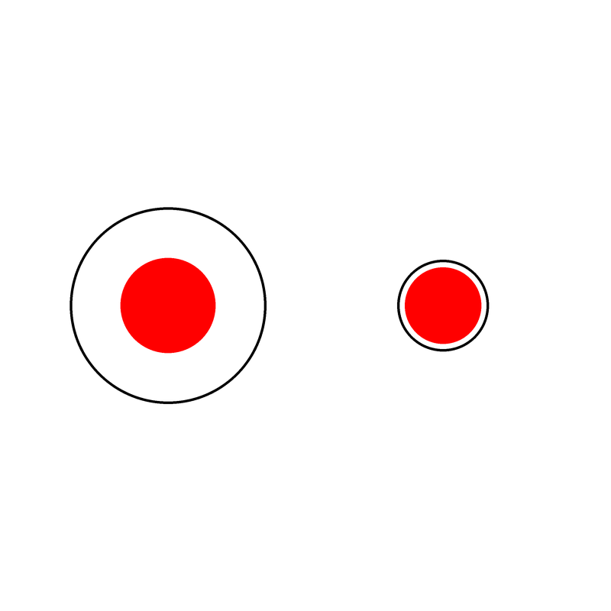


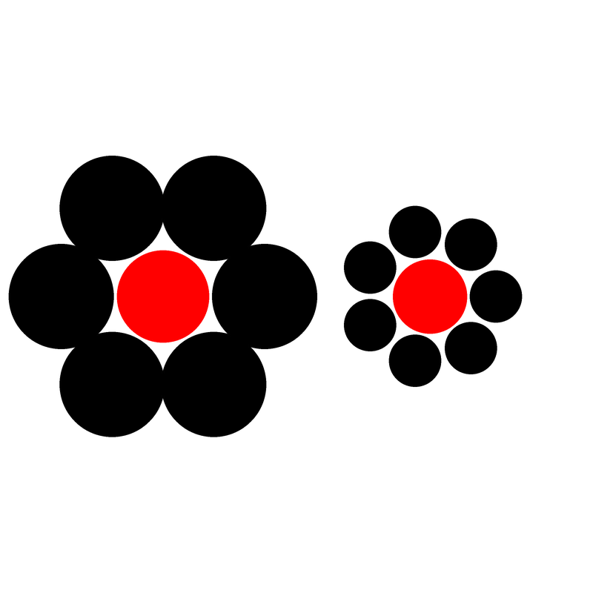
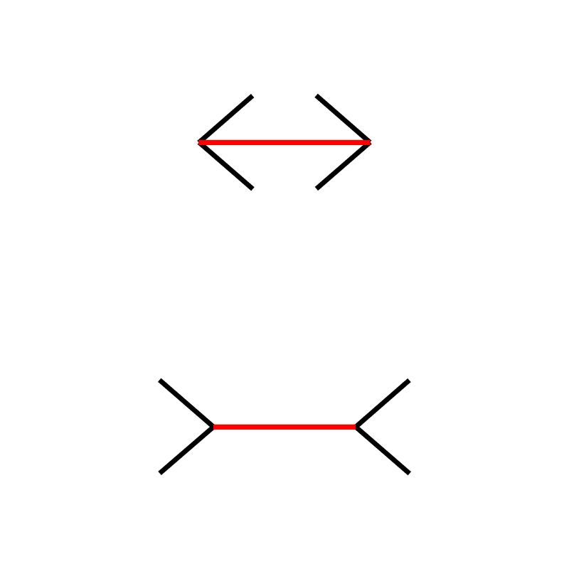
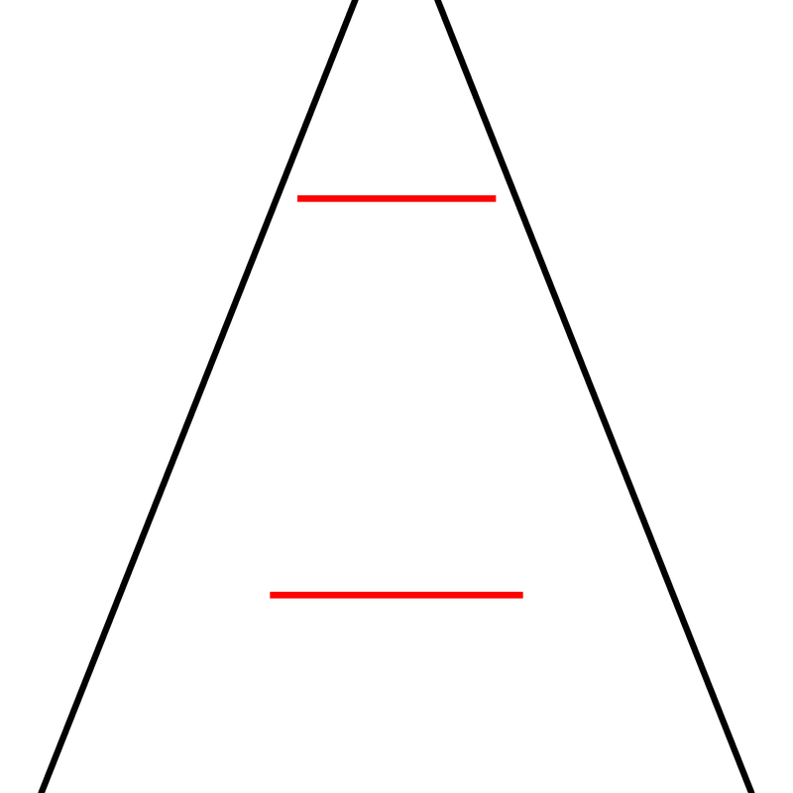
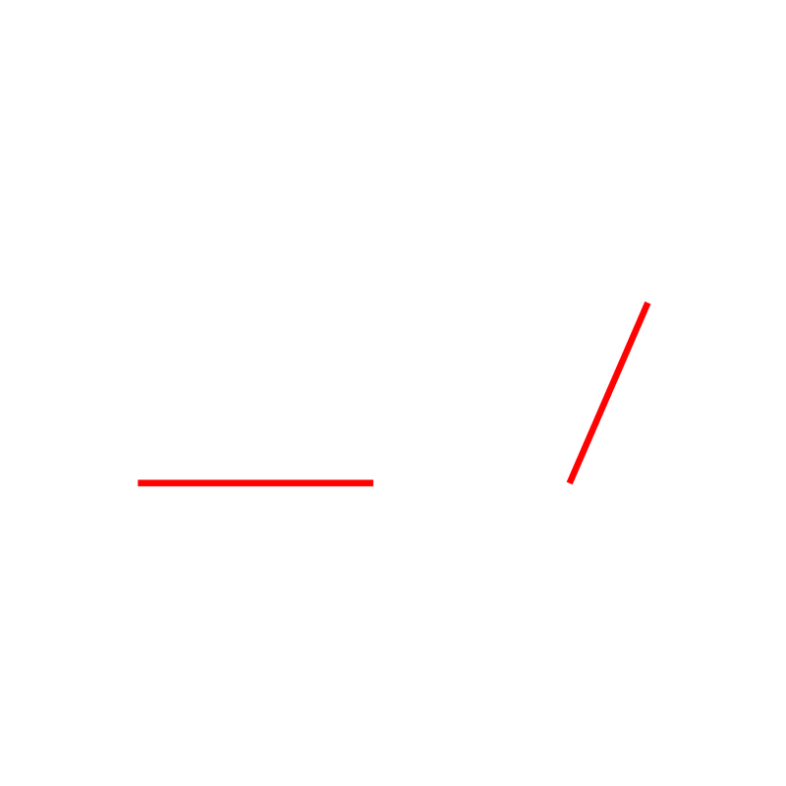
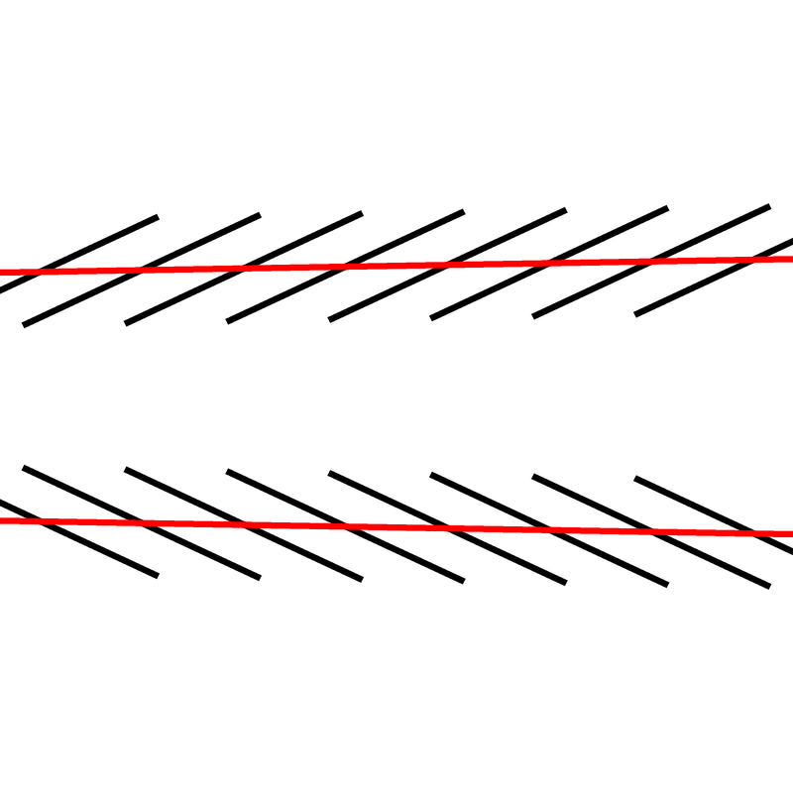
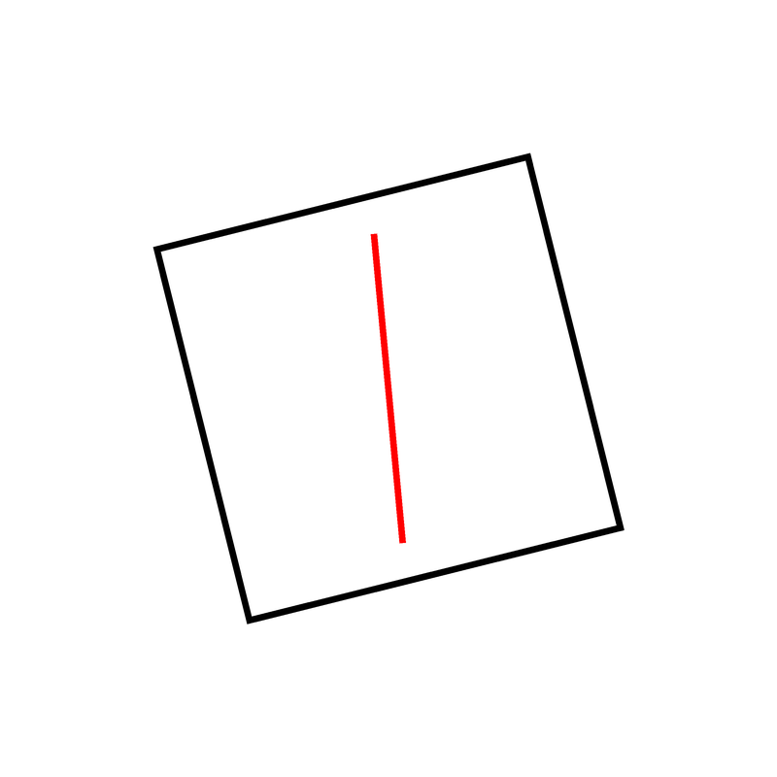
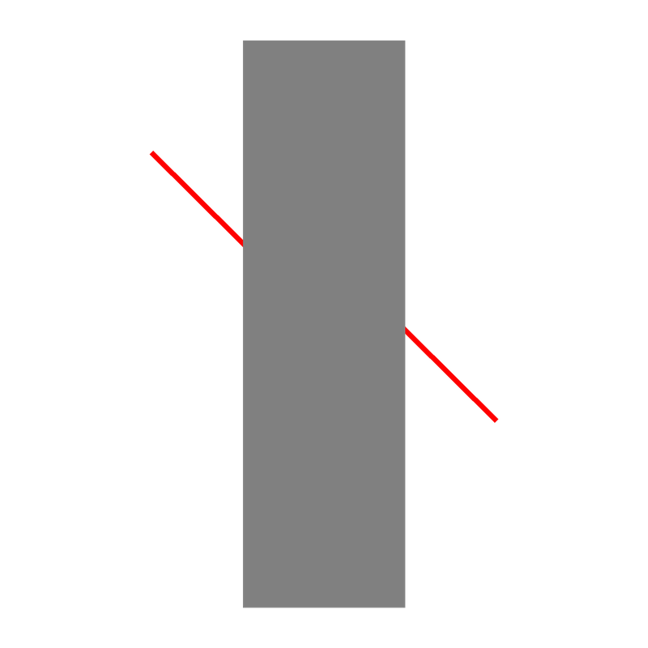


Illusion | Example | Task | Description
Delboeuf |  | Which red circle is bigger? | Two circles surrounded by outer rings. The circle with the closer outline appears larger than the one with the distant outline.
Ebbinghaus |  | Which red circle is bigger? | Two circles surrounded by other circles. The circle surrounded by smaller circles appears larger than the one with the larger surrounding circles.
Müller-Lyer |  | Which red line is longer? | Two parallel segments that end with inwards/outwards pointing arrow-like fins. The segment with inward-pointing fins is typically perceived to be longer.
Ponzo Illusion |  | Which red line is longer? | Two parallel segments embedded between a pair of converging lines. The segment on the convergence side is typically perceived to be longer.
Vertical-Horizontal |  | Which red line is longer? | Two lines segments, one horizontal and one angled. The angled line is usually perceived as longer.
Zöllner |  | Which direction are the red lines converging towards? | Represented by two long lines crossed with short, repeated lines, that appear as converging to one side.
Rod and Frame |  | Which direction is the red line leaning towards? | A segment (“rod”) enclosed in a tilted square (“frame”), that appears to be leaning to one side.
Poggendorff |  | Is the right line above or below the left line? | Two oblique segments separated by a rectangle. The right segment appears to be vertically misplaced.
Simultaneous Contrast |  | Which small rectangle is lighter? | Consists of two smaller grey rectangles embedded in backgrounds of different contrasts. The rectangle with the darker background appears lighter.
White |  | Which vertical rectangle is lighter? | Composed of a series of contrasting horizontal bars superimposed with vertical grey rectangles. Rectangles superimposed onto darker bars appear lighter.

