Slide 1
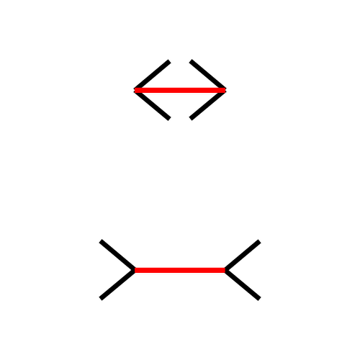
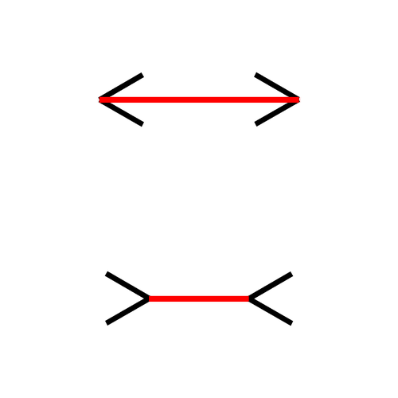
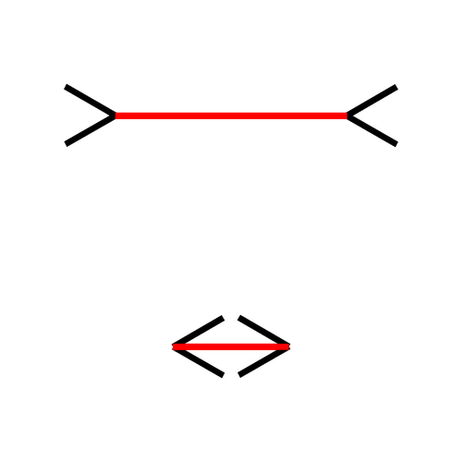
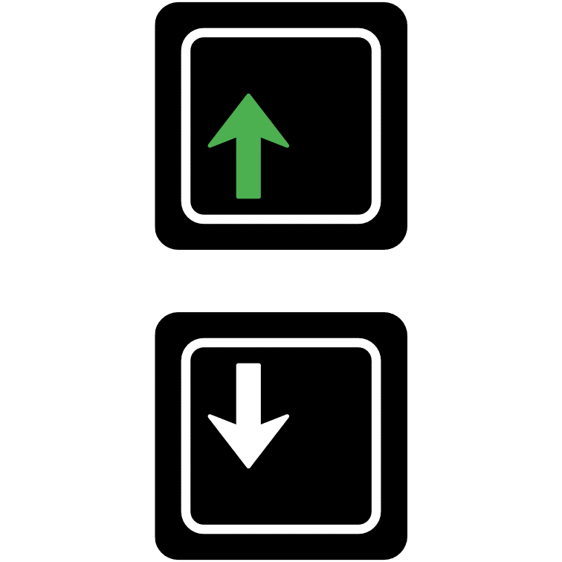
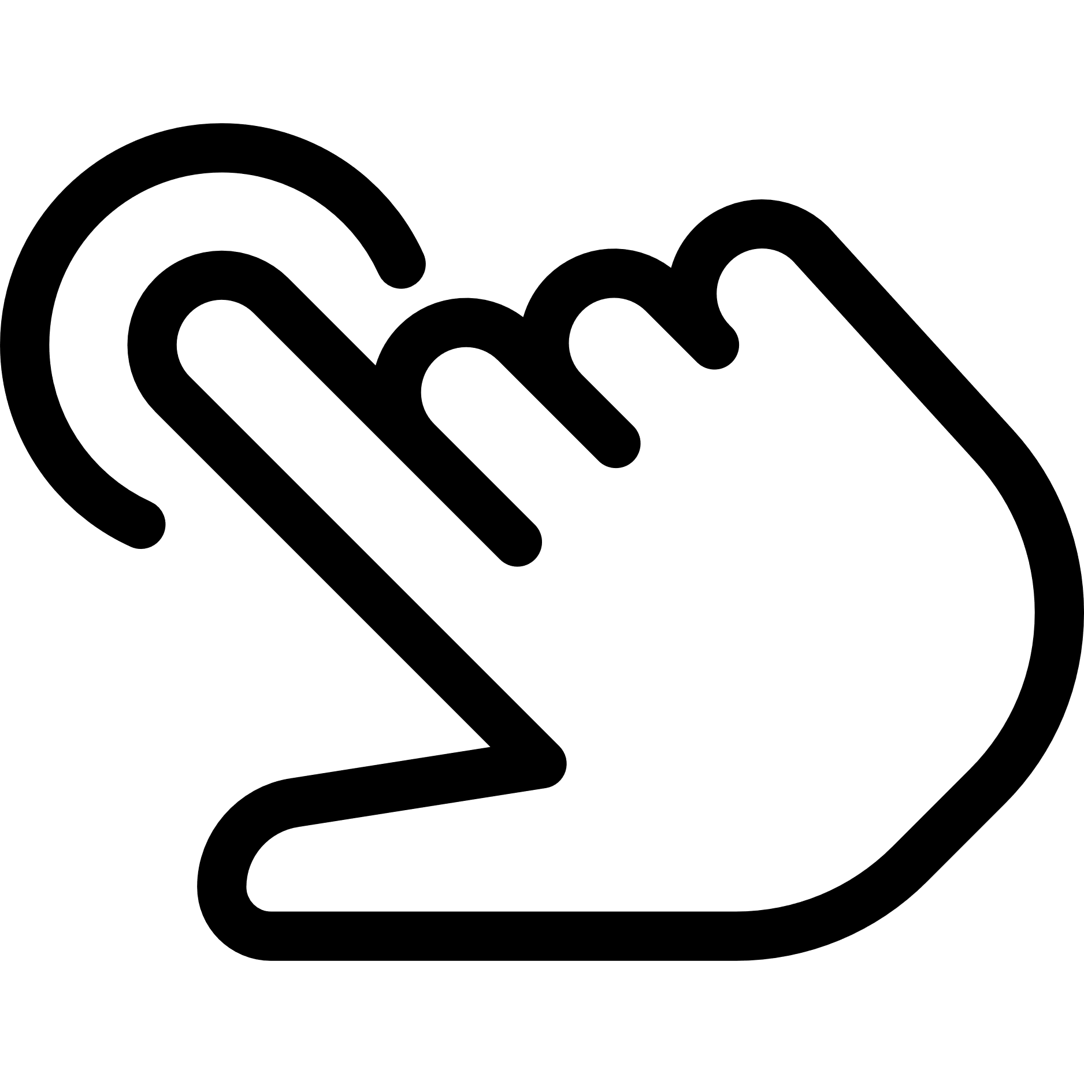
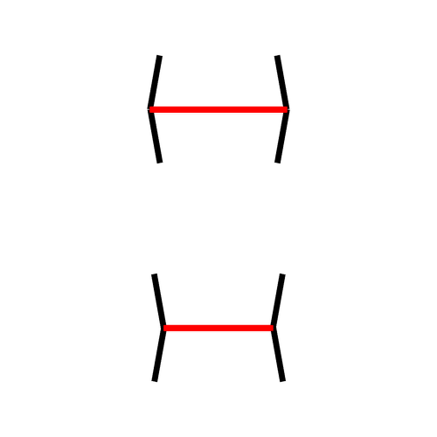
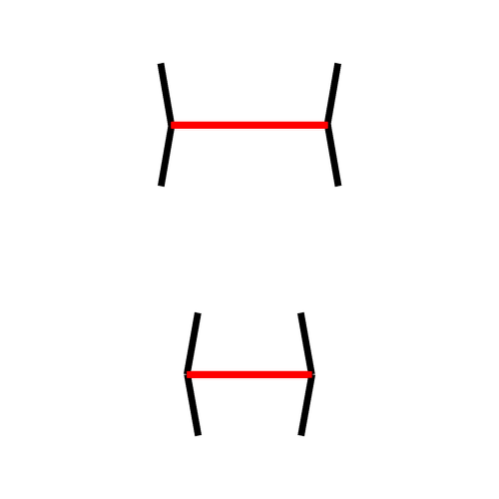
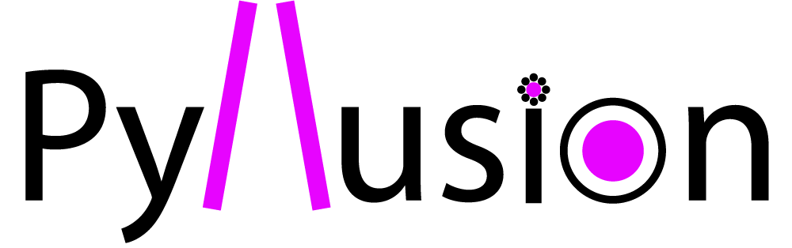
Parametric Framework for Visual Illusions
Example with the Müller-Lyer Illusion
The Müller-Lyer Illusion is traditionally presented as two segments (the red targets), which perception is biased by the context (the arrows). Here, the lower segment appears longer despite being of the same length.
In this illusion, the task difficulty corresponds to the difference between the lengths of the red target segments, and the illusion strength corresponds to the angle of the arrows. The illusion direction corresponds to the facilitating or impeding effect with regards to the task at hand.
Example of Stimuli
Illusion Direction: incongruent
(the illusion makes the task harder: red lines look more similar)
Illusion Direction: congruent
(the illusion makes the task easier: red lines look more different)
Task difficulty: easy
(top line is 2 times longer)
Illusion Strength: strong
(angle is sharp)
Task difficulty: hard
(top line is only 1.1 times longer)
Illusion Strength: weak
(angle is flat)
Task: For these stimuli, the correct response is always the « up » arrow, indicating the longer red segment. We measured the reaction time and the errors (in this case, the « down » arrow).
Stimuli created with the open-source software (Makowski et al., 2021)

Slide 2
Parametric Framework for Visual Illusions
Example with the Müller-Lyer Illusion
The Müller-Lyer Illusion is traditionally presented as two segments (the red targets), which perception is biased by the context (the arrows). Here, the lower segment appears longer despite being of the same length.
In this illusion, the task difficulty corresponds to the difference between the lengths of the red target segments, and the illusion strength corresponds to the angle of the arrows. The illusion direction corresponds to the facilitating or impeding effect with regards to the task at hand.
Example of Stimuli
Task difficulty: easy
(top line is 2 times longer)
Illusion Strength: strong
(angle is sharp)
Illusion Direction: incongruent
(the illusion makes the task harder: red lines look more similar)
Illusion Direction: congruent
(the illusion makes the task easier: red lines look more different)
Task difficulty: hard
(top line is only 1.1 times longer)
Illusion Strength: weak
(angle is flat)
Task: For these stimuli, the correct response is always the « up » arrow, indicating the longer red segment. We measured the reaction time and the errors (in this case, the « down » arrow).
Stimuli created with the open-source software (Makowski et al., 2021)

