Slide 1
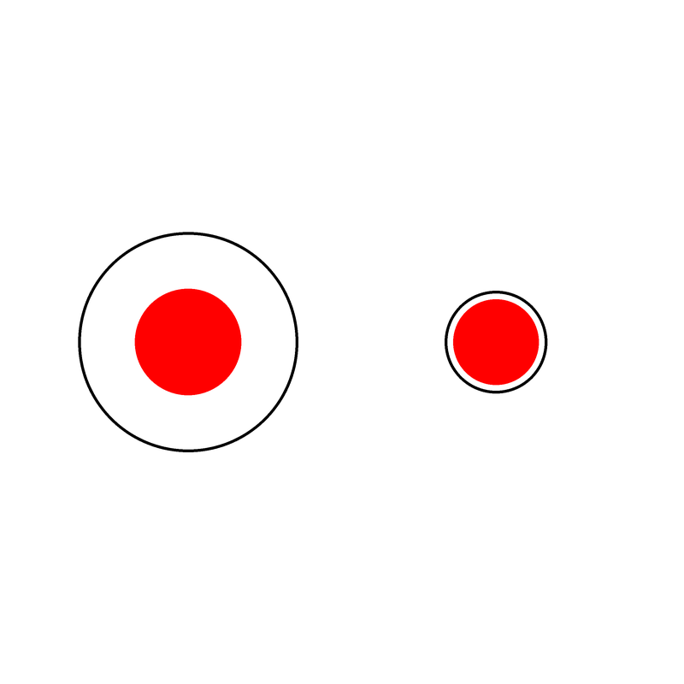


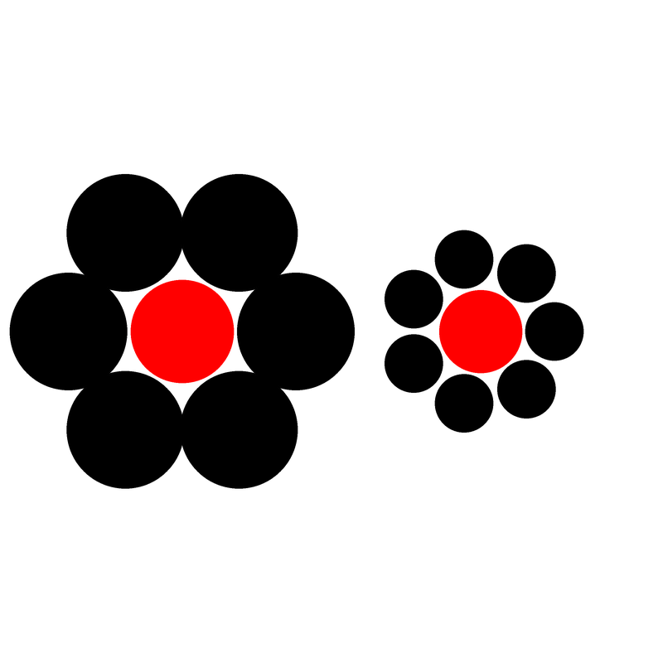
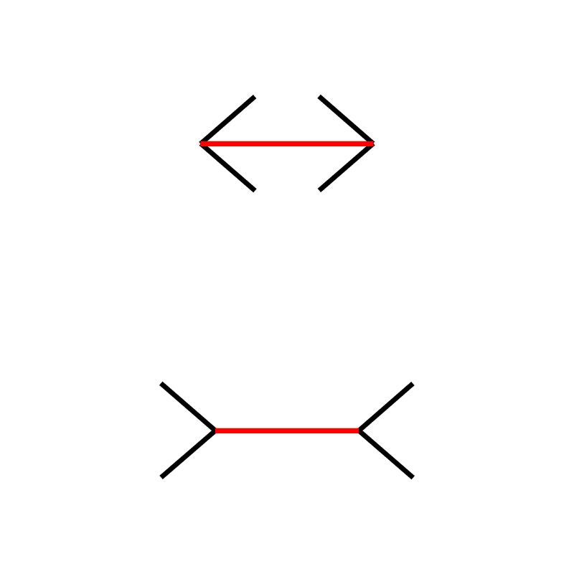
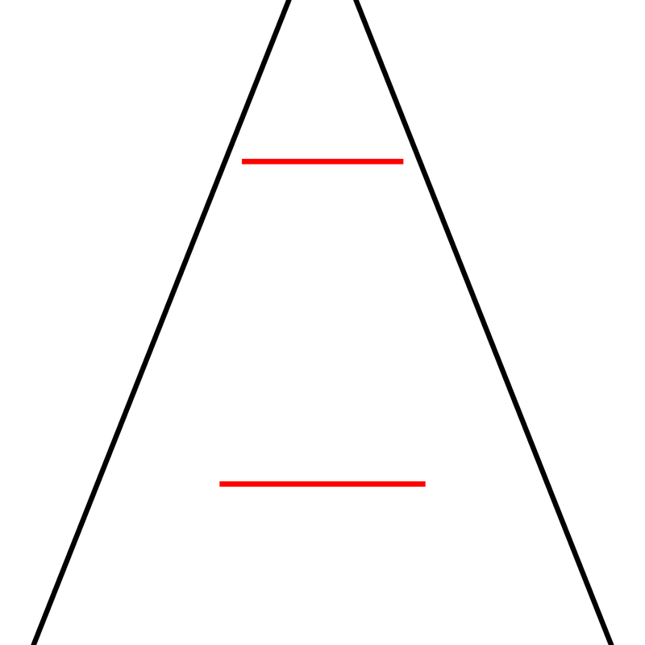
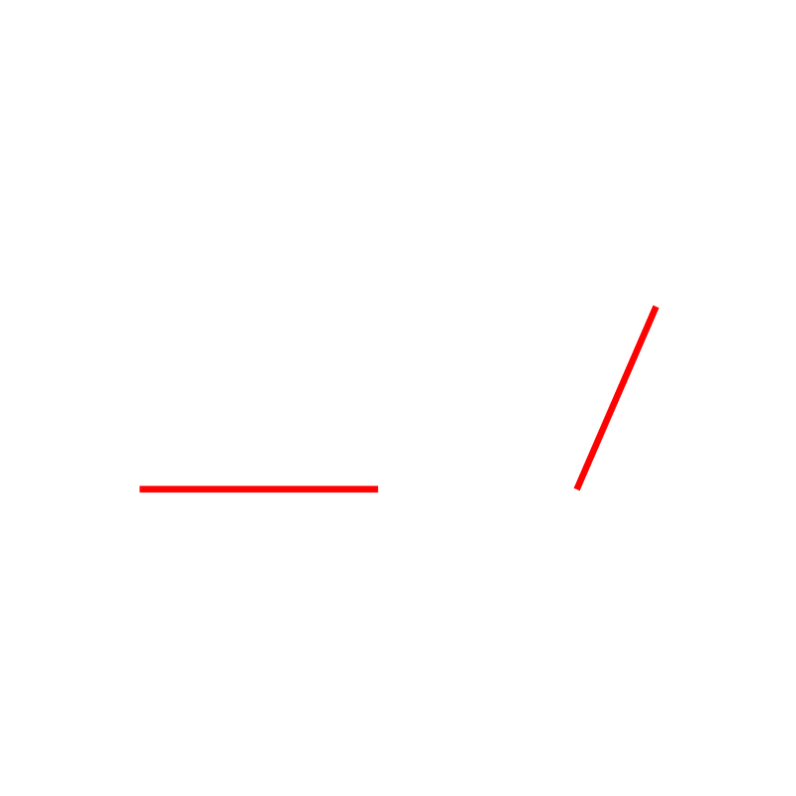
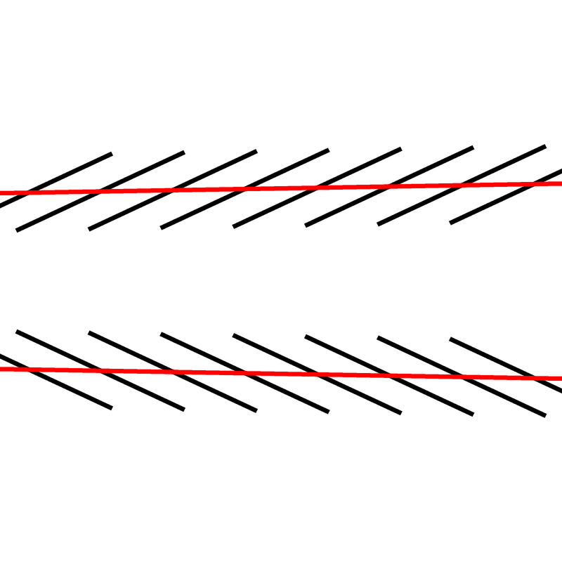
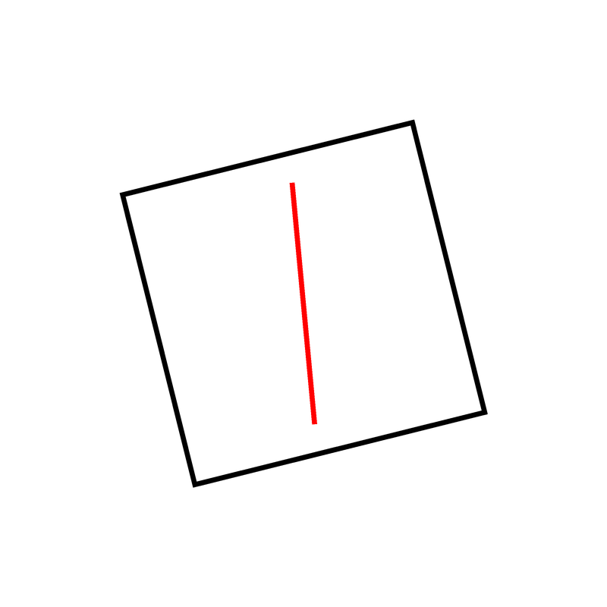
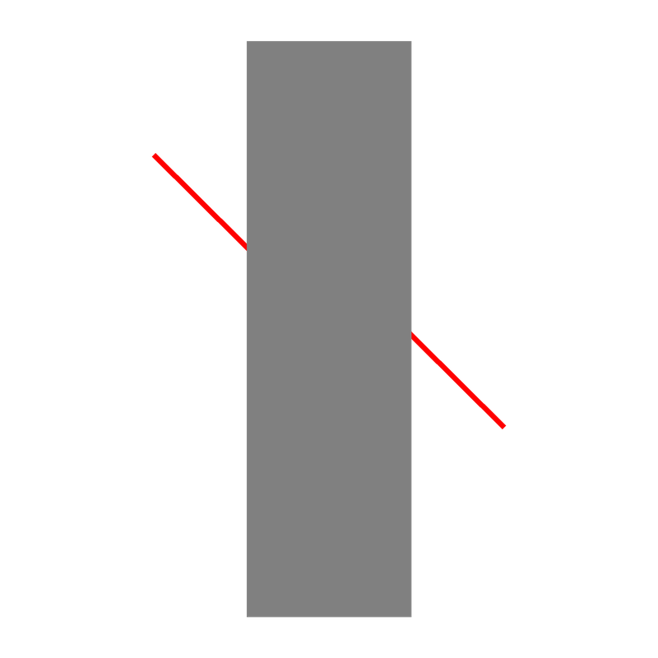
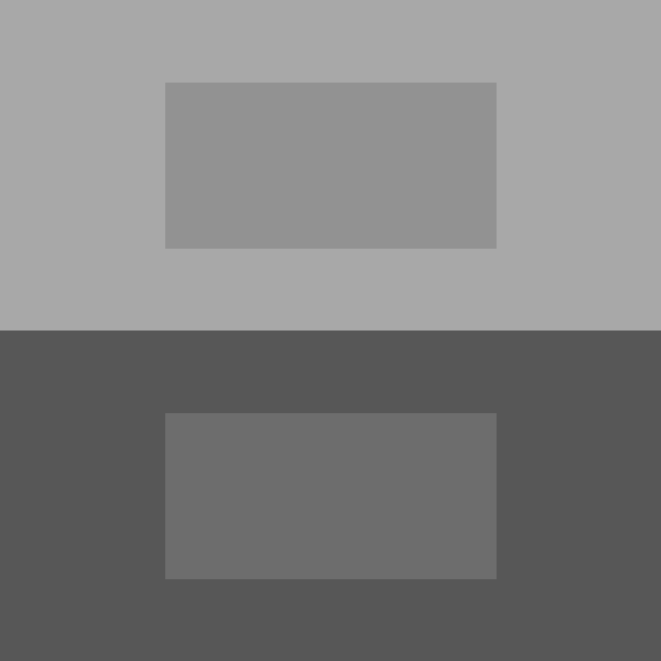

Illusion | Example | Task | Description
Delboeuf |  | Which red circle is bigger? | Two circles surrounded by outer rings. The circle with the closer outline appears larger than the one with the distant outline.
Ebbinghaus |  | Which red circle is bigger? | Two circles surrounded by other circles. The circle surrounded by smaller circles appears larger than the one with the larger surrounding circles.
Müller-Lyer |  | Which red line is longer? | Two segments that end with inwards/outwards pointing arrow-like fins. The line with inward-pointing fins is typically perceived to be longer.
Ponzo Illusion |  | Which red line is longer? | Composed of two equal-length parallel horizontal lines embedded between a pair of converging lines, the upper line is typically perceived to be longer.
Vertical-Horizontal |  | Which red line is longer? | Involves two equal-length line segments; one presented vertically and the other horizontally. The length of the vertical line is usually perceived to be longer, relative to that of the horizontal line
Zöllner |  | Which direction are the red lines converging towards? | Represented by two parallel horizontal lines crossed with short, repeated lines. The direction in which the repeated lines cross over the target parallel lines oppose one another, causing the target lines to appear not parallel.
Rod and Frame |  | Which direction is the red line leaning towards? | Consists of a vertical line segment ('rod') that is enclosed in a laterally tilted square ('frame'). The orientation of the line segment typically looks congruent with that of the frame
Poggendorff |  | Is the right line above or below the left line? | Characterized by an oblique collinear line that appears as two misaligned line segments separated by a rectangular structure, the upper line usually appears to be positioned higher than the point that would be collinear with the lower line.
Simultaneous Contrast |  | Which small rectangle is lighter? | Consists of two identical grey rectangles embedded in backgrounds of different color intensities. The rectangle on the dark background usually appears lighter than the rectangle on the light background.
White |  | Which vertical rectangle is lighter? | Composed of a series of black and white horizontal bars superimposed with identical grey rectangles. Rectangles that have been superimposed onto white bars typically appear darker than those superimposed onto black bars

