Slide 1
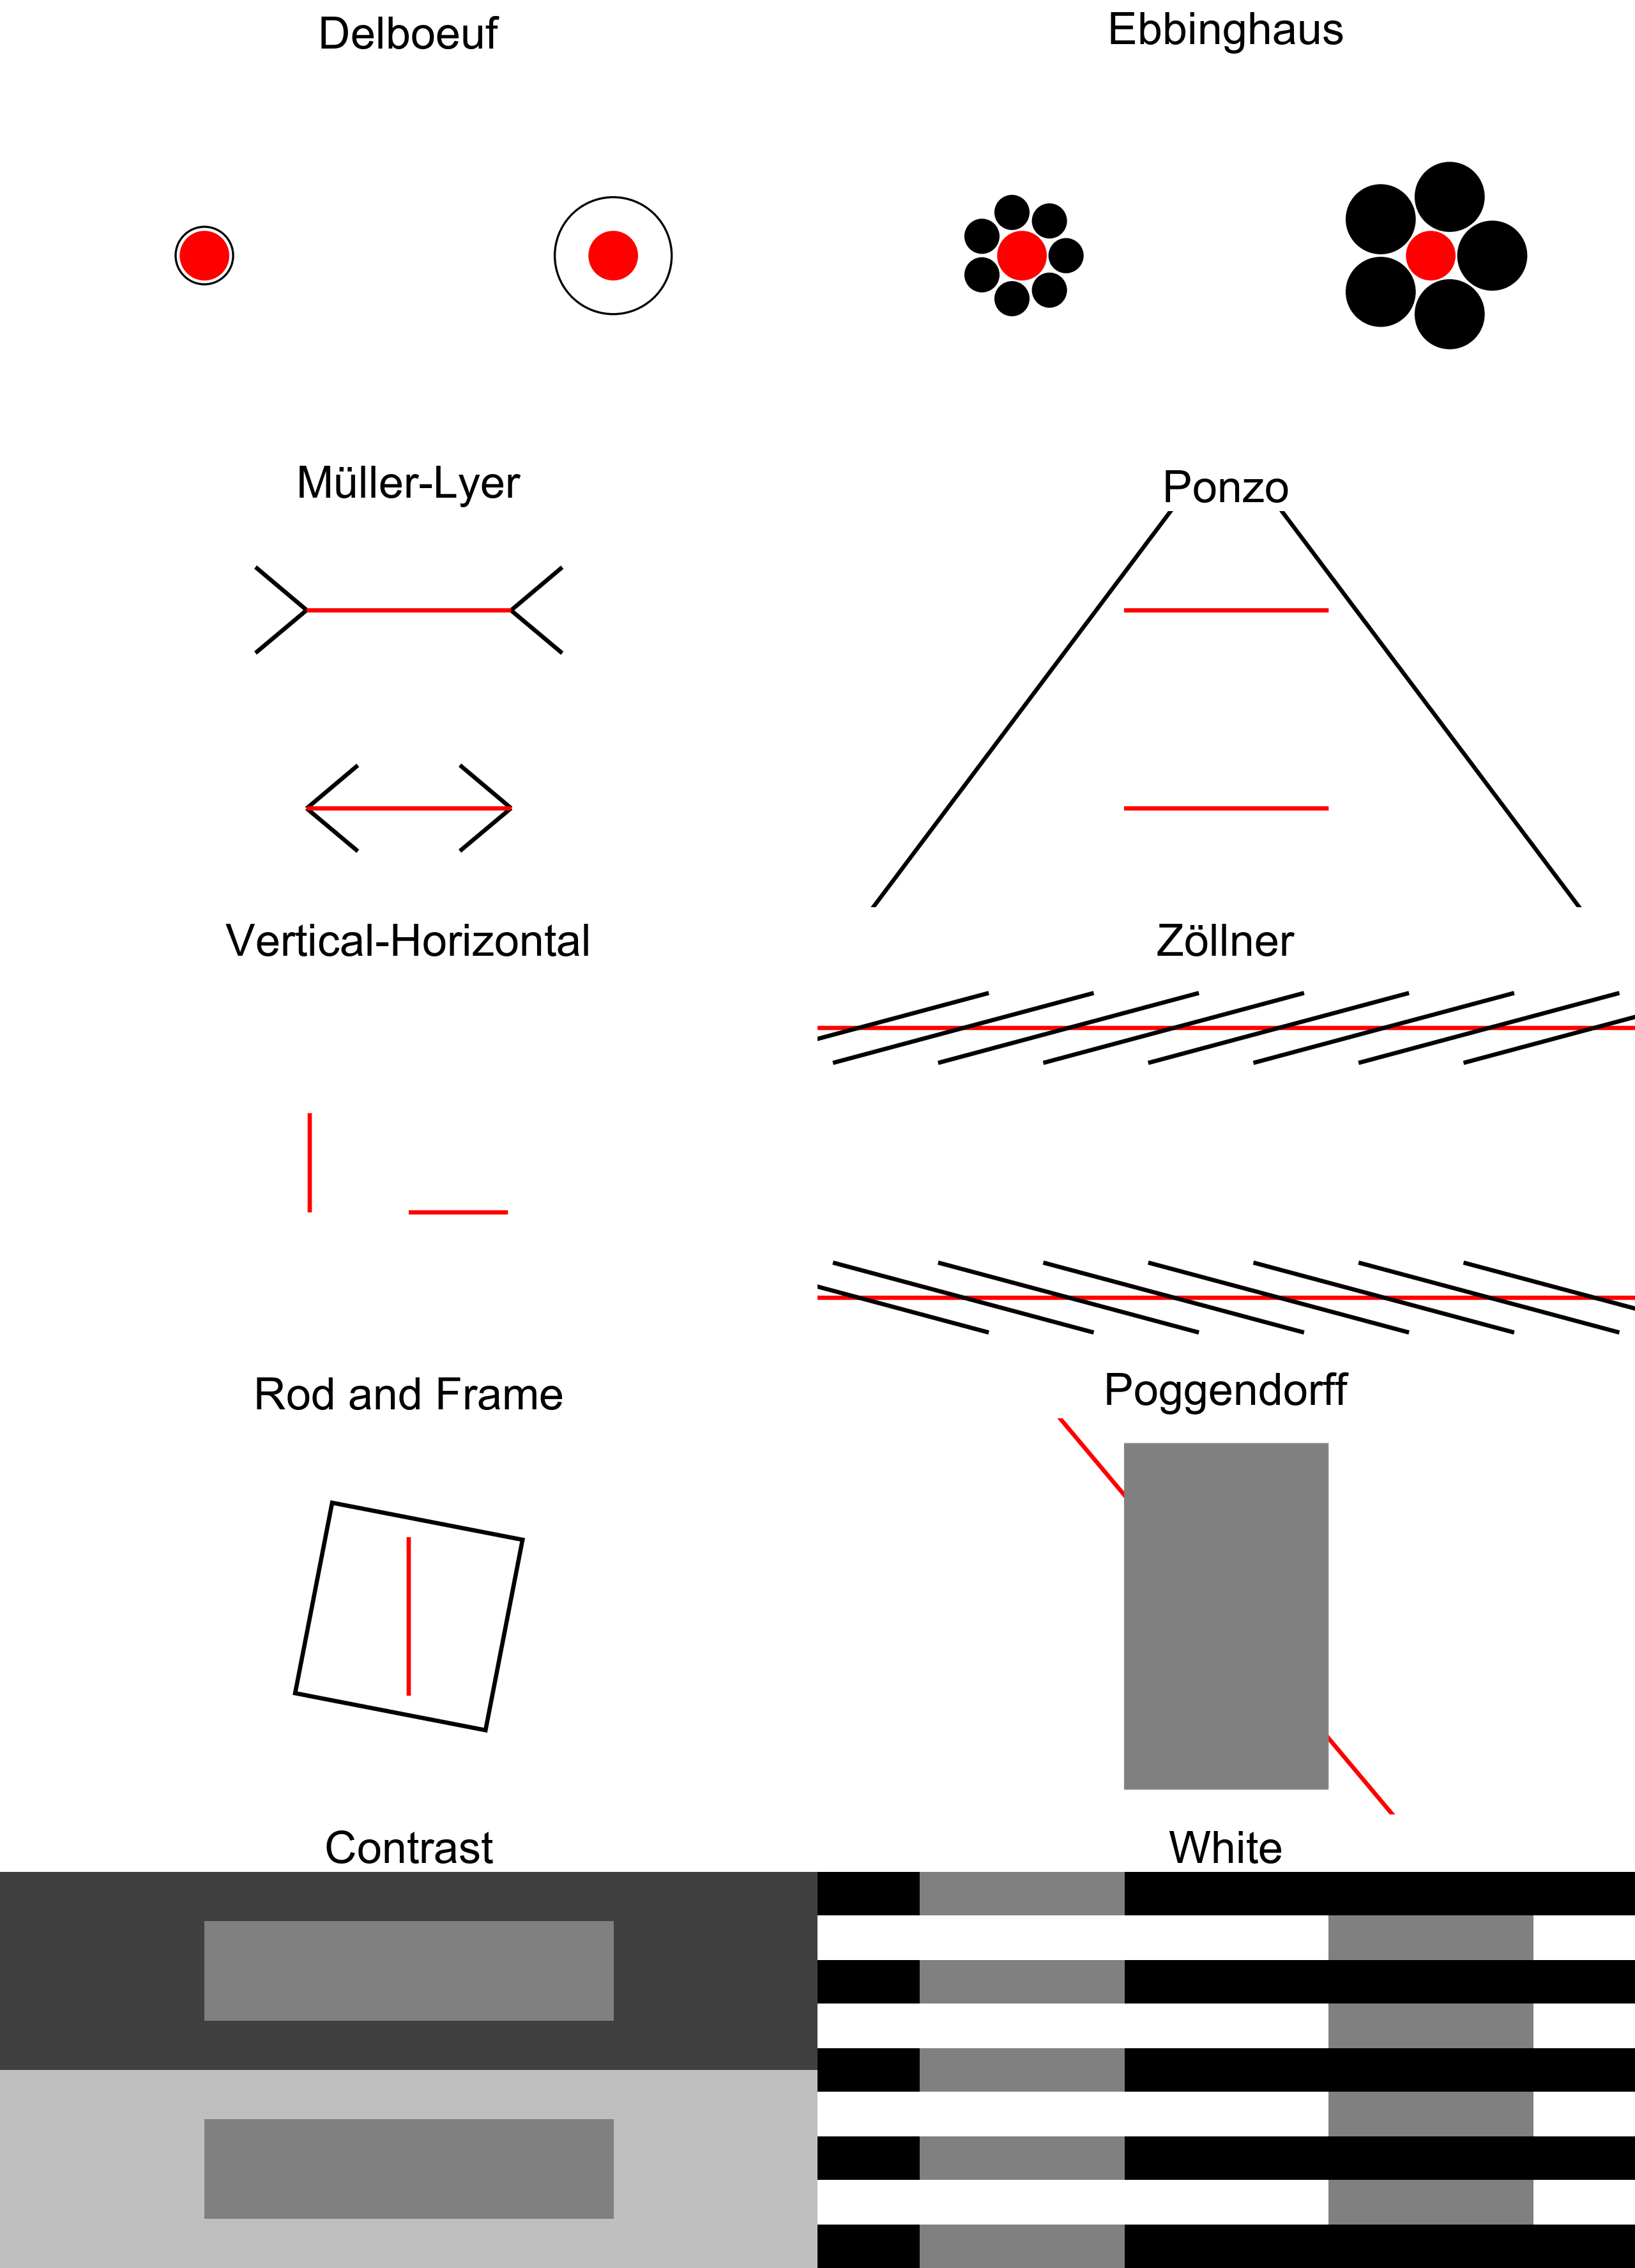







Illusion | Example | Task Question | Description
Delboeuf Illusion |  | Which red circle is bigger? | Represented by two identical-sized placed near each other; each surrounded by an outer ring. The central circle with the closer surrounding ring appears smaller than that with the distant surrounding ring.
Ebbinghaus Illusion |  | Which red circle is bigger? | Comprised of two identical-sized circles placed near each other, one circle is usually surrounded by smaller circles, while the other is surrounded by larger circles. The latter circle usually appears smaller than the former.
Müller-Lyer Illusion |  | Which red line is longer? | Represented by two equal-length line segments that end with inwards/outwards pointing arrow-like fins. The line with inward-pointing fins is typically perceived to be longer.
Ponzo Illusion |  | Which red line is longer? | Composed of two equal-length parallel horizontal lines embedded between a pair of converging lines, the upper line is typically perceived to be longer.
Vertical-Horizontal Illusion |  | Which red line is longer? | Involves two equal-length line segments; one presented vertically and the other horizontally. The length of the vertical line is usually perceived to be longer, relative to that of the horizontal line
Zöllner Illusion |  | Which direction are the red lines converging towards? | Represented by two parallel horizontal lines crossed with short, repeated lines. The direction in which the repeated lines cross over the target parallel lines oppose one another, causing the target lines to appear not parallel.
Rod and Frame Illusion |  | Which direction is the red line leaning towards? | Consists of a vertical line segment ('rod') that is enclosed in a laterally tilted square ('frame'). The orientation of the line segment typically looks congruent with that of the frame
Poggendorff Illusion |  | Which direction is the red line pointing? | Characterized by an oblique collinear line that appears as two misaligned line segments separated by a rectangular structure, the upper line usually appears to be positioned higher than the point that would be collinear with the lower line.
Simultaneous Contrast Illusion |  | Which grey rectangle is lighter? | Consists of two identical grey rectangles embedded in backgrounds of different color intensities. The rectangle on the dark background usually appears lighter than the rectangle on the light background.
White Illusion |  | Which grey rectangle is lighter? | Composed of a series of black and white horizontal bars superimposed with identical grey rectangles. Rectangles that have been superimposed onto white bars typically appear darker than those superimposed onto black bars

