Slide 1


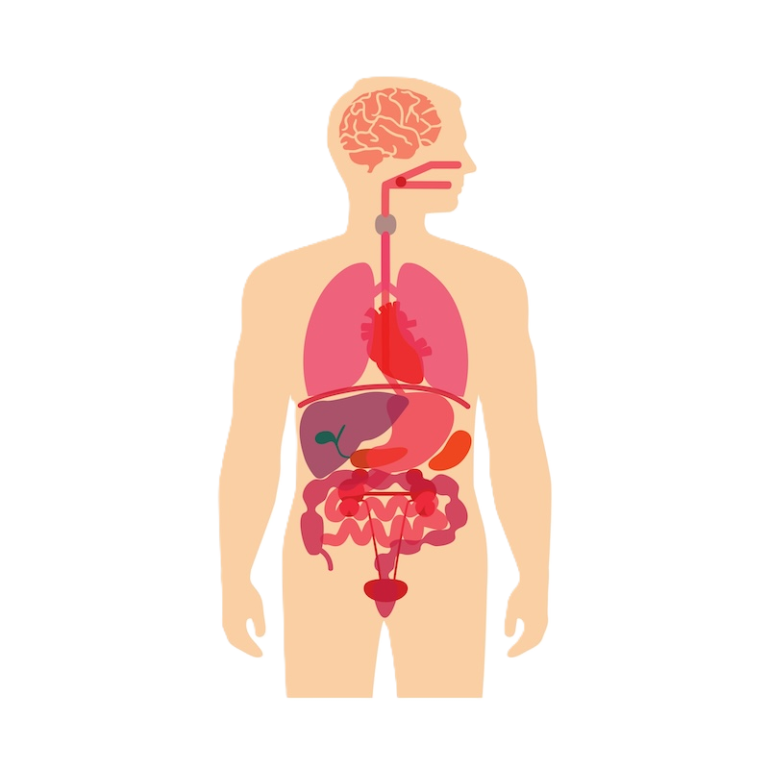
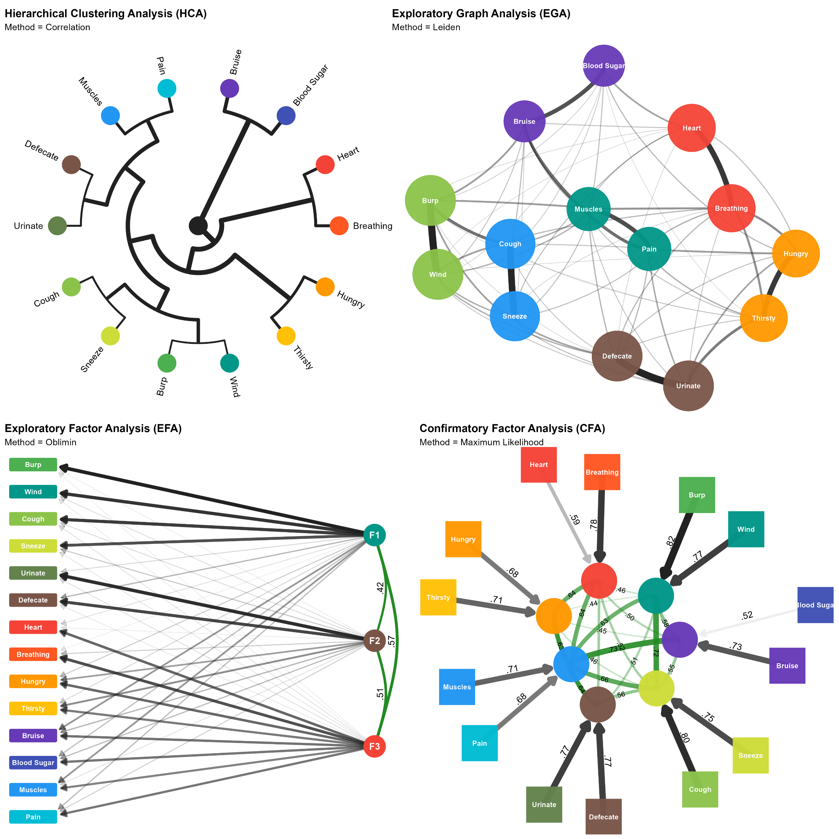
Mega-analysis of the Interoceptive Accuracy Scale (IAS) Structure and its Dispositional Correlates
Ana Neves , Magdalena Pfaff, Robyn Scharte , Raquel Nogueira-Arjona, Giulia L. Poerio, and Dominique Makowski
N > 33,000
Interoception | Mood | Psychopathological & Neurodevelopmental Traits | Personality
 |  |  | Consc | Open | Extra | Agree | Neuro | Hon-Hum
Cough / Sneeze
Bruise / Blood Sugar
Breathing / Heart
Hungry / Thirsty
Wind / Burp
Urinate / Defecate
Muscles / Pain
Study 1
Study 2
Cross-validated analysis suggests a 14-item, 7-pair structure to be optimal
IAS reflects correlated yet distinct domains, not a unidimensional scale
IAS positively links to adaptive traits, and negatively to maladaptive traits
Self-perceived interoceptive ability is differentiated across distinct bodily system
Calls for the development of novel, context-sensitive, and multi-dimensional, interoception measures

