Slide 1


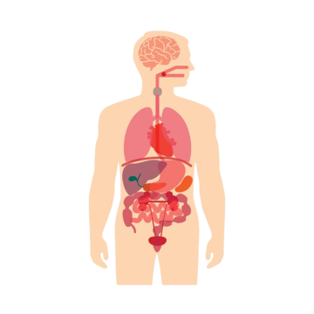
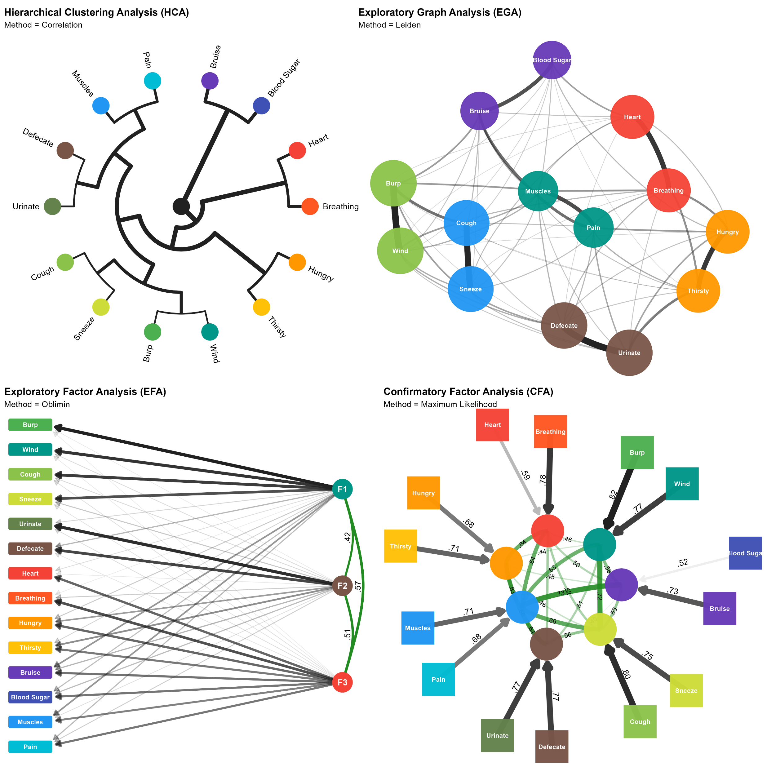
Mega-analysis of the Interoceptive Accuracy Scale (IAS)
Structure and its Dispositional Correlates
Cough / Sneeze
Interoception
Interoception Deficits
Mood
Psychopathological & Neurodevelopmental
Personality
Beliefs
Breathing / Heart
Bruise / Blood Sugar
Hungry / Thirsty
Wind / Burp
Urinate / Defecate
Muscles / Pain

Slide 2
 | ORIGNAL | HINGRY / TRURSTY | BRUISE / BLOOD SUGAR | MUSCLES / PAIN | COUGH / SNEEZE | WIND / BURP | BREATHING / HEART | URINATE / DEFECATE
Interoception
Interoceptive Deficits
Depression
Anxiety
Psychopathological Traits
Neurodevelopmental Traits
Personality
Beliefs

