Slide 1
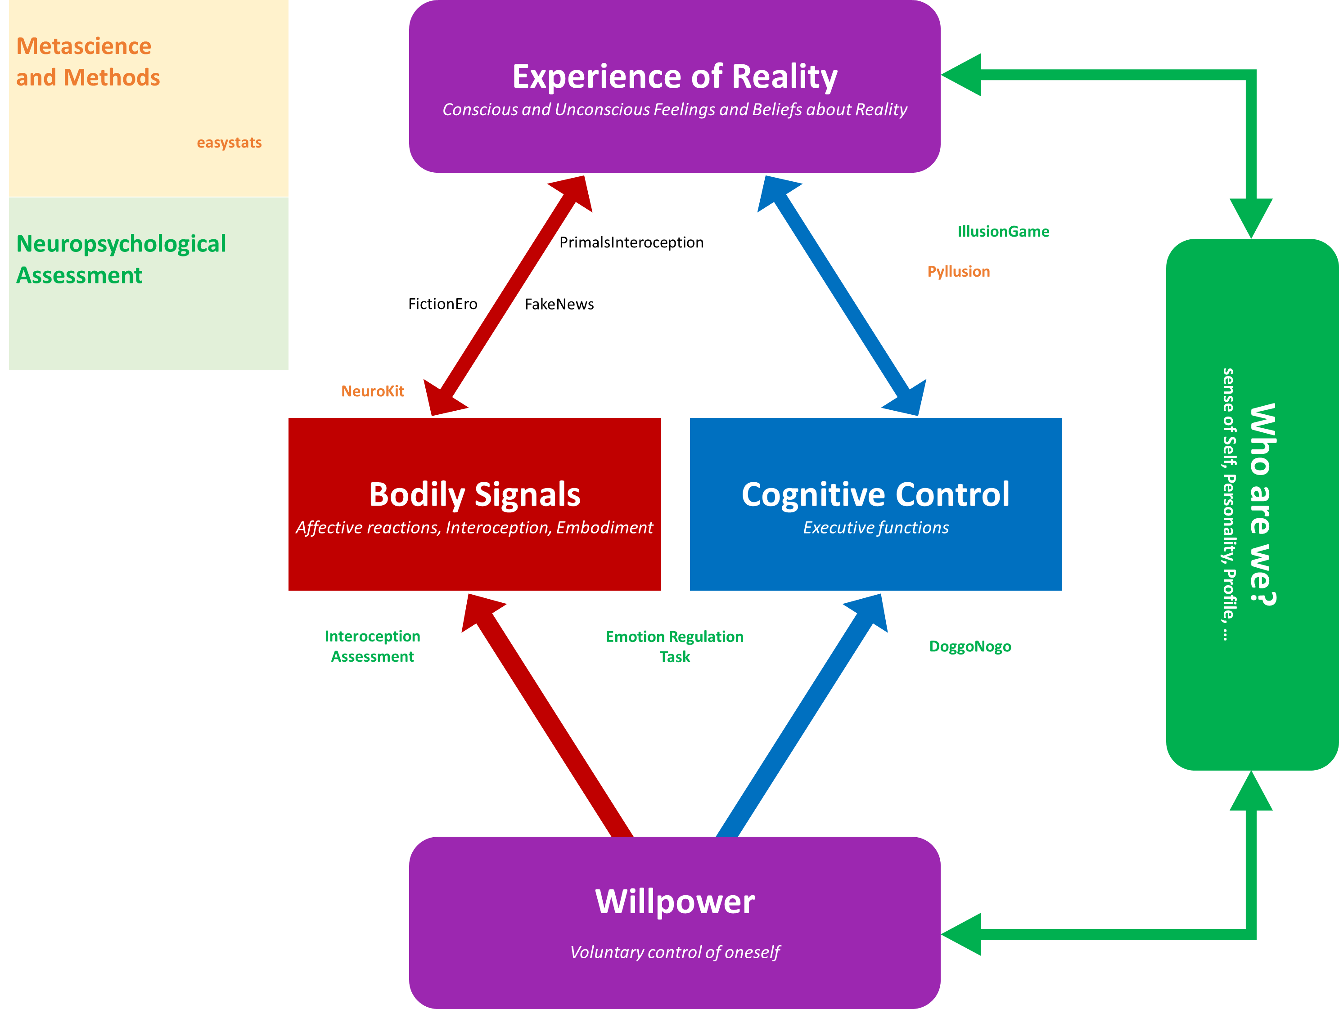


Slide 2
PrimalsInteroception
Goal
Test the link between interoceptive abilities and primal world beliefs
Method
Questionnaire of Primal World Beliefs (PI-99)
Interoceptive Battery

Slide 3
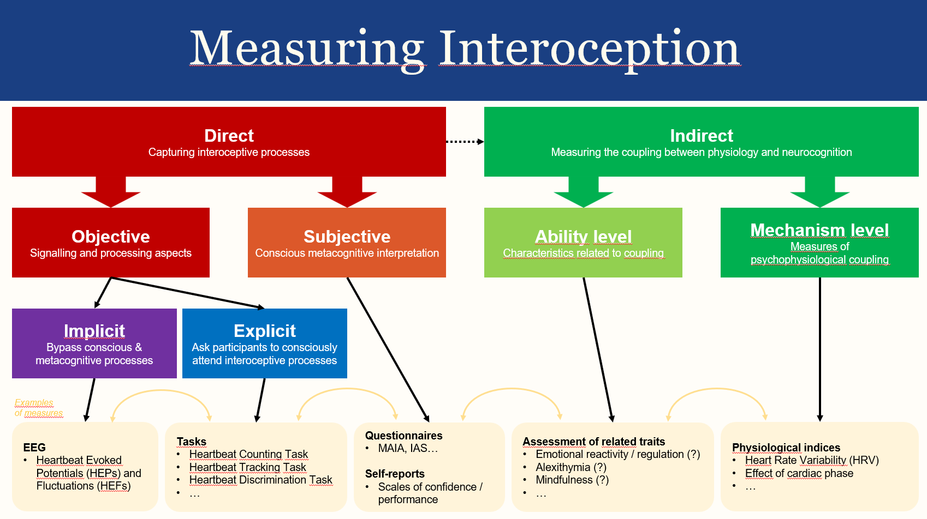
CODENAME:
Brief Assessment of Interoception in Neuropsychology (BrAIN)
Comprehensive Interoceptive Assessment (CIA)
…
Goal
Long term: Develop an interoception ability assessment paradigm for potential usage in clinical neuropsychology
Reliable
Cheap & « Portable »
Implicit and Explicit
Objective and Subjective
Short term: understand the relationship accross various indices related to interoception
Method
Resting State
« Tapping »
Rythmic (default, slow, fast)
Random
Heartbeat tracking
Heartbeat Counting Task
Questionnaires
MAIA-2
IAS

Slide 4
Subproject 1: Subjective Measure - IAS revalidation

Slide 5
Subproject 2: Implicit Measure - Tapping Task

Slide 6
Subproject 3: Implicit Measure - HEP

