Slide 1



Experience of Reality
Conscious and Unconscious Feelings and Beliefs about Reality
PrimalsInteroception
IllusionGame
FictionEro
Pyllusion
FakeNews
Metascience
Methods
Improving science
Developping tools
Context
History
Philosophy of science
Avengers
Neuropsychological Profile
Who are we?
Sense of Self
Core Personality
…
How to measure it?
Psychometry
Clinical applications
…
NeuroKit
Bodily Signals
Affective reactions,
Interoception, Embodiment
Cognitive Control
Executive functions
Interoception Assessment
Emotion Regulation Task
DoggoNogo
Willpower
Voluntary control of oneself

Slide 2
PrimalsInteroception
Goal
Test the link between interoceptive abilities and primal world beliefs
Method
Questionnaire of Primal World Beliefs (PI-99)
Interoceptive Battery

Slide 3
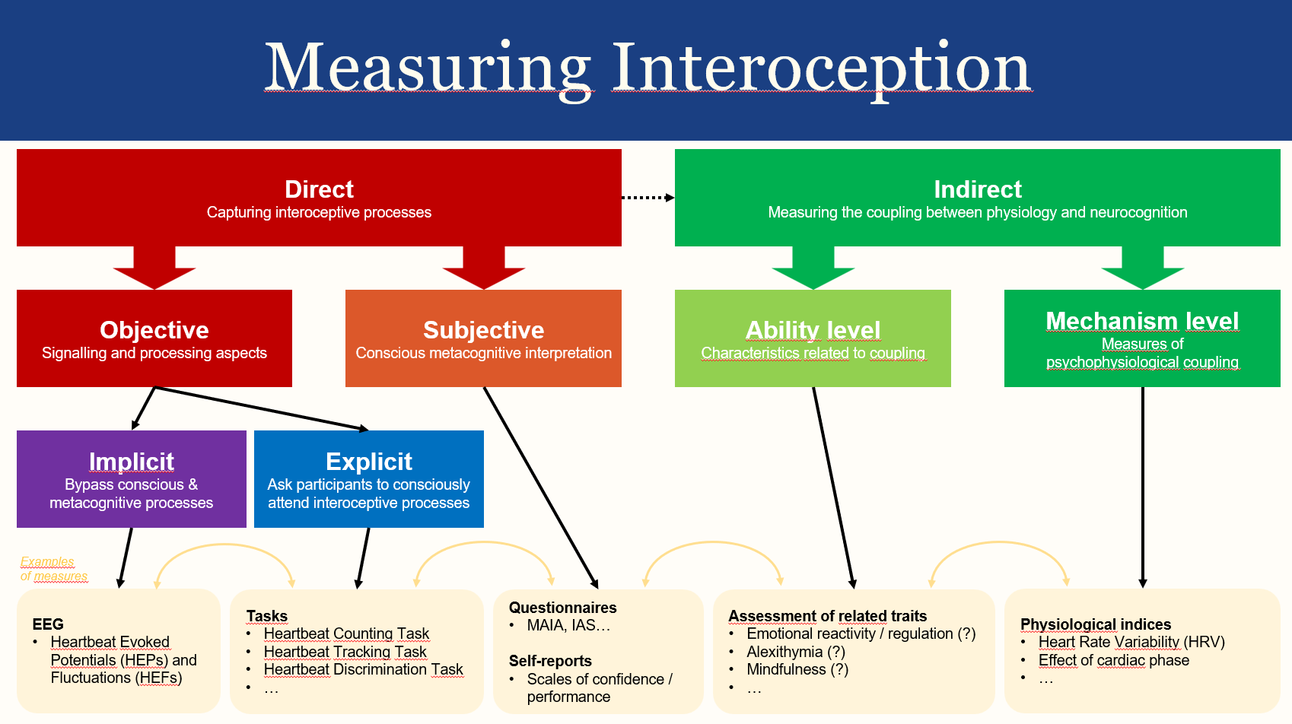
CODENAME:
Brief Assessment of Interoception in Neuropsychology (BrAIN)
Comprehensive Interoceptive Assessment (CIA)
…
Goal
Long term: Develop an interoception ability assessment paradigm for potential usage in clinical neuropsychology
Reliable
Cheap & « Portable »
Implicit and Explicit
Objective and Subjective
Short term: understand the relationship accross various indices related to interoception
Method
Resting State
« Tapping »
Rythmic (default, slow, fast)
Random
Heartbeat tracking
Heartbeat Counting Task
Questionnaires
MAIA-2
IAS

Slide 4
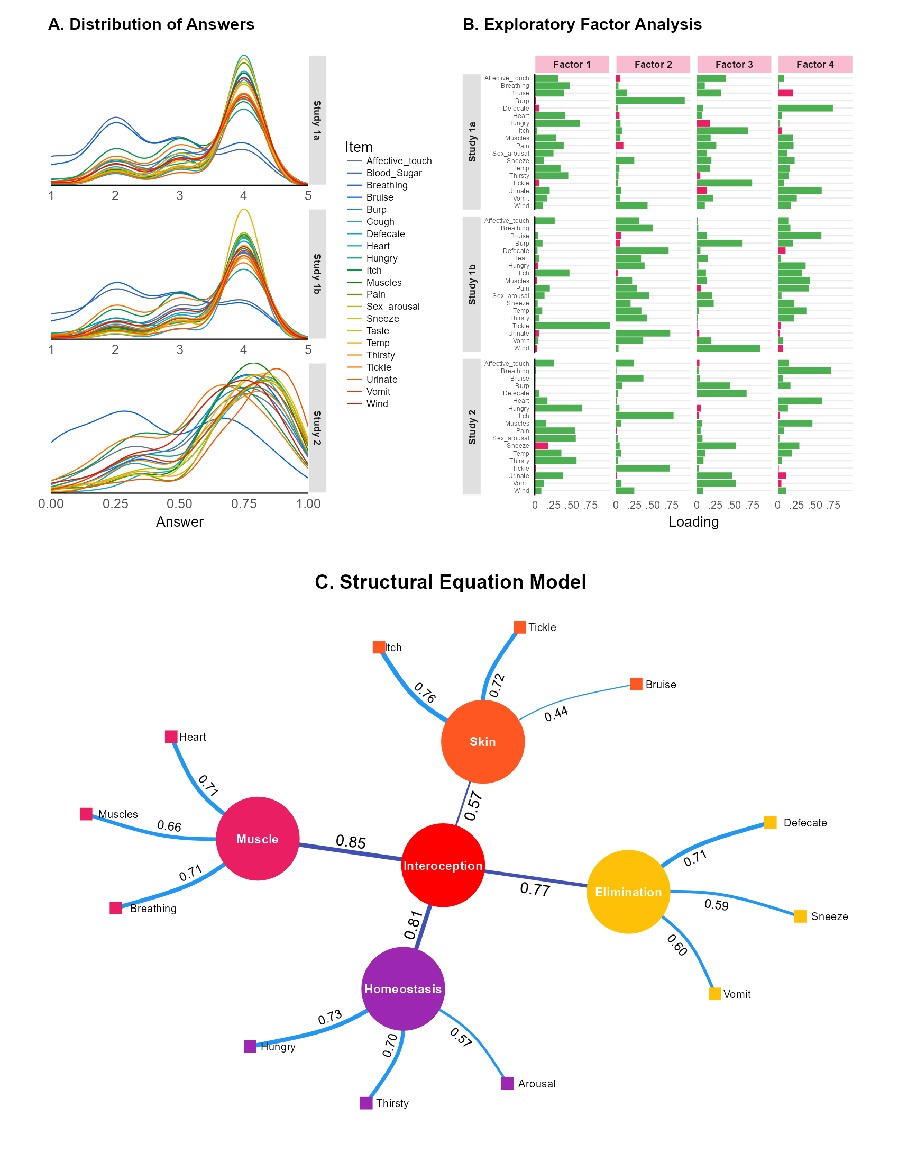
Subproject 1: Subjective Measure - IAS revalidation
(Re)validating IAS questionnaire
Long term question: can we measure interoception via questionnaires?

Slide 5
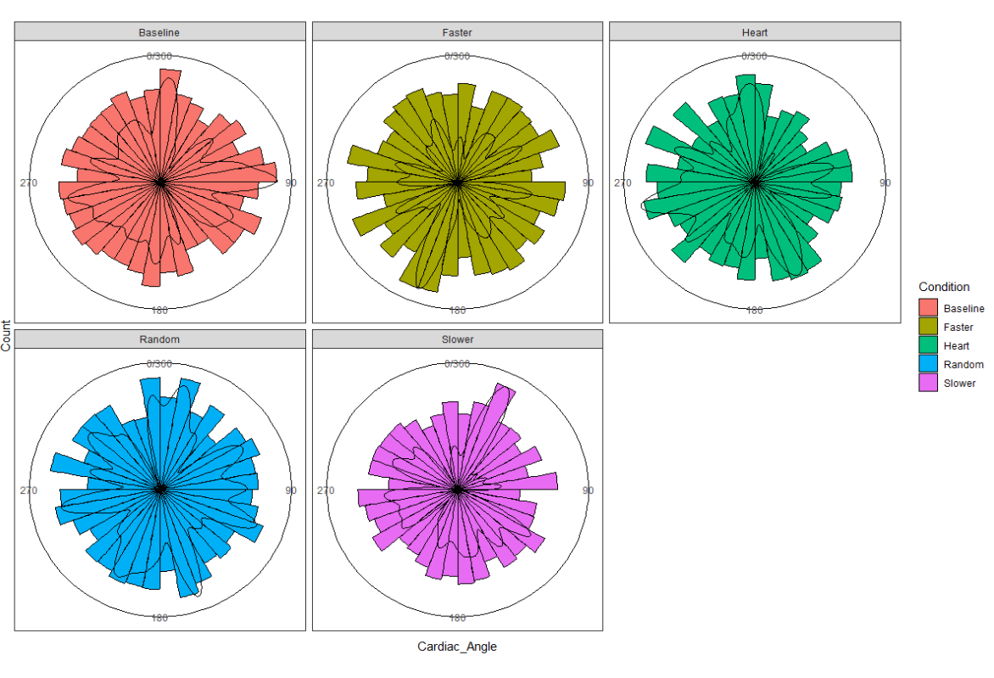
Subproject 2: Implicit Measure - Tapping Task
Is tapping rythm related to bodily signals?
Is the strength of association related to interoceptive abilities?

Slide 6
Subproject 3: Implicit Measure - HEP
Can we measure interoception in the brain using portable devices?

