Slide 1
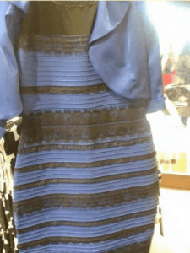
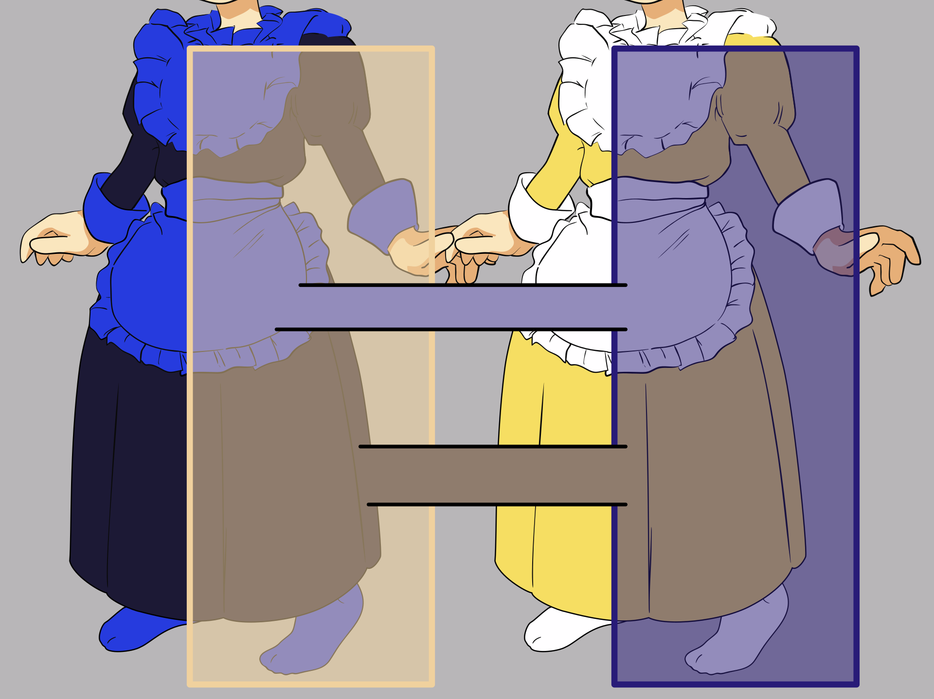

Slide 2
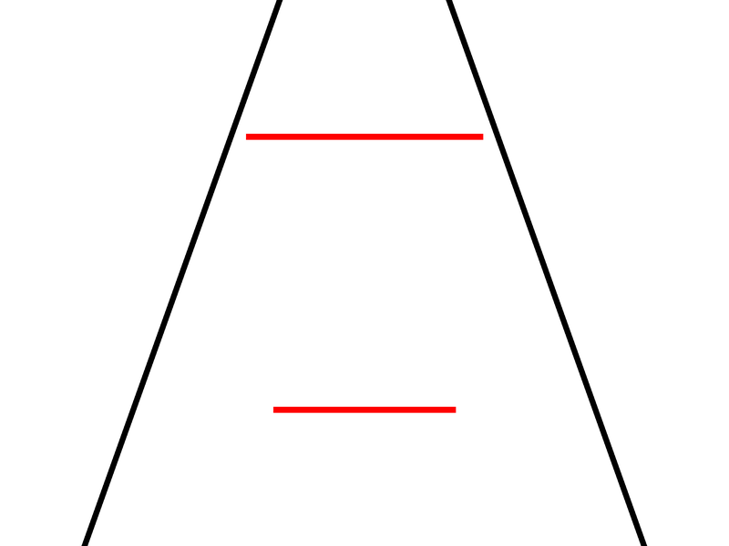
Parameters
Render
1
Illusion strength = -15
Objective difference = 0.3
Size of the smallest rod = 0.5
Color of the target = red
Color of the distractor = black
…
0.5
0
-0.5
-1
-1
-0.5
0
0.5
1

Slide 3
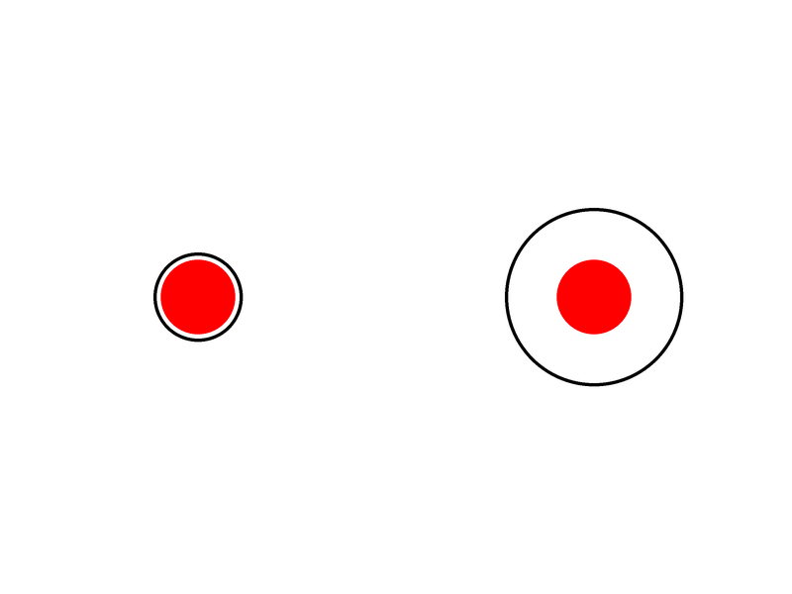
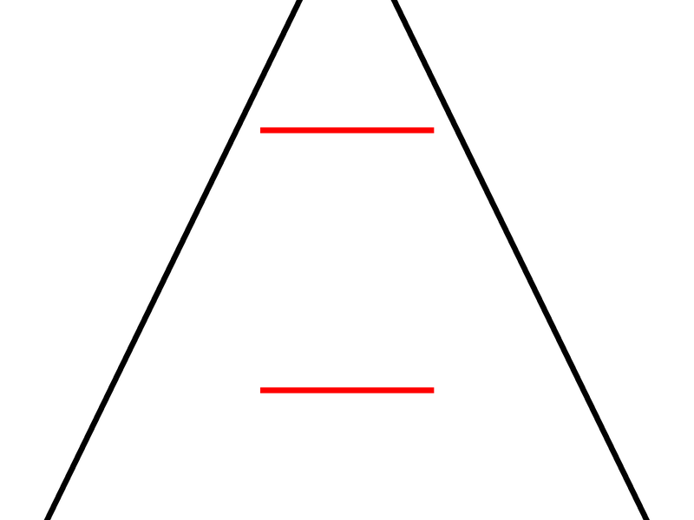
 | Delboeuf Illusion | Ponzo Illusion
Illusion strength | Manipulated by the area of outer circles | Manipulated by the angle of distractor lines i.e., non-horizontal lines
Achieved biased perception | The inner circle that has a smaller surrounding outer circle looks bigger than the inner circle that has a larger surrounding circle | The upper horizontal line looks longer than the bottom horizontal line as it appears to be “in the background”
Output

