Slide 1

Reactive Microservices in AWS

Slide 2

What is a reactive system?
Reactive Manifesto
Responsive
Resilient
Elastic
Message Driven
Notes:
https://www.reactivemanifesto.org/
Responsive: The system responds in a timely manner if at all possible. Responsiveness is the cornerstone of usability and utility, but more than that, responsiveness means that problems may be detected quickly and dealt with effectively. Responsive systems focus on providing rapid and consistent response times, establishing reliable upper bounds so they deliver a consistent quality of service. This consistent behaviour in turn simplifies error handling, builds end user confidence, and encourages further interaction.
Resilient: The system stays responsive in the face of failure. This applies not only to highly-available, mission-critical systems — any system that is not resilient will be unresponsive after a failure. Resilience is achieved by replication, containment, isolation and delegation. Failures are contained within each component, isolating components from each other and thereby ensuring that parts of the system can fail and recover without compromising the system as a whole. Recovery of each component is delegated to another (external) component and high-availability is ensured by replication where necessary. The client of a component is not burdened with handling its failures.
Elastic: The system stays responsive under varying workload. Reactive Systems can react to changes in the input rate by increasing or decreasing the resources allocated to service these inputs. This implies designs that have no contention points or central bottlenecks, resulting in the ability to shard or replicate components and distribute inputs among them. Reactive Systems support predictive, as well as Reactive, scaling algorithms by providing relevant live performance measures. They achieve elasticity in a cost-effective way on commodity hardware and software platforms.
Message Driven: Reactive Systems rely on asynchronous message-passingto establish a boundary between components that ensures loose coupling, isolation and location transparency. This boundary also provides the means to delegate failures as messages. Employing explicit message-passing enables load management, elasticity, and flow control by shaping and monitoring the message queues in the system and applying back-pressurewhen necessary. Location transparent messaging as a means of communication makes it possible for the management of failure to work with the same constructs and semantics across a cluster or within a single host. Non-blocking communication allows recipients to only consume resources while active, leading to less system overhead.

Slide 3
Why are these features important?
Responsive
System should behave consistently
System should return quickly
Builds user confidence
Not just front end

Slide 4

Why are these features important?
Resilient
Self healing
Blue-green deployments
Canary deployments
Design for failure
Degrade gracefully
Notes:
Where possible automate handling of failures, nobody want to be woken up at 2 AM to follow a script that can be automated.
Tired people make mistakes.
Where possible we can handle thing automatically
e.g. if an application crashes, capture logs and spin up a new instance to replace it
e.g. if we deploy a new version of a service and see a spike in errors we should roll back to previous version automatically
With blue green deployments you can move traffic over gradually comparing services, monitoring response time and roll back if degrades
Canary deployments to test new features in a limited environment
E.g. Netflix handled an outage of an entire AWS region when S3 with an availability of 99.99% went down
Moved traffic to another region and moved on with impact to customer of increased latency.
We prepared as they regularly test for such events and have designed application to handle failure.
Other service providers were down for hours
https://www.networkworld.com/article/3178076/why-netflix-didnt-sink-when-amazon-s3-went-down.html
Failure design patterns
Bulkheads, Circuit breaker, supervision
Often degrading is a business decision but this can

Slide 5
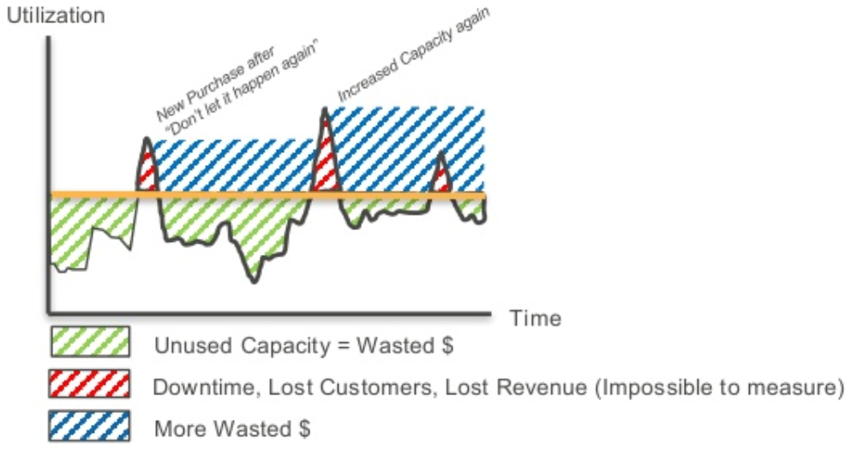
Why are these features important?
Elastic
Customers bring in revenue
Scale with use of service
Scaling up has limits
Design to scale horizontally
Notes:
Assuming with increased customer demand for you services you are going to increase revenue.
Therefore you want to scale your system in response to demand.
This requires effort in performance testing, capacity planning etc.
What happens if you get your guesses wrong? Outages and lost customers or unused capacity.
To do that traditionally you can scale up a server, gives it more RAM, faster CPU, Faster GPU, more storage etc.
Gets expensive fast and takes time to scale server. E.g. top of the range xeon processor is >£9000 What happens if that still isn’t good enough?
Scaling horizontally is cheaper, can have many small servers for the price.
Design principles to scale horizontally
Stateless
Shared nothing
Data partition
What happens when demand dips? Left with servers to pay for.

Slide 6
Why are these features important?
Message driven
Decouples services
Allows for easy scaling
Allows for failure by buffering
Can provide back pressure
Notes:
Senders and receivers don’t need to know abut each other. One service can complete its processing and post a message on queue, there can be one or more consumers of this messages but sender doesn’t need to concern itself with them.
To use a direct http webservice, the sender needs to know a destination and a schema, wait for a response and handle failures of a service outside of its domain.
What happens if the receiver is unavailable for a long time, if hold processing results and keep retrying this increases loads on the service which may cause failures and thus failures can cascade.
To add a new consumer of a services processing a change to the application is required which can introduce defects and increase size of application for no extra business value.
With a message driven system a new consumer can be added transparently.
Decoupling services allows for scaling and versioning independently of each other
Different services will have different needs e.g. memory intensive, CPU intensive IO intensive, can be deployed on hardware suited can be moved around as needed
Easy scalability, can add another consumer if queue depth gets too big
Can buffer up events that occurs while a system was down for processing
Can use the queue depth to tell the producing system to slow down

Slide 7
How does cloud help?
Elastic compute
Provisioned by demand
Pay for what you use
Set maximum price for job
Infrastructure as code
Many server configurations
Provision performance levels
Notes:
Can scale up system automatically based on demand metrics (CPU usage, memory usage. queue depth) in seconds and scale back down when not needed.
Linux charged per second, windows per hours
Also can do spot or reserved instances to further reduce costs, allows you to run jobs that are uneconomic at on demand prices e.g. GPU instances are expensive, could run a model training job only when below a certain price
EC2 has lots of instance types for different types of load e.g. CPU optimized, memory optimized, storage optimized, GPU attached.
Costs of having all these different server types are spread across multiple customers so much lower cost that having under utilized servers in your own DC
https://aws.amazon.com/ec2/instance-types/
Can change server type when workload changes with just a config change
Concepts also apply to DB

Slide 8
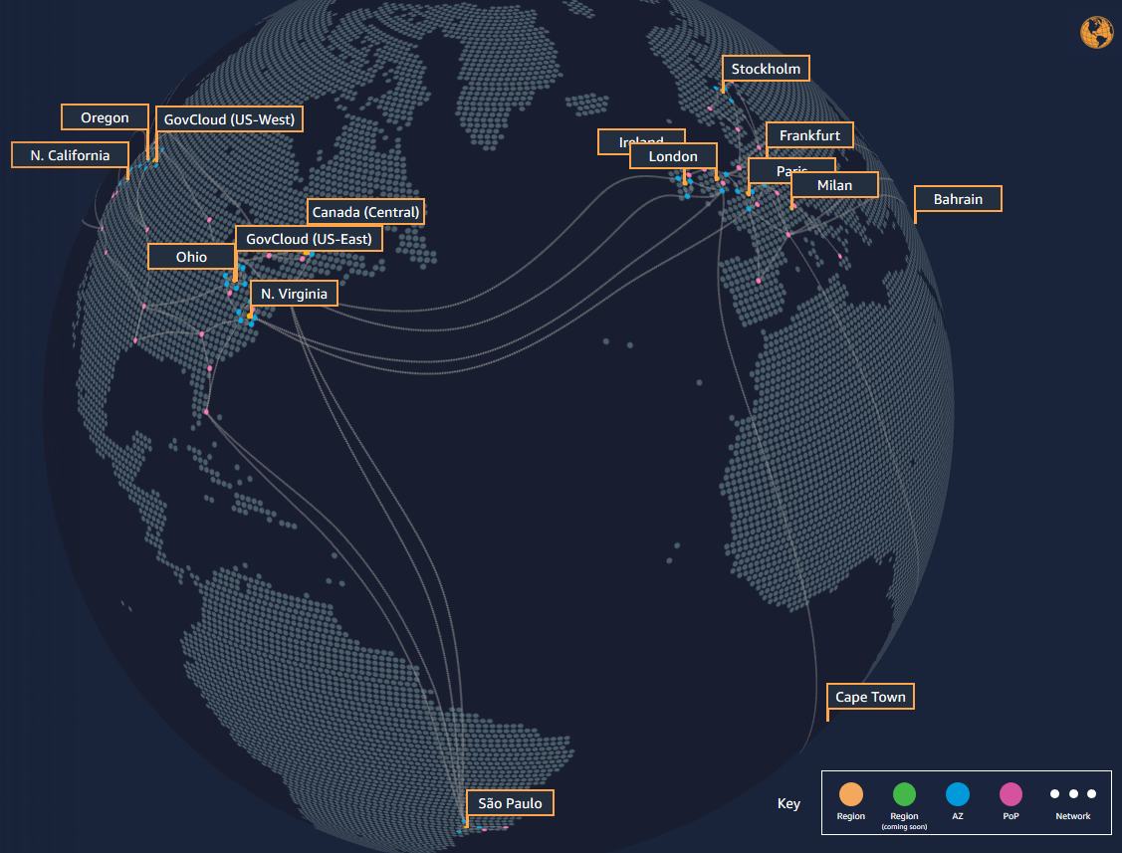
How does cloud help?
Resilience
Geographically dispersed
Experts at operating DCs
Load balancing across DCs
Push button Replication
Failover without extra cost
Notes:
Amazon has data centers across the worlds and has learned best practices
Have built their own servers to their own specification to give ease of operation.
Each region has multiple availability zones which consist of one or more data centers
Each availability zone has high speed low latency connections with other AZs
https://www.infrastructure.aws/
Can have push button load balancing of servers across multiple AZs where servers are spun up to replace failed servers
Can replicate servers and databases to other Azs at the push of button.
Don’t have to pay for the extra capacity needed for failover instances, only what's in use

Slide 9
AWS Compute Options
Elastic Compute Cloud (EC2)
Traditional VMs in the cloud (IaaS)
Own whole stack
Can be scaled with metrics
Charged by instance type
Charged by time instance running
Notes:
With increased customer demand

Slide 10




EC2 Microservice Example
Image Resizer
Image uploaded to a S3 bucket
Event message placed on a queue
SQS queue polled in application
Message consumed
Image resized
Resized image put in new S3 bucket
Notification email sent
Notes:
With increased customer demand

Slide 11
AWS Compute Options
Lambda Functions
Run code without provisioning servers
Continuous scaling
Highly available
Event driven
Charged by requests

Slide 12

Lambda Microservice Example
Image Resizer
Image uploaded to a S3 bucket
Event message placed on a queue
SQS defined as event source
Function triggered by message
Image resized
Resized image put in new S3 bucket
Notification email sent
Notes:
https://www.reactivemanifesto.org/
Responsive: The system responds in a timely manner if at all possible. Responsiveness is the cornerstone of usability and utility, but more than that, responsiveness means that problems may be detected quickly and dealt with effectively. Responsive systems focus on providing rapid and consistent response times, establishing reliable upper bounds so they deliver a consistent quality of service. This consistent behaviour in turn simplifies error handling, builds end user confidence, and encourages further interaction.
Resilient: The system stays responsive in the face of failure. This applies not only to highly-available, mission-critical systems — any system that is not resilient will be unresponsive after a failure. Resilience is achieved by replication, containment, isolation and delegation. Failures are contained within each component, isolating components from each other and thereby ensuring that parts of the system can fail and recover without compromising the system as a whole. Recovery of each component is delegated to another (external) component and high-availability is ensured by replication where necessary. The client of a component is not burdened with handling its failures.
Elastic: The system stays responsive under varying workload. Reactive Systems can react to changes in the input rate by increasing or decreasing the resources allocated to service these inputs. This implies designs that have no contention points or central bottlenecks, resulting in the ability to shard or replicate components and distribute inputs among them. Reactive Systems support predictive, as well as Reactive, scaling algorithms by providing relevant live performance measures. They achieve elasticity in a cost-effective way on commodity hardware and software platforms.
Message Driven: Reactive Systems rely on asynchronous message-passingto establish a boundary between components that ensures loose coupling, isolation and location transparency. This boundary also provides the means to delegate failures as messages. Employing explicit message-passing enables load management, elasticity, and flow control by shaping and monitoring the message queues in the system and applying back-pressurewhen necessary. Location transparent messaging as a means of communication makes it possible for the management of failure to work with the same constructs and semantics across a cluster or within a single host. Non-blocking communication allows recipients to only consume resources while active, leading to less system overhead.

Slide 13
Lambda
Advantages
Disadvantages
Simple to develop for
Simple to operate
Pay for what you use
Easy integration
Reactive scalability
Limited executable size
Native code
Short running jobs
Limited compute options
Limited scalability options
Notes:
Only need to develop the code in a lot of cases.
Operation is the case of logging and reacting to errors, no servers to operate and patch. No load balancers etc.
Only pay for invocations, 1 million free executions per month, execution cost tied to memory usage and execution time.
Can be triggered by events SQS, SNS, Kinesis, S3, cloudwatch, dynamoDB etc.
Scales in reaction to events
https://docs.aws.amazon.com/lambda/latest/dg/scaling.html
For Lambda functions that process Kinesis or DynamoDB streams the number of shards is the unit of concurrency. If your stream has 100 active shards, there will be at most 100 Lambda function invocations running concurrently. This is because Lambda processes each shard’s events in sequence.
When an Amazon SQS event source mapping is initially enabled, Lambda begins long-polling the Amazon SQS queue. Long polling helps reduce the cost of polling Amazon Simple Queue Service by reducing the number of empty responses, while providing optimal processing latency when messages arrive.
As the influx of messages to a queue increases, AWS Lambda automatically scales up polling activity until the number of concurrent function executions reaches 1000, the account concurrency limit, or the (optional) function concurrency limit, whichever is lower. Amazon Simple Queue Service supports an initial burst of 5 concurrent function invocations and increases concurrency by 60 concurrent invocations per minute.
Executable size limited to 50MB.
Functions run on a container on a AWS linux instance, no access to container or instance to install native packages from repos.
Libraries for python, node that rely on native code need to be installed and packaged on a matching server instance, some libraries may not be available and need to be compiled form source e.g. numerical libraries like numpy or need to be statically compiled with included dependencies
This causes issues for the lambda package size (e.g. ffmpeg and ffprobe, only one can be included in a package)
Some ways around these limitation e.g. using lambda layers to contain native libraries an share them with multiple functions, reduces issue with package size.
Maximum runtime is 15minutes, though there is an service called step functions for stateful lambda jobs
CPU is tied to the memory setting, scaling linearly in proportion to RAM, 1.8GB is 1VCPU (equivalent to lowest power EC2 instance types), no GPU option, Maximum of 3GB Ram, Max 500MB storage space.
Max 1000 concurrent execution per account, scaling in reaction to events is controlled by amazon

Slide 14
EC2
Advantages
Disadvantages
Many compute options
No restriction on code
Many scaling options
Long running applications
Operation Overhead
Can’t be reactive without cost
More effort to integrate
Notes:
In comparison with Lambda EC2 is incredibly flexible but has much more overhead to operate.
Have to deal with patching, creating images, securing the underlying OS, restricting ports.
Scalabbility is very flexible with lots of different options such as incrementing by 1 instance every x number of seconds by measuring 1 or more perfromance mertics, setting different levels of increment (scale by percentage, with minimum number of instances) depending on how far a metric has been exceeded etc.
Tradeoff is that an application can’t scale to 0 instance when no needed, react quickly and stay stable at load.
Instance take time to provision, specially e.g. a JVM application where the JVM has to start up before executing application code so really want 1 instance running at all times or customers will experience spikes in latency and calling service may time out
Metrics to evaluate for scaling events with variability need custom logic in e.g. a cron job or a lambda function making it difficult to
Integration with service such as message queues is manual, e.g. SQS queue has to be polled continuously in application logic to retrieve messages.
Can’t be directly integrated with S3 events, events notification have to go via, SNS, SQS or a lambda.

Slide 15
Lambda Use Cases
Conditions
Use Cases
Short running execution
Stateless
Code will be < 50MB
Not CPU intensive
Not memory intensive
Glue logic
Small data transformations
Simple API functions
Reacting to events

Slide 16
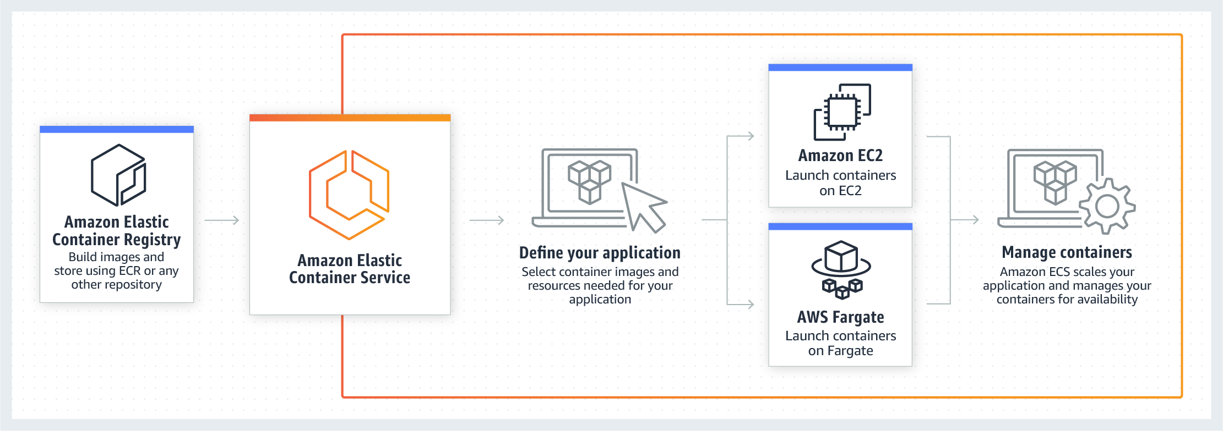
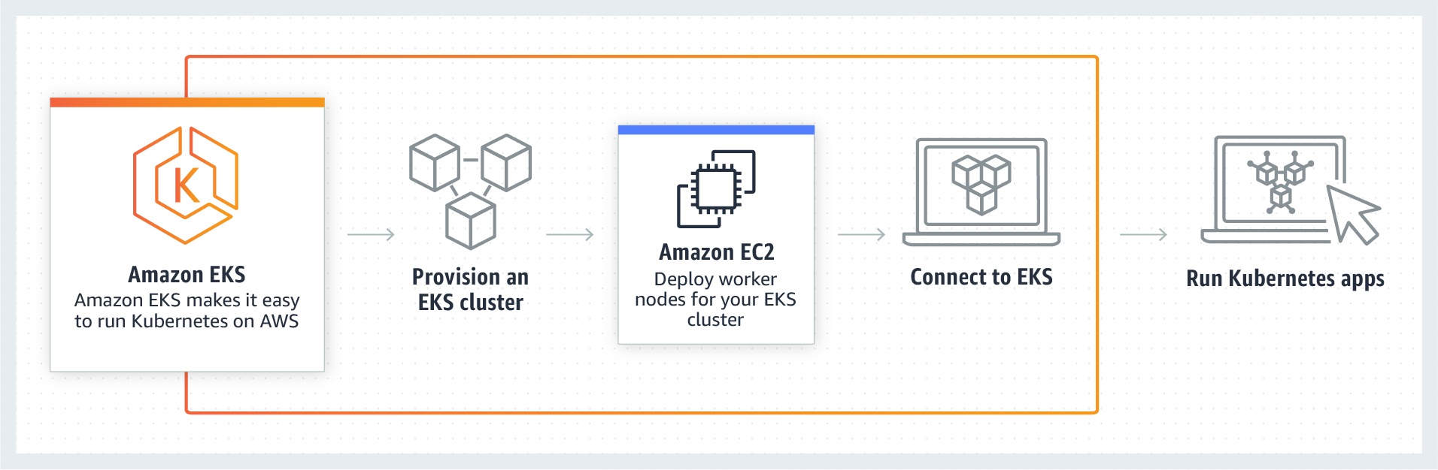
Other compute options
Container services
Elastic Container Service (ECS)
Docker containers deployed to EC2 cluster
Fargate (ECS)
AWS Managed docker containers without EC2 cluster
Elastic Container Service for Kubernetes (EKS)
Kubernetes cluster on EC2 cluster
Notes:
AWS has docker service for running on EC2 instances and their managed Fargate service
https://aws.amazon.com/ecs/?nc2=h_m1
Fargate is charged by vCPU per hour and per GB of memory, generally its only for experiments or short lived containers due to costs
ECS on EC2 is charged at normal EC2 instance rates
Amazon has a managed Kubernetes cluster where it takes care of management
https://aws.amazon.com/eks/?nc2=h_m1
Charged per hour per cluster on top of EC2 cluster costs, can run multiple applications per cluster using namespaces and IAM.

Slide 17
Resources
Node SQS consumer
https://github.com/bbc/sqs-consumer
Spring Cloud
https://cloud.spring.io/spring-cloud-aws/spring-cloud-aws.html
Sample code
https://github.com/RealityCtrl/learn_day

Slide 18
Recommend Resources
Reactive Design Patterns
The Practice of Cloud System Admin
Release It!
DevOps Handbook
A Cloud Guru courses
AWS Documentation

