Slide 1

Guguța maps

Slide 2
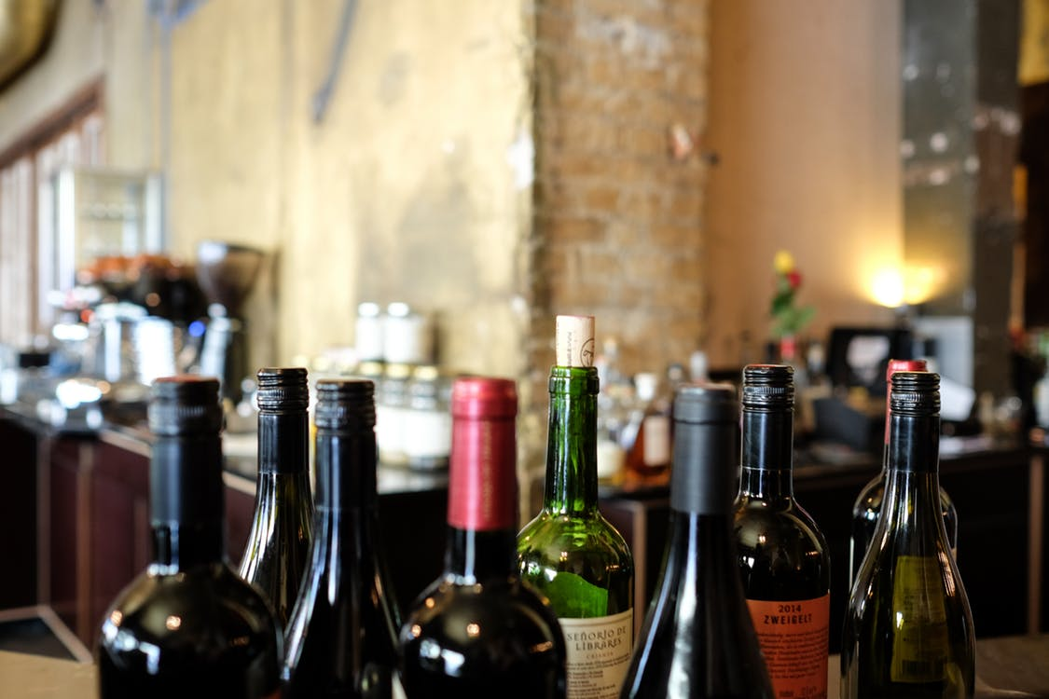
Roots of idea
Moldova is not only about Chisinau and wineries
Planning a journey may be easier
Locals are the best guides
Notes:
???????

Slide 3


Promoting national tourism
Cultural exchange
Strategical Goals
Sustainable travelling
Ensuring safety and convenience

Slide 4

Most appreciated*
MOLDOVA
Local hospitality
MOLDOVA
71%
Wines
65%
Nature
62%
*USAID: FACT SHEET: MOLDOVA COMPETITIVENESS PROJECT. TOURISM INDUSTRY.
Notes:
Какое-то исследование

Slide 5






Interactive map navigation
Advanced searching
Implemented booking
Review & rating system
Ask the locals
Ai-driven recommendations
Notes:
Функционал

Slide 6
OPPORTUNITIES
- unexpected insights
FOR LOCALS
- Supporting communities
- infrastructure
FOR TOURISTS
- Sense of accomplishment
- Traditions preservation

Slide 7
OPPORTUNITIES
- exclusive info from locals
FOR LOCALS
- Ease of use
- reliable recommendations
FOR TOURISTS
- discovering hidden gems
- local culture immersion

Slide 8
25%
25%
25%
All-in-one platform
Getting in touch with locals
не хотят сами делать выбор, рассчитывают на помощь
Why we make a difference
Love and soul
Value product
+25 % =100%
Notes:
Дополнительный* 7

Slide 9



Platform integration
1
3
Deploying
We are here
We will be here
2
Security implementation
Support and maintenance
Notes:
Планы дальнейшие

Slide 10
Long-term plan
2025-26
Syncing with events
Booking flights, buses, rent-a-cars
Weather API
Travel alerts
Summer 24
Ask the locals
AI-driven recoms
Emergency info
Notes:
прогнозы

Slide 11


Financial growth
survival
life
prosperity
Launch and Initial Marketing
Growth and monetization
Recoupment and
Post-Recoupment
40 ЕВРО
Ads
Ads
More Ads
Partnerships
More Partnerships
Subscription
Notes:
Как мы заработаем

