Slide 1
A* Algorithm
Dijkstra’s Algorithm + Greedy Algorithm

Slide 2
A* Algorithm (cont)
Dijkstra’s Algorithm + Greedy Algorithm

Slide 3
A* Algorithm (cont)
Dijkstra’s Algorithm
All possible directions
Always shortest
Slow
Greedy Algorithm
The most possible direction
Not guaranteed shortest
Fast
Use a heuristic function to guide the Dijkstra’s searching path

Slide 4
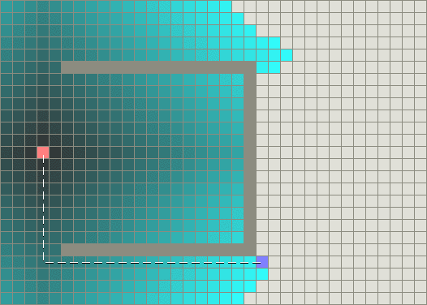
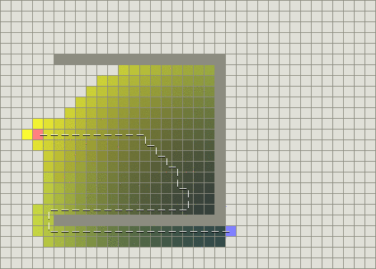
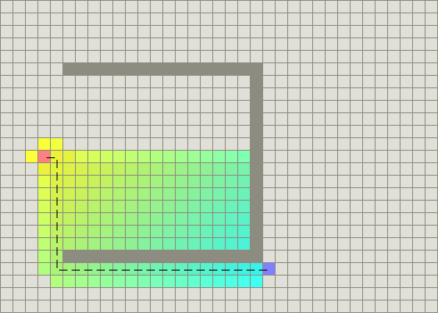
A* Algorithm (cont)
Dijkstra’s Algorithm
Greedy Algorithm
A* Algorithm

Slide 5
A* Algorithm (cont)
Also use a priority queue, but not just adding weights
$$f(n) = g(n) + h(n;d)$$
The cost from starting point to vertex n
Heuristic estimate the cost from n to destination d
Manhattan distance
Euclidean distance

