Slide 1
Self-playing Snake Game Based on Pathfinding algorithms
Yang Sui, Jin Xu, Runlin Hou

Slide 2
Snake Game
Snake Game can be divided into several parts:
Map
Snake
Food
Implement Snake Game using Graph Theory
Map, undrectied graph, each edge has the same weight
Snake, body of snake would be considered as unreachable vertex
Food, marked as a normal vertice

Slide 3
Goal
Principle
Snake length will be initialized as 3
New food will be generated on random position after the last food was taken
The snake can not hit the wall and its own body
Get score
Be alive
Less movements

Slide 4
Algorithms
BFS
A*
Hamilton

Slide 5
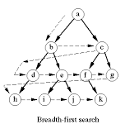
Breadth-First Search
BFS will try to traversal all the map to find the target.
All the vertices that is going to be visit will be added to a FIFO queue
Dijkstra is same with BFS when the
weights of edges are the same

Slide 6
Breadth-First Search
Visit the root vertice
Visit the adjacencies of root vertice
Visit the adjacencies of adjacencies until there is no un-visited vertices

Slide 7
Implementation on Snake Game
Connected(ver) will return a list that the vertices ver is connected to
It will be avoided to return where the vertices is wall or been occupied by body
Bfs(a, b) will find the shortest path from a to b using BFS
Strategy
1st target would be the food
If there is no path to the food, trace tail
If there is no path to tail, randomly walk

Slide 8
A* Algorithm
Dijkstra’s Algorithm + Greedy Algorithm

Slide 9
A* Algorithm (cont)
Dijkstra’s Algorithm + Greedy Algorithm

Slide 10
A* Algorithm (cont)
Dijkstra’s Algorithm
All possible directions
Always shortest
Slow
Greedy Algorithm
The most possible direction
Not guaranteed shortest
Fast
Use a heuristic function to guide the Dijkstra’s searching path

Slide 11
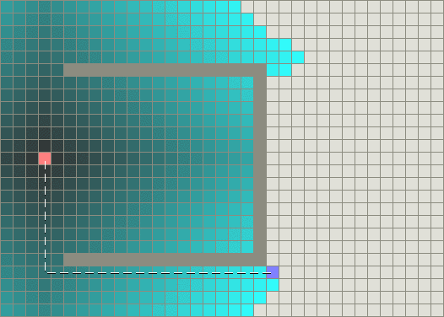
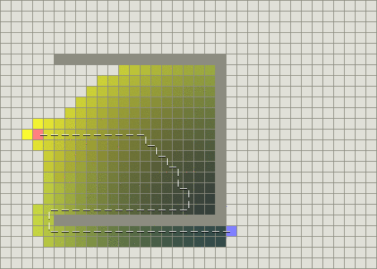
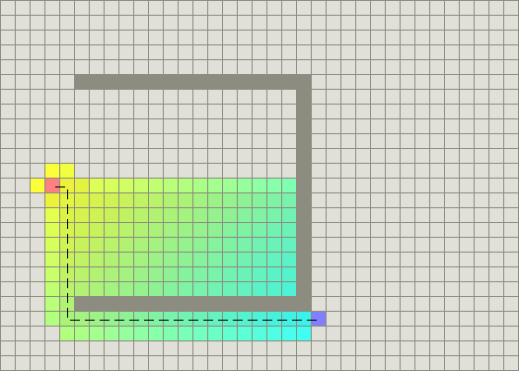
A* Algorithm (cont)
Greedy Algorithm
A* Algorithm
Dijkstra’s Algorithm

Slide 12

A* Algorithm (cont)
Also use a priority queue, but not just adding weights
$$f(n) = g(n) + h(n;d)$$
The cost from starting point to vertex n
Heuristic estimate the cost from n to destination d
Manhattan distance
Euclidean distance

Slide 13
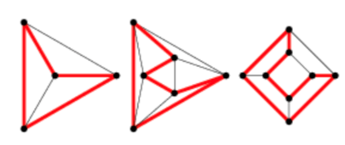
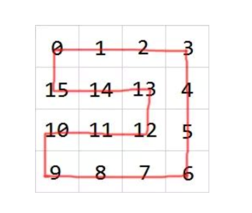
Hamilton Algorithm: Alive Longer
A Hamiltonian cycle, also called a Hamiltonian circuit, through a graph that visits each node exactly once.
HEAD
In Snake Game:
INITIAL SNAKE

Slide 14
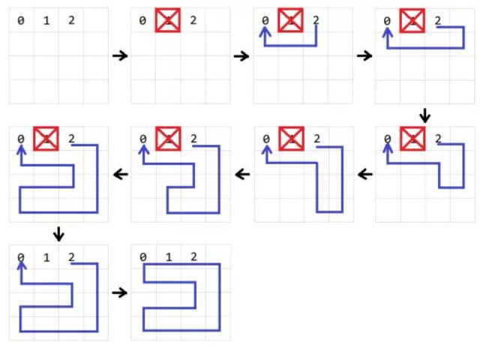
Build the Hamilton circle.
BFS

Slide 15
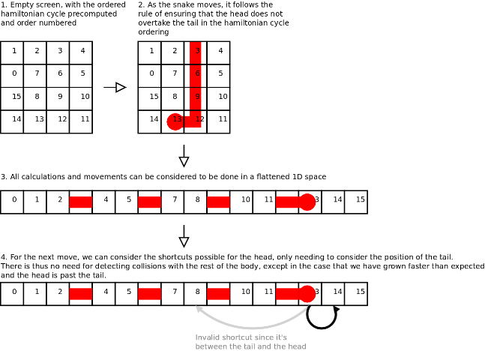
Short Way: Not always Longest Way.

Slide 16
Performance: Alive
Hamiton algorithm can finish the map every time
A*, BFS can only reach half of the map
BFS
A*
Hamilton

Slide 17
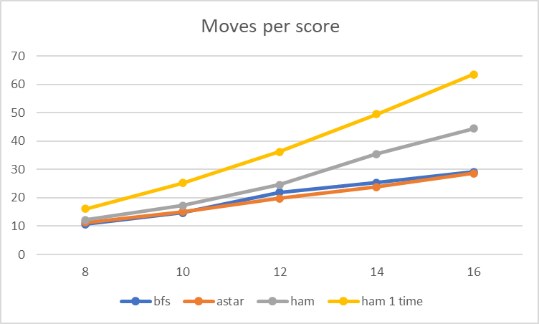
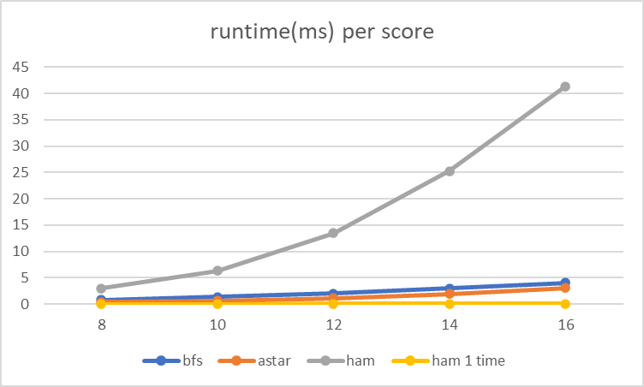
Performance: Move Length & Runtime

Slide 18
Conclusion
Move Path Length (less is better) :
BFS ≈ A* < Hamilton 1time < Hamilton
Alive(longer is better) :
Hamilton 1time = Hamilton > A* > BFS

