Slide 2
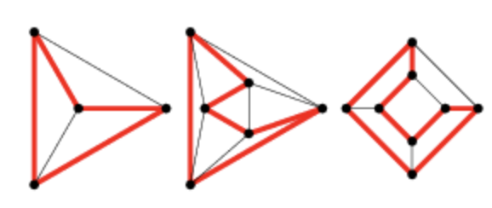
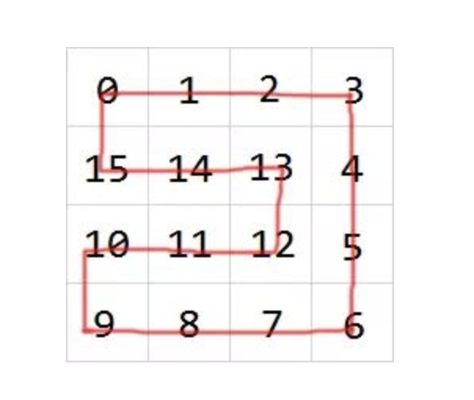
Hamilton Algorithm
A Hamiltonian cycle, also called a Hamiltonian circuit, through a graph that visits each node exactly once.
HEAD
In Snake Game:
INITIAL SNAKE

Slide 3
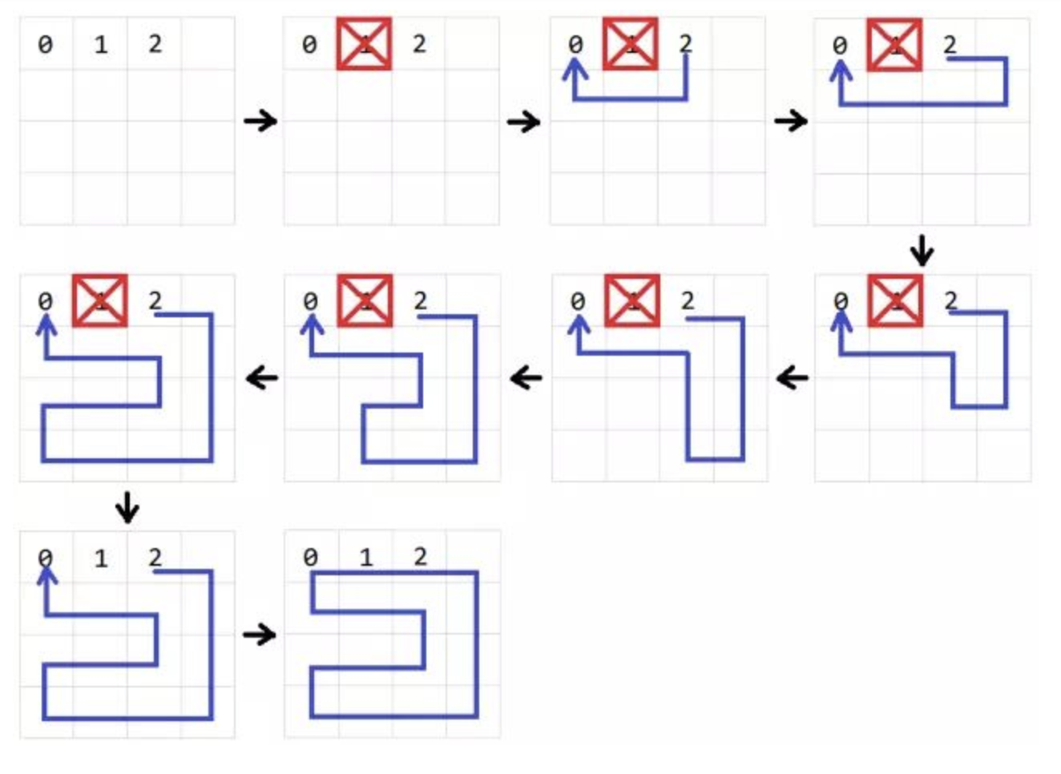
Build the Hamilton circle.
BFS

Slide 4
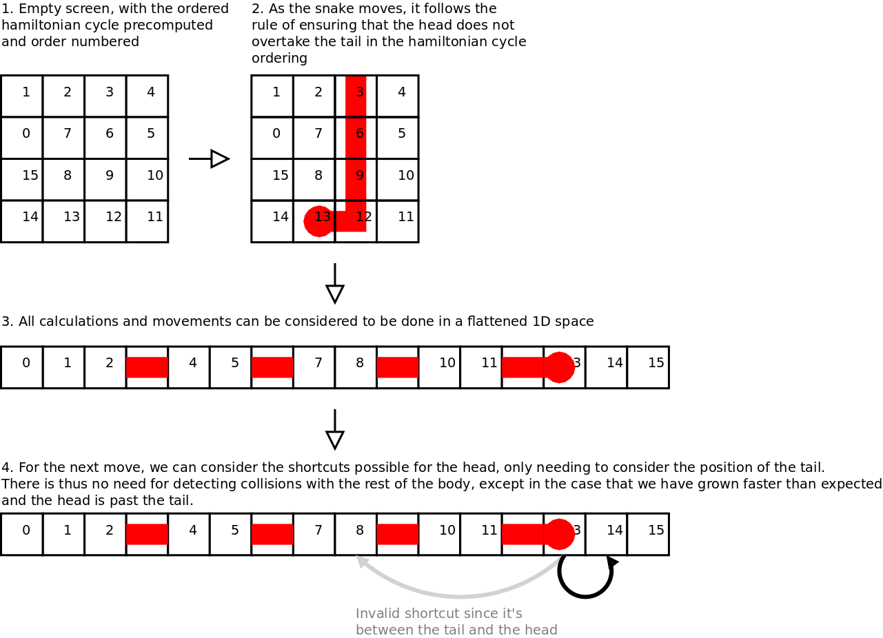
Short Way: Not always Longest Way.

