Slide 1
Self-playing Snake Game Based on Pathfinding algorithms
Yang Sui, Jin Xu, Runlin Hou

Slide 2
Snake Game
Snake Game can be divided into several parts:
Map
Snake
Food
Implement Snake Game using Graph Theory
Map, undrectied graph, each edge weights is 1, wall will be marked out as broken vertices
Snake, body of snake would also be marked as broken vertices
Food, marked as a normal vertice

Slide 3
Purpose
Principle
Snake length will start as 3
Food will generate after the last food was taken
The snake can not hit the wall and its own body
Implement an AI for the snake
Get score
Be alive

Slide 4
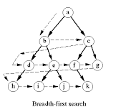
Breadth-First Search
BFS will try to traversal all the map to find the target.
All the vertices that is going to be visit will be added to a FIFO queue

Slide 5
Breadth-First Search
Visit the root vertice
Visit the adjacencies of root vertice
Visit the adjacencies of adjacencies until there is no un-visited vertices

Slide 6
Implementation on Snake Game
Connected(ver) will return a list that the vertices ver is connected to
It will be avoided to return where the vertices is wall or been occupied by body
Bfs(a, b) will find the shortest path from a to b using BFS
Strategy
1st target would be the food
If there is no path to the food, trace tail
If there is no path to tail, randomly walk

Slide 7
A* Algorithm
Dijkstra’s Algorithm + Greedy Algorithm

Slide 8
A* Algorithm (cont)
Dijkstra’s Algorithm + Greedy Algorithm

Slide 9
A* Algorithm (cont)
Dijkstra’s Algorithm
All possible directions
Always shortest
Slow
Greedy Algorithm
The most possible direction
Not guaranteed shortest
Fast
Use a heuristic function to guide the Dijkstra’s searching path

Slide 10
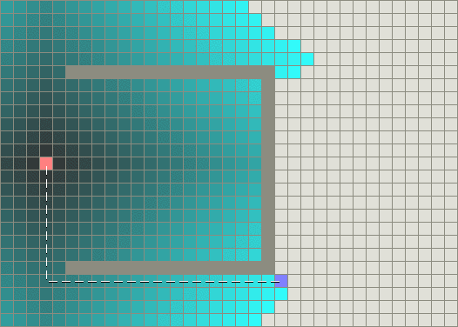
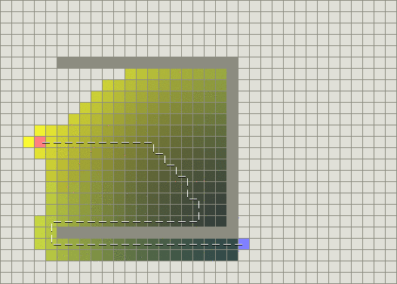
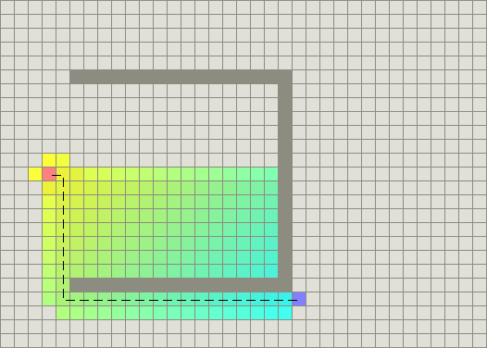
A* Algorithm (cont)
Greedy Algorithm
A* Algorithm
Dijkstra’s Algorithm

Slide 11

A* Algorithm (cont)
Also use a priority queue, but not just adding weights
$$f(n) = g(n) + h(n;d)$$
The cost from starting point to vertex n
Heuristic estimate the cost from n to destination d
Manhattan distance
Euclidean distance

Slide 12
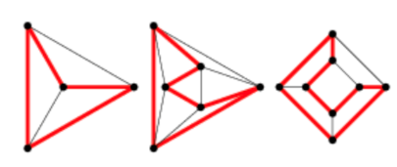
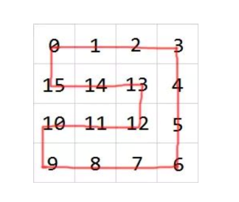
Hamilton Algorithm
A Hamiltonian cycle, also called a Hamiltonian circuit, through a graph that visits each node exactly once.
HEAD
In Snake Game:
INITIAL SNAKE

Slide 13
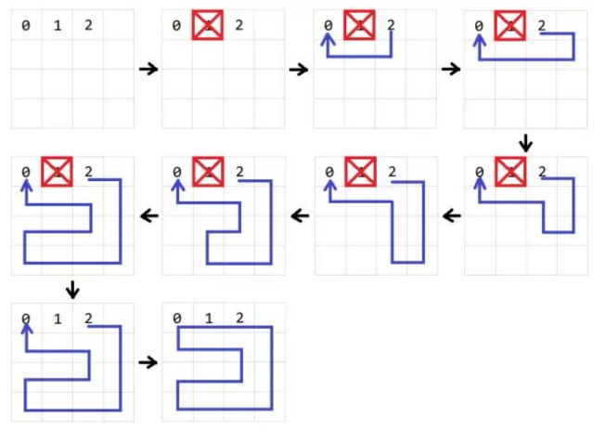
Build the Hamilton circle.
BFS

Slide 14
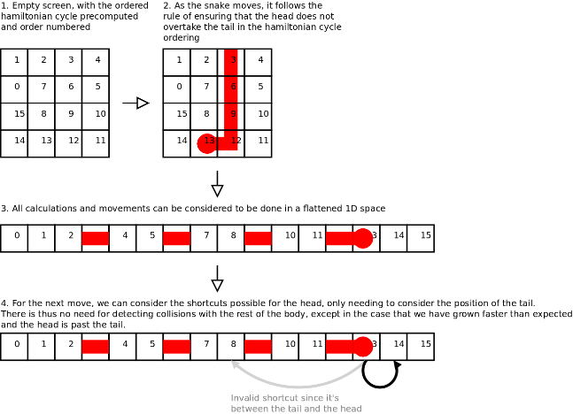
Short Way: Not always Longest Way.

Slide 15
Performance
Generally
Hamiton algorithm can finish the map every time
A*, BFS can only reach half of the map
BFS
A*
Hamilton

Slide 16
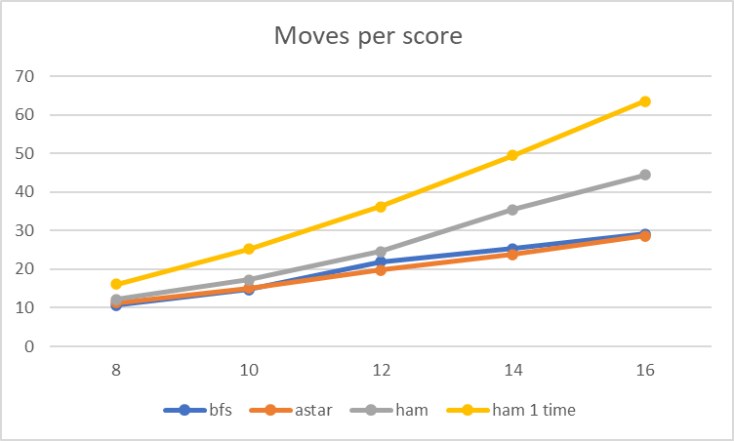
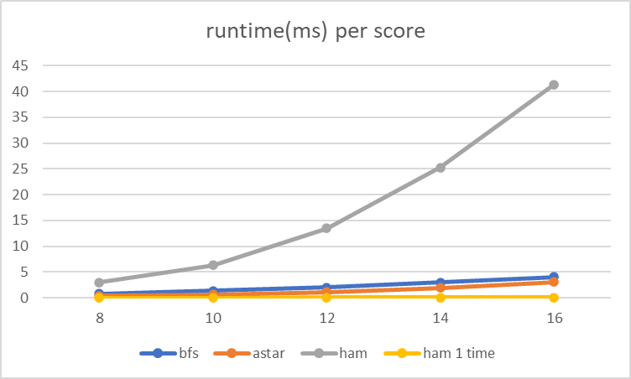
Performance

