Slide 1
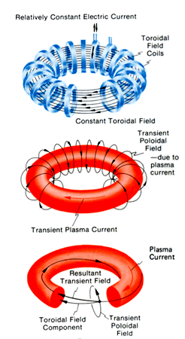
Magnetic Confinement
Using magnetic and electric fields to heat and squeeze the hydrogen plasma
Plasma contain a net electric charge
Most challenging condition is to avoid the plasma hit and the wall , which will make those plasma vaperize

Slide 2
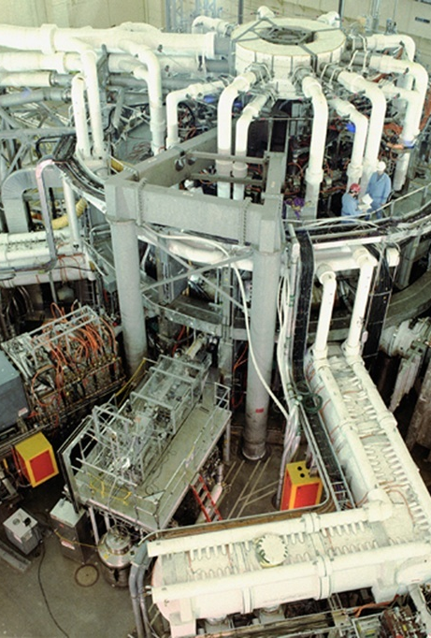
Tokamak Fusion Test Reactor (TFTR)
Location in Princeton Plasma Physic Laboratory (PPPL)
This facility entering service in 1982, and have been shut down after fifteen years of service in 1997
After the success of PLT, PPPL started to design TFTR as a successor that would demonstrate plasma burning in pulsed operation

Slide 3
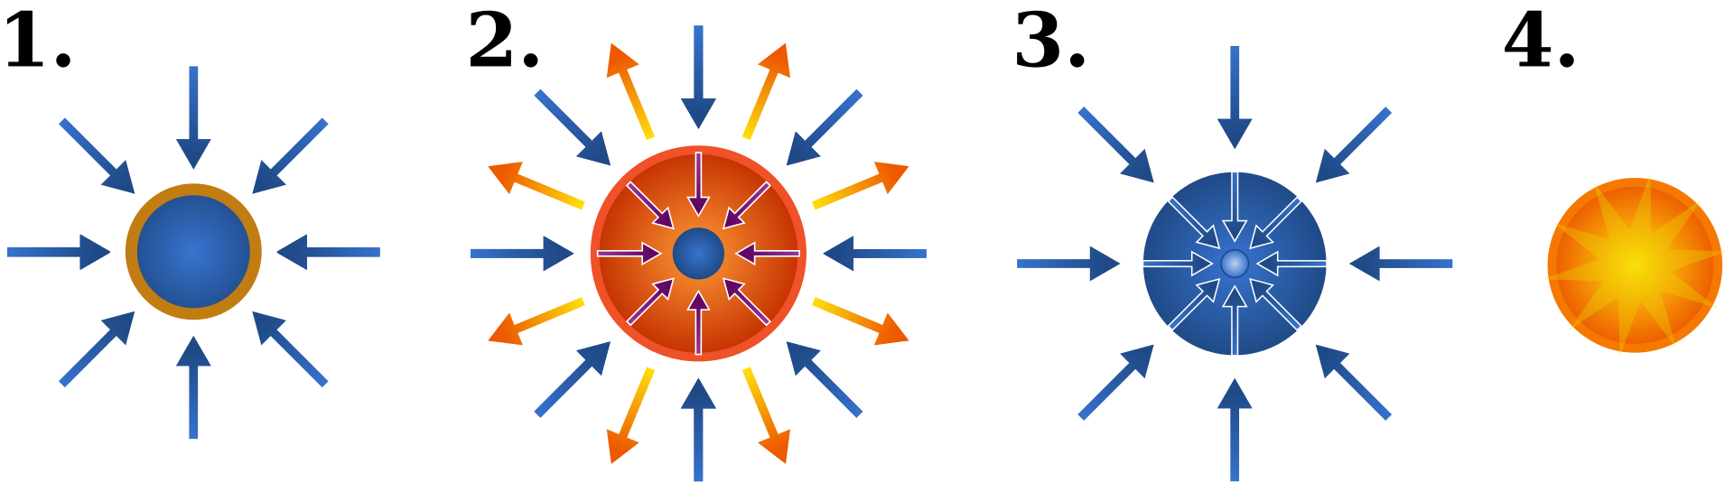
Inertial Confinement
Using high-energy beams of laser light to deliver the energy to outer layer of the target in order to compress and heat the fuel
Outer later expose, reaction force against remainder of the target to accelerate inwards compressing
Since outer layer expands much faster than inside layer, which have the fuel confinement by inertia of itself

Slide 4
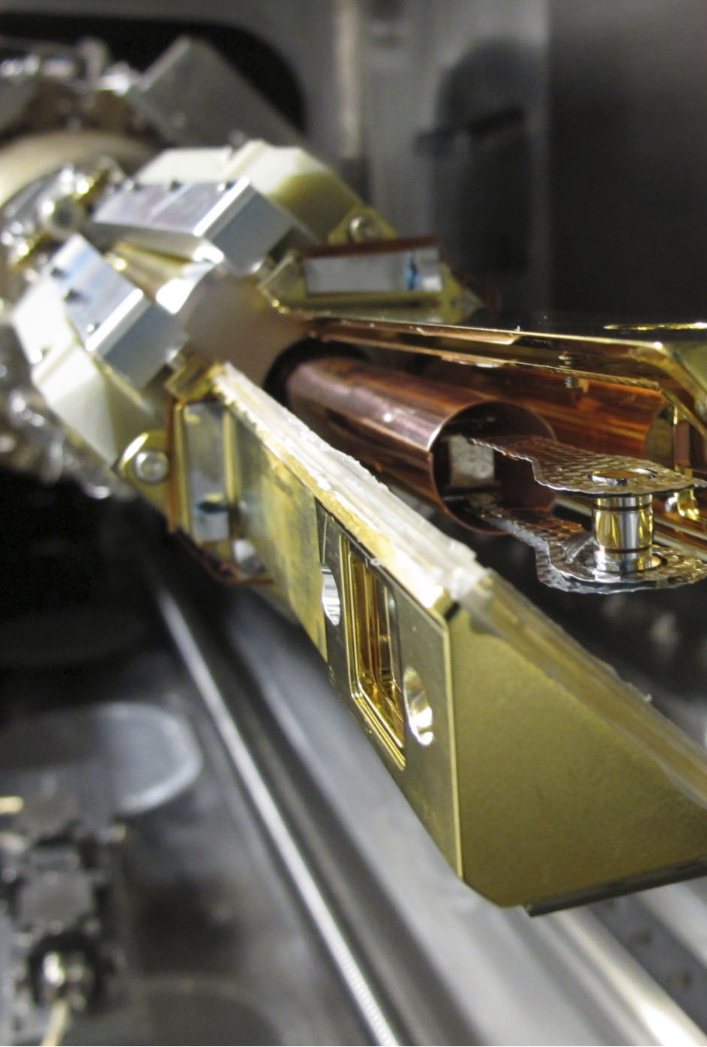
National Ignition Facility (NIF)
Located at Lawrence Livermore Laboratory
Construction begins 1997, certified complete in 2009, and started its first experiments in June, 2009
Using indirect drive method of operation
Laser heats a small metal cylinder(hohlarm)
Hohlarm re-emit energy as X-ray more evenly distributed and symmetrical

