Slide 1





























A 2-days National Level Hackathon on
AI in education
SELECTED AREA NAME
In-it to Win Mohammad Shees Abdulla
www.samadhan.sistec.ac.in/

Slide 2





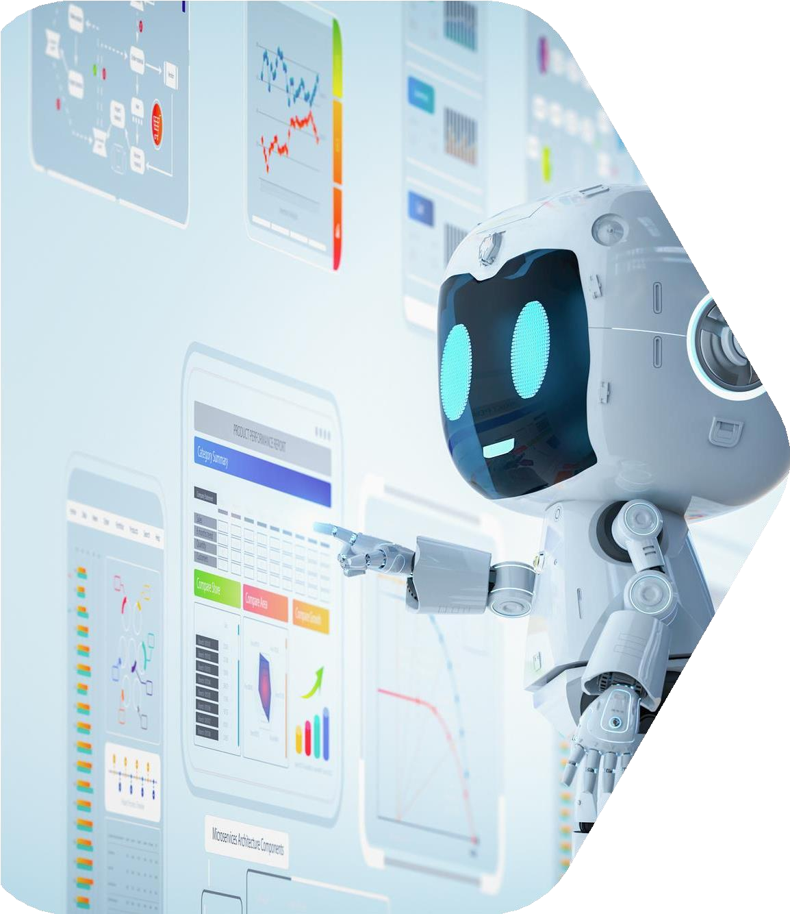


AREA OVERVIEW
We focus on Adaptive AI Tutors for high-stakes competitive exams like GATE. Our innovation is a platform that learns from the collective, real-time experience of all students.
AI enables hyper-personalization, moving beyond one-size- fits-all learning. It can proactively identify a student's "unknown unknowns" and generate targeted content that addresses the root cause of their struggles, boosting efficiency and scores.
Current AI tutors are limited by a "privacy barrier" — they cannot access the most valuable data (private mistake patterns). We are motivated to ethically harness the power of collective intelligence to build an AI that grows smarter with every user.

Slide 3
Potential Challenges and Opportunities
Challenges / Pain Points:
Generic Feedback: Tutors give textbook answers that miss the student's specific misconception.
Data Privacy Barrier: The most valuable data (mistake patterns) is sensitive and can't be shared centrally.
Inefficient Study: Students waste time on mastered topics or struggle with concepts they don't realize they misunderstand.
Opportunities with AI:
Hyper-Personalized Quizzes that target a student's predicted weak spots.
Proactive Intervention via a "Conceptual Map" that flags at-risk topics.
Data-Driven Pedagogy giving educators anonymzed insights into common struggles.

Slide 4
Preliminary Solution Concept
Initial Concept:
"The Collective Mind": A collaborative AI study platform for GATE. It's a personal tutor for each student, but its intelligence is fueled by secure, anonymized learning’s from the entire user base.
What the AI will achieve:
Answer with Context: Explain why a mistake is common ("70% of students confuse concept X with Y...").
Simplify Study Paths: Generate dynamic study plans that prioritize a student's predicted weaknesses.
Support Peer Learning: Proactively form optimal "Synergy Study Groups."

Slide 5
Key Features and Functionalities
Adaptive Problem Engine: A core federated model that predicts weaknesses and generates personalized quizzes.
Context-Aware Doubt Solver: Bilingual (Hindi/English) voice & text AI that provides context-rich answers.
Synergy Study Groups: AI-powered matching of students with complementary skills.
Gamified Leaderboards: Rewarding not just scores, but improvement and collaboration.
Predictive Progress Tracking: A "Conceptual Map" that visualizes mastery and predicted weak points.

Slide 6
Target Users and Expected
Use Cases
Target Users:
Students: GATE Aspirants needing efficient, personalized study.
Educators: Teachers using anonymized analytics to improve teaching.
Parents: View high-level, privacy-preserving progress reports.
Use Cases:
Personalized Plan: The AI identifies a student's weak topic and generates a custom 3-day study plan.
Voice Doubt-Solving: A student asks a question in Hindi; the AI responds with a voice note explaining the concept and a common pitfall.
Educator Insights: An institute gets a weekly report: "65% of students struggled with Kirchhoff’s Law.”

Slide 7
Data Requirements and Privacy Considerations
Data Required & Processing:
Interaction metadata (time per question, chosen answer) is required.
All processing happens exclusively on the user's local device. Raw data never leaves
Privacy & Security Measures:
Our platform is built on “Privacy by Design" architecture:
Federated Learning (FL): Trains models locally. Shares only anonymous mathematical insights, not user data.
Homomorphic Encryption (HE): Encrypts those insights. Our server aggregates data without ever seeing it.
Differential Privacy (DP): Adds statistical "noise" for a mathematical guarantee of user anonymity.

Slide 8
AI Technologies and Methods
AI Technologies:
Federated Machine Learning: For decentralized, privacy-preserving model training.
Homomorphic Encryption (e.g., OpenFHE): For secure aggregation of encrypted data.
Differential Privacy (e.g., Opacus): To provide formal privacy guarantees.
Large Language Models (e.g., Gemini API): For generating base explanations.
NLP (e.g., Whisper API): For bilingual speech-to-text.
Contribution:
FL, HE, and DP enable our core privacy-preserving value. LLMs and NLP provide an intuitive, modern user interface.

Slide 9
Implementation Approach
Preliminary Plan:
Phase 1 (Backend & Core Model): Build server architecture and train initial federated model.
Phase 2 (Platform MVP): Build web app with Adaptive Quiz Engine and Doubt Solver.
Phase 3 (Collaboration): Implement Study Groups and leaderboards.
Tools & Timeline:
Tools: Python, PyTorch, FastAPI, OpenFHE, Streamlit, Gemini/OpenAI APIs.
Timeline: A functional MVP (Phase 1 & 2) is achievable within the 2-day hackathon timeframe

Slide 10
Evaluation Metrics
Anticipated Impact:
Significantly improve learning efficiency, student satisfaction, and test scores. Provide a scalable tool for high-quality, personalized instruction.
Key Performance Indicators (KPIs):
User Success: Improvement in practice scores; reduced "Time-to-Mastery" per topic.
User Engagement: Daily Active Users (DAU); Doubt Solver adoption rate.
AI Accuracy: F1-score of our model in predicting student misconceptions

