Slide 1

MadhuTwin
DIGITAL TWIN CHALLENGE 2026
A physiological–AI digital twin that warns of glycaemic adverse events in type 2 diabetes before they happen
A real glucose day and the twin's next two hours
TEAM BIOT
Anish Karthik Ayyagari
Indian Institute of Technology Kharagpur
Notes:
Hook: Ramesh in Mysuru, reactive care, and what a digital twin changes. Madhu: from madhumeha, the classical Indian name for diabetes.

Slide 2
One builder, every layer: physiology, machine learning, data and product
TEAM BIOT
Anish Karthik Ayyagari
01
Physiological twin
02
Personalisation
Glucose–insulin model with Indian meals and medicines
Health-record prior × sensor likelihood, MAP fit
Indian Institute of Technology Kharagpur
03
Hybrid ML and validation
04
Bharat synthetic cohort
SOLO ENTRANT AND TEAM LEADER
Leave-patients-out study on real CGMacros data
80 fictional Indian patients, full EHR and wearables
Designed, built and validated end to end, from the glucose–insulin equations to the clinician dashboard. Every number in this deck is reproducible from open or synthetic data.
05
API and copilot
06
Clinician dashboard
FastAPI service, FHIR export, grounded summaries
Triage, live twin, what-if, AGP report, evidence

Slide 3
India has 101 million people with diabetes, yet their glucose is seen a few times a year
01 THE PROBLEM
101 M
136 M
11.4 %
15.3 %
adults living with diabetes
adults with prediabetes
national diabetes prevalence
prediabetes prevalence
ICMR-INDIAB national study, Anjana et al., Lancet Diabetes & Endocrinology 2023 (113,043 adults, 31 states and union territories).
Care is reactive. A quarterly HbA1c averages three months into one number. It cannot show the post-meal spikes or the afternoon lows behind complications and emergencies.
Sensors arrive; decisions do not. CGMs and smartwatches now produce thousands of readings per patient, but doctors receive data dumps, not early warnings.
Notes:
ICMR-INDIAB numbers. The clinic sees a snapshot; the harm happens in between.

Slide 4
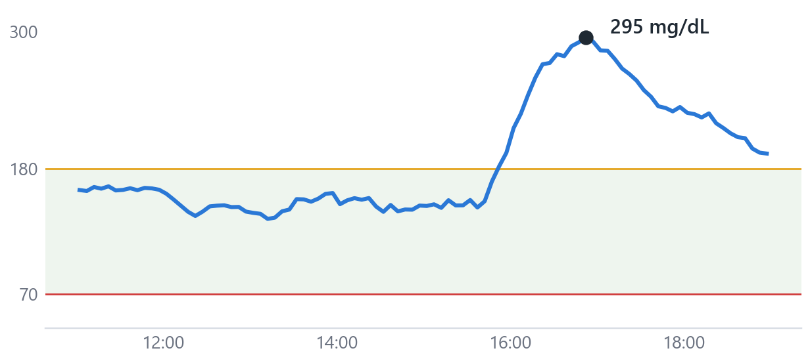
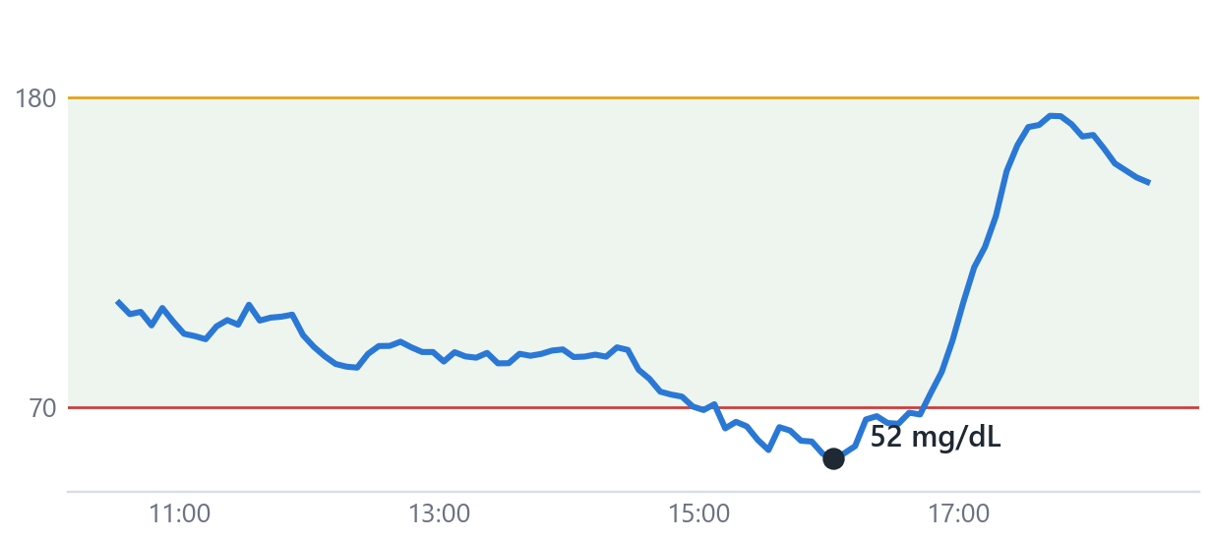
Two adverse events slip through between clinic visits
01 THE PROBLEM
POST-MEAL SPIKE
DRUG-INDUCED LOW
High-glycaemic-load meals push glucose past 250 mg/dL for hours
A sulfonylurea plus a skipped meal or a long walk pushes glucose below 70
Sourav, 45, Kolkata · late lunch · synthetic cohort
Ramesh, 61, Mysuru · glimepiride and CKD · synthetic cohort
The same meal raises glucose very differently from one person to the next.
Inexpensive and widely prescribed in India, sulfonylureas are a leading cause of severe lows.

Slide 5
A living model of each patient, fed by their health record and their sensors
02 THE TWIN
WHAT GOES IN
WHAT COMES OUT
THE TWIN
Static record
Personalised physiology, corrected by machine learning
Forecast
Demographics and diagnoses
HbA1c, fasting glucose and insulin, lipids, eGFR
Medications, TCF7L2, polygenic risk
Two hours ahead, with 90 % intervals
Glucose–insulin model with Indian meals and medicines
Personalised from the record, refined by sensor data
Synced to every CGM reading
ML corrects the residual, with calibrated uncertainty and reasons
Early warning
Hyperglycaemia, spikes and lows, with reasons
Live streams
CGM every 5 minutes
Heart rate, steps, METs
Sleep stages, HRV, meal log
What-if
Meals, walks, sleep and drug changes, simulated

Slide 6
Physiology first: a glucose–insulin model that understands Indian meals and medicines
02 THE TWIN
Same rice-and-sambar lunch (85 g carbohydrate), simulated for four physiologies
1
Meal absorption
Fast and slow chains: glycaemic index, fat, fibre and protein shape the curve
2
Insulin secretion and action
Beta-cell response, insulin sensitivity, glucose effectiveness
3
Activity, sleep, rhythm
METs raise uptake; short sleep lowers sensitivity; dawn and circadian effects
4
Medicines used in India
Metformin, sulfonylureas, DPP-4i (teneligliptin), SGLT2i, voglibose, pioglitazone, basal insulin
Notes:
Extended Bergman minimal model, numba-compiled: thousands of simulations per second on a laptop.

Slide 7
The health record sets the prior; the sensors make it personal
02 THE TWIN
1
2
3
Prior from routine labs
Onboarding fit
Continuous sync
HbA1c, fasting glucose and insulin (HOMA-IR, HOMA-B) and weight set the patient's starting physiology, so the twin is useful on day zero.
The first days of CGM, meals and activity refine the parameters by fitting the twin's own two-hour forecasts (maximum a posteriori).
Every CGM sample corrects the virtual patient; insulin, gut glucose and exercise effects evolve through the physiology.
41.9 → 29.7
ρ = −0.68
An interpretable phenotype. Insulin sensitivity, beta-cell response, disposition index, absorption speed, exercise response and dawn effect, normally measured with a clamp study, estimated from data the patient already generates.
mg/dL two-hour error of the physiology alone, before and after onboarding (real patients)
twin insulin sensitivity vs lab HOMA-IR across 45 real participants

Slide 8
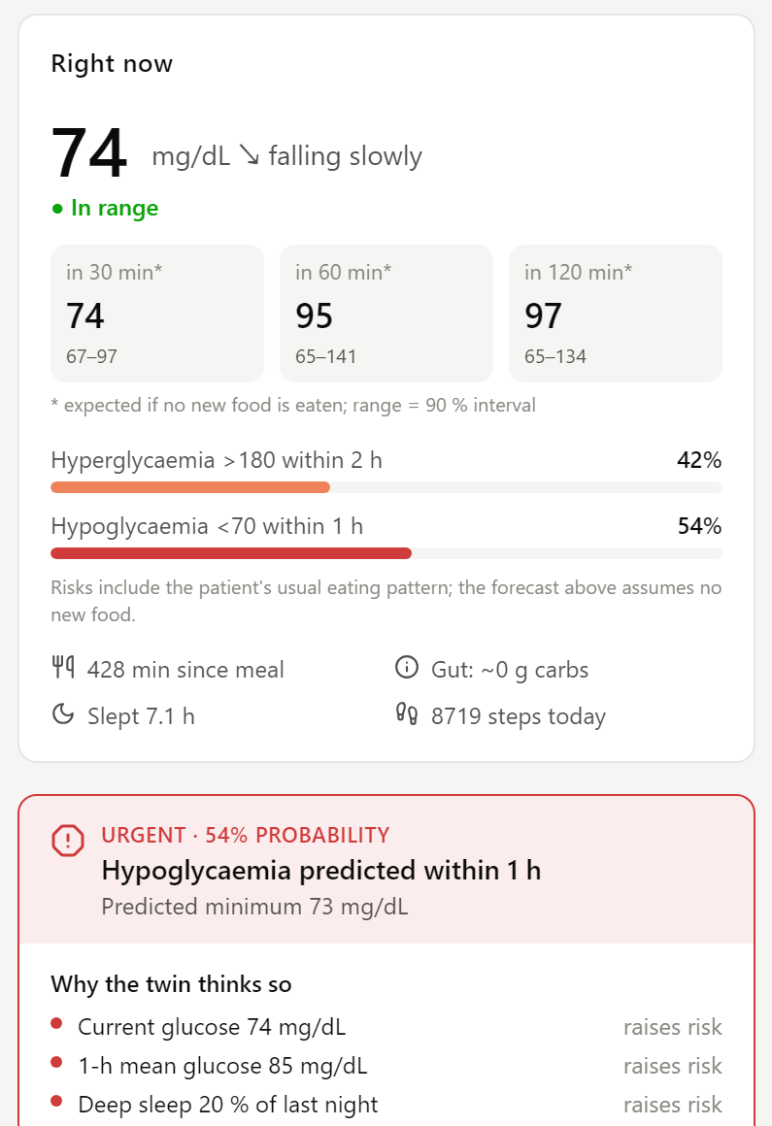
Machine learning corrects physiology, and says how sure it is
02 THE TWIN
1
Residual forecaster
Gradient-boosted trees for each horizon (30–120 min) see every stream plus the twin's own forecast and learn when to trust physiology. Forecasts assume no new food; new meals enter through the twin.
2
Conformal intervals
Conformalised quantile regression gives 90 % prediction intervals with a distribution-free guarantee. Observed coverage on unseen patients: 91.7 % at two hours.
3
Explained alerts
Calibrated risks for hyperglycaemia, spikes and hypoglycaemia. Exact TreeSHAP values, grouped by data stream, tell the doctor why each alert fired.
Live view: risk, reasons and evidence by stream

Slide 9
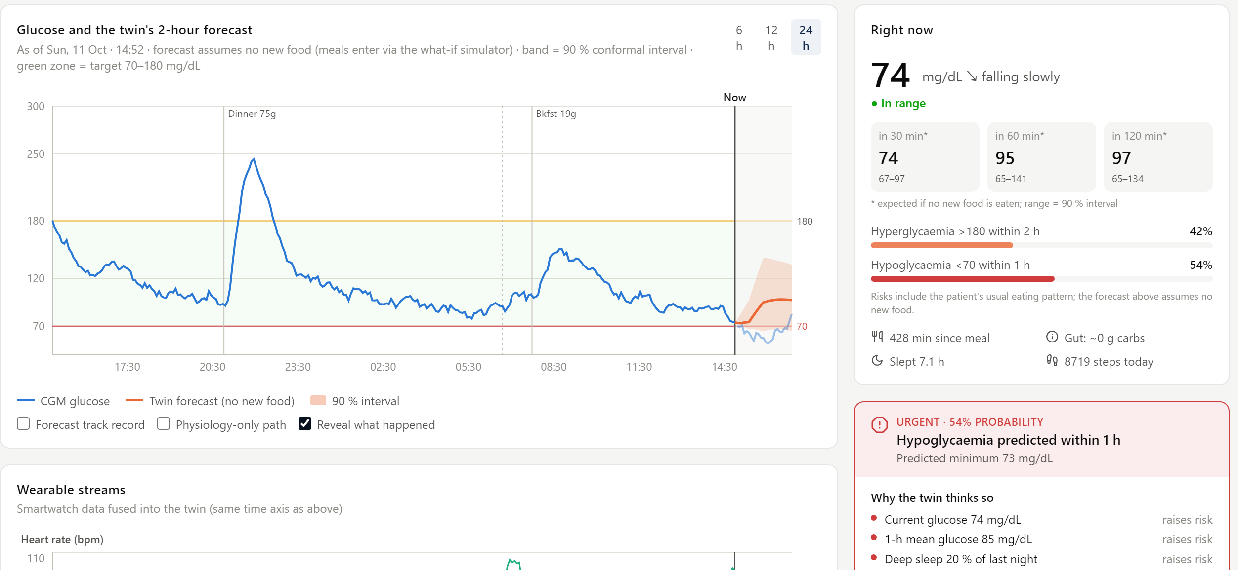
Ramesh's afternoon low, flagged before it happens
03 IN THE CLINIC
1
Who
61, glimepiride and CKD; skips lunch and walks to the market
2
What the twin sees
A falling trend, recent activity, a long fast and a sulfonylurea
3
Risk, not just a line
The median forecast expects recovery; the calibrated risk model gives a 54 % chance of a low. The low happens.
4
What the doctor gets
Pale blue after 'Now' is what actually happened, revealed for the demo. Synthetic patient.
An urgent alert with reasons, a twin-tested action (15 g carbohydrate) and a prompt to review the dose
Notes:
Replay the Ramesh story live in the dashboard; reveal what actually happened.

Slide 10
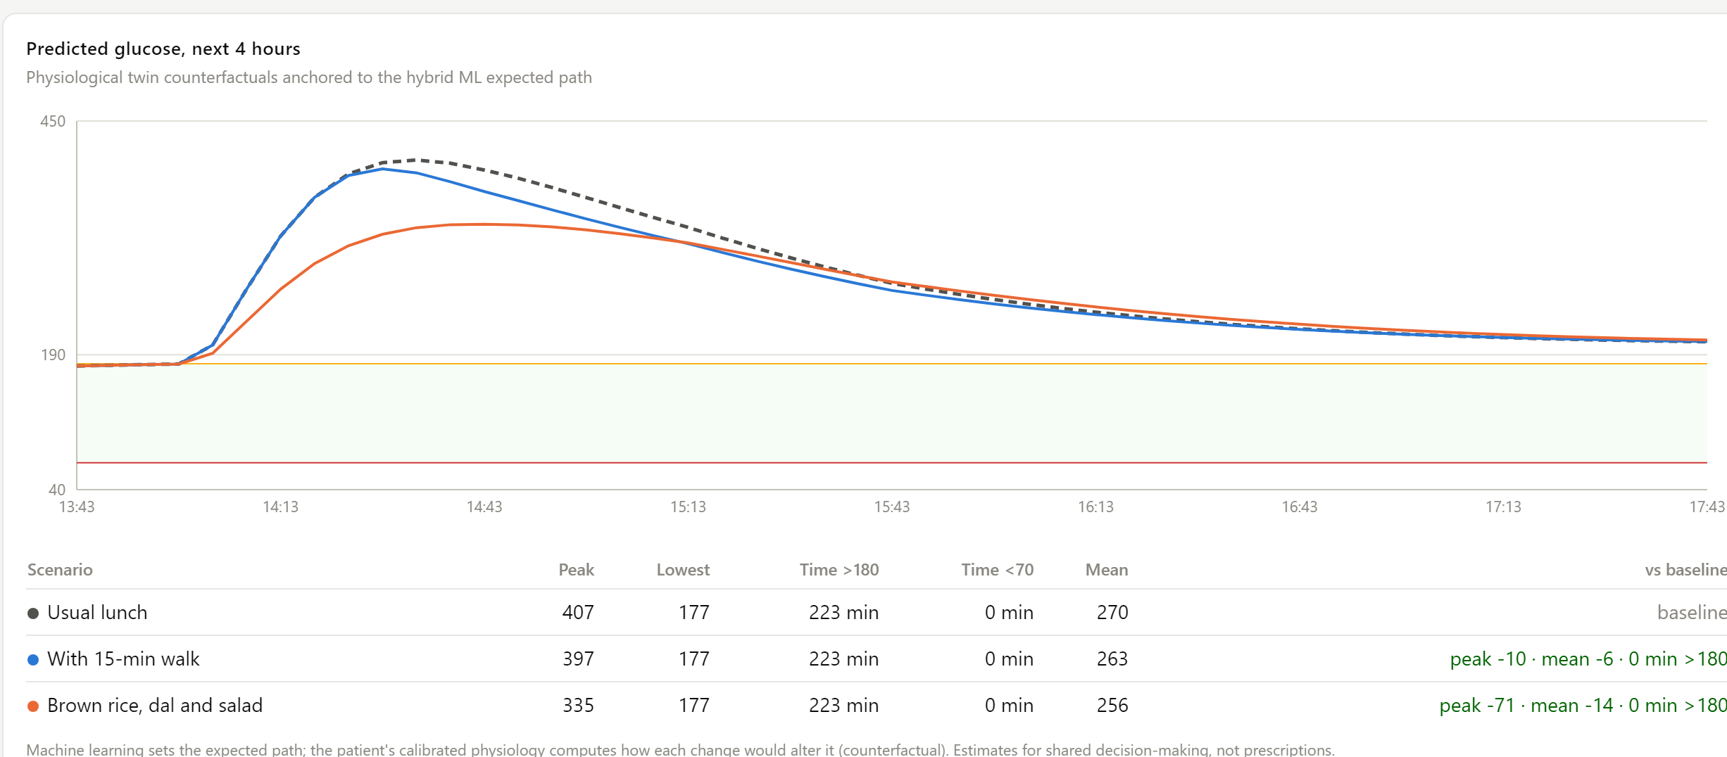
What-if: test a meal swap or a walk on the patient's own physiology
03 IN THE CLINIC
−71 mg/dL
peak with brown rice and dal instead of rice and rasam
−10 mg/dL
peak with a 15-minute walk after the usual lunch
Lakshmi, 54, Chennai: usual rice-and-rasam lunch, the same lunch with a 15-minute walk, and brown rice with dal. Twin estimates.
Machine learning sets the expected path; the patient's calibrated physiology computes how each change alters it.

Slide 11
On unseen real patients, two-hour error is 27 % below persistence
04 EVIDENCE
Forecast RMSE on unseen CGMacros patients, mg/dL (lower is better)
28.2 mg/dL
two-hour RMSE, vs 38.5 for persistence
99.0 %
of two-hour forecasts clinically acceptable (Clarke zones A+B)
91.7 %
45 adults with CGM, Fitbit, meals and labs · 5-fold leave-patients-out · twins personalised only on each patient's first days · 311 unseen patient-days · native sensor samples only
observed coverage of the 90 % interval

Slide 12
The record tells you who is at risk; the live streams tell you when
04 EVIDENCE
Predicting hyperglycaemia onset within two hours: AUROC by inputs
75 min
median warning before glucose crosses 180 mg/dL
61 %
of hyperglycaemic episodes flagged at least 15 minutes ahead
Record alone: AUROC 0.68 (who is at risk). With live streams: 0.83 (when). Spike AUROC 0.82; 1.4 false alerts per patient-day.

Slide 13
Where the physiological twin earns its place
04 EVIDENCE
Day-zero personalisation: twin two-hour RMSE vs days of onboarding data
Meal response: predicted vs actual peak, Pearson r (664 meals)
21 % lower error on day zero. The record makes the twin usable before any sensor data; after about a day the streams dominate.
Physiology beats carbohydrate counting. Carbs alone do not predict a person's response; the twin does. On the synthetic Indian cohort, 57 % of lows are flagged at least 10 minutes ahead.

Slide 14
What did not work, and what we did about it
04 EVIDENCE
Twin features vs the best fusion model
Three ideas rejected after validation
On rolling real-data forecasts, adding twin features to the ML layer did not beat the best fusion model. The twin's measured value is simulation, day-zero personalisation and meal-response prediction.
A disturbance observer, an activity-persistence prior and a fasting steady-state constraint were tested on held-out data and switched off: none improved accuracy.
A small, non-Indian real cohort
Lows: trust the risk, not the line
45 US adults, about ten days each. Indian diets, drugs and demographics are tested on a synthetic cohort that is always labelled and never mixed with real evidence.
Lows are rare in real data and point forecasts regress towards typical levels before them. The calibrated hypoglycaemia classifier (AUROC 0.85 real, 0.99 synthetic) is the primary signal.

Slide 15
Built for Indian clinics: diets, drugs, data law and standards
05 BUILT FOR INDIA
CLINICAL AND CULTURAL CONTEXT
PRIVACY BY DESIGN
INTEROPERABLE AND OPEN
Indian food, Indian prescriptions
Aligned with the DPDP Act 2023
Ready for ABDM-style exchange
54 Indian dishes with glycaemic index (IFCT 2017)
Teneligliptin, voglibose, glimepiride, gliclazide
Asian-Indian BMI and waist cut-offs; IDRS
Patient language recorded for notices and nudges
Purpose-bound consent per patient
Data minimisation and retention limits
Only open de-identified or fictional data
Decision support: no dosing instructions
HL7 FHIR R4 bundles
LOINC, SNOMED CT, ICD-10, WHO ATC
HL7 CGM summary codes; AGP report
Open source: Python, FastAPI, React

Slide 16
From prototype to clinic
06 WHAT COMES NEXT
NOW
NEXT SIX MONTHS
TWELVE MONTHS
BEYOND
Validated prototype
Clinical pilot
Scale
More conditions
Real-data evidence, Indian synthetic cohort, clinician dashboard, FHIR export
A remote-monitoring clinic in Bengaluru: alert-guided vs usual care on time in range and lows
Photo-based Indian meal logging, lower-cost sensors, an on-device twin for low connectivity
The same twin framework for hypertension and cardiovascular risk; CDSCO SaMD pathway
Who benefits. Endocrinologists and physicians running remote-monitoring clinics, diabetes educators, and community programmes where every specialist minute counts.

Slide 17
Warn early. Explain why.
Test before acting.
MADHUTWIN
Team BioT · Anish Karthik Ayyagari · Indian Institute of Technology Kharagpur

