Slide 1
S&P GLOBAL & CRISIL CAMPUS HACKATHON 2026
RiskPulse
A real-time AI/NLP risk engine that reads news and social posts, turns each into a structured risk signal, and acts on it: a tactical index rebalancer and a wholesale-bank stress test.
Anish Karthik Ayyagari
IIT Kharagpur
RiskPulse · 1 / 7
Notes:
RiskPulse is a risk engine for a bank's risk desk. It reads news and social text as it arrives, scores every item for sentiment, event type and impact, and feeds two applications: Module A, an index rebalancer, and Module B, an event-driven stress test. Everything you will see runs on a laptop, offline, on public or synthetic data.

Slide 2
02 · PROBLEM & APPROACH
Risk desks see the news; they cannot score all of it
The problem
Thousands of headlines and posts a day, in free text
Analysts triage by hand; stress tests run on fixed schedules
A static shock ignores what an event actually does to rates, spreads and sectors
1
Read
News (GDELT, RSS) and social posts, deduplicated into stories
2
Score
Sentiment −1…1, one of 12 risk events, impact 1–10 with its drivers
3
Act
Module A tilts index weights; Module B stress-tests a $8.5bn book
RiskPulse · 2 / 7
Notes:
In my words: the problem is not access to news, it is triage. A risk team cannot read and score everything, and periodic stress tests use the same shock whatever happened. RiskPulse reads, scores and acts, in one pipeline, with every score explainable.

Slide 3
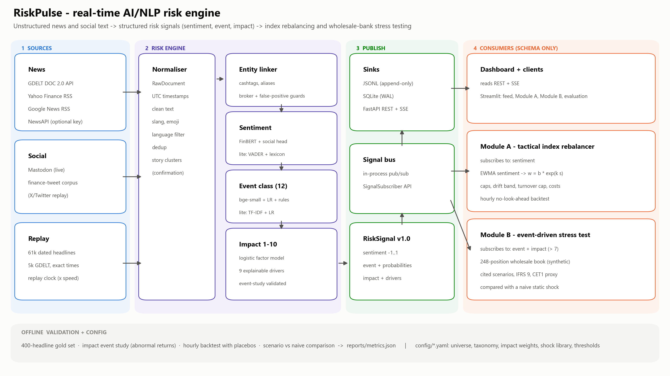
03 · SYSTEM DESIGN
One engine, decoupled consumers, one versioned signal
RiskPulse · 3 / 7
Notes:
Data flows left to right. Connectors produce RawDocuments; the normaliser cleans and clusters them into stories; the NLP stages link entities and score sentiment, event and impact. The output is a versioned RiskSignal published on a bus and written to JSONL, SQLite and a FastAPI REST and SSE API. The modules only know the schema, so they could run in another process or on another machine.

Slide 4
04 · IMPLEMENTATION HIGHLIGHTS
Built for a risk desk: explainable, testable, offline-first
Hybrid NLP
Explainable impact
Decoupled design
FinBERT + a tweet-trained head blended by source; 12-class event model with high-precision rules
Logistic factor model: 9 drivers stored on every signal, validated by an event study
Modules read only the RiskSignal schema via in-process, SQLite or SSE subscribers
Module A
Module B
Runs anywhere
Sentiment tilt with caps, drift band, turnover cap and costs; hourly no-look-ahead backtest
Fires only on reported adverse events; cited scenarios scaled by impact, IFRS 9 staging, Basel CRE20 weights, CET1 proxy
Lite tier without torch, offline replay demo, 114 tests, CI on Python 3.11
RiskPulse · 4 / 7
Notes:
Key choices and why: FinBERT because it understands financial language, plus a head trained on tweets because social text is different. Rules where phrases are near-certain, so behaviour is auditable. A transparent impact model because model-risk teams must explain scores. Two tiers so it runs on any laptop, and a replay mode so the demo never depends on the network.

Slide 5
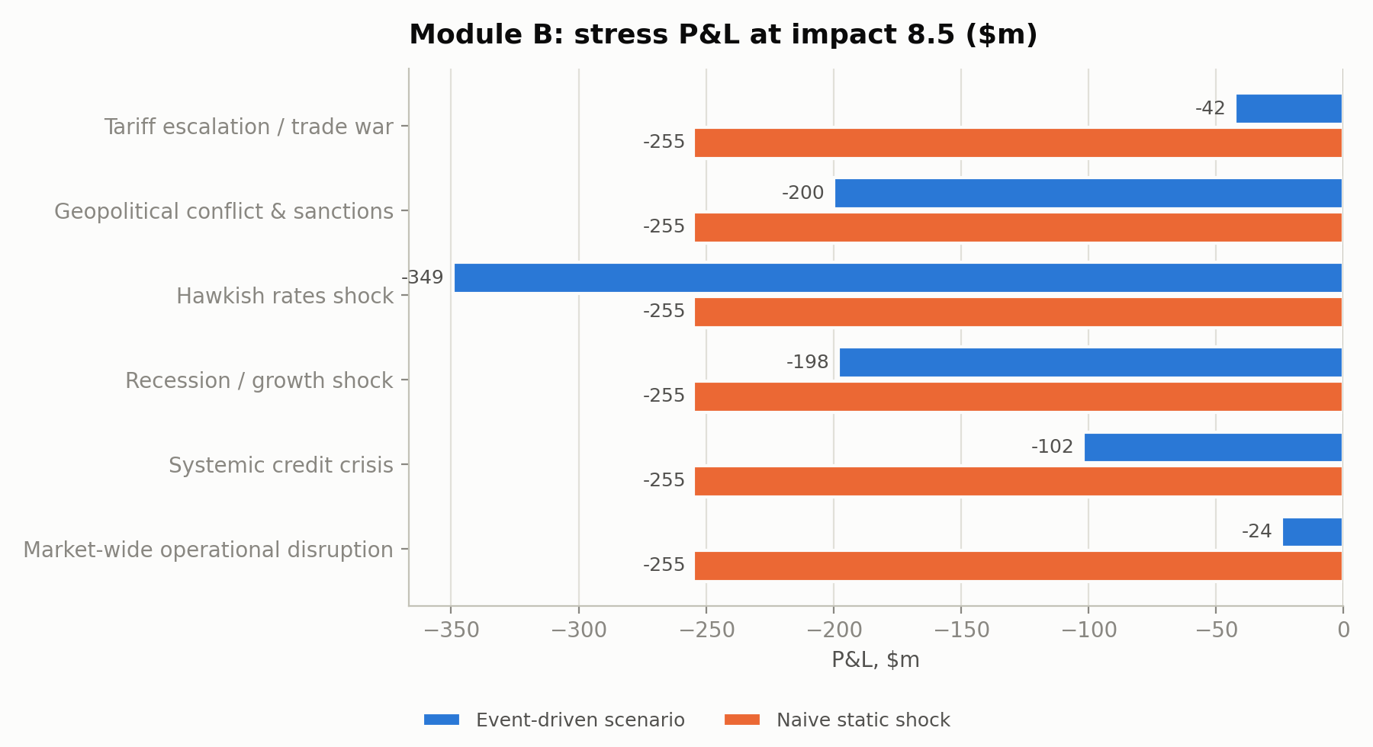
05 · KEY RESULTS VS NAIVE APPROACHES
Measured against naive baselines on held-out data
0.69 vs 0.46
sentiment macro-F1, 200 held-out headlines (naive: VADER)
0.65 vs 0.51
event macro-F1 on the same headlines (naive: keyword rules)
1.21× vs 0.85×
S&P 500 move on red-alert days, out of sample (naive: busiest news days)
Headline to stress result: 0.2 s on a laptop CPU, vs an overnight batch run (assumed).
Triage: ~84 headlines a day become 1.5 stress tests; the trigger rules cut 70% of high-impact alerts.
Honest result: with strict timing, sentiment tilts show no next-day edge (IC -0.004); an early IR of 3.7 was a look-ahead leak we traced and fixed.
4 / 6 scenarios
where a naive static stress test gets the rates P&L sign wrong
RiskPulse · 5 / 7
Notes:
Each number compares RiskPulse with a naive approach on data the models never saw. Sentiment and event classification beat their baselines; out of sample, days with a red alert moved the S&P 500 about a fifth more than other days, while simply picking the busiest news days did worse than chance; and event-aware stress tests avoid the sign errors of a static shock. I also report what did not work: no reliable trading edge once timing is strict.

Slide 6
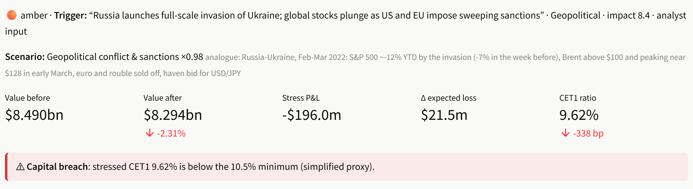
06 · DOMAIN IMPACT
From headline to capital impact in seconds
Risk managers
Portfolio managers
Model risk & audit
The right stress test runs when an adverse event is reported (not on commentary), with CET1 headroom and the positions that drive the loss
Index tilts react to company news within limits, every change linked to its headline
Every score carries its drivers, schema and model version; results are reproducible from the repo
Module B in the dashboard: the triggering headline, the scenario applied, value before and after, and the capital check
RiskPulse · 6 / 7
Notes:
Why it matters: a stress test usually runs on a schedule with a generic shock. RiskPulse runs the right scenario for the event that just happened, sized by its impact, and shows the capital effect within seconds. Because every score is explainable and reproducible, it fits model-risk governance.

Slide 7
07 · CHALLENGES, LIMITATIONS & NEXT STEPS
What was hard, what is missing, what comes next
Challenges we solved
A backtest information ratio of 3.7 was a look-ahead leak: traced and fixed
97% of 61,399 headlines carry a date, not a time: used only after the day ends
Questions and opinion pieces fired stress tests: now filtered (29 skipped in the replay)
The stress trigger ran on 90% of trading days: added a red-alert tier, tested out of sample
Limitations
Day-level history, so fast intraday reactions are untested
16 mega-cap names and two years of data
Gold labels from one annotator (AI-proposed, author-reviewed)
Sensitivity-based revaluation; simplified CET1 proxy
Next steps
Intraday timestamped feeds to test fast reactions
Multilingual sources and target-aware sentiment
Kafka bus, feature store, model registry
Full revaluation library and regulatory scenarios
Open source (MIT) · public and synthetic data only · github repo and demo video in the README
RiskPulse · 7 / 7
Notes:
The hardest problems were about trust, not models. An early backtest looked brilliant until I found it used news before it was published; with strict timing the edge disappears, and I report that. Most headlines carry only a date, so they count only after the day ends. And the stress trigger first fired on questions and opinion pieces, so it now runs only on reported, adverse events. Next: intraday feeds, more languages, a production message bus and a full revaluation library.

