Slide 1

NAV MESH GENERATION
7/15/2019
CS380 | Research Project
Haziq Hamsyari | Brennan Chng | Wong Kei Ken

Slide 2
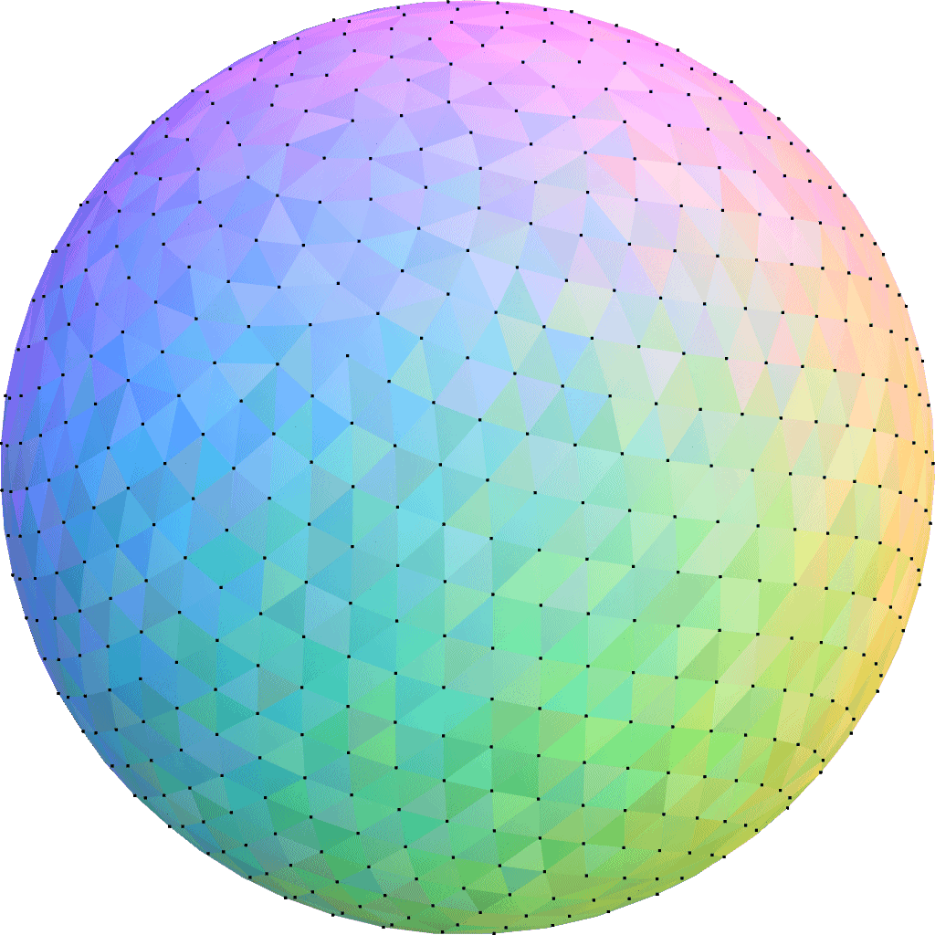
Goal of our navMesh algorithm
To support meshes of any kind of shape to allow level designers to test out unorthodox shapes

Slide 3

How we did it?

Slide 4
1
Remove all vertices within any obstacles
Identify key vertices necessary to surround obstacles
Group up triangles with same outward normal into polygons
Remove redundant vertices within each polygon
Triangulate remaining vertices

Slide 5
2
Remove all vertices within any obstacles
Identify key vertices necessary to surround obstacles
Group up triangles with same outward normal into polygons
Remove redundant vertices within each polygon
Triangulate remaining vertices

Slide 6
3
Remove all vertices within any obstacles
Identify key vertices necessary to surround obstacles
Group up triangles with same outward normal into polygons
Remove redundant vertices within each polygon
Triangulate remaining vertices

Slide 7
4
Remove all vertices within any obstacles
Identify key vertices necessary to surround obstacles
Group up triangles with same outward normal into polygons
Remove redundant vertices within each polygon
Triangulate remaining vertices

Slide 8

5
Triangulate remaining vertices

Slide 9


Slide 10

Able to generate nav mesh for any model

Slide 11

Triangulation algorithm
No linking with separate nav mesh
Generation algorithm is not optimized for high-poly mesh

Slide 12
QUESTION & ANSWER
Haziq Hamsyari | Brennan Chng | Wong Kei Ken

