Slide 1
B-BOT
Core Thesis
An Embedded Real-Time Control System for a WiFi-Enabled Wheel-Legged Balancing Platform
Robot is the validation platform.
Core work is the ESP32 embedded system.
Real-time control, I/O, communication and safety are measured.
Botao Su | Embedded Systems Individual Project | University of Manchester
B-BOT Final Presentation | 1

Slide 2
Embedded Systems Problem
A resource-constrained ESP32 must control an unstable platform while handling I/O and communication.
Real-Time Control
Embedded I/O Load
Design Rule
Changing leg length changes the balance dynamics.
Pitch, wheel torque and leg geometry are coupled.
The 4 ms control loop must remain local.
IMU, CAN motors, battery, BLE, UART and WiFi.
FreeRTOS tasks share limited timing margin.
Logging and communication must not destabilise control.
ESP32 owns the stabilising loop.
Remote inputs are target requests.
Watchdogs and arbitration enforce safe behaviour.
B-BOT Final Presentation | 2

Slide 3
Objectives
The evaluation is framed around embedded control, interfaces and safety.
O1 Embedded Control
O2 Command Interfaces
O3 Safe Arbitration
LQR/PID/VMC balance control.
ESP32 real-time loop and task timing.
Static stability and disturbance recovery.
ROS 2 camera and MediaPipe bridge.
WiFi TCP command-entry path.
Measured supervisory latency.
BLE, UART, TCP and vision command sources.
Watchdog stop behaviour.
Conflict suppression and dry-run/stunt gates.
B-BOT Final Presentation | 3

Slide 4
Embedded System Architecture
Time-critical firmware is separated from host-side supervisory command generation.
Host PC / ROS 2 / MediaPipe
Xbox BLE / UART / WiFi TCP
ESP32 Embedded Firmware FreeRTOS tasks, parser, watchdogs
Remote layers update targets, not stabilising feedback.
The embedded system owns sensing, motor feedback and safety stops.
Command loss or conflict is handled before it can become persistent motion.
This boundary is tested by E5, E6, E8, E10, E11 and O3-S.
Local Balance Control IMU + motor feedback, LQR/PID/VMC
Physical Robot wheels, legs, CAN motors, battery
B-BOT Final Presentation | 4

Slide 5
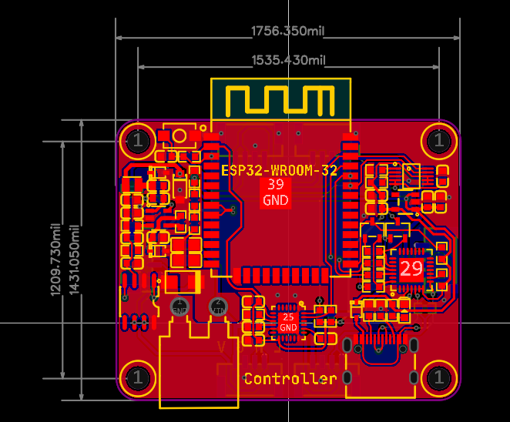
Embedded Hardware and Firmware
A lightweight ESP32 stack integrating sensing, CAN motor I/O, wireless interfaces and safety logic.
Embedded Implementation Evidence
Custom ESP32 controller PCB and wheel-legged platform.
MPU6050 attitude feedback and CAN-connected motors.
FreeRTOS tasks for CAN, IMU, motor output, balance, BLE, UART and WiFi.
Public software evidence snapshot: Realsbt/Y3-PROJECT.
B-BOT Final Presentation | 5

Slide 6
Embedded Control Hierarchy
The controller is designed to be interpretable and feasible on the ESP32.
State Estimate pitch, pitch rate, wheel speed, leg length
Gain-Scheduled LQR sagittal balance
PID Loops yaw, roll, leg length
VMC Mapping virtual leg forces to joint torques
Motor Commands wheels + joints
Chosen for ESP32 feasibility and interpretable control structure.
E3 and E9 test whether leg-length-dependent behaviour matters.
Ablation is used to justify complexity rather than just describe it.
B-BOT Final Presentation | 6

Slide 7
Embedded Command and Safety Architecture
Multiple interfaces are allowed, but persistent unsafe motion is not.
Command Sources
Parser + Queue
Safety Gates
Robot Targets
Xbox BLE
UART queue
WiFi TCP
ROS 2 vision
Shared command grammar
Queue start/pause/stop
Direct DRIVE/YAWRATE
Watchdogs
BLE disable
dry_run
stunt_armed
speed
yaw rate
leg action
stop
Direct commands expire if not refreshed.
Queue execution suppresses conflicting direct drive input.
Vision can be previewed in dry-run before real transmission.
O3-S verifies BLE/PC and queue/direct-command arbitration cases.
B-BOT Final Presentation | 7

Slide 8
Evaluation Strategy
Measured evidence for embedded timing, physical control, interfaces and safety.
O1 Evidence
O2 Evidence
O3 Evidence
E1 static balance: 0.291 deg pitch RMS.
E2 recovery: 9/10 forward, 10/10 backward.
E8 loop timing: mean 3.9998 ms, median 4.000 ms.
E9 controller ablation: FULL vs reduced variants.
E5 TCP ACK median 37.41 ms.
E7 camera bring-up.
E10 live gesture matrix and retained failures.
E11 bridge ACK median 66.13 ms.
E6 watchdog and disconnect fault injection.
dry_run and stunt gate behaviour.
O3-S: 5/5 BLE gate and 5/5 queue/direct suppression.
Not claimed as exhaustive over every race condition.
B-BOT Final Presentation | 8

Slide 9
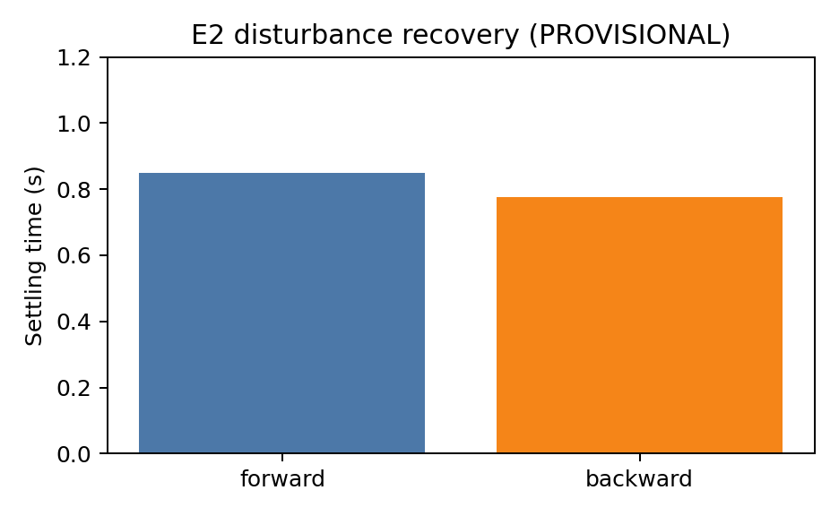
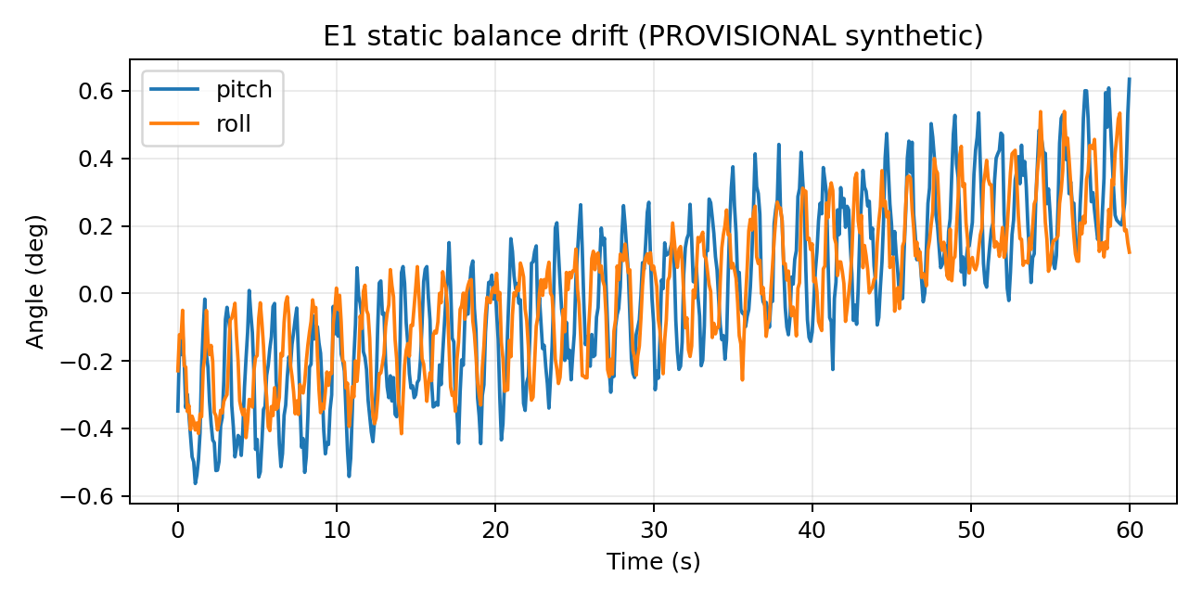
O1 Results: Static Balance and Recovery
Physical results support usable balance while exposing limits.
Static balance: 0.291 deg pitch RMS over three 60 s trials.
Impulse recovery: 9/10 forward and 10/10 backward trials.
The failed/protected forward case is retained as evidence of a real tuning/saturation limit.
B-BOT Final Presentation | 9

Slide 10
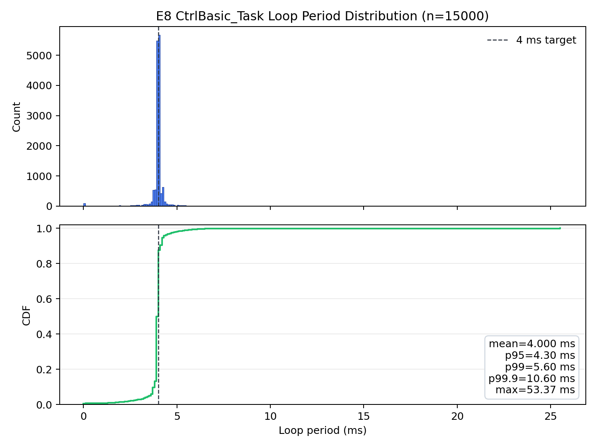
O1 Timing Boundary
The local loop is centred on 4 ms, but timing outliers are real.
Measured E8 Result
15,000 samples.
Mean period: 3.9998 ms.
Median period: 4.000 ms.
p95: 4.300 ms.
Maximum observed period: 53.365 ms.
Conclusion: WiFi/vision must remain outside the stabilising loop.
B-BOT Final Presentation | 10

Slide 11
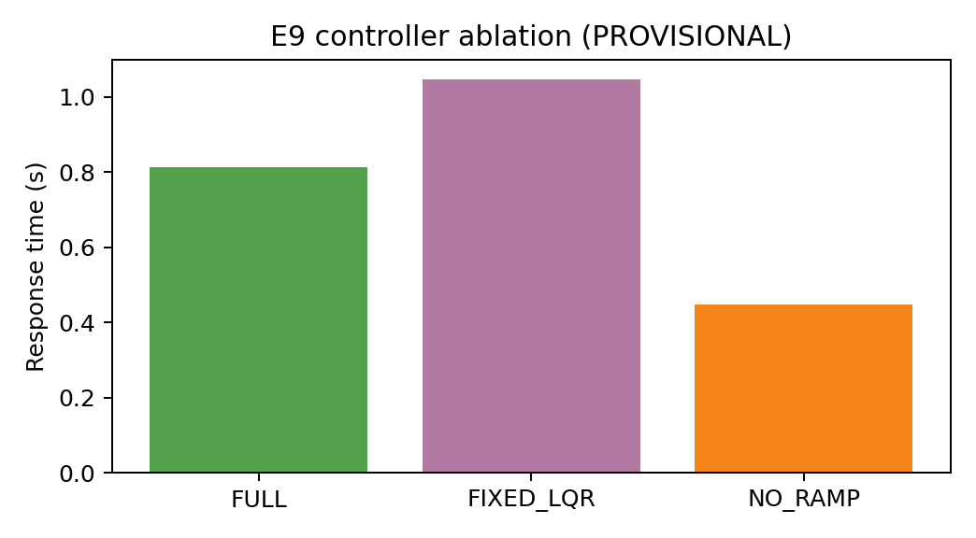
O1 Baseline: Controller Ablation
E9 tests whether added control complexity is justified.
FULL vs FIXED_LQR
FULL: 10/10 recovered.
FIXED_LQR: 9/10 recovered, one protected/failed trial.
Response metric: 1.049 s to 0.826 s, 21.3% reduction.
Peak pitch: 9.85 deg to 8.09 deg, 17.9% reduction.
Interpretation: engineering ablation evidence, not proof of global optimality.
B-BOT Final Presentation | 11

Slide 12
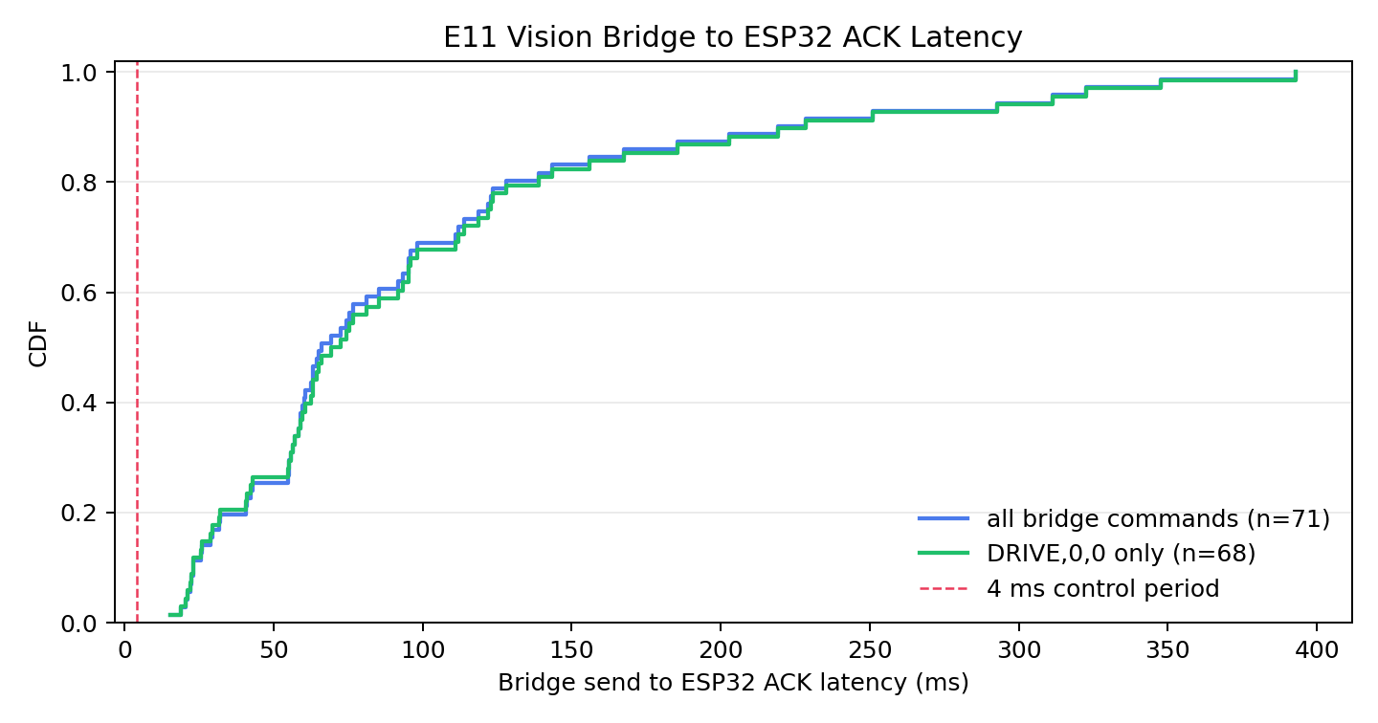
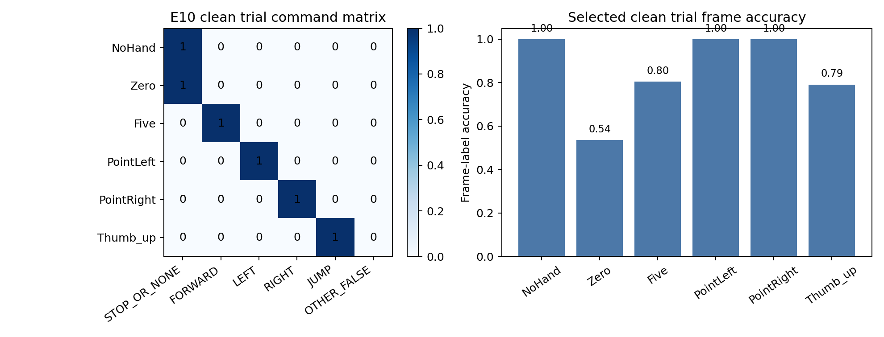
O2 Results: WiFi and Vision Teleoperation
Communication and vision are responsive enough for supervisory commands.
TCP command-entry ACK: median 37.41 ms, p95 88.31 ms across 300 samples.
Vision live matrix: clean 6/6 command classes; 85.3% selected-frame label accuracy.
Vision bridge-to-ESP32 ACK: median 66.13 ms across 71 safe commands.
B-BOT Final Presentation | 12

Slide 13
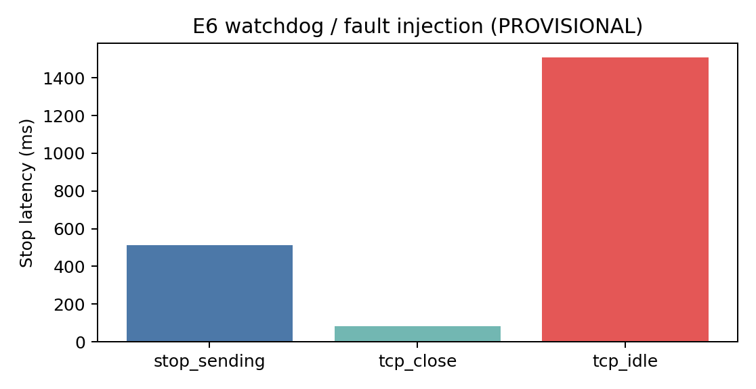
O3 Results: Safety and Arbitration
Safety behaviour is measured on the main command paths.
Measured Safety Evidence
Direct command watchdog cleared commands in 10/10 trials.
TCP socket close detected in 10/10 trials.
TCP idle produced full-stop in 10/10 trials.
O3-S: BLE/PC gate 5/5 and queue/direct suppression 5/5.
Scope is tested main paths, not every possible race condition.
B-BOT Final Presentation | 13

Slide 14
Live Demonstration Plan
Keep the demo conservative: show architecture, not maximum aggression.
Demo A: Local Balance
Demo B: Supervisory Command
Demo C: Vision Dry-Run
Robot already powered and calibrated.
Show stable balance briefly.
Small Xbox or keyboard command.
Return to zero motion.
Show terminal command path.
Explain DRIVE/YAWRATE as targets.
Show watchdog or stop behaviour conservatively.
Run vision bridge in dry_run=true.
Show gesture classified into command.
No real robot motion unless already rehearsed.
B-BOT Final Presentation | 14

Slide 15
Limitations and Future Work
The embedded-system boundaries are explicit.
Current Limitations
Next Technical Steps
Manual gain tuning and manually applied disturbances.
Small-sample physical trials.
IMU vibration, mechanical compliance and actuator saturation.
Measured timing tail outliers under shared workload.
WiFi/vision latency prevents use as balance feedback.
Better logging, event markers and parameter versioning.
Repeatable gain sweeps and larger E2/E9 datasets.
Improved state estimation and vibration isolation.
Onboard companion computer for ROS 2 vision, while ESP32 still owns balance.
B-BOT Final Presentation | 15

Slide 16
Conclusion
B-BOT demonstrates a practical ESP32 embedded control system on a challenging physical platform.
Main Embedded Systems Contribution
ESP32 owns the balance-critical feedback loop.
Firmware integrates IMU, CAN motors, FreeRTOS tasks, BLE, UART and WiFi.
LQR/PID/VMC control is implemented and physically evaluated.
WiFi, Xbox and ROS 2 vision are integrated as supervisory command sources.
Watchdogs, dry-run, stunt gates and command arbitration are measured.
The final system is not perfect, but its evidence chain is objective and traceable.
Thank you. I am happy to answer questions.
B-BOT Final Presentation | 16

Slide 17
Backup: Key Numbers for Q&A
Use this slide only if asked for evidence details.
Balance
Control Baseline
Teleoperation + Safety
E1 pitch RMS: 0.291 deg.
E2 recovery: 9/10 forward, 10/10 backward.
E8 mean/median: 3.9998 ms / 4.000 ms.
E8 max outlier: 53.365 ms.
E9 FULL: 10/10.
E9 FIXED_LQR: 9/10.
Response metric: 21.3% lower.
Peak pitch: 17.9% lower.
E5 TCP median/p95: 37.41 / 88.31 ms.
E11 ACK median: 66.13 ms.
E10 selected-frame accuracy: 85.3%.
E6 and O3-S main safety tests passed.
B-BOT Final Presentation | 17

