Slide 1




YYYYYYYYYYYY
Smart Water Management System
FOR SUPPORT:
@ 9865212396

Slide 2
About i-Tank
The i-Tank,
An adaptive solution of versatile, modular based and IOT integrated system for automating and reporting water level in tanks at large scale area and numerous in numbers.
Distinctiveness,
Commercial solutions available for controlling water level in the tanks won't suite present scenarios especially when the tanks are largely spaced. Hence so the i-Tank is with its unique feature of wired and wireless connectivity. Because of this it overcomes complications in wiring and integrating a large scale water distribution system. As the system is with current wireless technology the tanks and pumping stations can even be separated at most to a distance of 5Km & 50+ tanks can be monitored.

Slide 3
i-Tank Features
Water overflow & dry run is completely prevented.
• All time linear sensor with real time level.
• Manual, Semi-Automatic and Automatic modes.
• Valve control for automatic tank switching and refilling.
• Wired or wireless modules up to the range of 5Km, Up to 50+ tanks in total including multiple sump.
• Alarm for high level and low level thresholds.
• Consumption report and internet based level monitoring using application and web page.
• Motor status, power non-linearity protection and starter actuation status, SMS configuration and alerts, Suitable for urban, rural and hilly regions.
• Inert materialized sensor makes suitable for chemical level measurements also.

Slide 4
Challenges
Over Flow in OHT
Dry Run
Wastage of Electricity
Man Power Usage
Wastage of Water
Tank Level Not Known
Solutions from i-Tank
Stops Over Flow
Stops Dry Run
Save Usage of Electricity
Accountability for Water Consumption
Tank Level show as cm,ltrs,%
Tank Level Alert for Low & High
Manual, Semi & Automatic System

Slide 5







Main i-Tank Elements
M
MASTER
T
TRANSMITTER
R
REPEATER
DWG
DISPLAY WITH GSM
LLS
LINEAR LEVEL SENSOR
MV
MOTORIZED VALVE
VCU
VALVE CONTROL UNIT

Slide 6








Main i-Tank Elements
SMC
SMART MOTOR CONTROLLER
VCT
VALVE CONTROLLER
D
DISPLAY
FM
FLOWMETER
PRV
PRESSURE RELIEF VALVE
NRV
NON-RETURN VALVE

Slide 7


FULLY AUTOMATION – SUMP TO OVERHEAD TANK
Tx
LLS
OHT TANK
M
LLS
SUMP

Slide 8
SYSTEM REQUIREMENTS AND ESTIMATE – SUMP TO OVERHEAD TANK
UNIT | QUANTITY | UNIT COST | PRICE
I TANK MASTER GATEWAY CONTROLLER – 4G | 1 | 16,500 | 16,500
HYDROPHOBIC SUBMERSIBLE LINEAR LEVEL SENSOR (SS316L INDUSTRIAL GRADE) | 2 | 11,000 | 22,000
WIRELESS LONG RANGE TRANSMITTER | 1 | 14,500 | 14,500
HARDWARE INSTALLATION, TESTING, CALIBRATION & TRAINING CHARGES |  |  | 7,950
 | TOTAL COST WITHOUT TAX |  | 60,950
 | GST 18% |  | 10,971
 | TOTAL COST WITH TAX |  | 71,921

Slide 9
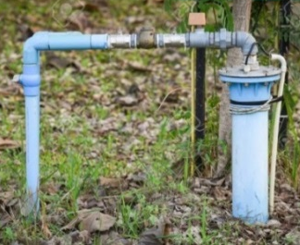
WIRED FULLY AUTOMATION – BORE TO OVERHEAD TANK
DWG
LLS
OHT TANK
SMC
BORE

Slide 10
SYSTEM REQUIREMENTS AND ESTIMATE – BORE TO OVERHEAD TANK
UNIT | QUANTITY | UNIT COST | PRICE
WIRELESS SMART MOTOR CONTROLLER | 1 | 13,500 | 13,500
MULTI SEGMENT GRAPHICS DISPLAY WITH GSM | 1 | 15,500 | 15,500
HYDROPHOBIC SUBMERSIBLE LINEAR LEVEL SENSOR (SS316L INDUSTRIAL GRADE) | 1 | 11,000 | 11,000
HARDWARE INSTALLATION, TESTING, CALIBRATION & TRAINING CHARGES |  |  | 8,800
 | TOTAL COST WITHOUT TAX |  | 48,800
 | GST 18% |  | 8,784
 | TOTAL COST WITH TAX |  | 57,584

Slide 11
FULLY AUTOMATION – BORE TO SUMP, SUMP TO OHT TANK
Tx
LLS
OHT TANK
M
SMC
LLS
BORE
SUMP

Slide 12
SYSTEM REQUIREMENTS AND ESTIMATE – BORE TO SUMP, SUMP TO OHT TANK
UNIT | QUANTITY | UNIT COST | PRICE
I TANK MASTER GATEWAY CONTROLLER – 4G | 1 | 16,500 | 16,500
WIRELESS LONG RANGE TRANSMITTER | 1 | 14,500 | 14,500
HYDROPHOBIC SUBMERSIBLE LINEAR LEVEL SENSOR (SS316L INDUSTRIAL GRADE) | 2 | 11,000 | 22,000
WIRELESS SMART MOTOR CONTROLLER | 1 | 13,500 | 13,500
HARDWARE INSTALLATION, TESTING, CALIBRATION & TRAINING CHARGES |  |  | 9,975
 | TOTAL COST WITHOUT TAX |  | 76,475
 | GST 18% |  | 13,766
 | TOTAL COST WITH TAX |  | 90,241

Slide 13
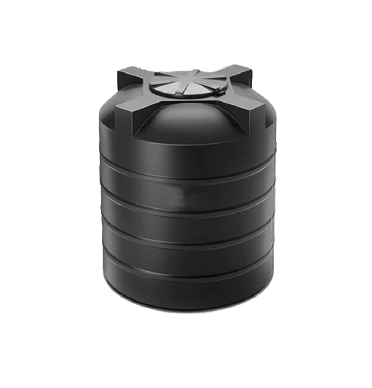
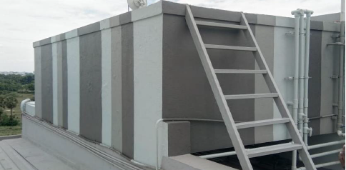
FULLY AUTOMATION – BORE TO MAIN BUILDING OHT & CANTEEN OHT
VCT
MV
5000 LTRS
LLS
VCT
CANTEEN OHT
MV
LLS
25,000 LTRS
MAIN BUILDING OHT
SMC
BORE

Slide 14
SYSTEM REQUIREMENTS AND ESTIMATE – BORE TO MAIN BUILDING OHT & CANTEEN OHT
UNIT | QUANTITY | UNIT COST | PRICE
GRAPHICS DISPLAY WITH VALVE INTERFACE CONTROLLER | 2 | 27,500 | 55,000
HYDROPHOBIC SUBMERSIBLE LINEAR LEVEL SENSOR (SS316L INDUSTRIAL GRADE) | 2 | 11,000 | 22,000
2” - MOTORIZED BUTTERFLY VALVE WITH MANUAL OVERRIDE | 2 | 16,500 | 33,000
WIRELESS SMART MOTOR CONTROLLER | 1 | 15,500 | 15,500
HARDWARE INSTALLATION, TESTING, CALIBRATION & TRAINING CHARGES |  |  | 18,825
 | TOTAL COST WITHOUT TAX |  | 1,44,325
 | GST 18% |  | 25,979
 | TOTAL COST WITH TAX |  | 1,70,304

Slide 15
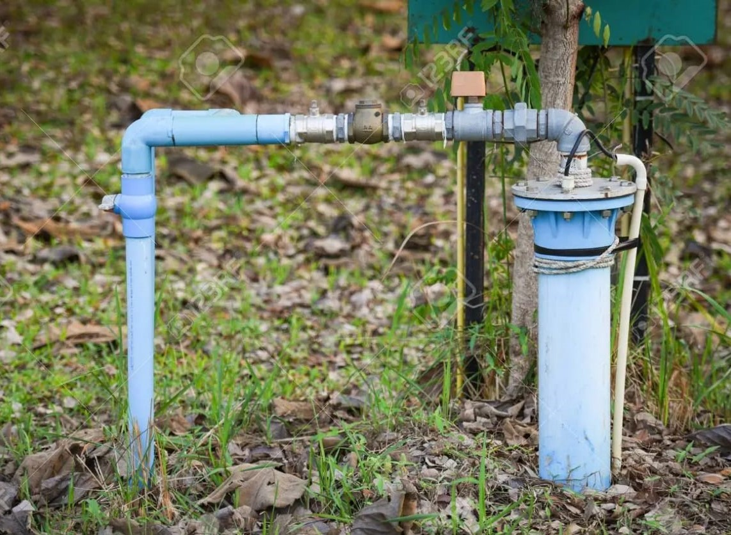
SET-3
FULLY AUTOMATION – 4 BORE WELL TO OVERHEAD TANK
DWG
LLS
SMC
DWG
LLS
EACH TANK 5,000 LTRS
BORE WELL
SMC
BORE WELL
SMC
BOTTOM LINE INTERLINKED
OHT TANK
BORE WELL
SMC
BORE WELL

Slide 16
SYSTEM REQUIREMENTS AND ESTIMATE – 4 BORE WELL TO OVERHEAD TANK
UNIT | QUANTITY | UNIT COST | PRICE
WIRELESS SMART MOTOR CONTROLLER | 4 | 15,500 | 62,000
HYDROPHOBIC SUBMERSIBLE LINEAR LEVEL SENSOR (SS316L INDUSTRIAL GRADE) | 2 | 11,000 | 22,000
MULTI SEGMENT GRAPHICS DISPLAY WITH GSM | 2 | 15,500 | 31,000
HARDWARE INSTALLATION, TESTING, CALIBRATION & TRAINING CHARGES |  |  | 17,250
 | TOTAL COST WITHOUT TAX |  | 1,32,250
 | GST 18% |  | 23,805
 | TOTAL COST WITH TAX |  | 1,56,055

Slide 17

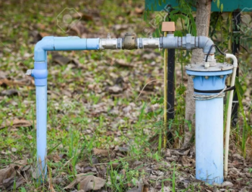
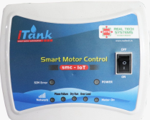
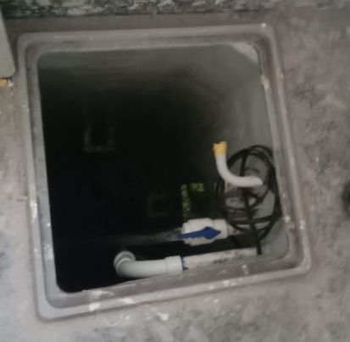

FULLY AUTOMATION – FROM 5 BOREWELLS TO SUMP TO MAIN BUILDING, WAITING HALL, IT BUILDING OHT TANK AND 3 OHT’S
SMC
BORE - 1
MV
MV
MV
MV
MV
MV
LLS
LLS
LLS
LLS
LLS
LLS
VCT
VCT
VCT
VCT
VCT
VCT
SMC
BORE - 2
MAIN BUILDING OHT
WAITING HALL OHT
IT BUILDING OHT
OHT 1
OHT 2
OHT 3
PRV
NEED 2NO’S NRV
SMC
BORE - 3
MOTOR 1
MOTOR 2
AUTO CHANGEOVER
SMC
BORE - 4
M
LLS
DWG
LLS
SUMP
SMC
BORE - 5

Slide 18
SYSTEM REQUIREMENTS AND ESTIMATE - FROM 5 BOREWELLS TO SUMP TO MAIN BUILDING, WAITING HALL, IT BUILDING OHT TANK AND 3 OHT’S
UNIT | QUANTITY | UNIT COST | PRICE
GRAPHICS DISPLAY WITH VALVE INTERFACE CONTROLLER (FULL AUTOMATIC) | 6 | 27,500 | 1,65,000
MASTER GATEWAY CONTROLLER (IOT) | 1 | 16,500 | 16,500
WIRELESS SMART MOTOR CONTROLLER | 5 | 13,500 | 67,500
2" - MOTORIZED BUTTERFLY VALVE WITH MANUAL OVERRIDE | 6 | 16,500 | 99,000
HYDROPHOBIC SUBMERSIBLE LINEAR LEVEL SENSOR (SS316L INDUSTRIAL GRADE) | 8 | 11,000 | 88,000
MULTI SEGMENT GRAPHICS DISPLAY WITH GSM | 1 | 15,500 | 15,500
QUICK PRESSURE RELIEF | 1 | 14,500 | 14,500
MULTI CONTROL MOTOR AUTO CHANGEOVER | 1 | 8,500 | 8,500
2”NRV | 2 | 3,000 | 6,000
HARDWARE INSTALLATION, TESTING, CALIBRATION & TRAINING CHARGES |  |  | 72,075
 | TOTAL COST WITHOUT TAX |  | 5,52,575
*WITHOUT GST 18%

Slide 19
(OR) FULLY AUTOMATION – SUMP TO MAIN BUILDING, WAITING HALL, IT BUILDING OHT TANK AND 3 OHT’S
MV
MV
MV
MV
MV
MV
LLS
LLS
LLS
LLS
LLS
LLS
VCT
VCT
VCT
VCT
VCT
VCT
MAIN BUILDING OHT
WAITING HALL OHT
IT BUILDING OHT
OHT 1
OHT 2
OHT 3
PRV
NEED 2NO’S NRV
MOTOR 1
MOTOR 2
AUTO CHANGEOVER
M
LLS
SUMP

Slide 20
SYSTEM REQUIREMENTS AND ESTIMATE - SUMP TO MAIN BUILDING, WAITING HALL, IT BUILDING OHT TANK AND 3 OHT’S
UNIT | QUANTITY | UNIT COST | PRICE
GRAPHICS DISPLAY WITH VALVE INTERFACE CONTROLLER (FULL AUTOMATIC) | 6 | 27,500 | 1,65,000
MASTER GATEWAY CONTROLLER (IOT) | 1 | 16,500 | 16,500
2" - MOTORIZED BUTTERFLY VALVE WITH MANUAL OVERRIDE | 6 | 16,500 | 99,000
HYDROPHOBIC SUBMERSIBLE LINEAR LEVEL SENSOR (SS316L INDUSTRIAL GRADE) | 7 | 11,000 | 77,000
QUICK PRESSURE RELIEF | 1 | 14,500 | 14,500
MULTI CONTROL MOTOR AUTO CHANGEOVER | 1 | 8,500 | 8,500
2”NRV | 2 | 3,000 | 6,000
HARDWARE INSTALLATION, TESTING, CALIBRATION & TRAINING CHARGES |  |  | 57,975
 | TOTAL COST WITHOUT TAX |  | 4,44,475
*WITHOUT GST 18%

Slide 21


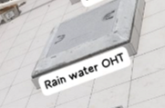
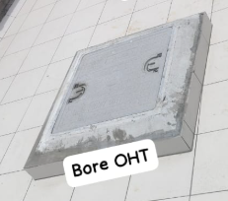
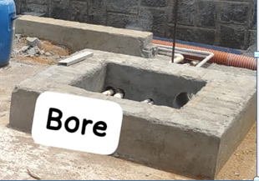
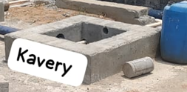
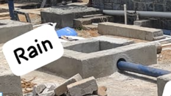
FULLY AUTOMATION – BORE
SET-2
T-1
S-2
2”
2”
VCU-1
V-2
T-1
S-2
V-1
S-3
T-1
S-2
BORE WATER OHT TANK
RAIN WATER OHT TANK
M-1
M-1
M-1
S-1
S-1
S-1
M-1
S-1
BORE STARTER POINT TO BORE SUMP
BORE WELL
BORE WATER SUMP
KAVERY WATER SUMP
RAIN WATER SUMP

Slide 22
SYSTEM REQUIREMENTS AND ESTIMATE – BORE
UNIT | QUANTITY | UNIT COST | PRICE
MASTER CONTROL UNIT | 4 | 16,500
HYDROPHOBIC SUBMERSIBLE LINEAR LEVEL SENSOR (SS316L INDUSTRIAL GRADE) | 8 | 11,000
WIRELESS LONG RANGE TRANSMITTER | 3 | 18,500
WIRELESS RANGE EXTENDER | 1 | 11,000
2” - MOTORIZED BUTTERFLY VALVE WITH MANUAL OVERRIDE | 1 | 16,500
2.5” - MOTORIZED BUTTERFLY VALVE WITH MANUAL OVERRIDE | 1 | 17,500
3” - MOTORIZED BUTTERFLY VALVE WITH MANUAL OVERRIDE | 1 | 19,500
3” DIGITAL FLOWMETER WITH TOTALIZER | 3 | 19,500
MULTI SEGMENT GRAPHICS DISPLAY | 1 | 12,500
HARDWARE INSTALLATION, TESTING, CALIBRATION & TRAINING CHARGES
 | TOTAL COST WITHOUT TAX

Slide 23
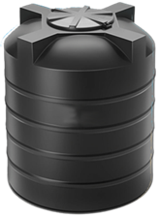
FULLY AUTOMATION + FLOWMETER – UG SUMP TO SHOP FLOOR – III, HEAD OFFICE OHT &CANTEEN VESSEL CLEANING M/C TANK
2”
VCT
LLS
2”
VCT
LLS
FM
MV
FM
MV
CANTEEN VESSEL CLEANING M/C TANK
10,350 LTRS
DWG
HEAD OFFICE
1000 LTRS
1000 LTRS
2”
FM
CANTEEN VESSEL CLEANING M/C
2”
VCT
LLS
SHOP FLOOR - III
OHT TANK
FM
MV
M
LLS
UG SUMP
16,500 LTRS

Slide 24
SYSTEM REQUIREMENTS AND ESTIMATE
SET-2
UNIT | QUANTITY | UNIT COST | PRICE
MASTER CONTROL UNIT | 1 | 16,500 | 16,500
GRAPHICS DISPLAY WITH VALVE & FLOWMETER INTERFACE CONTROLLER | 3 | 27,500 | 82,500
MULTI SEGMENT GRAPHICS DISPLAY WITH GSM | 1 | 15,500 | 15,500
HYDROPHOBIC SUBMERSIBLE LINEAR LEVEL SENSOR (SS316L INDUSTRIAL GRADE) | 4 | 11,000 | 44,000
2” - MOTORIZED BUTTERFLY VALVE WITH MANUAL OVERRIDE | 3 | 16,500 | 49,500
2” DIGITAL FLOWMETER WITH TOTALIZER | 4 | 10,500 | 42,000
HARDWARE INSTALLATION AND COMMISSIONING CHARGES |  |  | 37,500
 | TOTAL COST WITHOUT TAX |  | 2,87,500
 | GST 18% |  | 51,750
 | TOTAL COST WITH TAX |  | 3,39,250

Slide 25
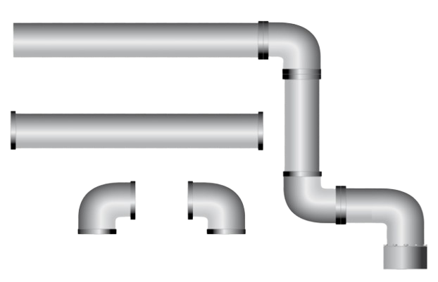
FLOWMETER – TEATMENT PLANT
2 INCH PIPESIZE
FM-1
DWG-1
2 INCH PIPESIZE
FM-2
DWG-2
2 INCH PIPESIZE
FM-3
DWG-3

Slide 26
SYSTEM REQUIREMENTS AND ESTIMATE – POWER HOUSE, TEATMENT PLANT & STP
UNIT | QUANTITY | UNIT COST | PRICE
MULTI SEGMENT GRAPHICS DISPLAY WITH GSM | 3 | 15,500 | 46,500
2” DIGITAL FLOWMETER WITH TOTALIZER | 6 | 10,500 | 63,000
HARDWARE INSTALLATION AND COMMISSIONING CHARGES |  |  | 16,425
 | TOTAL COST WITHOUT TAX |  | 1,25,925
*WITHOUT GST

Slide 27
SYSTEM REQUIREMENTS AND ESTIMATE – BORE MOTOR CONTROL
UNIT | QUANTITY | UNIT COST | PRICE
WIRELESS SMART MOTOR CONTROLLER | 1 | 13,500 | 13,500
HARDWARE INSTALLATION AND COMMISSIONING CHARGES |  |  | 2,000
 | TOTAL COST WITHOUT TAX |  | 15,500
 | GST 18% |  | 2,790
 | TOTAL COST WITH TAX |  | 18,290
TEAMS & CONDITIONS:
1. Payment: 100% in advance with PO.
2. Delivery: 3 -4 Weeks against PO.
3. Warranty: One year from the date of Commissioning.
4. No warranty for products failure under High Voltage & Natural disasters.
7. AMC would be 15% of the total value post-warranty.
8. Quotation Valid for 30 days.

Slide 28
FULLY AUTOMATION – BORE 1 & 2 TO MAIN SUMP, MAIN SUMP TO 3 OHT TANKS, MAIN SUMP TO 6 OHT TANKS & 1 TANK MONITORING ONLY
DWG
LLS
TOTAL 2 TANK
VCT - 2 NO’S
SENSOR – 2 NO’S
2” VALVE – 2 NO’S
TOTAL 2 TANK
VCT - 2 NO’S
SENSOR – 2 NO’S
2” VALVE – 2 NO’S
TOTAL 2 TANK
VCT - 2 NO’S
SENSOR – 2 NO’S
2” VALVE – 2 NO’S
MAIN OHT TANK
ADMIN BLOCK OHT TANK
A BLOCK
OHT TANK
B BLOCK
OHT TANK
M
M
SMC
LLS
LLS
BOYS HOSTEL OHT TANK
B TYPE
QUARTERS OHT TANK
STAFF QUARTERS OHT TANK
GIRLS HOSTEL
OHT TANK
GUEST HOUSE
OHT TANK
GIRLS HOSTEL
OHT TANK
TOTAL 8 TANK (INTERLINKED)
VCT - 1 NO’S
SENSOR – 1 NO’S
2” VALVE – 1 NO’S
TOTAL 1 TANK
VCT - 1 NO’S
SENSOR – 1 NO’S
2” VALVE – 1 NO’S
TOTAL 2 TANK
VCT - 2 NO’S
SENSOR – 2 NO’S
2” VALVE – 2 NO’S
TOTAL 4 TANK
(INTERLINKED)
VCT - 1 NO’S
SENSOR – 1 NO’S
2” VALVE – 1 NO’S
TOTAL 1 TANK
VCT - 1 NO’S
SENSOR – 1 NO’S
2” VALVE – 1 NO’S
TOTAL 1 TANK
VCT - 1 NO’S
SENSOR – 1 NO’S
2” VALVE – 1 NO’S
MAIN SUMP
SMC

Slide 29
System Requirements and Estimate- OVERALL
SITE NAME | PRICE
FULLY AUTOMATION – RAW WATER SUMP TO J BLOCK OHT, RAW WATER SUMP TO K BLOCK OHT & J BLOCK OHT | 2,56,473
FULLY AUTOMATION – RAW WATER SUMP TO 2 OHT TANKS, PHARMACY BORE TO PHARMACY SUMP | 1,99,479
FULLY AUTOMATION – PHARMACY SUMP TO PHARMACY OHT | 71,921
FULLY AUTOMATION – RO WATER SUMP TO A BLOCK GIRLS HOSTEL OHT, GRAVITY LINE (PHARMACY J BLOCK OHT & EEE BLOCK OHT) | 2,22,548
FULLY AUTOMATION – H BLOCK SUMP TO H BLOCK OHT | 71,921
FULLY AUTOMATION – OLD BOYS HOSTEL SUMP TO D BLOCK OHT | 71,921
FULLY AUTOMATION – OLD BOYS HOSTEL SUMP TO 2 OHT TANKS | 1,99,479
FULLY AUTOMATION – OLD BOYS HOSTEL SUMP TO G & I OHT | 71,921
FULLY AUTOMATION – OLD BOYS HOSTEL SUMP TO J BLOCK OHT | 73,278
FULLY AUTOMATION – OLD BOYS HOSTEL SUMP TO FOOD COURT OHT | 71,921
FULLY AUTOMATION – OLD BOYS HOSTEL SUMP TO I BLOCK OHT & GIRLS HOSTEL SUMP | 1,84,552
FULLY AUTOMATION – PLACEMENT C BLOCK SUMP TO 3 OHT TANKS | 2,63,258
FULLY AUTOMATION – GIRLS HOSTEL SUMP TO D BLOCK OHT | 71,921

Slide 30
System Requirements and Estimate- OVERALL
SITE NAME | PRICE
FULLY AUTOMATION – GIRLS HOSTEL SUMP TO G BLOCK OHT & RO RAW WATER SUMP | 1,84,552
FULLY AUTOMATION – GIRLS HOSTEL SUMP TO B BLOCK OHT & E BLOCK OHT | 71,921
FULLY AUTOMATION – GIRLS HOSTEL SUMP TO A BLOCK OHT | 73,278
TOTAL | 21,60,344
INLET LINES
FULLY AUTOMATION – MEDICAL COLLEGE BORE TO 2 SUMPS | 1,87,266
FULLY AUTOMATION – NURSING SUMP TO NURSING BLOCK OHT | 73,278
FULLY AUTOMATION – J BLOCK BORE TO NURSING BLOCK OHT | 18,320
FULLY AUTOMATION – H BLOCK BORE TO 2 SUMPS | 1,87,266
FULLY AUTOMATION – STP BORE TO WELL | 64,458
FULLY AUTOMATION – WELL TO H BLOCK SUMP | 83,456
FULLY AUTOMATION – EEE BLOCK BORE, D BLOCK BORE, M BLOCK SUMP, GIRLS HOSTEL SUMP TO OLD BOYS HOSTEL SUMP | 1,47,235
FULLY AUTOMATION – M BLOCK BORE TO PLACEMENT C BLOCK SUMP | 54,280
FULLY AUTOMATION – MBA BLOCK BORE TO 2 SUMPS, MAIN GATE GARDEN BORE TO GIRS HOSTE SUMP, E BLOCK BORE TO RO RAW SUMP & GIRLS HOSTEL SUMP | 3,40,607
FULLY AUTOMATION – MAIN GATE A BLOCK BORE TO MAIN GATE SUMP | 54,280
FULLY AUTOMATION – PHARMACY BORE TO PHARMACY SUMP | 54,280
TOTAL | 12,64,726

Slide 31




i Tank Application View
app
APARTMENT..
SUMP
APARTMENT
SUMP
OHT TANK
SUMP
OHT TANK
OHT TANK 4
OHT TANK 5
OHT TANK 3
OHT TANK 4
OHT TANK 5

Slide 32

i Tank Application View
app
APARTMENT..
SUMP
BORE WELL
SUMP TO OHT
SUMP
OHT TANK
OHT TANK 5

Slide 33



i Tank Mobile / Web View
KEC
KONGU ENGINEERING COLLEGE
KONGU ENGINEERING COLLEGE
SUMP
SUMP
OHT TANK 1
OHT TANK 2
OHT TANK 3
OHT TANK 4
OHT TANK 5
OHT TANK 3
OHT TANK 4
OHT TANK 5
WEB VIEW
MOBILE VIEW

Slide 34

i Tank Flowmeter Mobile / Web View
KEC
FLOWMETER 1
KONGU ENGINEERING COLLEGE
SUMP
FLOWMETER 2
SUMP
WEB VIEW
MOBILE VIEW

Slide 35

i Tank Flowmeter Mobile View
HOSUR
FLOWMETER 1
DEMO
FLOWMETER 2
SUMP

Slide 36


i Tank Flowmeter Web View

Slide 37

i Tank Chlorinator Mobile / Web View
PANCHAYAT
DWG VCT
PANCHAYAT
WEB VIEW
APP & WEB VIEW FEATURES:
1.TANK HIGH LEVEL
2.TANK LOW LEVEL
3.TANK CAPACITY
4.TANK PERCENTAGE
MOBILE APP VIEW

Slide 38
TERMS AND CONDITIONS
1. Payment: 75% in advance with PO and 25 % after installation.
2. Delivery: 3 -4 Weeks against PO.
3. Warranty: One year from the date of Commissioning.
4. No warranty for products failure under High Voltage & Natural disasters.
5. Civil Works, Plumbing and Electrical Supply would be on Customer Scope.
6. Additionally Wireless Repeater may be required if the signal is not sufficient, The cost of the Repeater will be Rs.11,000 Plus GST 18%.
7. AMC would be 15% of the total value post-warranty.
8. Quotation Valid for 30 days.

Slide 39



















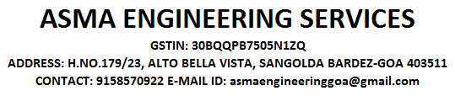
Our Prestigious i-Tank private Customers
KPR Mills, SIPCOT-Perundurai | Kongu Engineering College, Perundurai
Sakthi Group, PallagoundenPalayam | SA Textiles, Vijayamangalam
Cheran Plastics, Chennimalai | Velmurugan Scans,Erode
MSK Hero Group, Erode | Prithvi Inner Wears, Tirupur
Palani Murugan Temple, Palani | Kasipalayam CETP, Tirupur
CMV Global Clothing, Tirupur | Excel Group Institutions, Komarapalayam
Erode Railway Junction, Erode | Nithin Nivas Apartments, Erode
Tenx Health Care, Coimbatore | Sukra Colors, Bhavani
Roots Multi Clean Ltd, Pollachi | MohanRaj Poultry Farms, Namakkal
Sona College of Technology, Salem | ASMA Engineering Services, Goa

Slide 40



















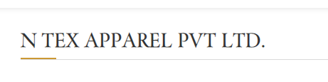
Our Prestigious i-Tank Private Customers
Sarvesh Multi Plast, Chennimalai | The Indian Public School, Erode
Annavaram Sathyanarayana Temple, Andhra Pradesh | Venbro Polymers, Bhavani
Maharishi Vidhya Mandir, Perundurai | Arasan Eye Hospital, Erode
Kongu Mahal, Tiruchengode | Angeripalayam CETP, Tirupur
PSG Institutions, Coimbatore | Sivabakkiyam Muthusamy School, Paramathi
G.Kuppusamy Naidu Memorial Hospital, Coimbatore | KPR Institute of Technology, Coimbatore
SRS Power Tech,Coimbatore | M.Mahendran - Home, Kangeyam
Nandha Institutions,Perundurai | VKS-Textiles, Komarapalayam
Rathinam Institutions, Coimbatore | K.M.T Hospital, Tiruchendur
Balasundaram - Home, Coimbatore | N-Tex Apparels private Limited, Tirupur

Slide 41




















Our Prestigious i-Tank Private Customers
Podaran, Melapalayam - Kangayam | Chinnakarai Common Effluent Treatment Plant (P) Limited
A.R Aswin Home – Kangayam | Jaishriram Engineering College, Tirupur
Mahalakshmi Poultry Farm – Namakkal | SSVM, Institutions, Coimbatore
Vivekanandha College of Engineering for Women - Elayampalayam | Sakthi Sugars Limited – Appakudal
Chendhoor Murughan Yarn Tex-Veppadi | Seshasayee Paper and Boards Limited – Pallipalayam
Ponmani Poultry Farm – Namakkal | Navaladi Poultry Farms – Namakkal
Palladam Water Projects – Palladam | Kumaraguru College of Technology, Coimbatore
K.S. Rangasamy College of Technology- Tiruchengode. | Best Cotton Mill (RRD Tex) - Dharapuram
SPAC Starch Products (India) Private Limited – Anthiyur | Gharuda Apartment – Erode
Tamil Nadu Newsprint and Papers Limited - kagithapuram | Mahendra Engineering College - Namakkal

Slide 42




















Our Prestigious i-Tank Private Customers
SPIRO Educational Institute - Namakkal | Apex - Kodaikanal
Aalaya academy - Tirupur | Sri Devaraja Agro Industries - Krishnagiri
VSM Weavess India (P) Limited - Namakkal | SUA Serenetia - Coonoor
Texmo Industries Pump Division - Coimbatore | Vellalar Educational Trust
Tamilmani Poultry Farm – Namakkal | Jai Ram Arts & Science College - Salem
JPS Academy - Thirchengode | Kummu Mahal – Perundurai
Shanthi Gears - Coimbatore | Ponnusamy Poultry Farms - Namakkal
Dhiyanalinga Modern Rice Mills – Palladam | Leyercaud Resort - Yercaud
Venus Home Appliance - Thuthukudi | VSR Industrial Corporation - Erode
Kavery Eductaional Institutions – Salem | VRL Supporters - Coimbatore
Asian Fabrics – Karur | Sri Swamy School - Salem
Kovai Medical Center Hospital – Coimbatore | Royal Care Hospital - Coimbatore

Slide 43





Our Prestigious i-Tank Government Customers
Mettupalayam Municipality - Coimbatore | Nagercoil Corporation – Nagercoil
Sathyamangalam Municipality – Erode | Erode Corporation - Erode
Bhavani Municicpality - Erode | Tirupur Corporation - Tirupur
Gobichettipalayam Municipality - Erode | Kumaravalasu Panchayat-Chennimalai Union, Erd
Arcot Municipality - Ranipet | Thirumalaigiri Panchayat - Salem
Kodaikanal Municipality - Dindugal | Vadakuthu Panchayat - Cuddalore
Narasingapuram Municipality – Salem | Mangal Panchayat - Thiruvanamalai
Musiri Municipality - Trichy | Ponmudi Panchayat – Perundurai Union - Erode
Udamalapet Municipality - Tirupur | Thiruvachi Panchayat – Perundurai Union - Erode
Puliyampatti Municipality - Erode | Mullampatti Panchayat – Perundurai Union - Erode

Slide 44

Our Prestigious i-Tank Government Customers
Devakottai Municipality - Sivaganga | Madurai Corporation - Madurai
Kuttapalayam Panchayat- Chennimalai Union, Erode | Devanakuruchi Panchayat - Namakkal
Mooperi Palayam Town Panchayat- Coimbatore | Gajjalnayakkanpatti Panchayat - Kallakuruchi
Pugalur Municipality-Karur | Lakkampatti Town Panchayat - Gobi
Pattukottai Municipality-Thanjavur | Kunnavakkam Panchayat - Chengalpett
Srivilliputhur Municipality-Viruthunagar | Veerapuram Panchayat - Chengalpett
Pallapatti Municipality - Karur | Tambaram Corporation -Chengalpett
Perambalur Municipality - Perambalur | Muthalipalayam Panchayat - Coimbatore
Coimbatore Corporation - Coimbatore | Gudalur Municipality - Coimbatore

Slide 45



i-TANK TESTIMONIALS
We are feeling very comfortable on managing water in tank by online monitoring, Advance knowledge on water level makes it further more efficient in handling and looking for an another installation at a new site. - Palani Murugan Temple
The purpose for which we installed is accomplished by the iTank. The over flow
prevention, Prevention of unnecessary operation increases energy saving and reduces
water sourcing. Simple, User Friendly, Managing all the 54 tanks in a single web page
gives over all visibility instantly. We are having plans to extent the system for our host institutions. - Kongu Engineering College
Better at conservation of water and energy by reducing overflow from tanks. A good solution to prevent rupturing of pipelines due to shut off valves and inadvertent staring of motor. Electrical team is totally relaxed of water management at running room.
- Erode Railway Junction

Slide 46


i-TANK TESTIMONIALS
Water over flow is completely under control, Consumption report makes us easier to
estimate the total intake. Feeling relaxed of water management. Having plans to extend
the solution in other institutions. - The Indian Public School
By using of I tank our Poultry farm was reducing overflow from tanks. This system has an inbuilt motor auto-cut-off & dry run functions, So we Prevents the motor & Electrical persons work is reduced and simply working excellent. I will see the tank levels in my mobile itself no need to go farm.
- Mohanraj Poultry Farms

Slide 47


TESTIMONIAL CERTIFICATE

Slide 48
THANK YOU FOR THE OPPORTUNITY
REAL TECH SYSTEMS
9, Erode Road Cross Street -1,
Vengamedu, Perundurai,
Tamil Nadu, 638052.
www.realtech.in
GSTIN: 33AAIFR6845A1ZD.

