Slide 1
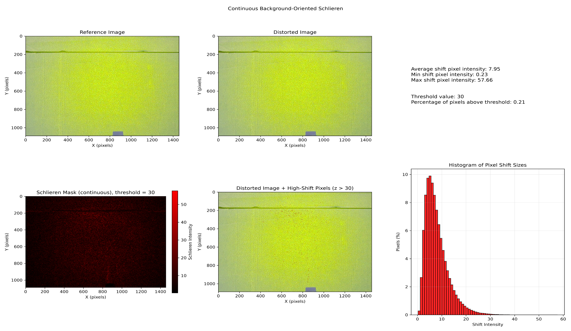
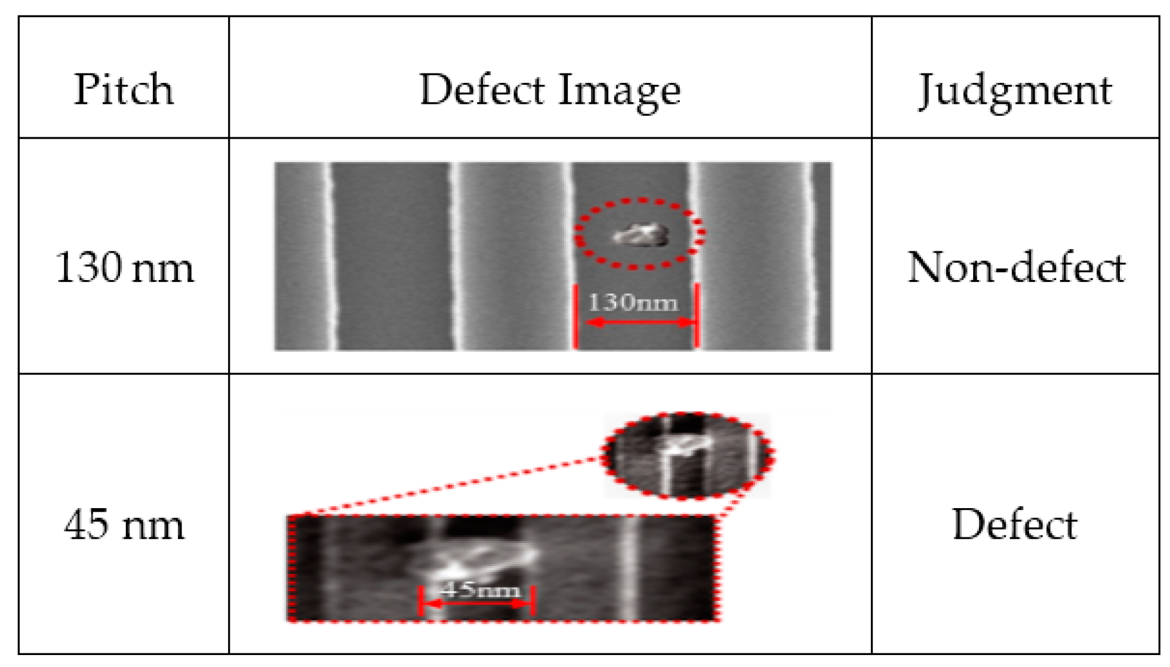

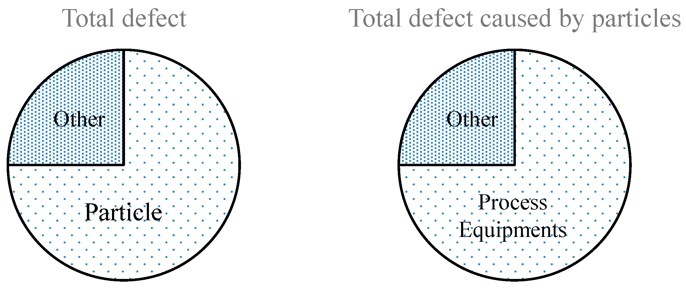














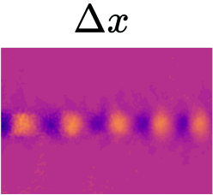
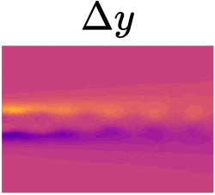
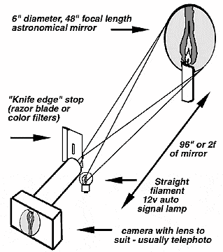
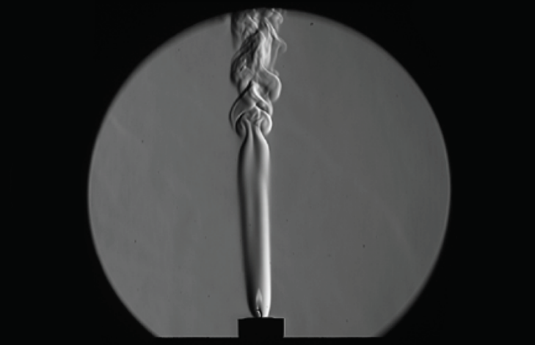
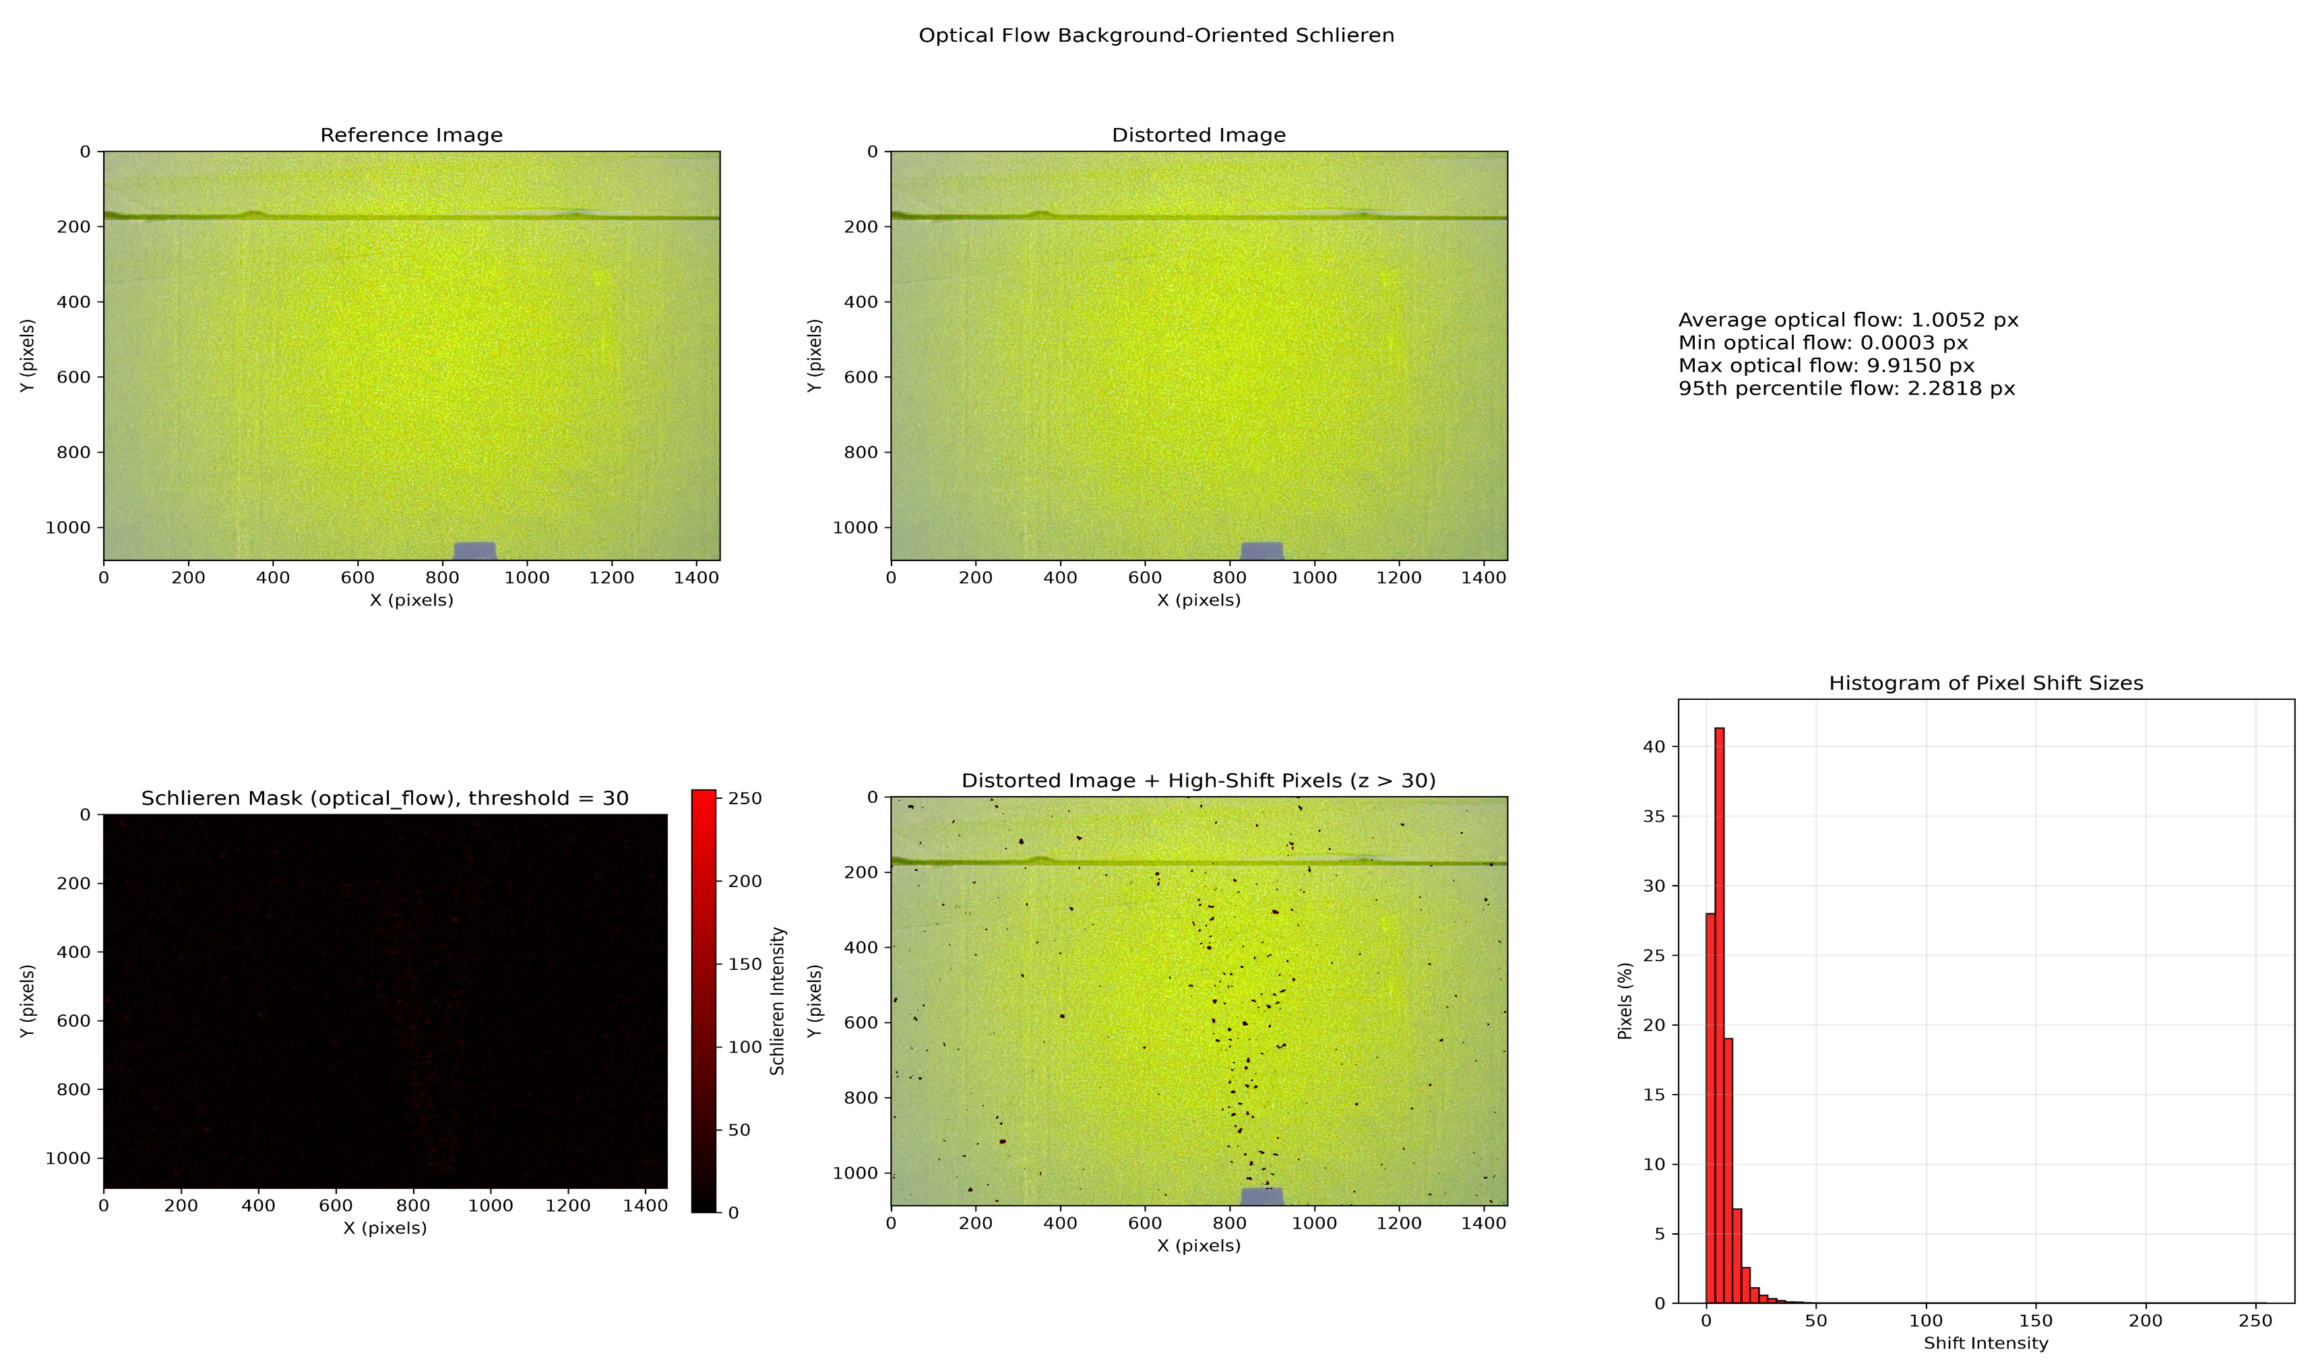
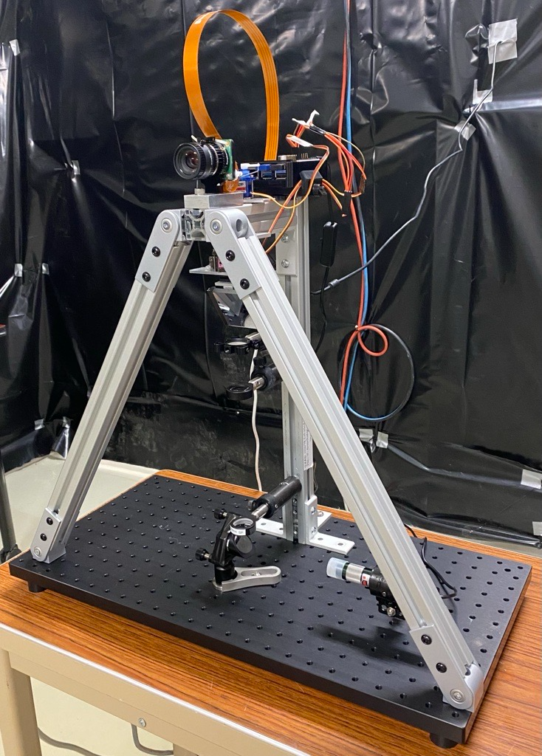
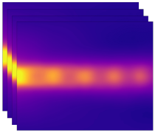
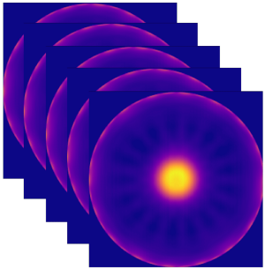
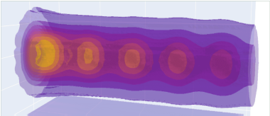

Real-Time Versatile Structured Light Imaging (rtVSLI)
John Greenhalge, Rebekah Cross PhD, Battelle Memorial Institute
Problem
Approach^{1,3}
Results
Next Steps
Advancing product technology is outpacing environmental monitoring technology
Contamination events cost companies hundreds of millions of dollars and represent significant safety concerns in high containment environments.
Current monitoring procedures generally provide low resolution data, are reactive instead of proactive, and can amount to hot-spot measurements.
Identifying contamination sources often requires costly investigations, downtime, and repeat testing that adds no direct value to production.
Advancing product technology necessitates advanced environmental monitoring technology yet current monitoring methods are significantly behind.
Project a structured laser grid background onto the environment
From the same device, image distortions in background caused by air density gradients
Use of two wavelengths for high fidelity and noise control, if necessary
Controlled perturbations of projected background to separate the variable and establish a baseline
Cross reference output from both wavelengths for a synthesized differential measurement and visual.
Initial testing of BOS pipeline
De-risking of current prototype architecture and scripts
Refinement of BOS and optical flow processing parameters
Video processing
Institute reference-free differential imaging
Data summary and report for Mk1 prototype
Internal or external funding for Mk2 to begin integrating parallax and dual-wavelength differential imaging
a)
Market Assessment
On-Device Processing
(current stage)
Biopharma Manufacturing
BSL-3/4 Laboratories
Data Centers
Sterility Validation
Semiconductor Manufacturing
Containment Assurance
Yield Protection
Inhalation research
Temp. regulation
$755.3 billion market⁵
$269.8 billion market⁴
$3.5 billion market⁶
$1.8 trillion market⁷
Green ~520nm
(high fidelity)
Potential infrared ~1000-1600nm
(noise filtering)
b)
rtVSLI System
Air Density Gradient
Projected Structured Laser Grid
rtVSLI System
Air Density Gradient
Projected Structured Laser Grid
Figure 3. Distribution of defects in a semiconductor manufacturing process. The pie chart on the left shows that the particle defects account for 75% of the total defects. As shown in the pie chart on the right, 75% of the particle defects are caused by process equipment ².
Figure 2. Change in the particle defect size with respect to the pitch.²
Fast alternating image capture between green and infrared grid
Solution - rtVSLI
Preprocessing
Preprocessing
Based on most comparable systems, final product cost (if sold direct to consumer) would be ~$200k-$500k^{8,9}
Potential direct to consumer or provided service business model
Average cost of one recall in pharma or semiconductor manufacturing is between $50M-$600M just for product cost. This doesn’t include indirect costs like litigation, settlements, or brand damage^{10,11}
Design an automated and portable system
Figure 4: BOS algorithm initial testing. A heat jet of approximately 400°C was used to create distortions in the projected background. The purpose of these tests is to inform initial baseline parameters. A general 2x – 3x increase in percentage of pixels above threshold for the variable tests (b) compared to the control (a) has been observed during initial testing. Average pixel shift intensity along with other parameters are being used to inform optical flow processing parameters for more sensitive measurements.
Initial testing of optical flow pipeline
Give industries an intuitive and continuous view of the environments that protect their products by turning airflow into actionable insight for contamination prevention
Market Estimates | Top-Down Assessment | Bottom-Up Assessment
Total Accessible Market (Global) | ~$4.1B per year | ~$350 - 400M per year
Total Accessible Market (U.S.) | ~$1.0 - 1.3B per year | ~$100 - 110M per year
Serviceable Available Market (Global) | ~$300 - 400M per year | ~$120 - 130M per year
Serviceable Available Market (U.S.) | ~$150 - 170M per year | ~$30 - 35M per year
On-Host Processing
(future stage)
Project laser-grid background onto the environment and measure how the light’s path bends as it moves through the air
Using a slide projector and camera array, the laser grid can be moved and scaled to adjust for distances
Projected background can be perturbed by a rotating mirror, allowing evaluation with reference-free shadowgraph or BOS methods¹
References & Acknowledgements
Integration into cross-referenced single image
Raffel, Markus, et al. “Projected Moving Patterns for Reference-Free Background-Oriented Schlieren Technique (BOS).” Measurement Science and Technology, vol. 35, no. 11, 29 Aug. 2024, p. 115306, https://doi.org/10.1088/1361-6501/ad7165. Accessed 6 Aug. 2025.
Park, Seung, et al. “Kernel-Density-Based Particle Defect Management for Semiconductor Manufacturing Facilities.” Applied Sciences, vol. 8, no. 2, 1 Feb. 2018, p. 224, https://www.mdpi.com/2076-3417/8/2/224, 10.3390/app8020224. Accessed 9 Aug. 2026.
Bron, Joachim A, et al. “Density Field Reconstruction of an Overexpanded Supersonic Jet Using Tomographic Background-Oriented Schlieren.” ArXiv.org, arXiv, 17 Nov. 2023, arxiv.org/abs/2311.10332. Accessed 6 Oct. 2025.
“Data Center Market Size, Share & Trends | Growth Report [2032].” www.fortunebusinessinsights.com, Fortune Business Insights, 22 Sept. 2025, www.fortunebusinessinsights.com/data-center-market-109851. Accessed 7 Oct. 2025.
“Semiconductor Market Size & Share | Industry Growth [2020-2027].” www.fortunebusinessinsights.com, Fortune Business Insights, 22 Sept. 2025, www.fortunebusinessinsights.com/semiconductor-market-102365. Accessed 7 Oct. 2025.
“Biosafety Level 3 (BSL-3) Laboratories Market 2025 | Trends, Growth & Insights in the United States.” www.verifiedmarketreports.com, Verified Market Reports, 15 Feb. 2025, www.verifiedmarketreports.com/product/biosafety-level-3-bsl-3-laboratories-market/. Accessed 7 Oct. 2025.
“Impact of Covid-19 on the Pharmaceuticals Market Size & Share, 2020.” www.fortunebusinessinsights.com, Fortune Business Insights, 22 Sept. 2025, www.fortunebusinessinsights.com/impact-of-covid-19-on-pharmaceuticals-market-102685. Accessed 7 Oct. 2025.
“Automated Optical Inspection Machine Price Guide (2025).” Www.averroes.ai, Averroes, 7 Feb. 2025, averroes.ai/blog/automated-optical-inspection-price. Accessed 7 Oct. 2025.
“How Much Does a High Content Imaging System Cost?” Www.excedr.com, Excedr, 29 Aug. 2024, www.excedr.com/blog/how-much-does-a-high-content-imaging-system-cost? Accessed 7 Oct. 2025.
“Global Quality in Manufacturing Survey Reveals Dramatic Rise in Product Recalls - ETQ.” www.etq.com, ETQ | Hexagon, 31 July 2024, www.etq.com/press-releases/global-quality-in-manufacturing-survey-reveals-dramatic-rise-in-product-recalls/. Accessed 7 Oct. 2025.
“The Rising Cost of Product Recalls: Why Prevention Matters - Honeywell.” www.spartasystems.com, Honeywell, 20 Sept. 2025, www.spartasystems.com/resources/the-rising-cost-of-product-recalls-why-prevention-matters/. Accessed 7 Oct. 2025.
I’d like to acknowledge and thank Gabe Meister, Steven Risser, David Glasbrenner, Jen Malik, Rachel Spurbeck, Kent Brasseale, Suhithi Peiris, Forrest Svingala, Jeff Thoroman, Young Choi, Johnathan Velazquez Cruz, Morgan Wendling, Ryan Rodriguez, Mass Challenge, and ESEC for their support
Density integration
Density integration
UI & Visualization (3D Flow Maps)
Figure 5: BOS algorithm with integrated optical flow initial testing. The same source images used for the BOS algorithm were used for initial testing of the optical flow algorithm. Parameters for optical flow were informed by data acquired from BOS runs and qualitative data demonstrates a region of pixel shifts clustered around the expected region of the heat plume.
Stacking
Figure 6: t-Test results for preliminary BOS runs with a threshold (z) of 30. Analysis of the run data shows a significant difference in %I_{px}>z (p=0.045569) between the control and variable conditions. These results suggest the rtVSLI Mk1 can detect pixel intensity changes associated with heat induced changes to air density gradients.
2D density slice stitching
3D density field
Scan QR code for updated results and progress
Figure 3: rtVSLI Mk1 prototype

