Slide 1

Fundamental Principles of Scouting
World Organization of the Scout Movement

Slide 2

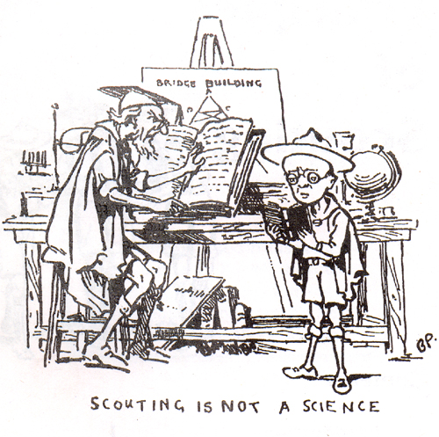
Introduction
Fundamentals refers to the basic element
These fundamentals are found in Chapter 1 of WOSM’s Constitution
Adopted by the 26th World
Scout Conference in
Montreal in 1977

Slide 3
The Scout Movement
Voluntary
Non-Political
Educational
Movement for Young People
Open to All without Distinction of origin, race, or creed
In Accordance with the purpose, principles, and method conceived by the founder

Slide 4
The Scout Movement
Voluntary
  Emphasizes the fact that members adhere to it by their own free will and because they accept the fundamentals of the Movement.
  It applies to both young people and adults.

Slide 5
The Scout Movement
Non-Political
  Scouting is not involved in the struggle for power which is the subject-matter of politics.
  It is constitutionally required from all national associations (including the Boy Scouts of the Philippines).
  This does not mean Scouting is completely divorced from political realities within a given country which is necessary to develop responsible citizens.

Slide 6
The Scout Movement
Educational
  Process aiming at the total development of a person’s capacities.
  Scouting is Non-Formal Education which is an organized educational activity outside the established formal system that is intended to serve an identifiable learning clientele or objective.

Slide 7
The Scout Movement
Educational
  In the founders own word:
    “…the most important aim in the Boy Scout training – to educate; not to instruct, mind you, but to educate, that is, to draw out the boy to learn for himself, of his own desire, the things that tend to build up character in him.”

Slide 8
The Scout Movement
Movement for Young People
  Movement means a series of organized activities working towards an objective. It implies both an objective to be achieved and some type of organization to achieve it.
  It is youth movement and the role of adults consists of assisting young people in achieving the objectives of Scouting.

Slide 9
The Scouting Movement
Without Distinction
  Principle of non-discrimination is one of the basic precepts of the Movement.
  A provision that the person must voluntarily adheres to its purpose, principles, and method.

Slide 10
Purpose of the Movement
“To contribute to the development of young people in achieving their full physical, intellectual, social, and spiritual potentials as individuals, as responsible citizens and as members of their local, national, and international communities.”

Slide 11
Purpose of the Movement
Emphasizes educational character
Aim of total development of person’s capabilities
Development of physical, intellectual, social, and spiritual cannot be done in isolation.
Integrated development

Slide 12
Purpose of the Movement
Scouting recognizes that it is but one of the several contributing factors of development.
Scouting is not there to replace family, school, religious, or social institutions
Scouting exists to complement the impact of these institutions

Slide 13
Principles of the Movement
Duty to God
Duty to Others
Duty to Self

Slide 14
Principles of the Movement
Duty to God
  “Adherence to spiritual principles, loyalty to the religion that expresses them and acceptance of the duties resulting therefrom”
  The definition does not use the word “God” making it clear that it include non-monotheistic religions (e.g., Hinduism) or those that does not recognizes a personal God (e.g., Buddhism)

Slide 15
Principles of the Movement
Duty to Others
  “Loyalty to one’s country in harmony with the promotion of local, national, and international peace, understanding and cooperation. Participation in the development of society, with recognition and respect for the dignity of one’s fellow-man and for the integrity of the natural world.”
  Loyalty to country not in a chauvinistic and narrow concept
  Must be in harmony with the promotion of peace, understanding, and cooperation

Slide 16
Principles of the Movement
Duty to Self
  “Responsibility to the Development of Oneself”
  In harmony with the aim of developing the full potentials of an individual

Slide 17
Methods of Scouting
A Promise and Law
Learning By Doing
Membership of Small Groups
Progressive and Stimulating Programs

Slide 18
Methods of Scouting
A Promise and Law
  Embodies the Principles
  Young person makes a personal commitment of his own free will

Slide 19
Methods of Scouting
Learning by Doing
  Active education
  A boy is always ready to do rather than digest

Slide 20
Methods of Scouting
Membership of Small Groups
  Small groups as agents of socialization (e.g., Barkada)
  A self-governing group with the role of adult being one of guidance
  Facilitates in the development of character

Slide 21
Methods of Scouting
Progressive and Stimulating Programs
  Progressive to satisfy the need for gradual and harmonious development of young people such as the badge system
  Varied activities based on the interest of each participant
  Games, useful skills, and service to community

