Slide 1
Car rent the perfect choice to rent a car
Made by:
-Szalanics Szabolcs
-Váradi Szabolcs
-Vágner Dávid Zoltán

Slide 2
Problem:
There is no application to rent a Car so easy.
Hard to find a place where you can rent, and take a driver if you want to.
Solution
Car Rent
Standard platform
Easy handling
Easy to browse, to rent, to cancel rents

Slide 3
Functions of the program
Registration
Login
To browse
Save necessary informations
Select car and a driver if you need
Select start / end date to your rent

Slide 4
The Program
3 different parts:
Frontend (React JS)
Backend (Node JS)
Database (MySQL)

Slide 5
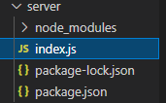
backend
Node JS 16.13.1v (latest version at the beginning)
Contains only HTTP requests
Authentication
Connection to Database

Slide 6
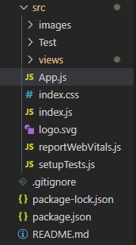
Frontend
React JS 17.0.2v (latest version at the beginning)
Role
App.js (Routes, lookForUser)

Slide 7

Frontend
SRC files:
Test folder
Contains App.test.js

Slide 8
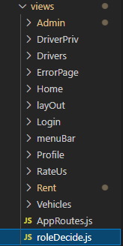
Frontend
Views folder
Contains rendered Components
Role decider
AppRoutes.js

Slide 9
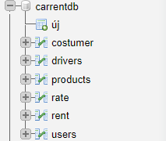
Database
MySQL
PHP web
Loading Data
Examples
6 tables

Slide 10
Tests
Frontend(in Test folder)
Rendering (only 1 page)
Axios request's (fail)
Backend(attached)
Postman

Slide 11
Teamwork
Github
Github project
Discord
TeamViewer

Slide 12
Teamwork - backend
Szalanics Szabolcs
Váradi Szabolcs
All Express / HTTP requests
Authentication
Postman tests

Slide 13
DataBase - TeamWork
Váradi Szabolcs
Database Schema
Creating and managing datas in database, creating tables
Fill database with test datas
Attributes connection (one to one ect.)

Slide 14
Frontend -Teamwork
Szalanics Szabolcs
Vágner Dávid Zoltán
Static HTML pages / CSS
Converting to React
Acces management / Role
Routes
Context
Login / Registration
Static HTML / CSS

Slide 15
Future plans
Online payment
Search bar for previous rents and rates
Image upload function
Map to finf our site
Show up car and driver while select at rent

Slide 16
Car Rent demo

