Slide 1
Llama
Steve
Jérome
Aurélie
Jeff
Zhou

Slide 2
Index
Web site
Technologies
Process
Web service

Slide 3
Website
Our website sell specifics pets : Llama
Browse llama collection
Filter result
Backend : admin
Comments on llamas

Slide 4
Technologies
Client
Play framework
Java 7
RequireJS
KnockOutJS
Server
Java 7
JBPM4.4
JBPM_Console
Tomcat 8
Maven
javax.servlet
org.json
Reflections
mysql-connector-java
commons-lang3

Slide 5
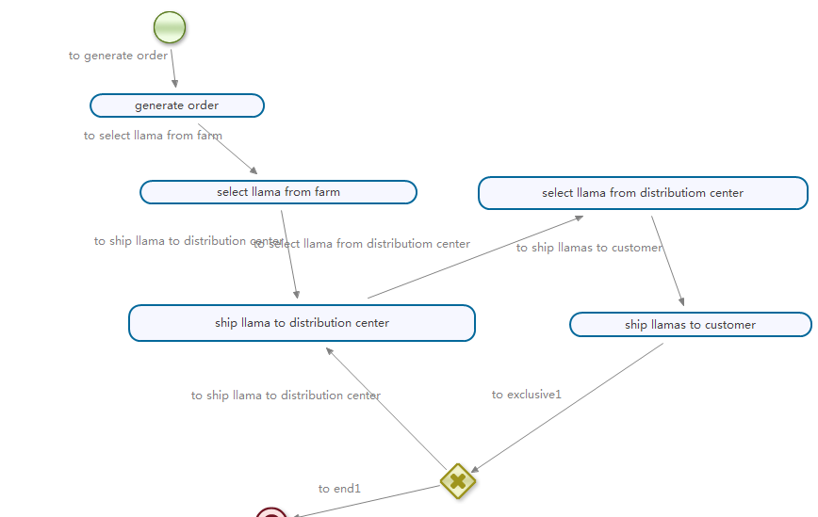
Process

Slide 6
Web service
Reflection by introspection
Remote procedure call (RPC) : Java remote method invocation
Remote service annotation for external services
Services & Services manuals access by POST request
Use of JSON instead of XML for the simplicity of parsing (org.json)
Custom MySQL ORM (with prepared statement) + JDBC

Slide 7
Thanks

