Slide 1
Project Development III
Order Analysis System with Hadoop

Slide 2
Download
URL：http://pan.baidu.com/s/1i3opWu5
Password：hv1y

Slide 3
Agenda
Week 1: Introduction & Requirement
Week 2: System Architecture and Sqoop
Week 3: Order Analysis using Map-Reduce
Week 4: Integration with Practise I
Week 5: Deployment and Testing

Slide 4
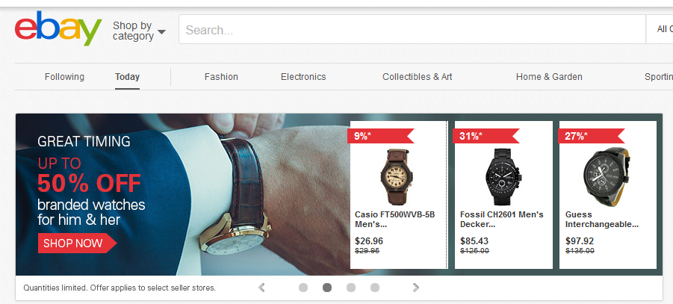
Week1: Introduction & Requirement
What will we complete in this practise?
A Order Analysis System with Hadoop

Slide 5
Week1: Introduction & Requirement
This is a Order Analysis System with Hadoop which provide following functions:
  Data Exchange with Sqoop
    Use Sqoop to extract the order business data from our Online Shopping System (Practice I)
    Use Map-Reduce to find the most three popular products
    Use Sqoop to load the analysis result back to our Online Shopping System (Practice I)
  Integration with Practise I
    Display the most three popular products on the home page of our Online Shopping System

Slide 6
Week1: Introduction & Requirement
Output for Day 1:
  System Requirement document
  System Architecture Design

