Slide 1
Project Development II
Web Shipment Processing System with jBPM

Slide 2
Download
URL：http://pan.baidu.com/s/1i3Bq2xR
Password：1udy

Slide 3
Agenda
Week 1: Introduction & JBPM JPDL
Week 2: Database Design
Week 3: Process instance and executions
Week 4: Integration with Practise I
Week 5: Deployment and Testing

Slide 4

Week1: Introduction & JBPM JPDL
What will we complete in this practise?
A Web Shipment Processing System with jBPM

Slide 5
Week1: Introduction & JBPM JPDL
What is BPM?
  Business process management (BPM) is a management discipline that focuses on improving corporate performance by managing and optimizing a company's business processes. -- wikipedia
  BPM is a discipline that leverages software and services to provide total visibility into your organization. Discover, document, automate, and continuously improve business processes to increase efficiency and reduce costs . --IBM

Slide 6
Week1: Introduction & JBPM JPDL
What is jBPM?
  jBPM is an extensible and flexible process engine that can run as a standalone server or embedded in any Java application.
  jBPM WebSite：http://www.jboss.org/jbpm

Slide 7
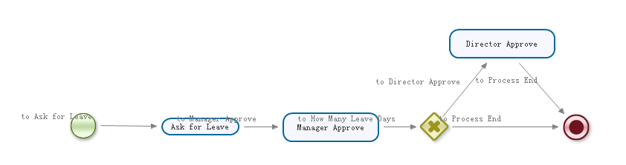
Week1: Introduction & JBPM JPDL
What is jBPM?
  Demo

Slide 8
Week1: Introduction & JBPM JPDL
JBPM JPDL Element --- process
  The top level element representing one process definition.
Attribute | Description | Required? | Comments
name | process name | required | name or label of the process used to display to the process name in user interactions.
key | process key | optional | identification to distinct different process definitions. Multiple versions of a process with the same key can be deployed. The key:name combination must remain exactly the same for all deployed versions.
version | version number | optional | version number of this process

Slide 9
Week1: Introduction & JBPM JPDL
JBPM JPDL Element --- transition
  One or many transitions can be assigned to a task.
    "Start" task can only have one transition.
    "End" task can not have the transition.
    Other tasks can have one or many transition.

Slide 10

Week1: Introduction & JBPM JPDL
JBPM JPDL Element --- Start Node
  "Start" Node
    Indicates where an execution for this process starts.
    Typically there is exactly one start activity in a process.
    A process has to have at least one start activity.
    A start activity must have exactly one outgoing transition and that transition is taken when a process execution starts.

Slide 11

Week1: Introduction & JBPM JPDL
JBPM JPDL Element --- End Node
  "End" Node
    Ends the execution.
    A process can have one or many End nodes.

Slide 12
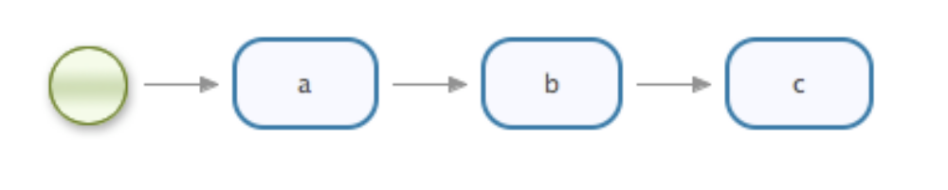
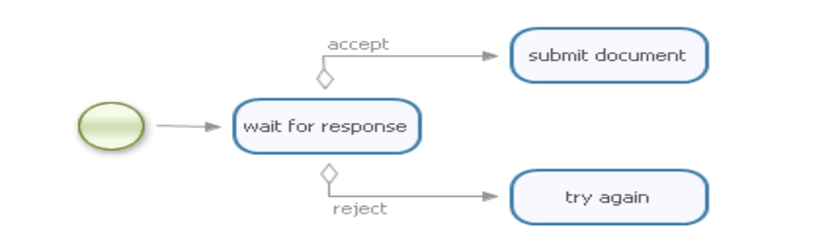
Week1: Introduction & JBPM JPDL
JBPM JPDL Element --- State Node
  "State" Node
    A wait state. Process execution will wait until an external trigger is provided through the API.

Slide 13
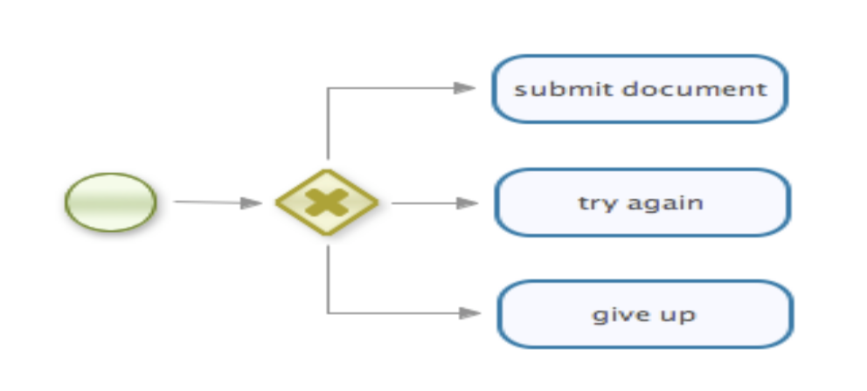
Week1: Introduction & JBPM JPDL
JBPM JPDL Element --- Decision Node
  "decision" Node
    Takes one path of many alternatives.
    A decision activity has multiple outgoing transitions and when an execution arrives in a decision activity, an automatic evaluation will decide which outgoing transition is taken.

Slide 14
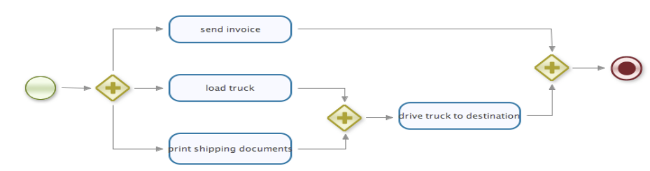
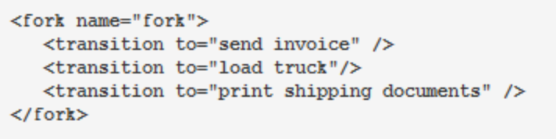
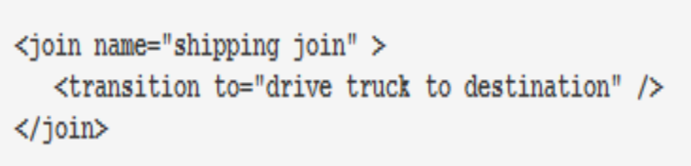
Week1: Introduction & JBPM JPDL
JBPM JPDL Element --- fork and join
  "fork" Node and "join"
    Concurrent paths of executions can be modeled with the fork and join activities.

Slide 15

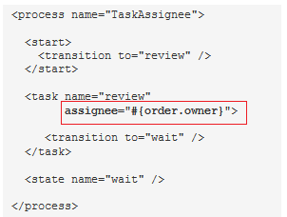
Week1: Introduction & JBPM JPDL
JBPM JPDL Element --- Task for a person
  "task" Node for a person
    Creates a task for a person in the task component.

Slide 16
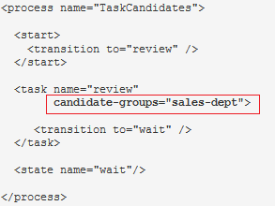
Week1: Introduction & JBPM JPDL
JBPM JPDL Element --- Task for a group
  "task" Node for a group
    Creates a task for a group in the task component.

Slide 17
Week1: Introduction & JBPM JPDL
JBPM JPDL Element
  More details, please refer to jBPM User Guide.

Slide 18
Week1: Introduction & JBPM JPDL
Environment Setup
  Eclipse + jBPM +Tomcat + DB (DB2, Oracle, mySql, etc.)
jBPM User Library
Verify

Slide 19
Week1: Introduction & JBPM JPDL
This is a shipment processing system website which provide following functions:
  For the administrator
    Manage a process, including deploy a process, start or stop a process
    Monitor a process
    User management, including users and groups
  For the end users
    Different users should complete their tasks according to their roles.
  For the customer(Mandatory Requirement)
    Track the shipement status from the website

Slide 20
Week1: Introduction & JBPM JPDL
Output for Day 1:
  System Requirement document
  Logistics Processing Flow Definition Chart

