Slide 1
Project Development II
Web Logistics management system with JBPM

Slide 2
Project 2:
Web Logistics management system with JBPM
Week 3: Process instance and executions
JBPM Database Tables
JBPM API and sample codes
  ProcessEngine and Service API
  JBPM Query API
  Process Definition Management
  Process Instance Management
  Process Variables
  etc...

Slide 3
JBPM Database Tables
Resource Library and Runtime
Table Name | Description
JBPM4_DEPLOYMENT | Deployment record of the process definition.
JBPM4_DEPLOYPROP | The details of the process definition
JBPM4_LOB | The resource files of a process definition
JBPM4_EXECUTION | The runtime process instance that is currently executing
JBPM4_TASK | The task that is currently executing
JBPM4_PARTICIPATION | The users and the groups information in a task
JBPM4_SWIMLANE | JBPM SwimLane information
JBPM4_JOB | JBPM Timer definition
JBPM4_VARIABLE | The temporary variables in a process
JBPM4_PROPERTY | The JBPM engine information

Slide 4
JBPM Database Tables
History Information
Table Name | Description
JBPM4_HIST_PROCINST | The history of the process instance
JBPM4_HIST_TASK | The history of a task
JBPM4_HIST_ACTINST | The history of the activity
JBPM4_HIST_DETAIL | The change history of the variables
JBPM4_HIST_VAR | The history variables

Slide 5
JBPM Database Tables
Users and Groups
Table Name | Description
JBPM4_ID_GROUP | The basic user's authentication and authorization. As these three tables are too simple, suggest to develop the project's own tables to implement the user's authentication and authorization.
JBPM_ID_MEMBERSHIP
JBPM4_ID_USER

Slide 6
JBPM API and sample codes
ProcessEngine and Service API
  Interacting with jBPM occurs through services. The service interfaces can be obtained from the ProcessEngine which is build from a Configuration. A ProcessEngine is thread safe and can be stored in a static member field.

Slide 7


JBPM API and sample codes
ProcessEngine and Service API
  Build ProcessEngine
    Method One
    Method Two

Slide 8
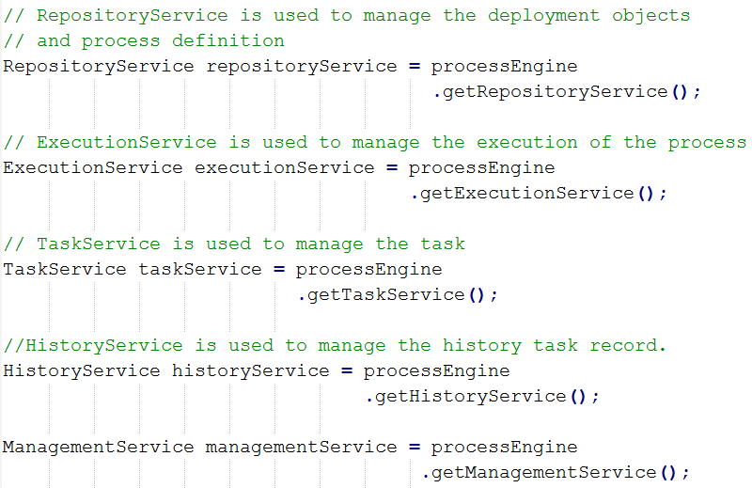
JBPM API and sample codes
ProcessEngine and Service API
  JBPM Service API

Slide 9
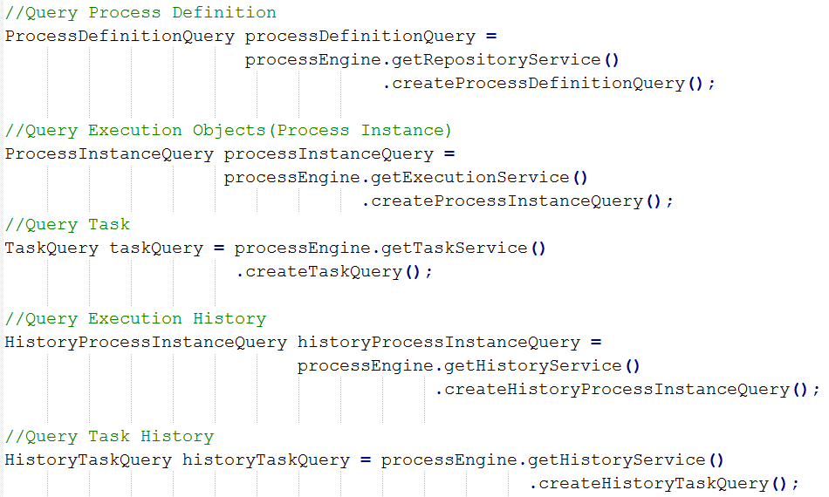
JBPM API and sample codes
JBPM Query API

Slide 10
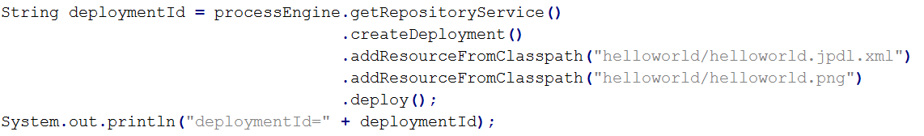
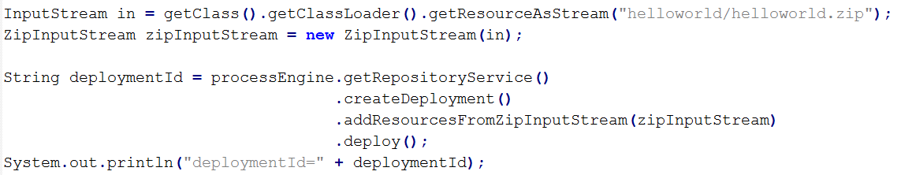
JBPM API and sample codes
Process Definition Management
  Deploy Process Defintion
    Method One
    Method Two

Slide 11

JBPM API and sample codes
Process Definition Management
  Delete Process Defintion

Slide 12
JBPM API and sample codes
Process Instance Management
  Start Process Instance

Slide 13
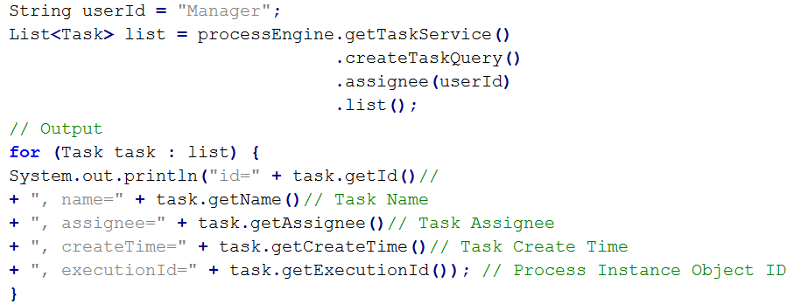
JBPM API and sample codes
Process Instance Management
  Query Personal Task List

Slide 14

JBPM API and sample codes
Process Instance Management
  Complete Task

Slide 15
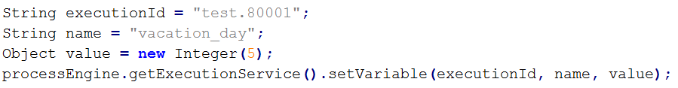
JBPM API and sample codes
Process Variables
  Set Process Variables

Slide 16
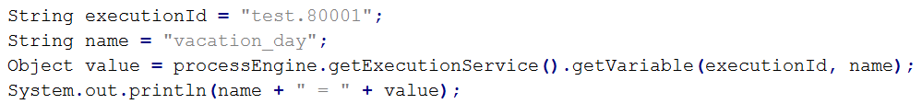
JBPM API and sample codes
Process Variables
  Get Process Variables

Slide 17
JBPM API and sample codes
More details about JBPM API sample, please refer to JBPM Document

Slide 18
Project 2:
Web Logistics management system with JBPM
Week 3: Output
System Design:
  High Level Design Document
  Low Level Design Document
Coding

