Slide 1
Project Development II
Web Logistics management system with JBPM

Slide 2
Project 2:
Web Logistics management system with JBPM
Week 4: Integration with Practise I
New Customer Requirement
  It is required to query the logistics shipment status in our online shopping system (Practise I) from Web Logistics management system (Practise II)

Slide 3
Project 2:
Web Logistics management system with JBPM
Week 4: Integration with Practise I
Hint
  Based on the new customer requirement, the development team decide to use WebService to implement the new feature.

Slide 4
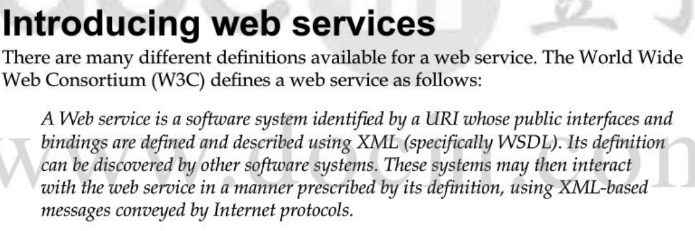
Project 2:
Web Logistics management system with JBPM
Week 4: Integration with Practise I
What is WebService?
Demo

Slide 5
Project 2:
Web Logistics management system with JBPM
Week 4: Output
System Design:
  High Level Design Document
  Low Level Design Document
Coding

