Slide 1
Project Development III
Order Analysis System with Hadoop

Slide 2
Project 3:
Order Analysis System with Hadoop
Week 2: System Architecture and Sqoop
System Architecture
Sqoop

Slide 3



Project 3:
Order Analysis System with Hadoop
Week 2: System Architecture and Sqoop
System Architecture
DataSource
Hadoop Cluster
RDBMS
HBASE
Result
RDBMS
Sqoop
HDFS
Sqoop
Map-Reduce
Log Data
Others

Slide 4
Project 3:
Order Analysis System with Hadoop
Week 2: System Architecture and Sqoop
Sqoop
  What is Sqoop?
  Sqoop Configuration
  Sqoop Commands
  Demo

Slide 5
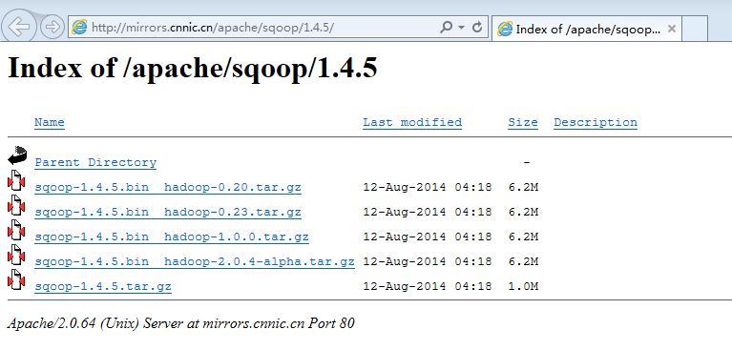
What is Sqoop?
Apache Sqoop(TM) is a tool designed for efficiently transferring bulk data between Apache Hadoop and structured datastores such as relational databases.
  SQL-to-HDFS
  Based on JDBC
  Download Sqoop

Slide 6
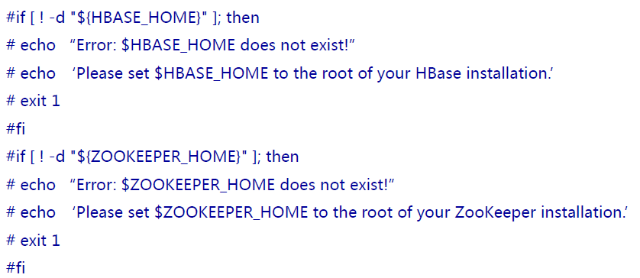
Sqoop Configuration
Modify "configure-sqoop" file as the following:configure-sqoop to comment the lines that check the avaibility of hbase and zookeeper.
Check the enviroment variables,such as $HADOOP_HOME
Startup Hadoop

Slide 7
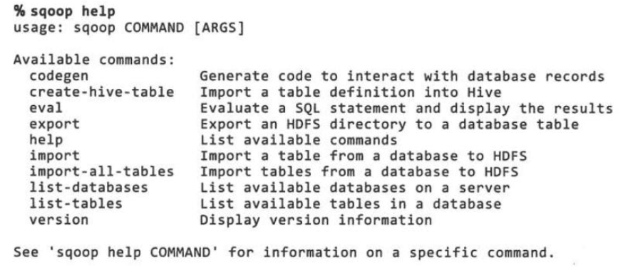
Sqoop Commands

Slide 8
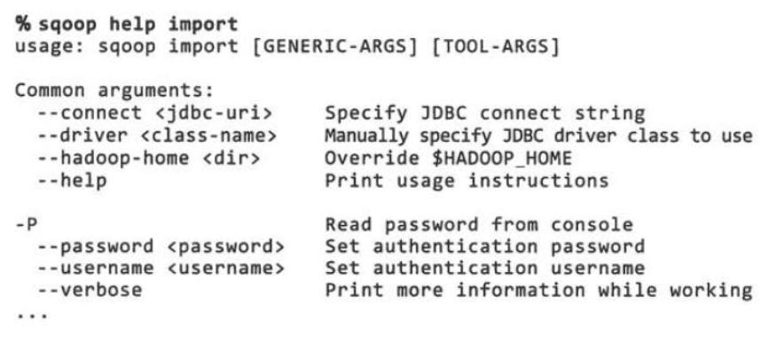
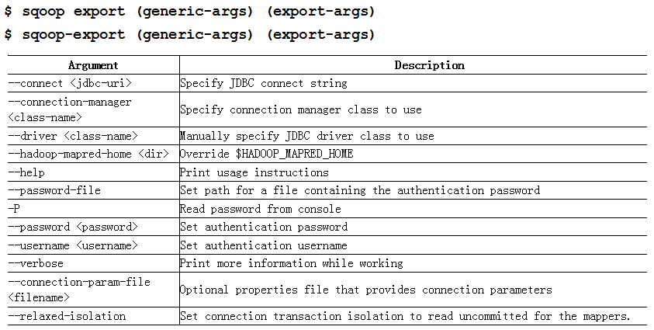
import & export

Slide 9
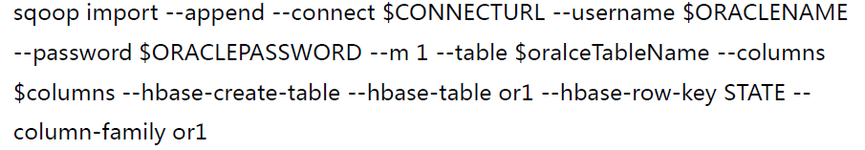
Demo
Import the data from Oracle
Where:
Parameter | Description | Sample
CONNECTURL | Oracle Connection URL | jdbc:oracle:thin:@localhost:1521:orcl
ORACLENAME | Oracle Username | scott
ORACLEPASSWORD | Oracle User Password | tiger
oralceTableName | Table Name to be imported | emp
columns | Column Names to be imported | empno,ename,sal
hdfsPath= | HDFS path to store the data | /hdfs/

Slide 10
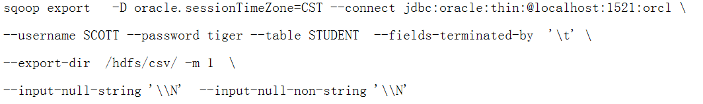
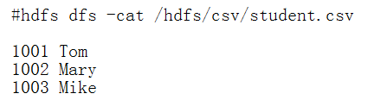
Demo
Export the data into Oracle
Where:

Slide 11
Project 3:
Order Analysis System with Hadoop
Week 2: Output
System Architecture Document
Setup the Hadoop Environment
Notice:
  Use a mock program to generate a large number of random order data in our online shopping system for the simulation.

